Slide 1
The Object-Oriented Thought Process Chapter 10
Creating Object Models

Slide 2
Object Models
The UML class diagrams used concerns modeling object-oriented systems or, as I like to call it, object-modeling.
The purpose of this section is to provide a quick overview of object models and, specifically, class diagrams.

Slide 3
What Is UML?
In a nutshell, UML offers a way to graphically represent and manipulate an object-oriented (OO) software system.
It is not only the representation of the design of a system, but a tool to assist in this design.

Slide 4
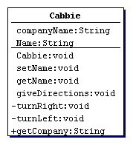
The Structure of a Class Diagram
A class diagram is constructed of three parts: the class name, the attributes, and the methods.

Slide 5
Attributes
Normally, attributes are not thought of as having signatures, as do methods.
However, an attribute has a type, and this type is represented in the class diagram.
Consider the two attributes that are in the Cabbie example:
-companyName:String
-name:String

Slide 6
Methods
If you look at the following snippet from the Cabbie example, you can see that the name of the method is presented, along with the return type and the access modifier (for example, public, private):
+Cabbie:
+giveDirections:void
+getCompanyName:String

Slide 7
Access Designations
As mentioned previously, the plus signs (+) and minus signs (-) to the left of the attributes and methods signify whether the attributes and methods are public or private.
The attribute or method is considered private if there is a minus sign.
This means that no other class can access the attribute or method; only methods in the class can inspect or change it.

Slide 8
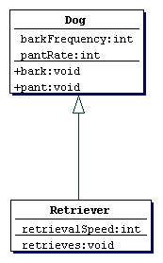
Inheritance
Inheritance
is represented in UML by
a line with an arrowhead
pointing in the direction
of the parent or
superclass.

Slide 9
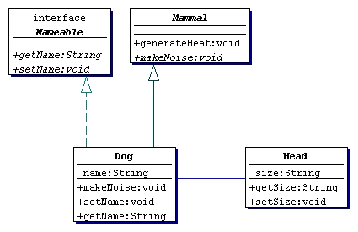
Interfaces
A dashed line with an arrowhead indicates an interface.

Slide 10
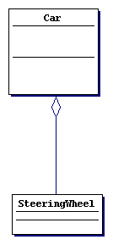
Aggregations & Association
An aggregation is represented by a line with a diamond at the head.
Associations are represented with no shape on either end.

Slide 11
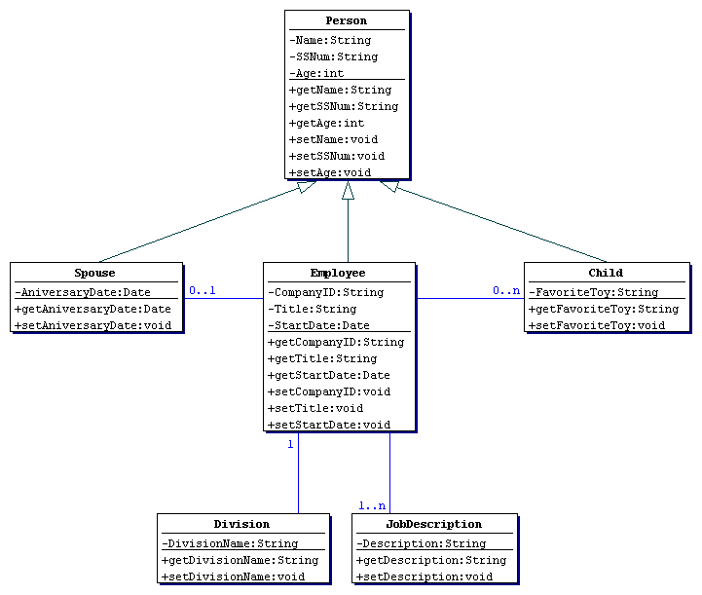
Cardinality
Cardinality pertains to the range of objects that correspond to the class.

