Slide 1
The Object-Oriented Thought Process Chapter 11
Objects and Portable Data: XML and JSON

Slide 2
Portability
Although portable languages are powerful tools, they are really only half of the application development equation.
The programs that are written using these languages must process data, and this data must be turned into information.
Information is the other half of the portability equation.

Slide 3
Portable Data
XML provides standards to move data in a variety of ways.
Often we can think of data as moving vertically and horizontally.
The term vertical means that data is meant to move through multiple industry groups.
Horizontal applications are specific to a particular industry, such as retail or transportation.

Slide 4
The Extensible Markup Language (XML)
The primary function of HTML is to present data in a browser.
XML, on the other hand, does concern itself with data verification issues.
XML is much more strict with its format than HTML and was designed to represent data.

Slide 5
XML Versus HTML
HTML tags are all predefined. Tags such as <HTML>, <HEAD>, <BODY>, and so on are all defined in the HTML specification.
You cannot add your own tags.
Because HTML is intended for formatting purposes, this is not a problem.
XML, however, is meant to define data.
To define data, you need to create your own tag names.

Slide 6
XML and Object-Oriented Languages
XML works hand-in-hand with object-oriented languages to provide what I have termed “portable information.”
Often, an application written in an object-oriented language is developed to interact with XML.
The goal is to share data in a pre-determined, portable manner.

Slide 7
Parsers
A parser is an application that reads a document and extracts specific information.
The parser reads each line of a program and uses specific grammar rules to determine how to produce code.
A parser would verify that a print statement was written with the appropriate syntax.

Slide 8
Validating the Document (DTD)
To define data, you need to create your own tag names.
This is where a document called the Document Type Definition (DTD) comes into play. The DTD is where you define the tags that describe your data.
You are not required to use a DTD. However, using a DTD provides a great benefit to validating XML documents.

Slide 9
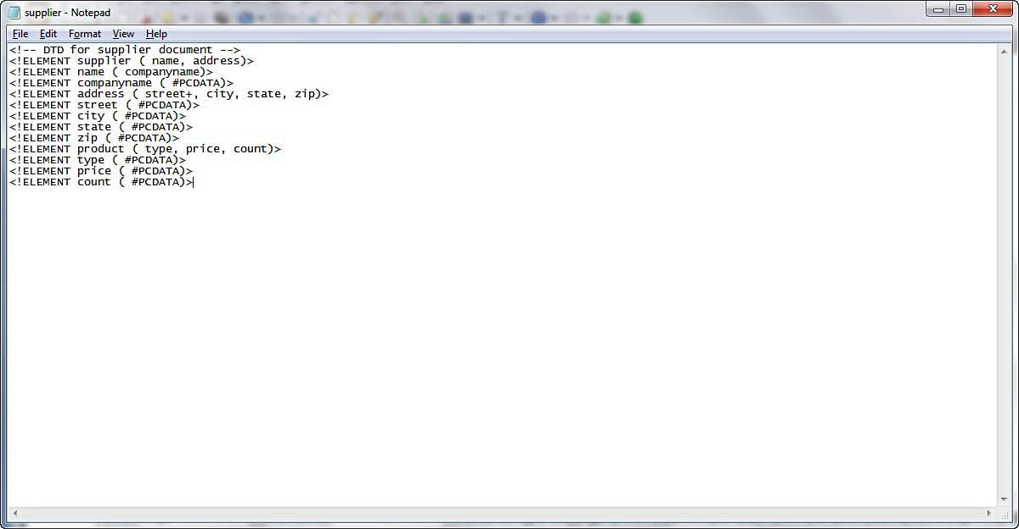
Integrating the DTD into the XML Document

Slide 10
XML Validation
Many applications will validate XML code.
The XML validator at the w3schools site is one that is easily accessible.
http://www.w3schools.com/xml/xml_validator.asp

Slide 11
Using Cascading Style Sheets
Although XML is not generally used for presentation purposes, there are ways to format XML.
One of these is to use CSS. CSS are used heavily in the HTML world to format content.
To a certain degree, CSS can be used to format XML.

Slide 12
JavaScript Object Notation (JSON)
Although XML is much more structured, especially when using a DTD, technologies such as the JavaScript Object Notation, or JSON, fall into the category of “more flexible.”
The w3schools site provides the following bullet item description of JSON as:
lightweight text-data interchange format
language independent
“self-describing” and easy to understand

