Slide 1





Empowering Growth, Built on Trust
SUMMARY FOR ADVISORY SERVICE FOR GROUP
1 September 2025
BY CHERMANT CORPORATE SERVICES

Slide 2
AGENDA
Empowering Growth, Built on Trust
Background
01
Benefit of Our Retainer Service
05
Service Scope
02
Our Business Profile
(Thailand & Vietnam)
06
Service Arrangement
03
Fee Models Proposal
04

Slide 3



{{section.Background.0.title}}
01
We understand that the legal team of Group is seeking support for their daily and adhoc legal tasks for Thailand and Vietnam jurisdiction as well as some coordination with China team.
Currently Group is using several service providers for each type of works in these two countries. The legal team is considering whether hiring an additional permanent lawyer as an employee or using sub-contract service provider should be more suitable for their need.
The challenge is to have an independent legal and corporate support who can complete assignments without the need for close supervision or training, to streamline the works of several teams across the jurisdictions, and to align with the Group standard and budget.
This presentation present our services designed to complement your internal resources and ensure reliable, practical outcomes.

Slide 4



02
KEY REQUIREMENTS FOR A LIMITED COMPANY SETUP
1. Minimum Capital Requirements: There is no minimum capital requirement by law for majority Thai shareholding structure. However, at least 2 million THB for majority foreign shareholding structure.
Directors: At least one director of any nationality is required. Work permit is required for signing director who is a foreigner. Appointment or removal of directors including their remuneration shall be resolved by a shareholders meeting.
Shareholders: Minimum two shareholders are required at all time. Furthermore, at least 2 shareholders are required to legally convened a shareholder meeting under Thai law.
Foreign Business License: In case more than 50% of the shares are held by foreigner(s), a Foreign Business License will be required.
Hiring an expat: At least 2 million THB registered capital and 4 Thai employees must be employed for each expat.
Timeline and government fees: Approximately 2-4 weeks for standard company setup. Approximately THB 10,000 for company establishment for Thai structure.

Slide 5


SERVICE SCOPE
02
Services required include:
Services that could be included in our retainer fee structure:
Legal research and executive summaries
Business compliance reviews and reporting
Commercial contract review, drafting, and negotiation
Advisory in relation to court cases and disputes (with litigation counsel where required)
General corporate and regulatory advisory
Liaison with authorities or government agencies for discussion (upon request)
Services that may be arranged separately on a fixed fee basis:
Court cases
Compliance reports
Applications or government liaison

Slide 6
03
SERVICE ARRANGEMENT
First phase (first 3 months): As it may not be estimated at this stage of the type of works or hours to be used. We suggest that we provide advisory services and support as like if you would hire a new permanent staff. We could design on the fee with a minimum estimated hours to be used. During this stage, we will understand your work scope and expectations for the next stage.
Second phase (4th month onward): Once we understand your requirement and expectation, we can further customize our services and packages to streamline your legal operations across Thailand and Vietnam. At this point, we may discuss and customize our work scope again. For example, we may be your point of contact for your other service providers or we may be your sole one-stop-service provider in order to streamline all your legal works.

Slide 7


04
FEE MODEL PROPOSAL
Special Hourly Rate
Monthly Retainer Model
Annual Retainer Model
Our standard rate are:
THB 6,500 per hour (applied to hours covered by standby retainer).
32,500/month for 5 hrs.
Starting from 5 hours per month (THB 32,500/month at THB 6,500/hour). No carried forward to the following month.
130,000/year for 20 hrs.
Starting from 20 hours per year (THB 130,000/year at THB 6,500/hour). No carried forward to the following year.
THB 8,000 per hour (blended hourly rate for additional hours).
Additional hours billed at THB 8,000/hour.
Additional hours billed at THB 8,000/hour.
Lump Sum Fee Model: For works such as court case, compliance reports, and applications or government liaison, we believe a lump sum fee structure is often more beneficial to you, as these assignments can be difficult to evaluate solely on an hourly basis—particularly where engagement with third parties or government officers is required. In these cases, we will propose a lump sum fee for your approval in advance.
Our service fees are exclusive of 5% disbursement, out-of-pocket expense, and VAT

Slide 8






05
BENEFITS OF OUR RETAINER SERVICE
IMPLEMENTATION PLAN
Reduce HR & Training issues
No overheads, management time, and risks associated with permanent hires.
Tailored Fee Structure
Efficiency & Streamlining
A single point of contact for both Thailand and Vietnam, enabling you to reduce dependency on multiple service providers.
Expertise on Demand
Immediate access to senior lawyers with regional expertise.
Fixed standby fees for certainty with flexible hourly billing for varying workloads. Project work is based on lump sum basis to avoid uncertainty of the time spent.

Slide 9
BUSINESS PROFILE OF
Empowering Growth, Built on Trust

Slide 10










With 100+ years of combined experience across various industries,
our seasoned team of professionals in accounting, legal and corporate compliance across ASEAN expertly navigate the intricacies of business operation to allow you to focus on what you do best.
We deliver tailored solutions that meet your exacting and unique needs,
ensuring compliance and timely deliverables while building trust for a sustainable partnership.
Whether you are a startup or large enterprise, we leverage on cutting-edge technology for a bespoke approach, enabling a flexible and scalable delivery model.
Empowering Growth, Built on Trust

Slide 11









{{section.Why_Us.0.title}}
ASEAN Footprint
We are ASEAN-focused with strategic presence in Singapore, Malaysia, Indonesia, Thailand and Vietnam.
Client-Centric
We work closely with you to understand your unique business needs and specific requirements, and deliver tailored solutions that best fit your business.
Seasoned Experts
Professionals with over 100 years of combined experience across various industries, our seasoned team of professionals are ready to support your growth and expansion.
Technology-Driven
We leverage on cutting-edge technology and tools that integrates seamlessly with your business operations to deliver results.
One-Stop Services
Wide range of solutions for your business needs, from market entry, essential compliance services to tax advisory, family office solutions and business automation.
Flexible & Scalable Delivery Models
Whether you are a startup or large enterprise, our tailored approach ensures that you receive the right level of support at every phase of your business growth.
International Standards
Our commitment to excellence is reinforced by our adherence to international standard process controls.

Slide 12












{{section.How_We_Can_Help_You.0.title}}
Market Entry
Tax Advisory & Compliance
Corporate Services
HR & Payroll Administration
Treasury & Payments Administration
Legal Services
Family Office &
Private Wealth Solutions
Accounting & Financial Reporting
SaaS, RPA & Tech Solutions
Q R
Visit www.chermant.com for more information

Slide 13


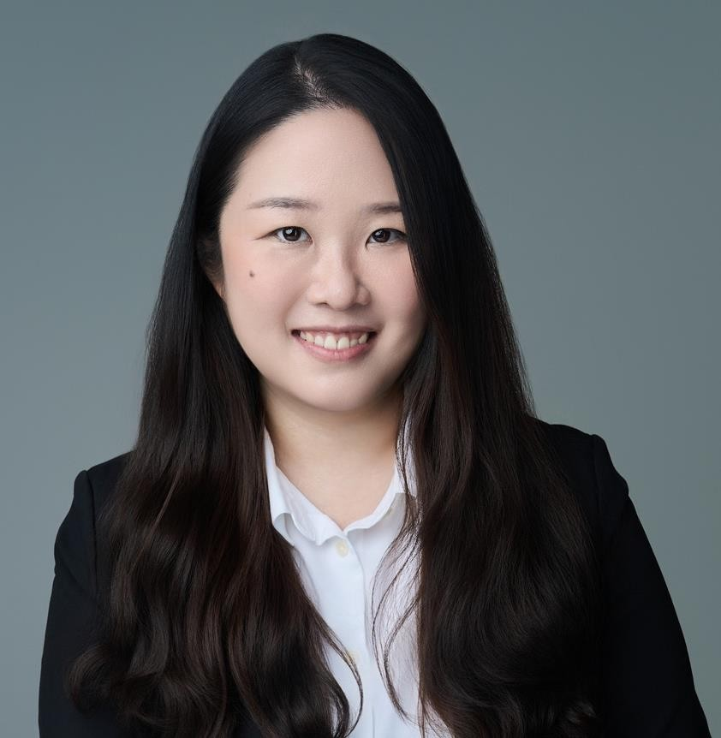
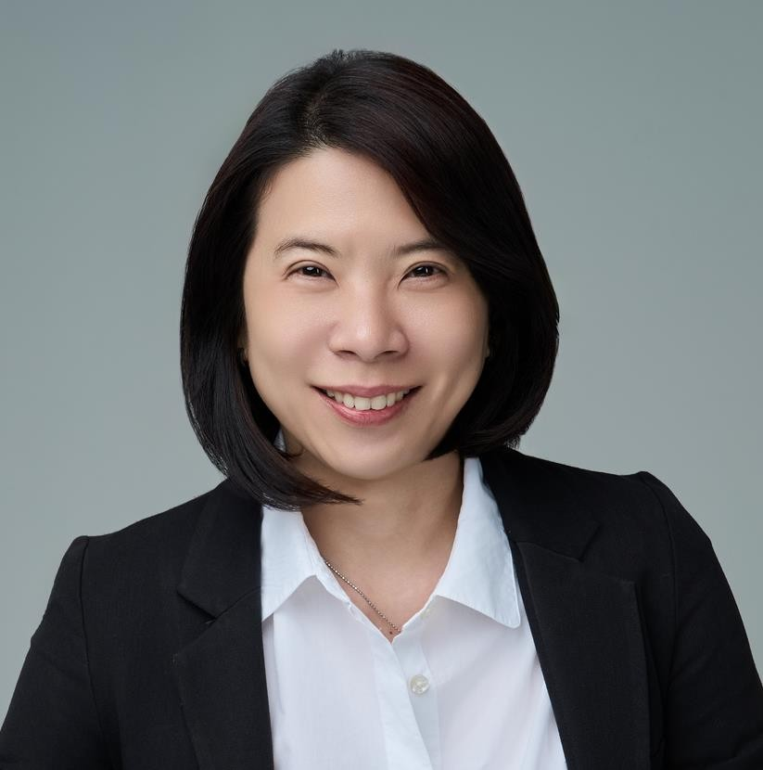
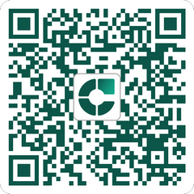
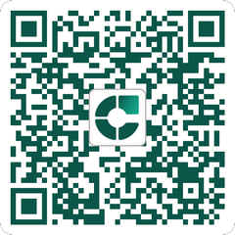
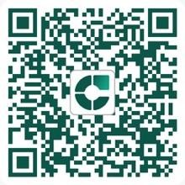
{{section.Service_Team.0.title}}
Arunrat Rattanaarun
Executive Director Corporate Services
Angkana Aroonrung
Executive Director Corporate Services
Over 10 years experience at leading international law firm and business-
focused firms, Angkana specializes in corporate structuring, regulatory
compliance, market entry strategies,
business advisory, and regulatory compliance across various industries.
Panvad Puthaviruttikul
Executive Director Accounting & Tax Services
With over 20 years of experience in
Q
R
Q
R
Q
R
With over a decade of experience at leading international law firms, Arunrat specializes in commercial law,
compliance and foreign direct investment,
offering clients strategic solutions for cross-border business.
international accounting and tax compliance, Panvad brings her experience across a wide range of industries, supporting multinational clients with financial reporting, tax filings and regulatory compliance.

Slide 14
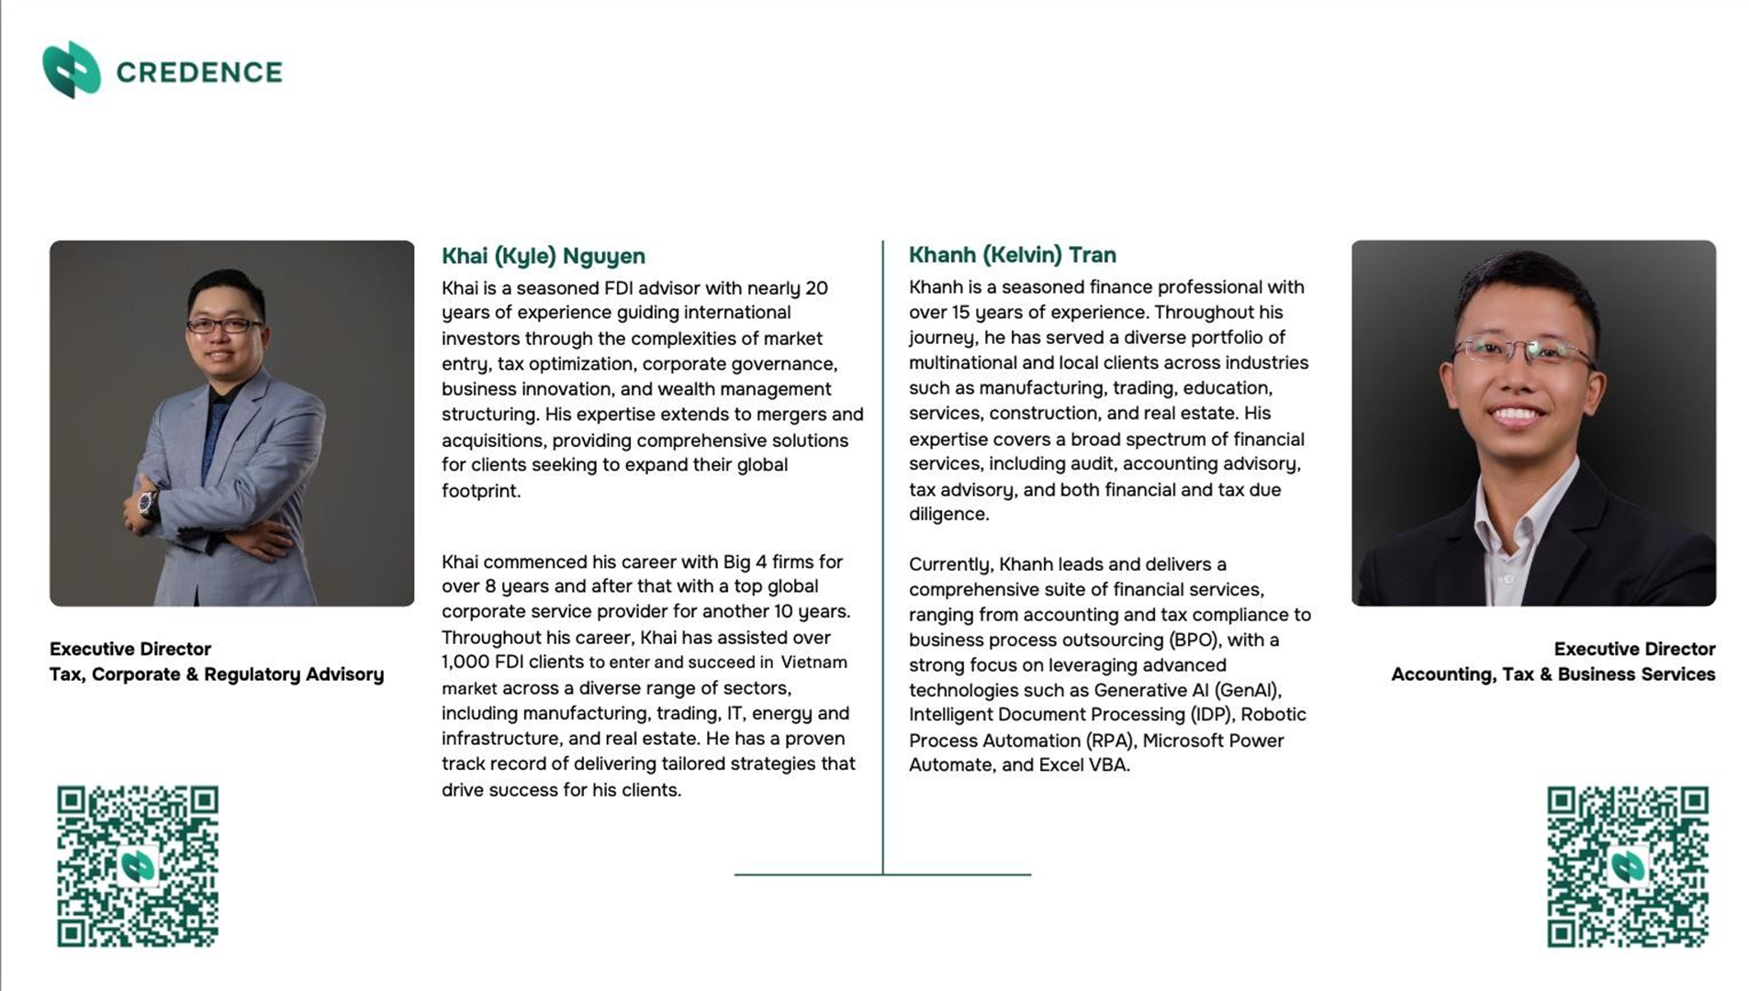
{{section.Service_Team.1.title}}

Slide 15
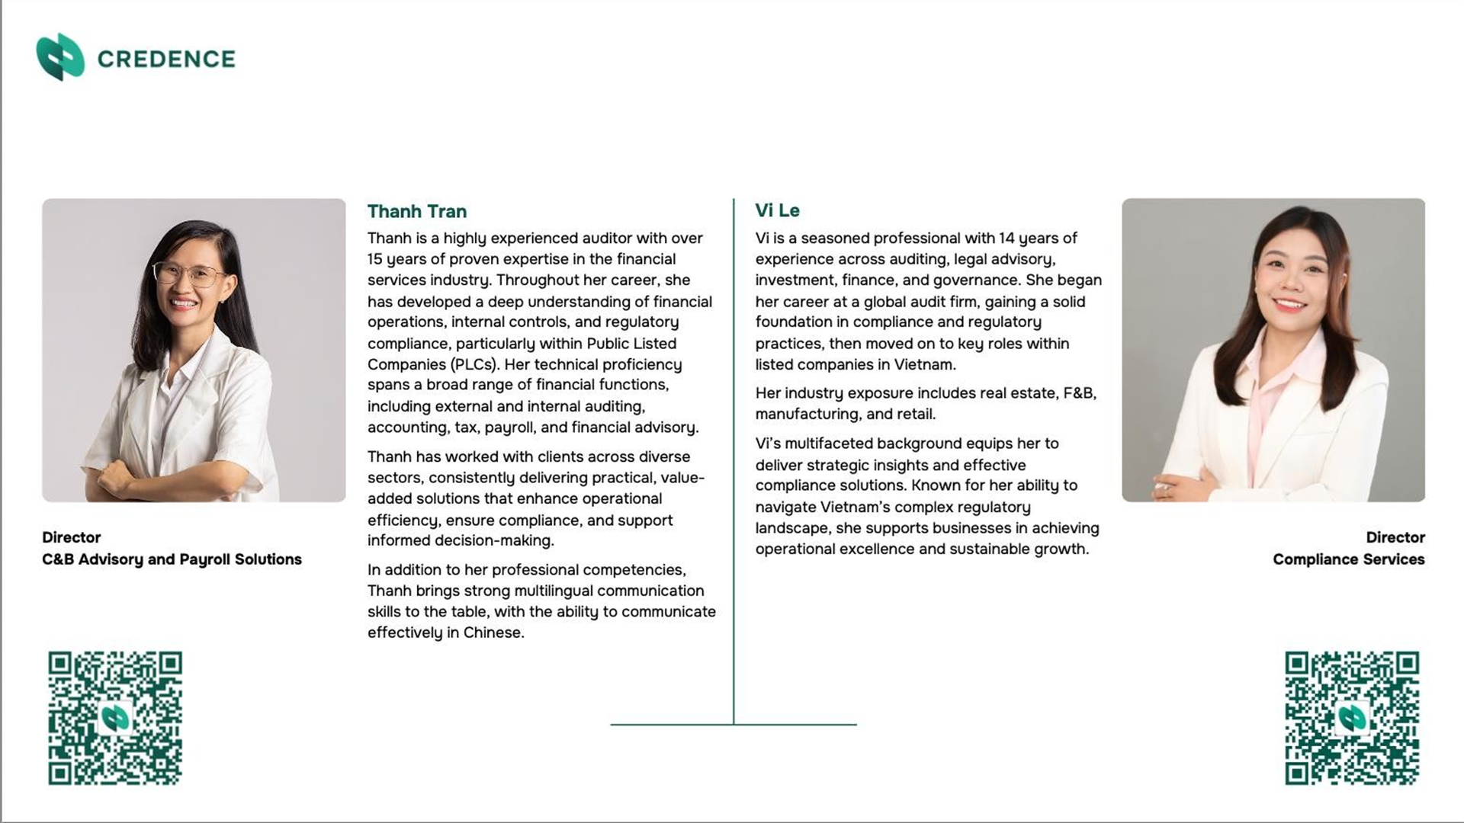
{{section.Service_Team.2.title}}

Slide 16





Our Regional Offices
Thailand - Bangkok
Vietnam – Ho Chi Minh City
Singapore - Singapore
Malaysia – Kuala Lumpur, Johor Bahru, Labuan
Indonesia – Jakarta

Slide 17

Empowering Growth, Built on Trust

Slide 18

















Contact Us
Chermant Accounting & Tax Limited
Website
www.chermant.com
Chermant Corporate Services Limited
One City Centre, 37th Floor,
548 Ploenchit Road, Lumpini, Pathumwan, Bangkok 10330, Thailand
E-mail
info@chermant.com
Chermant Payroll Limited
Telephone
086-369-2781

Slide 19
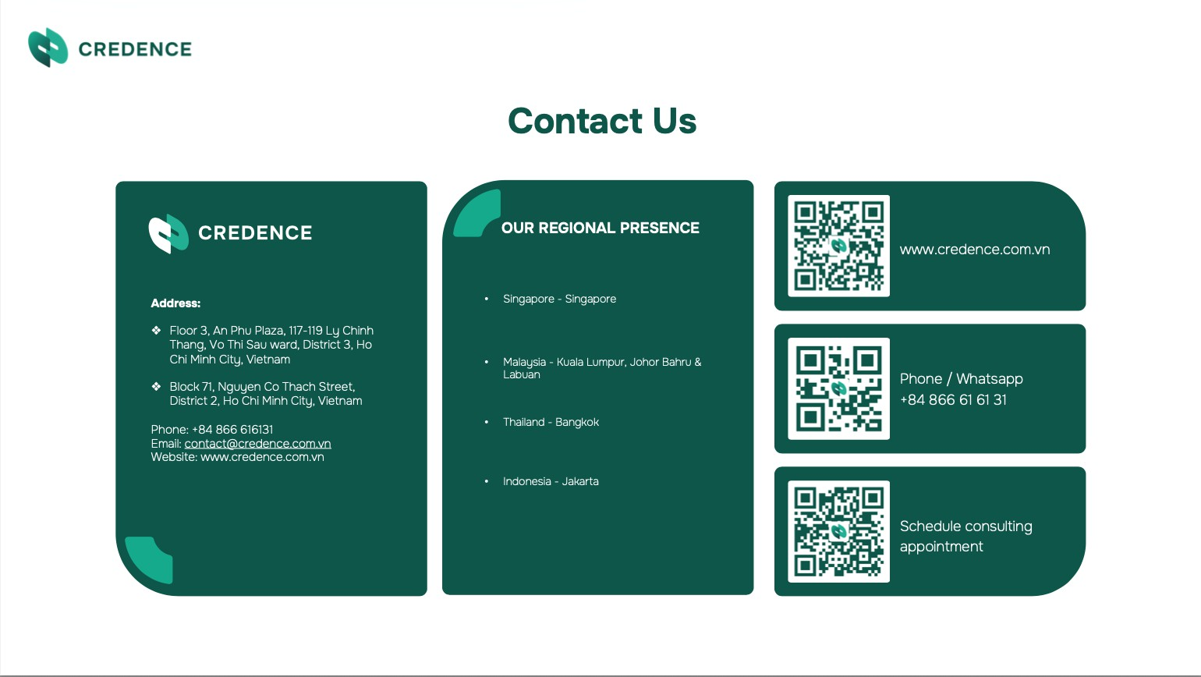
(Vietnam)

