Slide 1
Filtering Spam with Behavioral Blacklisting
Dat Quoc Ngo
University of Texas at Dallas
October 29, 2021

Slide 2
Agenda
Background
Behavior of Spamming IP Addresses
Performance of IP-Based Blacklists
Behavioral Blacklisting
Solution: SpamTracker
Algorithm
Design
Changes in Sending Behaviors
Data & Evaluation
Challenges
Incorporating with existing systems
Deployment

Slide 3
Background: Behavior of Spamming IP Addresses
Persistence
How much spam does an IP address send in a day?
How does the set of IP addresses change over time?
e.g. 1000 spams on Monday, but 20 spams on Tuesday
Distribution
What is the distribution of spam across over target domains
How the distribution changes over time?
e.g. 20% and 40% of spams targeting Fashion and Travel

Slide 4
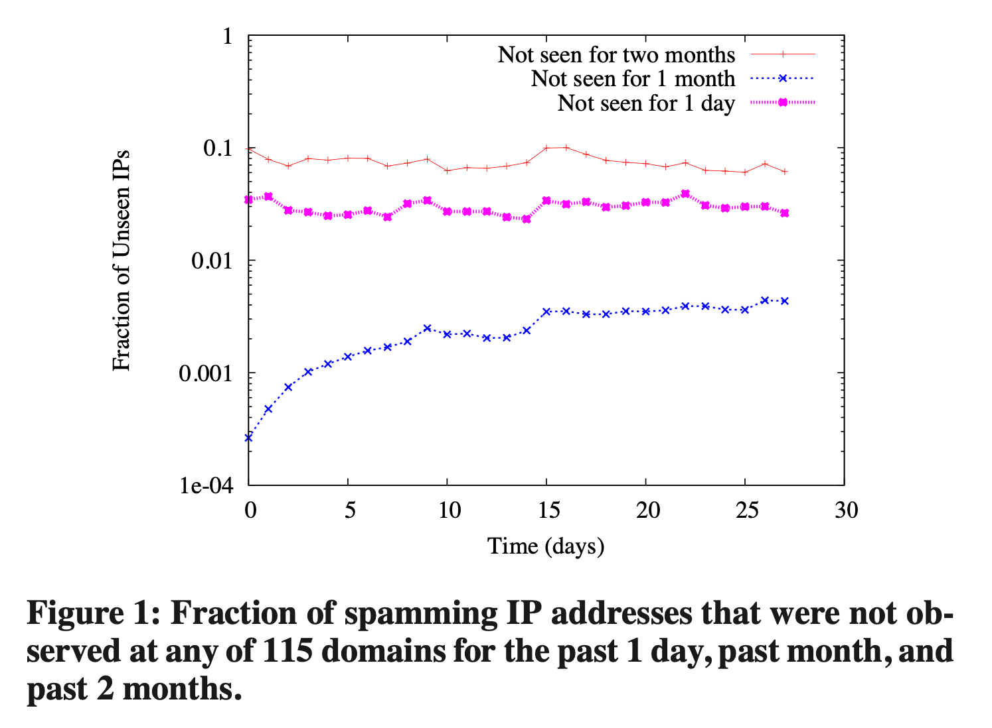
Background: Behavior of Spamming IP Addresses
Persistence
Significant number of IPs never seen is sending spams
Lack of persistence in spamming IPs
-> Difficult to detect spammers based on Ips solely
-> Blacklisted IPs keep changing

Slide 5
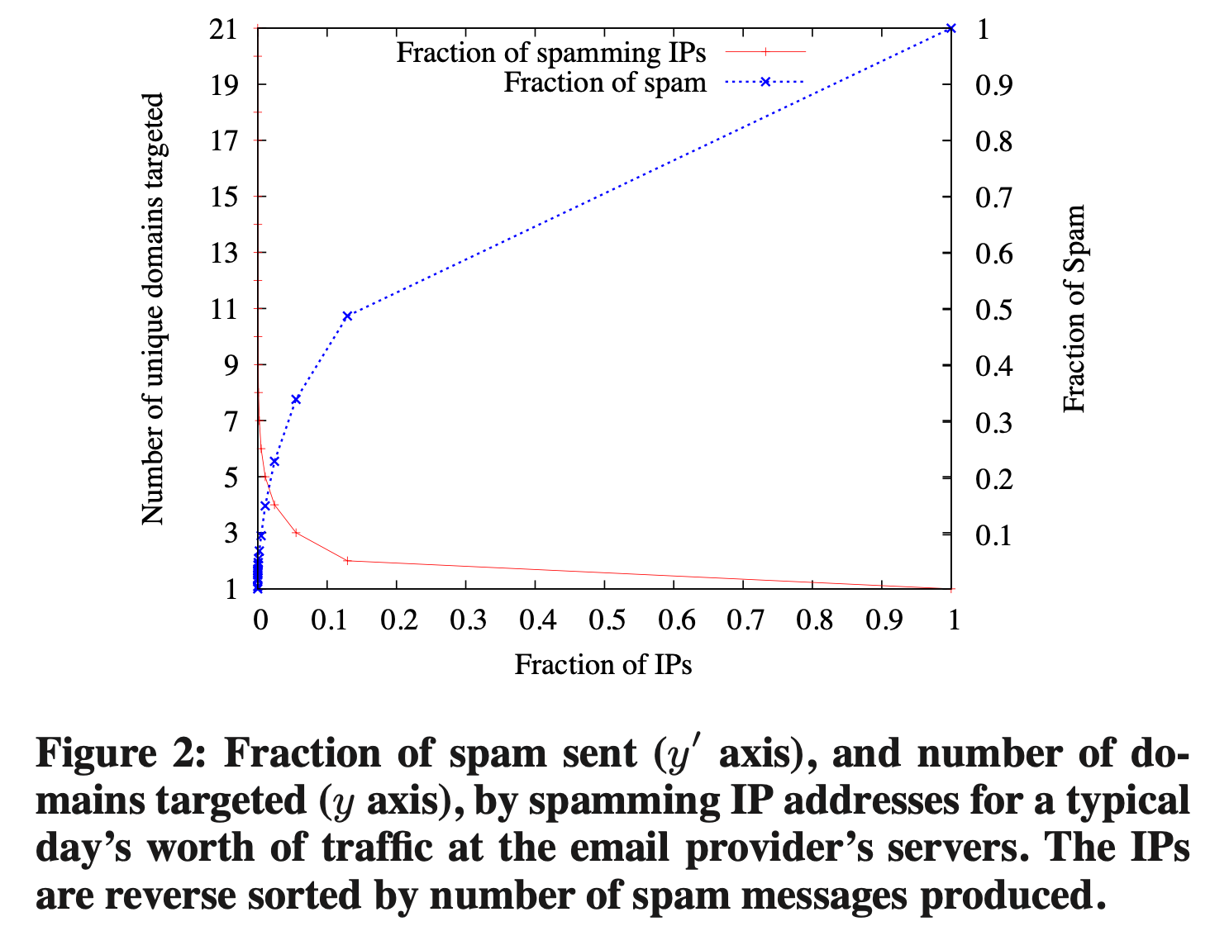
Background: Behavior of Spamming IP Addresses
Distribution: IPs target many domains
Detection based on sending patterns in a single or multiple domains
Evade detection by
Distribute evenly across target domains
Send “low and slow” spams to domains

Slide 6
Background: Performance of IP-based Blacklists
Adds an IP address to a blacklist
Based on reports from network operators
By using spam traps
Determines how long an IP address remains listed

Slide 7
Background: Performance of IP-based Blacklists
Completeness – fraction of spamming IP addresses listed at the time the spam was received
Experiment 1: 35% and 20% of IPs not listed in Trap 1 and 2
After a month, 20% and 8.5% of IPss not listed in Trap 1 and 2
Experiment 2: 2% (110M out of 5M) of spam senders listed after 1 month.

Slide 8
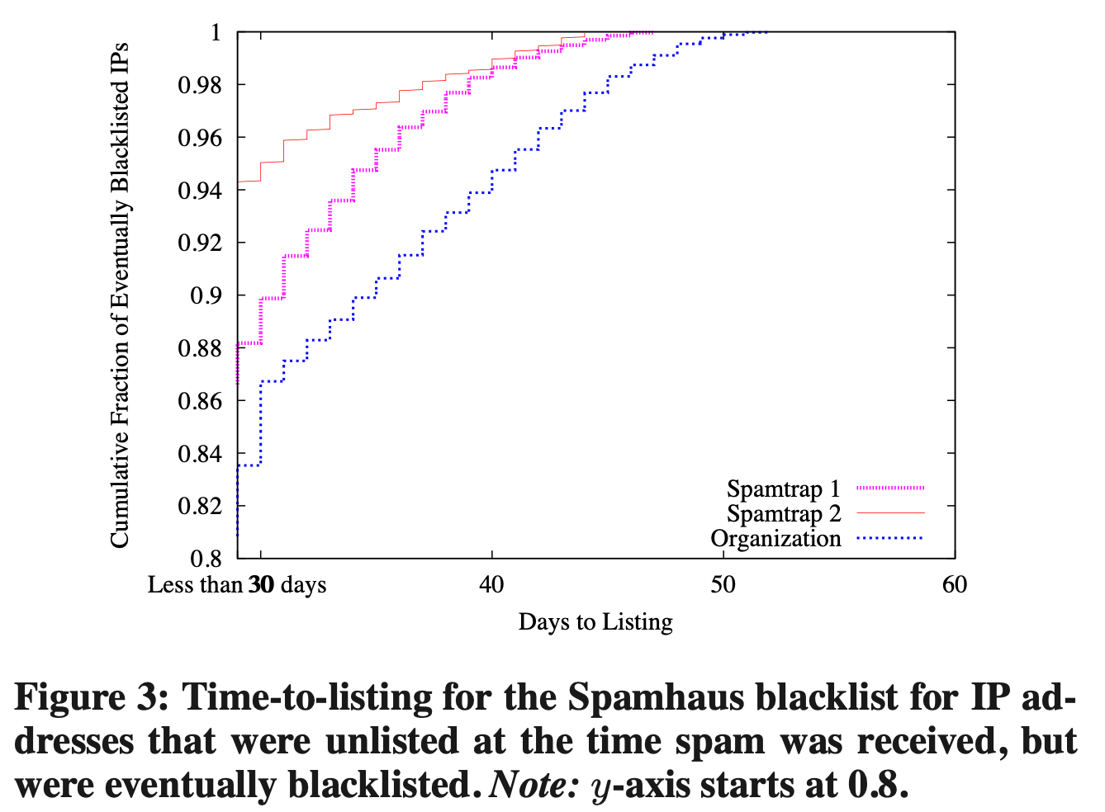
Background: Performance of IP-based Blacklists
Responsiveness – the time for a blacklist to eventually list spamming IP addresses after first occurrence.
Factors:
Manual verification
Based on multiple end-user reports
10-15% of spam senders unlisted until 30 days after receipt of spams

Slide 9
Background: Behavioral Blacklisting
Utilize sending patterns of spammers
Able to distinguish between spam and legit senders
Similar patterns when observed across multiple domains
-> SpamTracker – behavioral blacklisting, classifies spams by the network behavior

Slide 10
Solution: SpamTracker
Classifies email senders by sending behaviors
Hypothesis:
Sending patterns of spamming hosts – similar to others and stable
Similar across domains, even sending low volumes of spam to each domain
-> Clustering based ono sending patterns

Slide 11
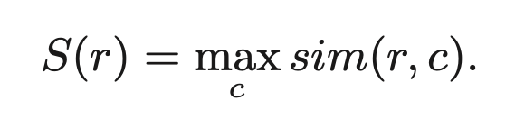
Solution: Algorithm
Two Stages:
Clustering: Spectral Clustering
Yields a set of clusters of IP addresses C = {C₁, C₂, …, C_{k}}
Classification
Compute the max similarity of the IP address’s sending behavior to any of clusters

Slide 12
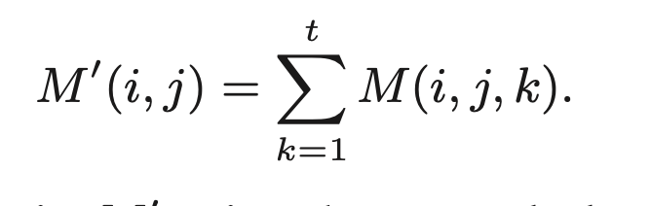
Solution: Algorithm - Clustering
Input: n x d x t matrix M
n – number of IP addresses
d – number of domains
t – time windows
Denoted as M(i, j, k)
Collapses into M matrix of size n x d

Slide 13
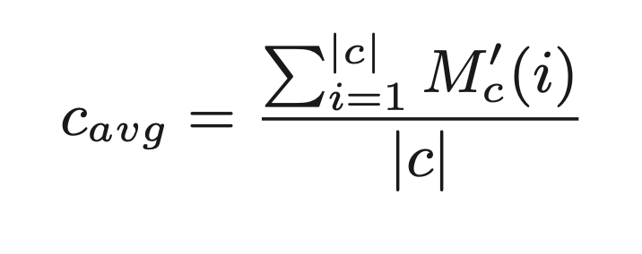
Solution: Algorithm - Clustering
Spectral Clustering:
Yields a set of clusters of IP addresses C = {C₁, C₂, …, C_{k}}
Compute c_{avg} for each cluster
Save c_{avg} for reference use

Slide 14
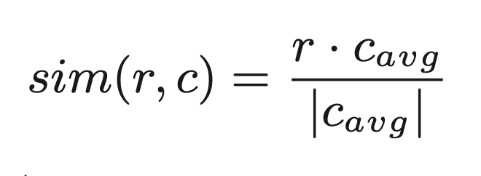
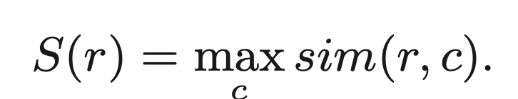
Solution: Algorithm - Classification
Input: a 1 x d vector r – recent behavior of an IP
d – number of domains
Compute the similarity scores for all clusters
Select the cluster with the max similarity score

Slide 15
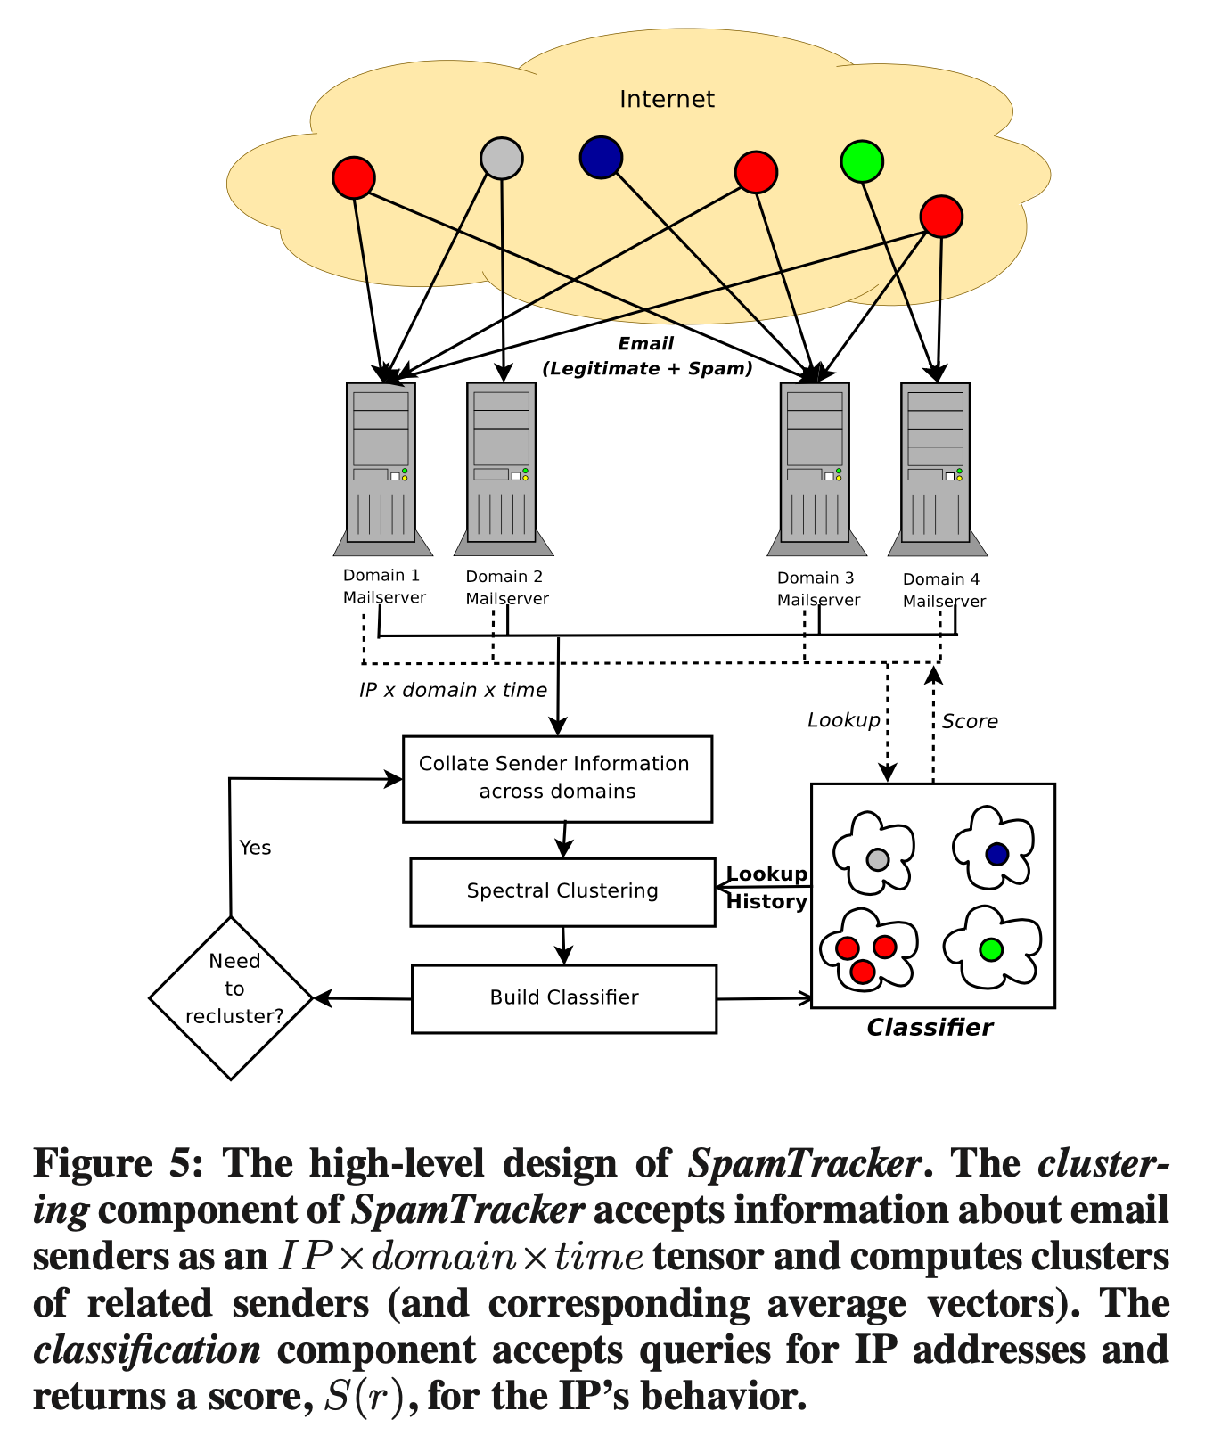
Solution: Algorithm - Design
Due to expensive cost of the Spectral Clustering,
C_{avg} of all clusters are saved in advanced
Only the S(r) is computed per lookup

Slide 16
Solution: Changes in Sending Behaviors
Must recluster as sending patterns change
Issue:
Reclustering cost increases with larger input matrices (large time windows)
Preserving historical information
Solution:
Scale c_{avg} in the previous stage by the cluster size in the current state
Add scaled c_{avg} to c_{avg} in the current stage

Slide 17
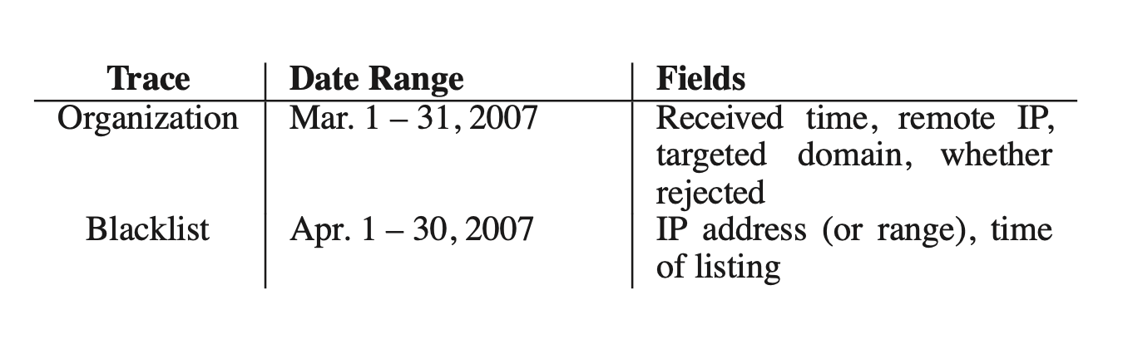
Data

Slide 18
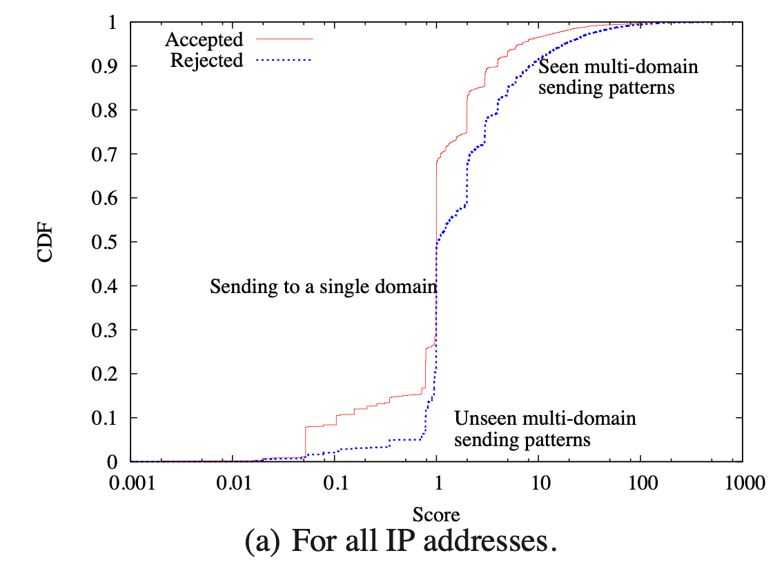
Evaluation
[t, t + ∆t), ∆t = 6 hours

Slide 19
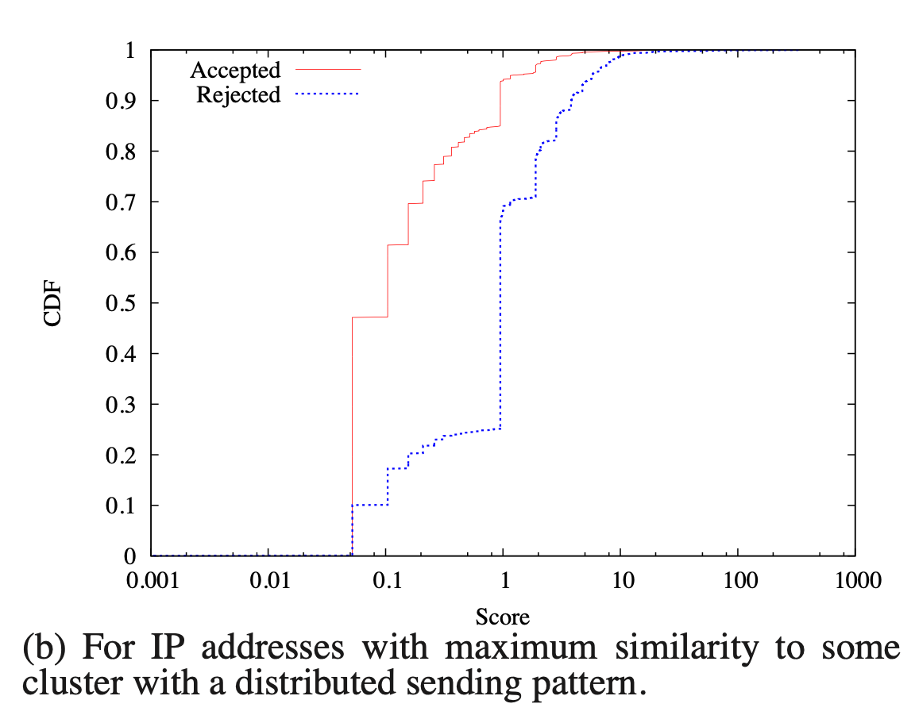
Evaluation
[t, t + ∆t), ∆t = 6 hours

Slide 20
Challenges: Incorporating with existing systems
Backend settings remain the same
Requires to run a DNS server (e.g. XML-RPC server) that accepts requests from SpamTracker
SpamTracker – standalone system & used internally

Slide 21
Challenges: Scalability
Due to an incoming large volume of emails and senders
Concern: reliability
SpamTracker servers replicated and placed in different locations
Concern: centralized clustering algorithm
Distribute clustering to reduce load
Compressing data in distributed servers before sending to a centralized server
-> Reduce bandwidth consumption

