Slide 1
A Generalization of Transformers Networks to Graphs
Vijay Prakash Dwivedi and Xaiver Bresson

Slide 2
Background
GraphNN – most effective for graph arbitrary graph structures
Most work focuses on local node neighborhood
Transformers – widely applied in NLP
Meaningful interactions among words in sentences
=> Extend Transformers to arbitrary graphs

Slide 3
Related Work
Note: graph nodes must be linearized for input to Transformer
Attention to all graph nodes + w/o positional encoding
-> Lose the structural information
Sub-graph batches -> Attention + w/ positional encoding
-> Retain the original structural information
Local GraphNN + Attention + w/ coordinate encoding
-> Retain the original structural information

Slide 4
Contributions
Sparsity – graph-size directly affects computational limit
=> Computationally feasible for graph-size <= 1000
=> Impractical for graph-size > 1000
Notes:
Unlike NLP, text is consumed left-to-right and top-to-bottom. Similarly, context is consumed in the likewise way.
Graph is not that lucky. There is no explicit order information, only structural information. At the moment, to get global info/context, must consume the entire graph

Slide 5
Contributions (cont.)
Positional Encoding for Transformer
In NLP, represent unique word representations
In GraphNNs,
All node positions are symmetrically invariant
GAT applies attention over local neighbors -> limited performance

Slide 6
Graph Transformer
Inputs:
Node + Edge features
Laplacian Positional Encodings
Model: based on vanilla Transformer
Transformer Layer
Transformer Layer with Edge Features

Slide 7
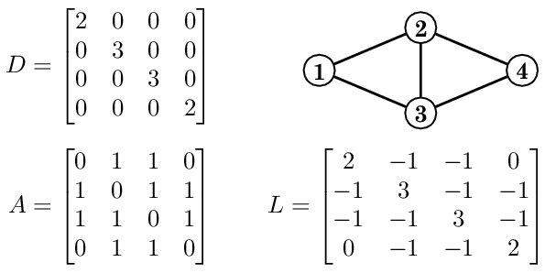
Laplacian Positional Encodings
Laplacian Eigenvectors computed from the graph Laplacian matrix
Represent distance-aware information of nodes
Randomly flip signs during training
Notes:
* Graph Laplacian matrix => similar to kernel filter in Conv.

Slide 8
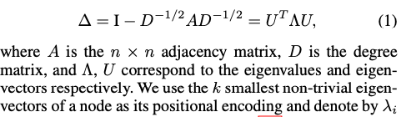
Laplacian Positional Encodings (cont.)
Laplacian Eigenvectors – factorization of the graph Laplacian matrix
Notes:
* Right image, LPEs from factorization of graph Laplacian matrix

Slide 9
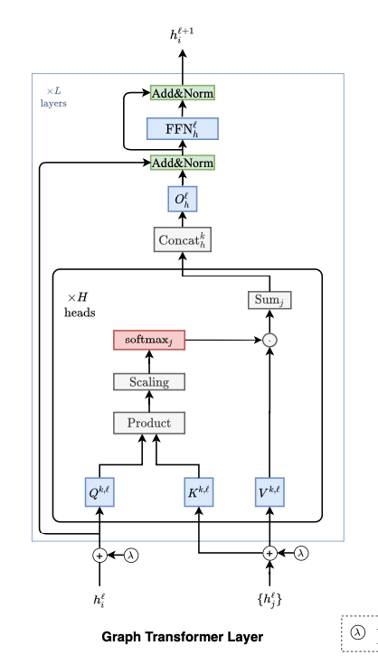
Graph Transformer Architecture & Layer
Similar to vanilla self-attention Transformers
Inputs: node + (edge) + positional-encoding

Slide 10
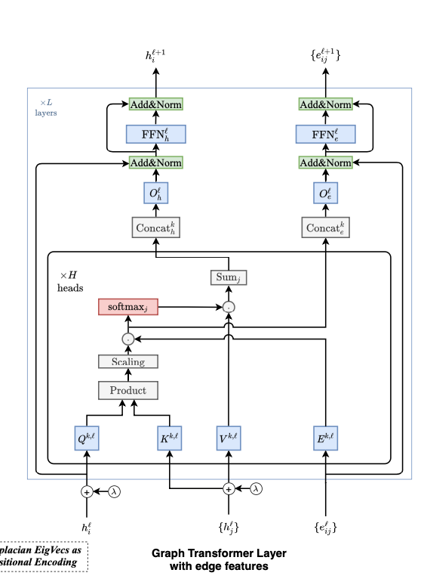
Graph Transformer Layer w/ Edge Features
Many Graph datasets has edge features
e.g., molecular (bond-type)
Tie edge features to pairwise attention among nodes
Inputs: node + (edge) + positional-encoding
Notes:
Product of self-attention before softmax -> represent edge relation

Slide 11
Experiments
CLUSTER, Node Classification
PATTERN, Binary Node Classification
ZINC, Graph Property Regression
Molecular dataset w/ edge features

Slide 12
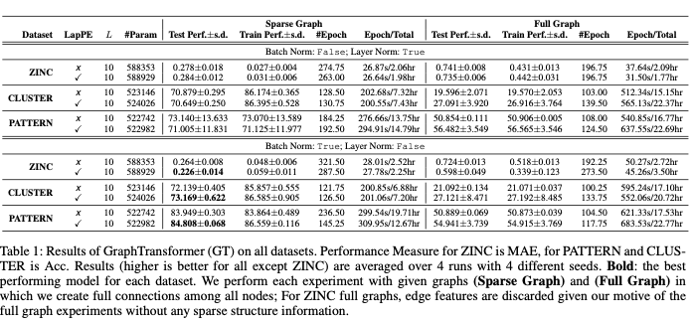
Results
Notes:
Showing that good for sparse-graph dataset. Like latice-graph summarization.

Slide 13
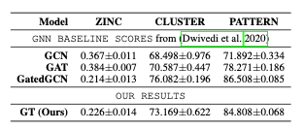
Results (cont.)

Slide 14
Other thoughts
Proved for arbitrary and homogenous graph
Limit: graph-size > 1K nodes (e.g. knowledge graph)
Better to experiment w/:
Heterogenous graph: multi-modals and multi-node-types
Generation tasks
Notes:
L-PE => distance aware info => may fit for generation tasks

