Slide 1
Robust Physical-World Attacks on Deep Learning Visual Classification
Dat Quoc Ngo
University of Texas at Dallas
September 24, 2021

Slide 2
Agenda
Background
Deep Learning in Computer Vision
Safety Concern
Challenges
Related Work
Solution
Experiments & Evaluation

Slide 3
Background: DL in Computer Vision
Deep Neural Networks (DNNs) achieved state-of-the-art results in many Computer Vision tasks
e.g. YOLOvx for Object Detection
Applied in physical systems: UAVs, robots

Slide 4
Background: Safety Concern
Concern of DNNs’ vulnerability to adversarial perturbations (aka digitally and physically modified visual input)
=> Misbehavior of systems in potentially dangerous ways
=> Raising safety transportation concerns

Slide 5
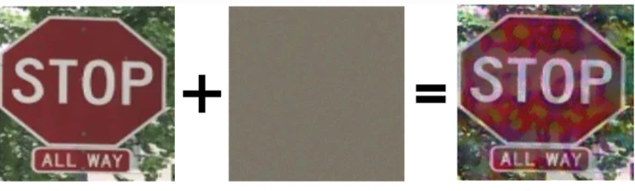
Background: Road Sign Classification
Significant in self-driving systems and transportation
Challenging to hide perturbations due to simplicity
Notes:
Image Reference: Wu et al.

Slide 6
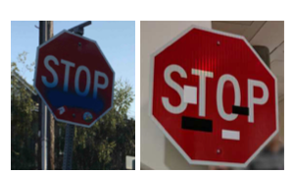
Challenges
Environment Conditions:
Continuous change of distance and angle of a camera
Lightning/weather conditions, and debris on camera
Spatial Constraints:
Background of road signs changes
Difficult to place adversarial examples on road signs

Slide 7
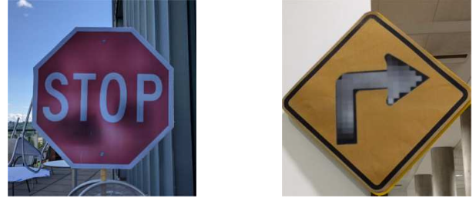
Challenges (continued)
Imperceptibility Limits
Tiny modifications are imperceptible
Fabrication Error
All modification must be realistic (i.e. colors)
Dependent on sensing hardware
Notes:
Image Reference: Eykholt et al.

Slide 8
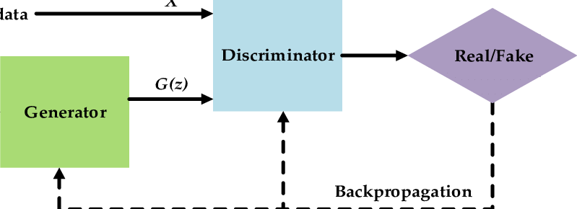
Related Work
Digital Adversarial Examples
Full-access to classifiers
Reverse engineering to
Extract models
Generate adversarial examples to fool classifiers
e.g. GAN
Notes:
Reference: Research Gate(https://www.google.com/url?sa=i&url=https%3A%2F%2Fwww.researchgate.net%2Ffigure%2FThe-original-generative-adversarial-network-GAN-model-In-simple-terms-G-wants-to_fig1_340481789&psig=AOvVaw0kUBHbYUu5UApI1lV0TD1X&ust=1632605270565000&source=images&cd=vfe&ved=0CAwQjhxqFwoTCJDt3dzGmPMCFQAAAAAdAAAAABAY)

Slide 9
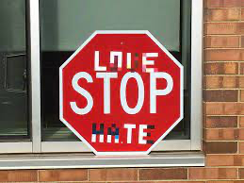
Related Work (continued)
Physical Adversarial Examples
Not modify objects, print digitally perturbed masks on objects
Change physical conditions
e.g. post, distance/angle from camera
Notes:
Image Reference: Eykholt et al.

Slide 10
Notation
x - original clean image
x’ - adversarial image that is closely similar to x
f(.) - road sign classifier
y - ground truth
y* - targeted class

Slide 11
Solution & Evaluation
Robust Physical Perturbations (RP^2)
Focus on road sign classification
Generate adversarial examples in various physical conditions
Two-stage evaluation: in lab and in field tests

Slide 12
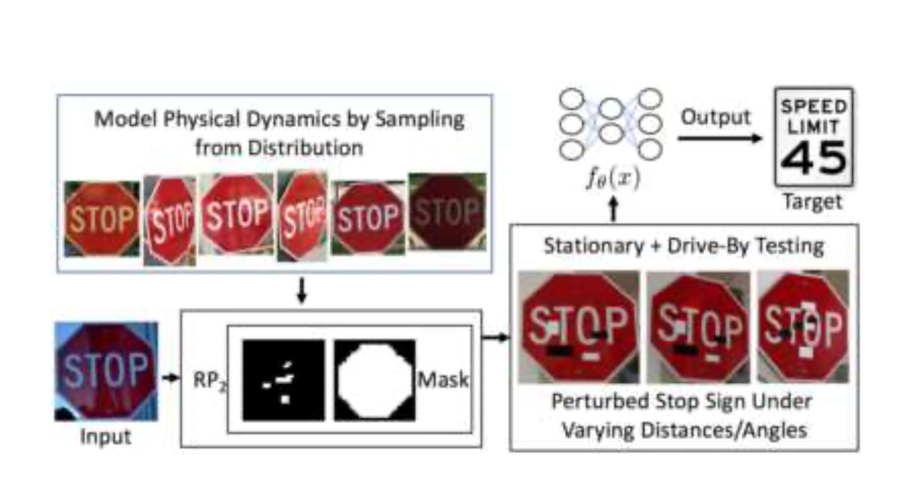

Slide 13
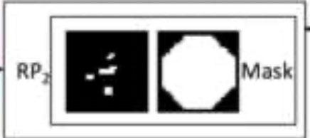
Position of masks
Target weak areas of road signs
Pipeline:
L1 to compute perturbations - location of weak areas
L2 to recompute perturbations

Slide 14

Loss Function
||𝛿|| - Euclidean Distance between x and x’
J - cross entropy

Slide 15

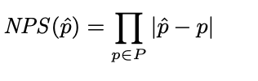
Considering Fabrication Error & Alignment
NPS - printer color reproduction errors
T(.) - alignment function

Slide 16
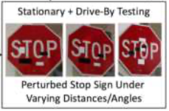
Testing Environments
Stationary Tests:
Clean images C taken at fixed positions
With varying distances D and angles G
Adversarial images A(c^dg)
Drive-by Tests
Camera on moving platforms
Driving speed: 0-20 mph

Slide 17

Experiments
Classifiers:
LISA-CNN (pretrained w/ U.S. traffic signs)
GTSRB-CNN (pretrained w/ German traffic signs)
Datasets:
LISA: 47 road signs but only 17 common signs in use
Own dataset: 181 stop sign images

Slide 18
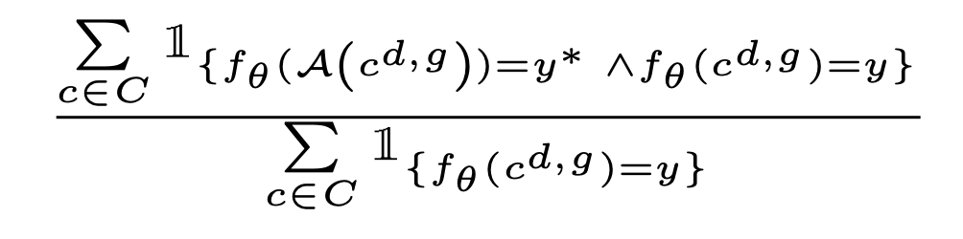
Evaluation: Success Attack Rate

Slide 19
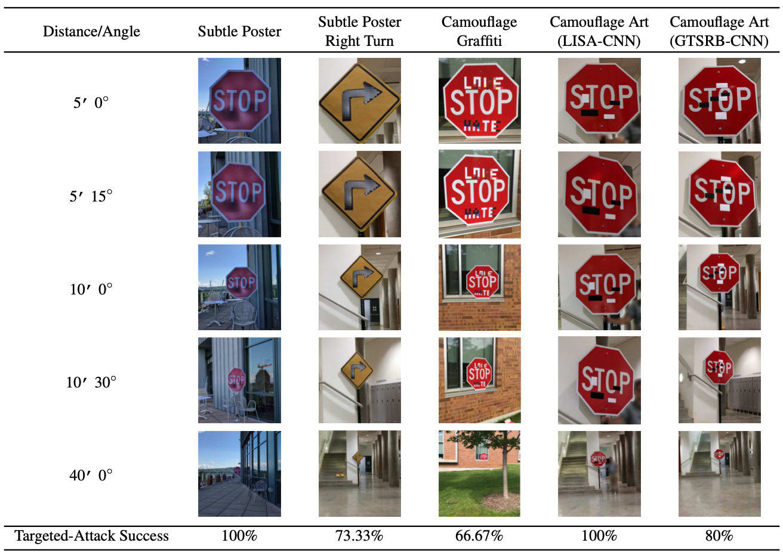
Slide Title

