Slide 1
Efficient Graph Generation with GRAN
Liao et al.

Slide 2
Graph G = (V, E)
Represented by the adjacency matrix A

Slide 3
Related Work: Graph Generation
Generators disregarding graph structures
e.g. VAE with CNN variants predicting the adjacency matrix
Auto-regressive generating decisions
Graph generation -> sequential process using RNNs or GNN
Key: exploit domain-specific graph structures
e.g. RNNs on SMILES strings for molecular graph generation
Challenge: not scalable for generating graphs with more than 100 nodes
Notes:
Efficiency for parallel computation, low quality of graph generation
Reasons
A graph = V! permutation of nodes aka node orderings
if consider all, out-of-memory
if using a single node ordering (BFS) -> low quality of large graphs

Slide 4
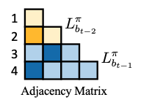
Input
A node ordering π – sequence of nodes
Block-size B – speed or number of nodes to be generated at every time step t
Triangular Adjacency Matrix L
At t = 0, L is empty
A sub-graph G_{t} containing already generated nodes and edges
At t = 0, G₀ is empty
At t = 1, G₁ has the first B nodes from ordering π
Notes:
* node ordering - provide new nodes to be added to graph
* block-size B = 1, -> standard auto-regressive models w/ 1 output at a time

Slide 5
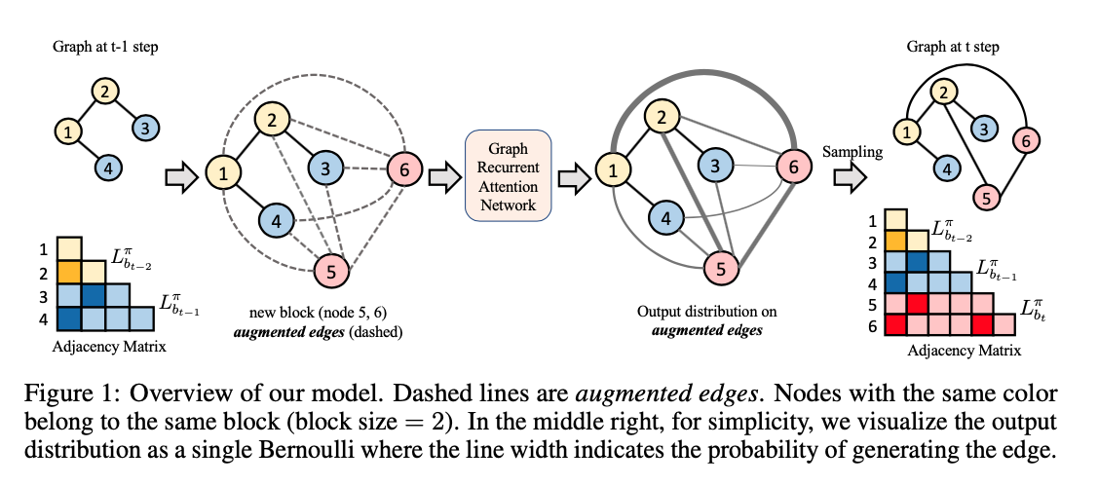

At every t step,
B nodes are added to the current graph by π
GRAN generates a block of B rows or a BxN matrix L^{π} (N = 1, 2, … V)
p(L^{π}) – probability of specifying all edges from nodes in this block to each other and to nodes generated earlier
p(L^{π}) generated by GNN -> In RNNs, 2 nearby nodes may be far apart in the node ordering.
Notes:
* Conditional prob – the prob of generating the current block (all edges from the new nodes to each other and to nodes generated earlier)
* Usually, RNN is chosen to model this sequential dependenccy
* Issue with RNN - In linearized input, 2 nearby nodes - are far apart due to the node ordering
* briefly, GNN collects information from nearby nodes based on adjacency matrix

Slide 6

Node Representation, at t step
H⁰_{bi} (BxH) – reinitialized by a FFN (GNN not carrying hidden states over t steps)
When t=0, h⁰_{bt} = 0
Using the fixed H size -> reduce embedding size & handle large scale graphs
Notes:
R rounds -> collect information nodes that far apart from the current node
Larger R rounds, the better representation

Slide 7
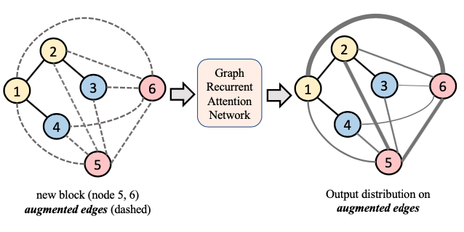
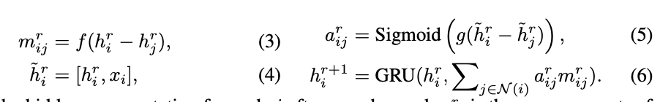
GRAN, at t step given graph G_{t} containing B new nodes, generated nodes, and all edges between them
All node representations are updated by r rounds of message passing
f and g – 2-layer MLPs with RELU
a – attention associated with edge (i, j)
Notes:
R rounds -> collect information nodes that far apart from the current node
Larger R rounds, the better representation
Binary mask – position embedding in Attention

Slide 8
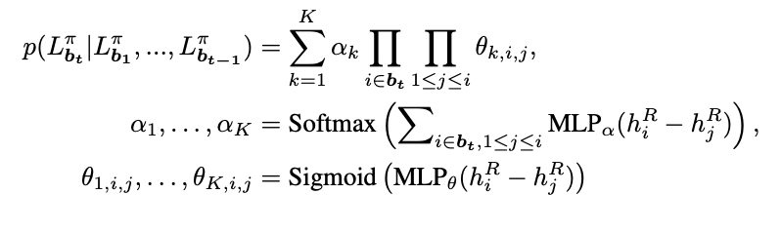
Output
Sigmoid output -> probability block (BxN, N = 1,2, …V) specifies edges from new nodes to generated nodes
Softmax output -> contribution of each K-th Bernoulli distribution
By a mixture K Bernoulli distribution
When K = 1, assuming independence of edges on the existing graph
When K > 1, exists dependence of every edge to other edges
Notes:
Idea: modeling underlying edge generation rules that are usually hardcoded

Slide 9

Objectives & Ordering
Maximize log-likelihood
Issue: intractable gradients if considering all π orderings (a factorial of graph size)
Nearly impossible to calculate gradients of V! orderings
Select a set of Q orderings (e.g. BFS, DFS, etc)
-> Maximize the lower bound log-likelihood
Trade-off between the generation quality and computational cost

Slide 10
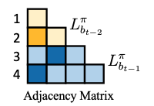
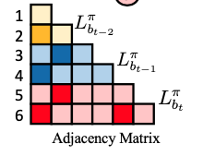
Trade-off: Block Size and Stride
Block-size B -> speed or number of nodes to be generated
Larger B -> faster but lower quality
In the sequential order (B =1), there is V steps
B > 1, there is T = [N/B] steps
Stride
Keep the first S rows, 1 <= S <= B
When S < b, neighboring blocks have an overlap of B – S rows
Idea:
B_{t} row ignores dependency with B_{t-1}
Considering dependency between rows -> improve quality
Notes:
Idea: dependency between rows in block

Slide 11
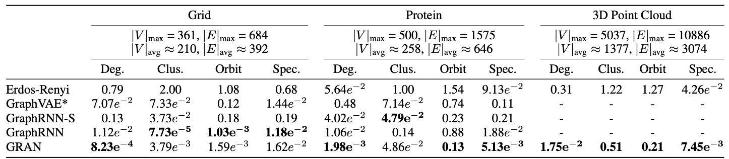
Experiments
Datasets:
Grid: 2D grid graphs with 100 < |V | < 400.
Protein: graphs 100 < |V| < 500
Point Cloud: average graph size over 1K nodes
Metrics (based on graph statistics):
Degree distribution
Clustering coefficient (measure of nodes tied together)
Occurrence of orbits
Notes:
Evaluating graph is difficult, hence based on graph statistics

Slide 12
