Slide 1
Property Controllable Variational Autoencoder via Invertible Mutual Dependence

Slide 2
Issues
VAEs, by learning the latent variables, useful for generative process
Chemical molecules, images, etc.
e.g. Property-controllable molecule generation
Encoder: GraphNN + Z
Decoder: GraphNN + 2 continuous properties

Slide 3
Issues
VAEs, by learning the latent variables, useful for generative process
Chemical molecules, images, etc.
Limits:
Poor interpretability and control over latent representation of properties
-> Entangled representations -> sensitive changes among properties
-> Less useful in generation process

Slide 4
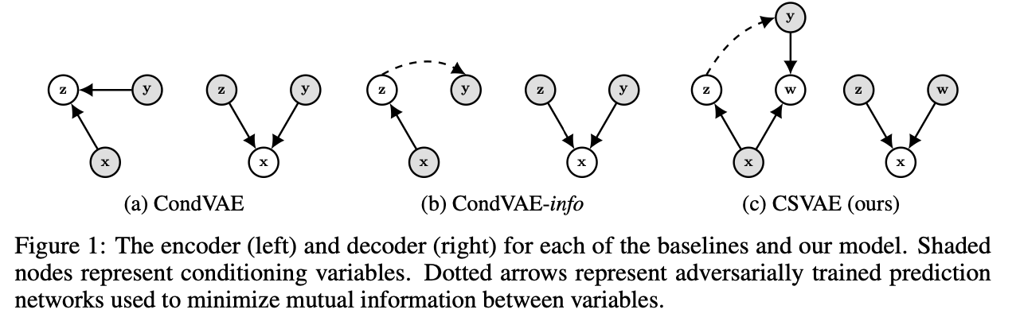
Issues
Solution: enforce relationship between latent representations & data properties
e.g. CondVAE, CondVAE-info, CSVAE

Slide 5
Challenges
Enforce mutual independence among properties & variables
Efficiently ensure each property only correlated to its corresponding latent variable(s)
Capture/control correlated properties
Correlated properties not “one-on-one” mapped to independent variables
Handling continuous-valued properties
Existing methods to categorical (typically binary) properties

Slide 6
Notation
Dataset D, each instance (x, y) with y_K, K properties of x
e.g. x is a molecule, y = {cLogP and cLogS}
(z, w) latent variables
Each w_k variable controls one y_k properties
z controls all aspects of x

Slide 7
Goals
Generative model
Subset of variables (e.g. z) – disentangled from w
Variables in w – disentangled from each other

Slide 8
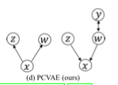
Bayesian Variational Inference of PCVAE
Variational Lower Bound Term:
Each property is mapped to corresponding latent variables
Notes:
Model dependence between x and (w,z) for latent representation
Model dependence between y and w for property manipulation
To do so,
W disentangled -> w independent of y

Slide 9

Group-Wise and Property-Wise Disentanglement
Further penalty to guarantee:
Each property mapped to corresponding variables
Each variable captures only the assigned property
Notes:
First term (group-wise) -> enforce independence between 2 subsets of z and w
2nd term (property-wise) -> enforce independence within w -> each latent variable -> capture a single property

Slide 10
Invertible Constraint for Property Control
Precise control of property
-> Invertible function: maximize the probability that y_k = m
Notes:
Invertible function
Choose variable w that maximizes probability for that probability
All variables in w -> generate x

Slide 11
Architecture
Encoder and 2 Decoders: MLP, CNN, GraphNN
Invertible function p(y_k=m | w): MLP

Slide 12
Datasets
dSprites of 2D shapes: 730K images
3DShapes: 480K images
QM9 dataset: 134K organic molecules

Slide 13
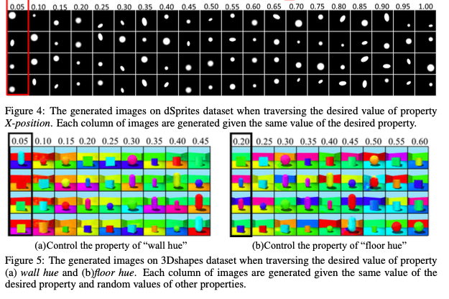
Evaluation: Property Controllable Generation
Notes:
Same X-position but different properties

Slide 14
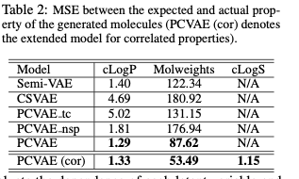
Evaluation: Property Controllable Generation

