Slide 1

PHP
CMS base on Codeigniter Framework 2.1.4
by quocdunginfo, kienkimkhung

Slide 2




Cat on rail paradigms
CMS bus rail
Component bus rail
Module bus rail

Slide 3
MVC Module definition
Module (Lite)
Controllers
Models
Views
Module (Full)

Slide 4
Admin component > Module inheritance
Admin_user[s]
Home
Admin_category[s]
Admin_post[s]
Admin_group[s]
Admin_setting
Admin_template
…
Admin_menu
Admin_url
Admin_feedback[s]
Admin_antivirus

Slide 5
Shopping component > Module inheritance
Product[s]
Home
Register
Contact
Static page
Login
Search
…
Logout
Login or Register
Account
Cart

Slide 6
Blog component > Module inheritance
Home
…
Post[s]

Slide 7
Model inheritance & Relation (p1)
*Description:
-Bold:
Built-in Model
-Normal:
Extension Model
0..*
0..*
Category
Post
Painting
Automatic Detection
Mapping
Painting
Page
Page
Menu
Template
System
System
Feedback
Feedback
Slider
Slider
…
…
Order
Order detail
…
Material
…

Slide 8
Model inheritance & Relation (p2)
*Description:
-Bold:
Built-in Model
-Normal:
Extension Model
…
Manager
User
0..*
Customer
0..1
Group
0..*
Setting
0..*
Permission

Slide 9
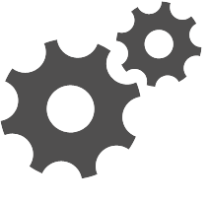
Shopping component > Cart module’s MVC structure
Cart module
Controllers
Views
Cart
Cart index
Rendering
Cart checkout
Models
Cart confirm
Painting
Cart online payment
Order
…
Cart finish

Slide 10
Component bus rail >Synchronization between components
User
Authentication
Service
Component bus rail
member
member
Admin
component
Shopping
component
member
Blog
component

Slide 11
Module bus rail >Synchronization between modules
Menu Provider
Service
Module bus rail
Caller
Provider
Admin_Menu module
Admin_painting module
Provider
Admin_category module

Slide 12
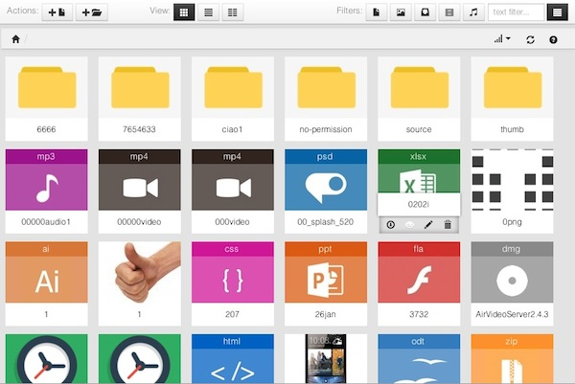
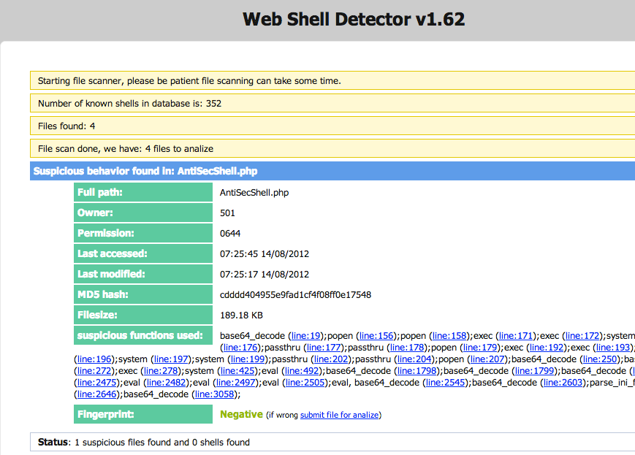
Third party utilities as Extension components
Responsive file manager v9.3
…
Web shell detector v1.62 Antivirus & Malware

