Slide 1
Time series forecasting using a hybrid ARIMA and neural network model
G. Peter Zhang
Neurocomputing 50 (2003) 159–175
link
Presented by Trent Goughnour
Illinois State Department of Mathematics
Notes:
Working with Dr. Xu.
Share with you a paper discussing…
This is a subject that we have been exploring in more depth, but I am no means an expert on forecasting or the algorithms described.
Feel free to ask questions, but my apologies if I am unable to answer them.

Slide 2
Overview
Background
Methodology
Data
Results
Conclusion
Notes:
General journal structure.
I will fill in some details not mentioned in the article.
A few more details related to these methods.

Slide 3
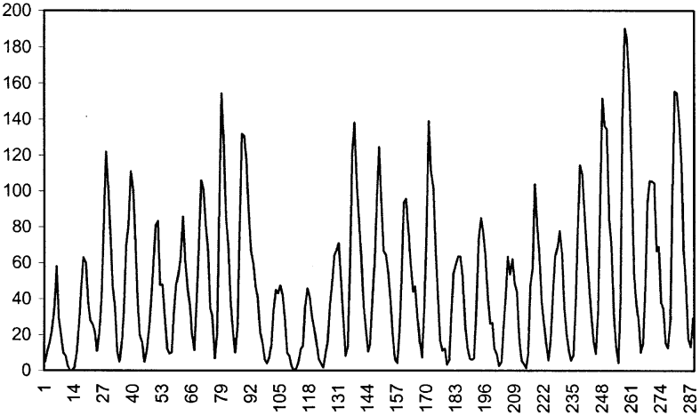
Traditional Time series forecasting models
Forecasting
Past observations to develop a model
Model is then used to forecast future values
Linear Methods
Auto Regressive
Moving Average
Exponential smoothing
Non-Linear Methods
Bilinear model
Threshold autoregressive (TAR) model
Autoregressive conditional heteroskedastic (ARCH)
More recently artificial neural networks (ANN) and other machine learning
Notes:
Past observations of a variable, collected, analyzed to develop a model describing relationships and behavior.
This model is used to the forecast future values.
Univariate forecasting is used when the underlying stochastic process is not well understood, complex, or other data is unavailable that might help explain the process.
A lot of research and development have been put into forecasting over the years for obvious reasons.
Supervised Machine Learning. Applying algorithms to data to generalize a function or mapping from inputs to targets. We can then use this as a method for predictions or forecasts.
The first three are limited in that they are developed for specific non-linear patterns.
ANN recent added

Slide 4
ARIMA
Autoregressive Integrated Moving Average (ARIMA) Models:
Refer to models where the dependent variable depends on its own past history as well as the past history of random shocks to its process.
Auto Regressive (AR)
Integrated (I)
Moving Average (MA)
An ARIMA(p, d, q) is represented by three parameters: p, d, and q, where p is the degree of autoregressive, d is the degree of integration, and q is the degree of moving average.
Notes:
ARMA was first described in the 50’s.
ARIMA is popular due to it’s statistical properties, and methods available for model development (Box-Jenkins)
Linearity also imposes limits on their flexibility.

Slide 5
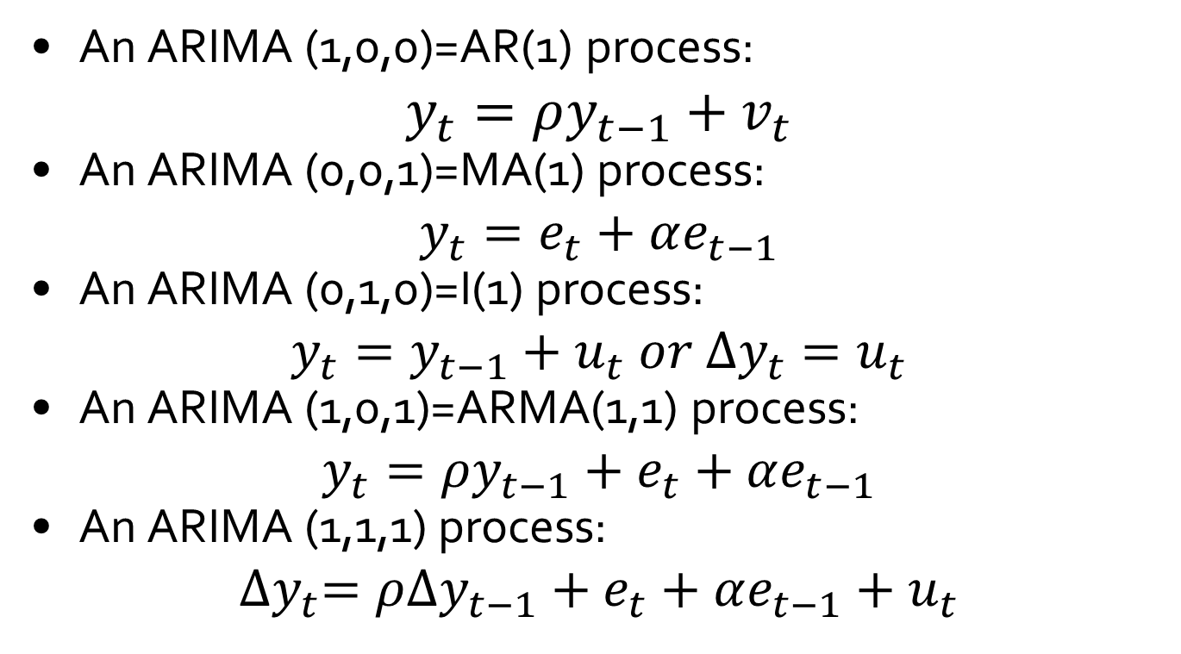
ARIMA Examples
An ARIMA (1,0,0)=AR(1) process:
$$y_{t}=ρy_{t−1}+v_{t}$$
An ARIMA (0,0,1)=MA(1) process:
$$y_{t}=e_{t}+αe_{t−1}$$
An ARIMA (0,1,0)=I(1) process:
$$y_{t}=y_{t−1}+u_{t} or ∆y_{t}=u_{t}$$
An ARIMA (1,0,1)=ARMA(1,1) process:
$$y_{t}=ρy_{t−1}+e_{t}+αe_{t−1}$$
An ARIMA (1,1,1) process:
$${∆y}_{t}=ρ∆y_{t−1}+e_{t}+αe_{t−1}+u_{t}$$
Notes:
Rho or rhu plus some error vt
Moving average as the trend. Et is a shock for that period plus some alpha of the last shocks.
Integration

Slide 6
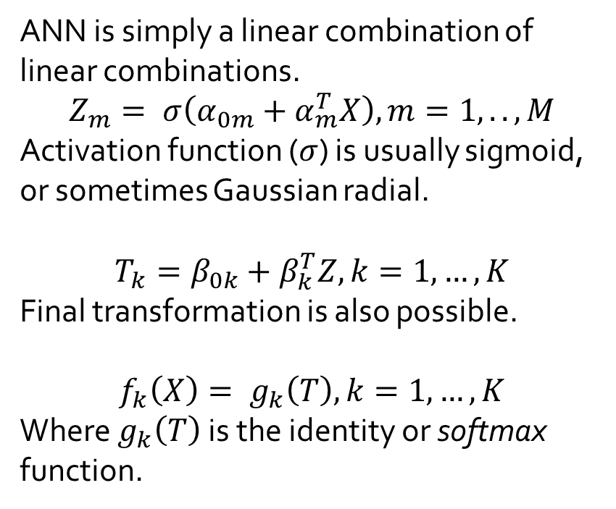
Artificial Neural Networks
ANN is simply a linear combination of linear combinations.
$$Z_{m}= σ\left(α_{0m}+α_{m}^{T}X\right), m=1,..,M$$
Activation function ($σ$) is usually sigmoid, or sometimes Gaussian radial.
$$T_{k}=β_{0k}+β_{k}^{T}Z,k=1,…,K$$
Final transformation is also possible.
$$f_{k}\left(X\right)= g_{k}\left(T\right), k=1,…,K$$
Where $g_{k}\left(T\right)$ is the identity or softmax function.
Notes:
Combination of combinations. Can have any number of hidden layers and units, as well as targets, providing for continuous and classification predictions.
This example is generalized to 1 hidden layer and 1 target (continuous)
Input (independent) to hidden layer(s) to target(dependent).
X is the vector [x1…xp]
M is the number of units in the layer
K is the number of targets
Z is vector of [Zm]
Overfitting is one of the drawbacks of ANN. With the flexibility in the function, you can see how it would be easy for this to happen, especially when you start increasing the number of units and layers.
Many implemented variations. This would be a single layer perceptron. You can have multi layers, obviously. Baysian Neural networks. And more.

Slide 7
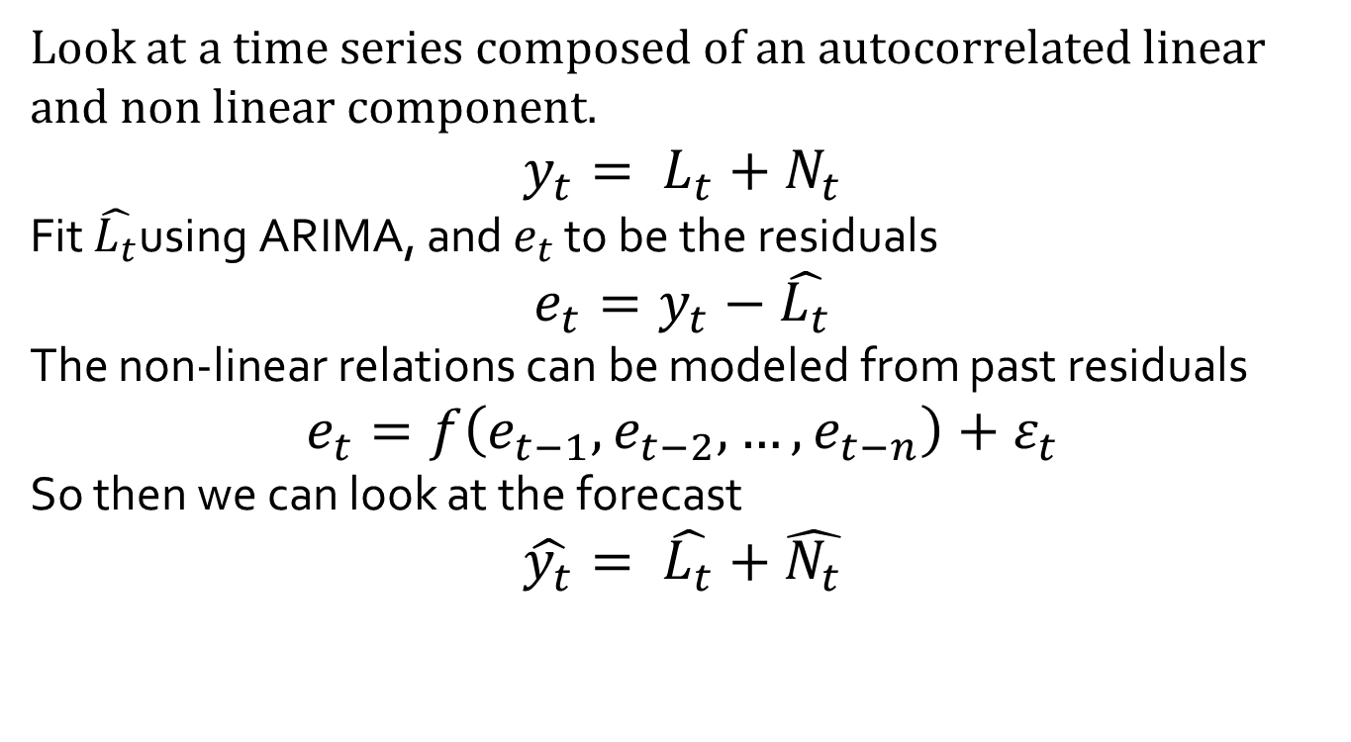
Hybrid Approach
Look at a time series composed of an autocorrelated linear and non linear component.
$$y_{t}= L_{t}+N_{t}$$
Fit $\hat{L_{t}}$using ARIMA, and $e_{t}$ to be the residuals
$$e_{t}=y_{t}−\hat{L_{t}}$$
The non-linear relations can be modeled from past residuals
$$e_{t}=f\left(e_{t−1},e_{t−2}, …,e_{t−n}\right)+ε_{t}$$
So then we can look at the forecast
$$\hat{y_{t}}= \hat{L_{t}}+\hat{N_{t}}$$
Notes:
Target yt composed of a linear and non-linear component
Estimate Linear portion of this using ARIMA
Error term consists of nonlinear relationship with previous errors.
Use ANN to predict et, as estimate for Nt

Slide 8
Implementation
ARIMA is implemented in this paper using SAS/ETS systems
ANN models are built using Generalize Reduced Gradient Algorithm (GRG2). GRG2 based training system is used for this portion.
Side note that both of these are available in R.

Slide 9
Data
Three well-known data sets
the Wolf’s sunspot data
the Canadian lynx data
the British pound/US dollar exchange rate
Sample compositions in three data sets
Series | Sample size | Training set (size) | Test set (size)
Sunspot | 288 | 1700–1920 (221) 1700-1951(253) | 1921–1987 (67) 1952-1987(35)
Lynx | 114 | 1821–1920 (100) | 1921–1934 (14)
Exchange rate | 731 | 1980–1992 (679) | 1993 (52)
Notes:
These three sets that are popular in forecasting, and have been used in various studies.
Available in most statistics packages as an academic and example set.
Wolf sunspot data.
Series of annual sunspot counts from 1700-1987. 288 obs
Lynx data.
This series is counts of lynx cats trapped in Mackenzie River district in Canada (1821-1934) 114 obs
BP exchange data.
Weekly average exchange rates Pounds to Dollars 1980-1993 731 obs
Split into two sized set. Training and testing sets.
Sunspot data is split twice.

Slide 10
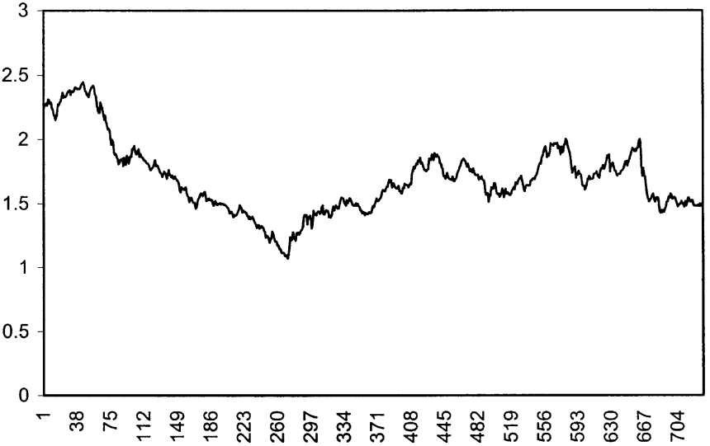
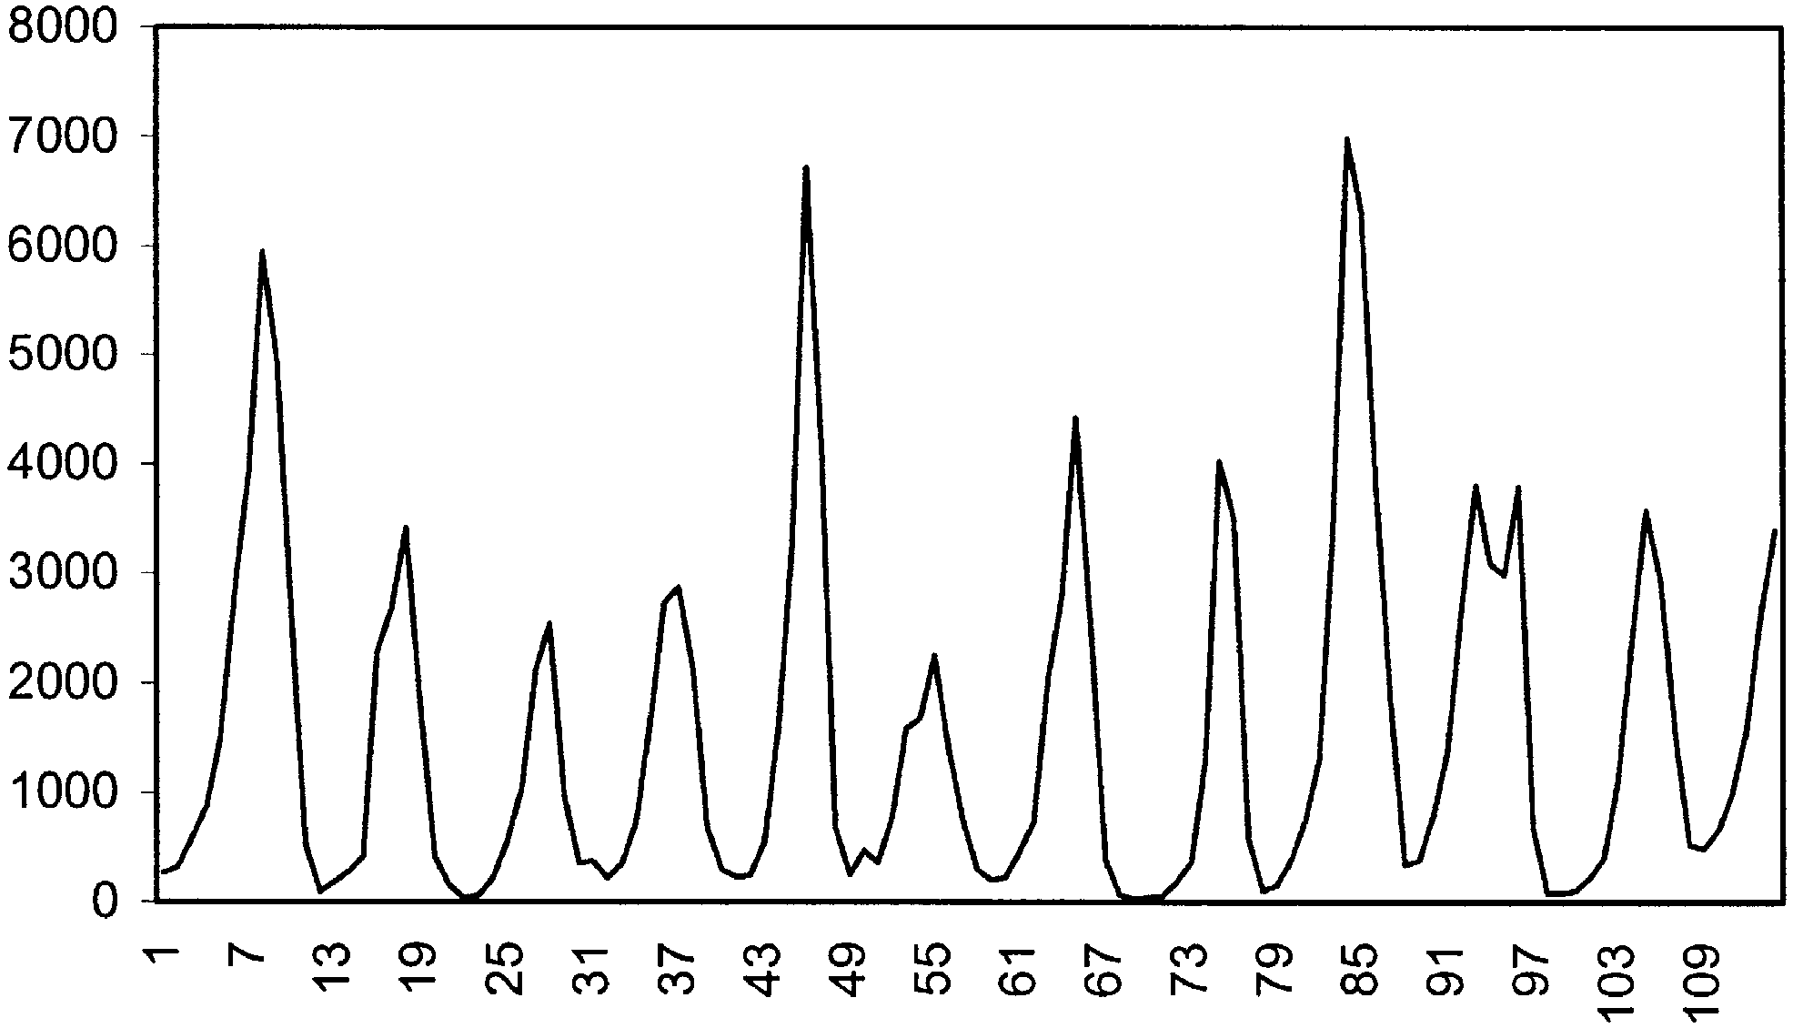
Data Visualized
Canadian lynx series (1821-1934)
Weekly BP=USD exchange rate series (1980–1993)
Sunspot series (1700–1987)
Notes:
See some repeating cycles in both lynx and sunspot data.
Lynx data show a periodicity of about 10 year
Sunspot shows a 11 year cycle
BP data is irregular, without any obvious trend or cycles.
This set has been used in a number of neural network studies.

Slide 11
Sunspot Results
 | Model | MSE | MAD
35 ahead | ARIMA | 216.965 | 11.319
 | ANN | 205.302 | 10.243
 | Hybrid | 186.827 | 10.831
67 ahead | ARIMA | 306.08217 | 13.033739
 | ANN | 351.19366 | 13.544365
 | Hybrid | 280.15956 | 12.780186
35-period forecasts for hybrid are 16.13% better MSE than ARIMA
67-period not as good, but still better predictions.
Notes:
One step ahead, rolling forecasts across the testing period.
Two measures
Mean Squared Error And Mean Absolute Deviation
Lower is better.
Results show hybrid is best with sunspot.

Slide 12
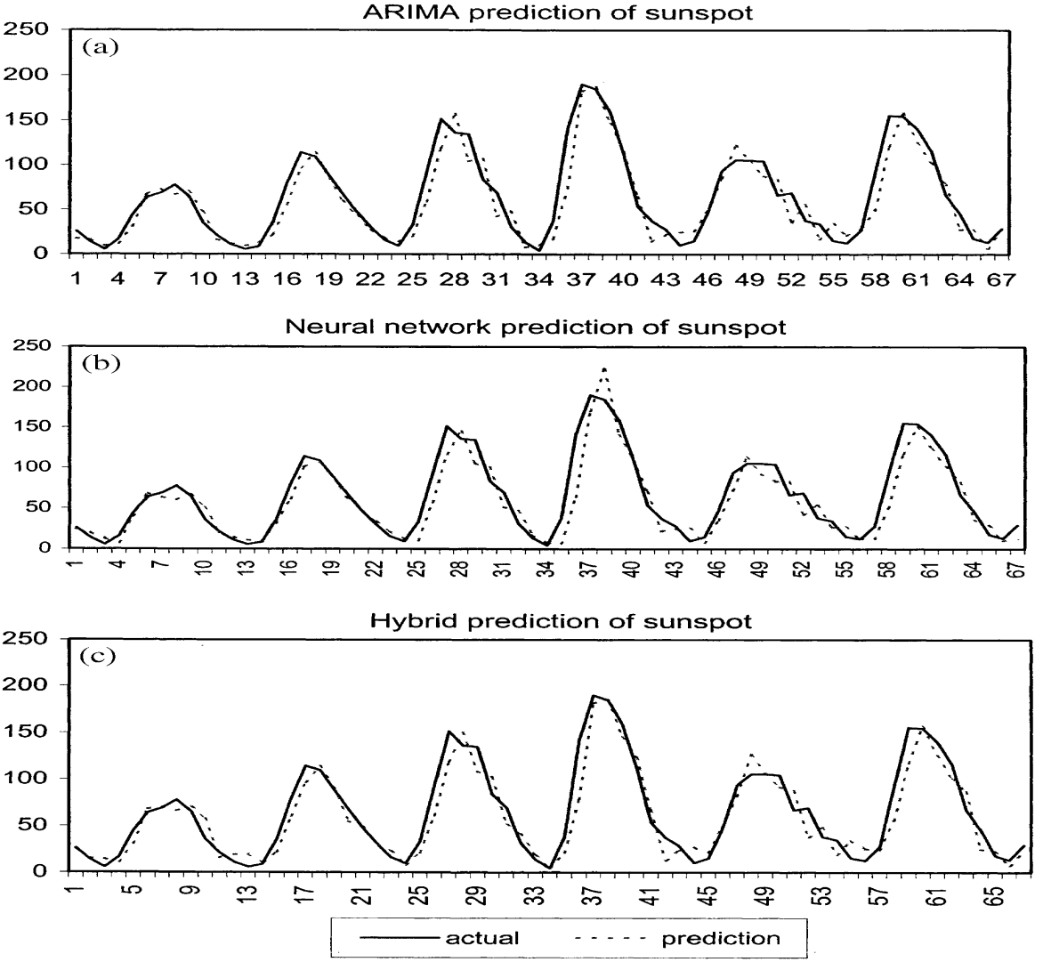
Sunspot Results

Slide 13
Lynx Results
Model | MSE | MAD
ARIMA | 0.020486 | 0.112255
ANN | 0.020466 | 0.112109
Hybrid | 0.017233 | 0.103972
18.87% decrease in MSE
7.97% improvement in MAD
Notes:
Again one step ahead.
Hybrid wins.

Slide 14
Lynx Results

Slide 15
Pound/Dollar Conversion
 | Model | MSE | MAD
1 month | ARIMA | 3.68493 | 0.005016
 | ANN | 2.76375 | 0.004218
 | Hybrid | 2.67259 | 0.004146
6 month | ARIMA | 5.65747 | 0.0060447
 | ANN | 5.71096 | 0.0059458
 | Hybrid | 5.65507 | 0.0058823
12 month | ARIMA | 4.52977 | 0.0053597
 | ANN | 4.52657 | 0.0052513
 | Hybrid | 4.35907 | 0.0051212
Shows improvement across three different time horizons.
ARIMA model shows that a simple random walk is the best model
Notes:
Instead of one step ahead, they did horizon predictions with this P/D data.
With a 1 month 6 month and 1 year forecast.

Slide 16
Additional Results
Tuning of neural network was done to get optimal predictions
4x4x1 network for sunspot data
7x5x1 for lynx data
7x6x1 for exchange rate data
ARIMA for exchange rate becomes random walk
Notes:
Tuning is only lightly discussed in this paper but it a critical part of both methods.

Slide 17
Conclusions
Artificial neural nets alone seem to be an improvement over standard ARIMA.
The empirical results with three real data sets clearly suggest that the hybrid model is able to outperform each component model used in isolation.

Slide 18
Conclusions cont.
Theoretical as well empirical evidences suggests using dissimilar models or models that disagree with each other strongly, the hybrid model will have lower generalization variance or error.
using the hybrid method can reduce the model uncertainty
fitting the ARIMA model first to the data, the overfitting problem that is related to neural network models can be eased.
Notes:
Overfitting is shown to be better with hybrid compared to ANN alone.

