Slide 1

Selenium
Page Object Model

Slide 2
What is Page Object Model
Page Object Model is a design pattern to create Object Repository for web UI elements. Under this model, for each web page in the application, there should be corresponding page class. This Page class will find the WebElements of that web page and also contains Page methods which perform operations on those WebElements.
Name of these methods should be given as per the task they are performing, i.e., if we will perform a search for jobs on ITJobs site, POM method name can be searchForJobs() on ITJobs class.

Slide 3
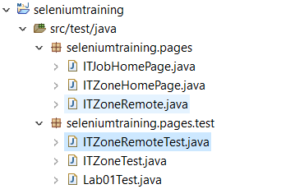
What is Page Object Model
Final project looks like below:

Slide 4
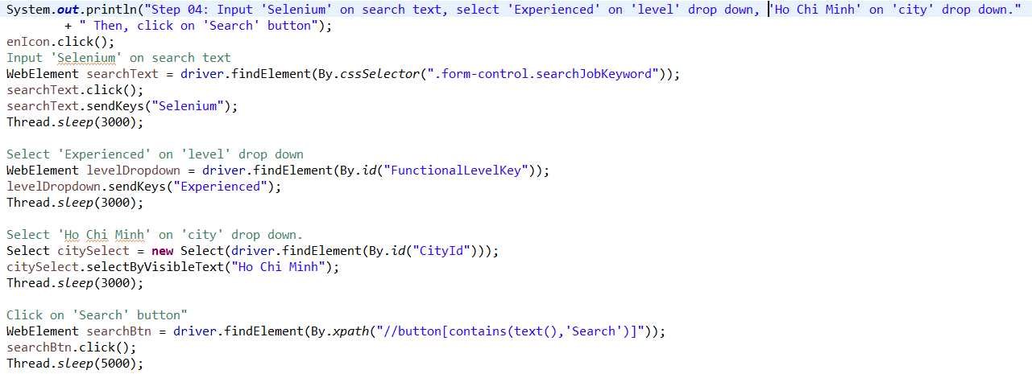
Why Page Object Model
Starting an UI Automation in Selenium WebDriver is NOT a tough task. You just need to find elements, perform operations on it.
Consider this script to search for jobs on ITJobs site below:

Slide 5
Why Page Object Model
As you can observe, all we are doing is finding elements and filling values for those elements.
This is a small script. Script maintenance looks easy. But with time test suite will grow. As you add more and more lines to your code, things become tough.
The chief problem with script maintenance is that if 10 different scripts are using the same page element, with any change in that element, you need to change all 10 scripts. This is time consuming and error prone.
A better approach to script maintenance is to create a separate class file which would find web elements, fill them or verify them. This class can be reused in all the scripts using that element. In future, if there is a change in the web element, we need to make the change in just 1 class file and not 10 different scripts.
This approach is called Page Object Model(POM). It helps make the code more readable, maintainable, and reusable.

Slide 6
Advantages of Page Object Model
Page Object Pattern says operations and flows in the UI should be separated from verification. This concept makes our code cleaner and easy to understand.
The Second benefit is the object repository is independent of test cases, so we can use the same object repository for a different purpose with different tools. For example, we can integrate POM with TestNG/JUnit for functional Testing and at the same time with JBehave/Cucumber for acceptance testing.
Code becomes less and optimized because of the reusable page methods in the POM classes.
Methods get more realistic names which can be easily mapped with the operation happening in UI. i.e. if after clicking on the button we land on the home page, the method name will be like 'gotoHomePage()'.

Slide 7
What is Page Factory
Page Factory is an inbuilt Page Object Model concept for Selenium WebDriver but it is very optimized.
Here as well, we follow the concept of separation of Page Object Repository and Test Methods. Additionally, with the help of PageFactory class, we use annotations @FindBy to find WebElement. We use initElements method to initialize web elements.
@FindBy can accept tagName, partialLinkText, name, linkText, id, css, className, xpath as attributes.

Slide 8
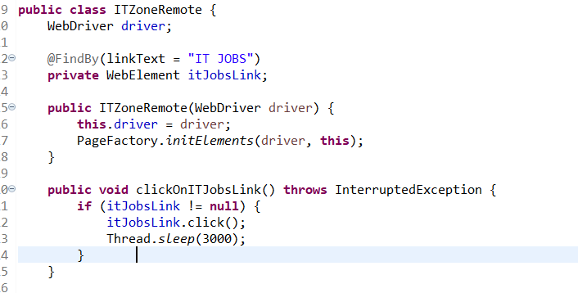
Page Factory
Let’s take a look on the example below:

Slide 9
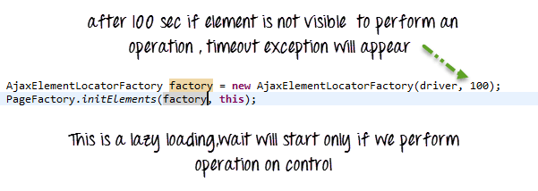
AjaxElementLocatorFactory
It is working on lazy loading concept, i.e. a timeout for a WebElement will be assigned to the Object page class with the help of AjaxElementLocatorFactory .
Here, when an operation is performed on an element the wait for its visibility starts from that moment only. If the element is not found in the given time interval, Test Case execution will throw 'NoSuchElementException' exception.

Slide 10
Q&A

