Slide 1

Selenium
Day 02

Slide 2

Webdriver - Chrome
Download Chrome driver: https://chromedriver.chromium.org/downloads
Init webdriver

Slide 3
Webdriver - Firefox
Download Gecko driver: https://github.com/mozilla/geckodriver/releases
Init webdriver

Slide 4
Webdriver – IE11
Download Internet Explorer Driver Server:
https://www.seleniumhq.org/download/
Init webdriver

Slide 5
Webdriver – Microsoft Edge
Download Microsoft Webdriver:
https://developer.microsoft.com/en-us/microsoft-edge/tools/webdriver/#downloads
Init webdriver

Slide 6
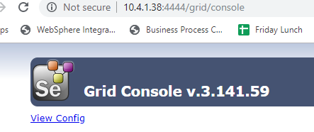
Webdriver – Remote webdriver
Go to VM and place the webdriver files to a folder
Download Selenium Standalone Server from https://www.seleniumhq.org/download/
Start the hub by running:
java -jar selenium-server-standalone-3.141.59.jar -role hub
Access to the grid console: http://10.4.1.38:4444/grid/console

Slide 7
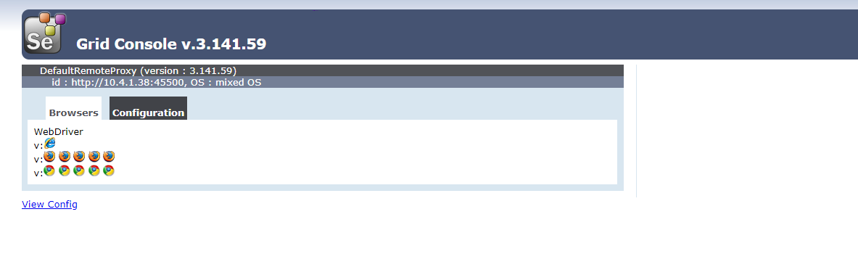
Webdriver – Remote webdriver
Start a node by running
java -jar selenium-server-standalone-3.141.59.jar -role node -nodeConfig NodeConfig.json -hub http://localhost:4444/grid/register

Slide 8
Webdriver – Remote webdriver
Init webdriver
driver = new RemoteWebDriver(new URL(http://10.4.1.38:4444/wd/hub), options);

Slide 9
Q&A

