Slide 1

Selenium
Wait

Slide 2
Why Do We Need Waits In Selenium?
Most of the web applications are developed using Ajax and Javascript. When a page is loaded by the browser the elements which we want to interact with may load at different time intervals.
Not only it makes this difficult to identify the element but also if the element is not located it will throw an "ElementNotVisibleException" exception. Using Waits, we can resolve this problem.

Slide 3
Implicit Wait
Selenium Web Driver has borrowed the idea of implicit waits from Watir.
The implicit wait will tell to the web driver to wait for certain amount of time before it throws a "No Such Element Exception". The default setting is 0. Once we set the time, web driver will wait for that time before throwing an exception.
Syntax:
driver.manage().timeouts().implicitlyWait(TimeOut, TimeUnit.SECONDS);

Slide 4
Explicit Wait
The explicit wait is used to tell the Web Driver to wait for certain conditions (Expected Conditions) or the maximum time exceeded before throwing an "ElementNotVisibleException" exception.
The explicit wait is an intelligent kind of wait, but it can be applied only for specified elements. Explicit wait gives better options than that of an implicit wait as it will wait for dynamically loaded Ajax elements.
Once we declare explicit wait we have to use "ExpectedCondtions" or we can configure how frequently we want to check the condition using Fluent Wait. These days while implementing we are using Thread.Sleep() generally it is not recommended to use
Syntax
WebDriverWait wait = new WebDriverWait(WebDriverRefrence,TimeOut);

Slide 5
Expected Conditions in Explicit Wait
alertIsPresent()
elementSelectionStateToBe()
elementToBeClickable()
elementToBeSelected()
frameToBeAvaliableAndSwitchToIt()
invisibilityOfTheElementLocated()
invisibilityOfElementWithText()
presenceOfAllElementsLocatedBy()
presenceOfElementLocated()
textToBePresentInElement()
textToBePresentInElementLocated()
textToBePresentInElementValue()
titleIs()
titleContains()
visibilityOf()
visibilityOfAllElements()
visibilityOfAllElementsLocatedBy()
visibilityOfElementLocated()

Slide 6
Implicit Wait Vs Explicit Wait
Implicit Wait | Explicit Wait
Implicit Wait time is applied to all the elements in the script. | Explicit Wait time is applied only to those elements which are intended by us
In Implicit Wait, we need not specify "ExpectedConditions" on the element to be located. | In Explicit Wait, we need to specify "ExpectedConditions" on the element to be located
It is recommended to use when the elements are located with the time frame specified in implicit wait | It is recommended to use when the elements are taking long time to load and also for verifying the property of the element like(visibilityOfElementLocated, elementToBeClickable,elementToBeSelected)

Slide 7
Fluent Wait
The fluent wait is used to tell the web driver to wait for a condition, as well as the frequency with which we want to check the condition before throwing an "ElementNotVisibleException" exception.
Frequency: Setting up a repeat cycle with the time frame to verify/check the condition at the regular interval of time
Wait wait = new FluentWait(WebDriver reference)
.withTimeout(Duration.ofSeconds(SECONDS))
.pollingEvery(Duration.ofSeconds(SECONDS))
.ignoring(Exception.class);

Slide 8
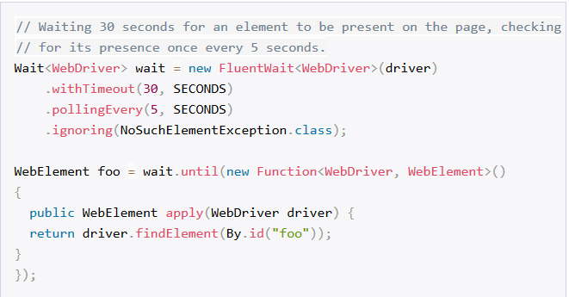
Fluent Wait
It should be used when you try to test the presence of an element that may appear after every x seconds/minutes.

Slide 9
Q&A

