Slide 1

Selenium
JavascriptExecutor

Slide 2

What is JavaScriptExecutor?
JavaScriptExecutor is an Interface that helps to execute JavaScript through Selenium Webdriver. JavaScriptExecutor provides two methods "executescript" & "executeAsyncScript" to run javascript on the selected window or current page.

Slide 3
Why do we need JavaScriptExecutor?
In Selenium Webdriver, locators like XPath, CSS, etc. are used to identify and perform operations on a web page.
In case, these locators do not work you can use JavaScriptExecutor. You can use JavaScriptExecutor to perform an desired operation on a web element.
Selenium supports javaScriptExecutor. There is no need for an extra plugin or add-on. You just need to import (org.openqa.selenium.JavascriptExecutor) in the script as to use JavaScriptExecutor.

Slide 4
executeScript
This method executes JavaScript in the context of the currently selected frame or window in Selenium. The script used in this method runs in the body of an anonymous function (a function without a name). We can also pass complicated arguments to it.
The script can return values. Data types returned are:
Boolean
Long
String
List
WebElement.
Syntax
JavascriptExecutor js = (JavascriptExecutor) driver;
js.executeScript(Script,Arguments);

Slide 5
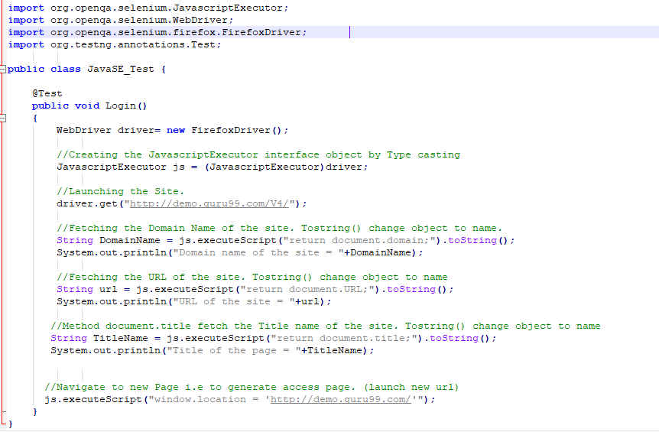
Example

Slide 6
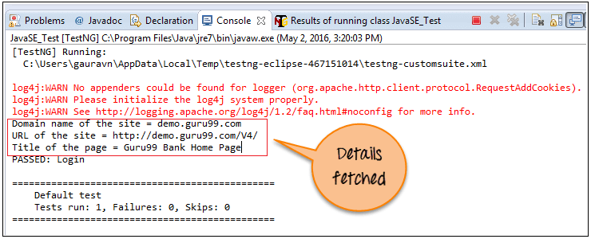
Example

Slide 7
executeAsyncScript
With Asynchronous script, your page renders more quickly. Instead of forcing users to wait for a script to download before the page renders. This function will execute an asynchronous piece of JavaScript in the context of the currently selected frame or window in Selenium. The JS so executed is single-threaded with a various callback function which runs synchronously.
Unlike executing synchronous JavaScript, scripts executed with this method must explicitly signal they are finished by invoking the provided callback. This callback is always injected into the executed function as the last argument. The first argument passed to the callback function will be used as the script's result. This value will be handled in the same way as the synchronous case

Slide 8
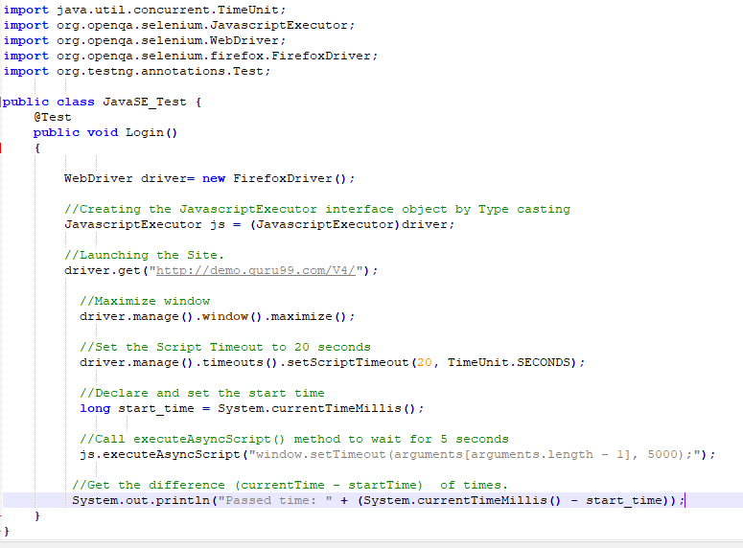
Example

Slide 9
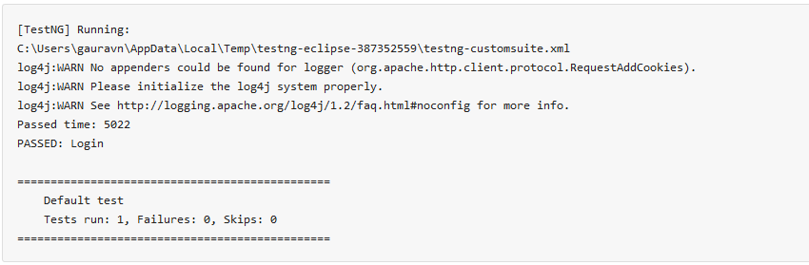
Example

Slide 10
Q&A

