Slide 1

Automation Test

Slide 2

INTRODUCTION TO TEST AUTOMATION
WHAT IS TEST AUTOMATION?
WHEN TO AUTOMATE?
WHY TO AUTOMATE?
AUTOMATED TESTING PROCESS

Slide 3

WHAT IS TEST AUTOMATION?
Software Test automation makes use of specialized tools to control the execution of tests and compares the actual results against the expected result. Usually, regression tests, which are repetitive actions, are automated. (from tutorialspoint.com)
At its core, test automation means that no human has to manually initiate the test. (from techopedia.com)

Slide 4
When to automate
Retesting
Regression Testing
Unit Testing
Performance Testing
API Testing
UI Testing

Slide 5
Why to automate
ROI
Running Test 24/7
Fewer Human Resource
Reusability
Bugs
Reliability
Simultaneity
Continuity
Additional methods
Volume
from Saucelabs

Slide 6
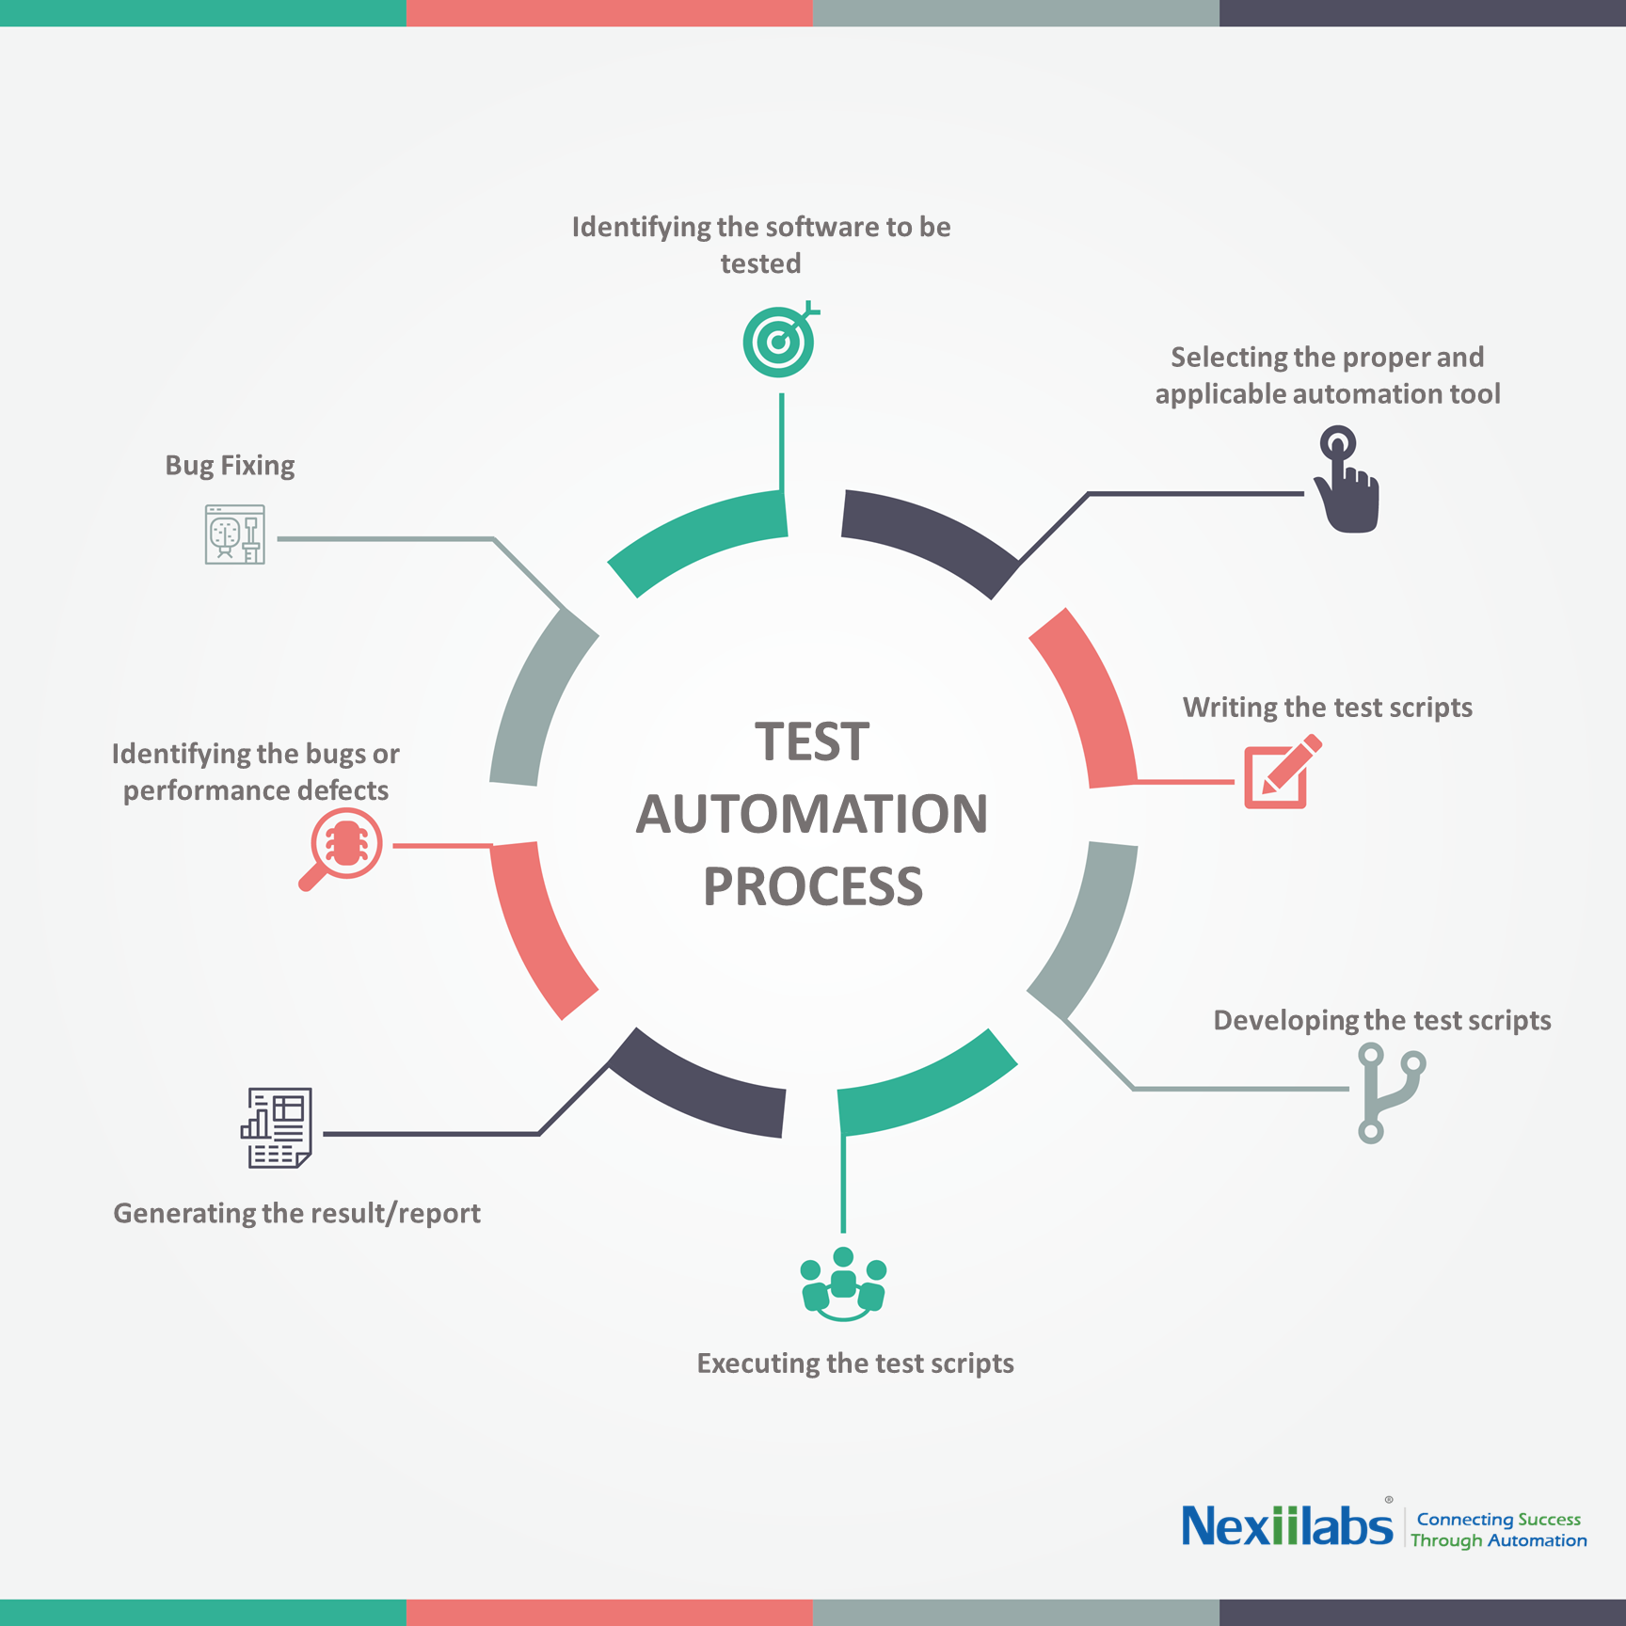
Automated Testing Process

Slide 7
SELENIUM
WHAT IS SELENIUM?
SELENIUM WEBDRIVER VS RC
SELENIUM GRID
SELENIUM REPORT

Slide 8
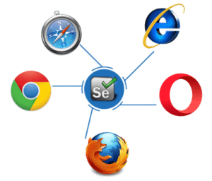
Selenium
Selenium is an open source tool which is used for automating the tests carried out on web browsers
Support many programming languages: Java, Python, C#, PHP, Ruby, Perl & .Net
Support many OS: Windows, Mac or Linux
Support many browsers: Mozilla Firefox, Internet Explorer, Google Chrome, Safari or Opera

Slide 9
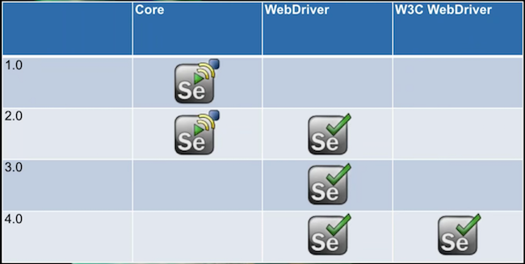
Selenium Roadmap

Slide 10
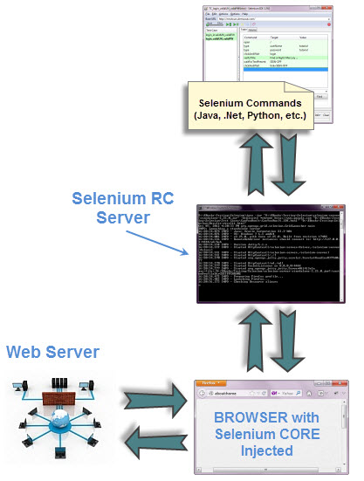
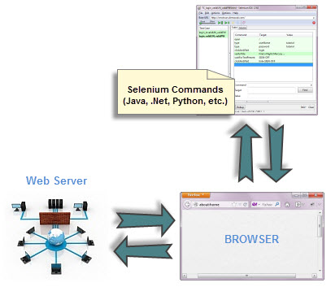
Selenium Webdriver vs RC

Slide 11

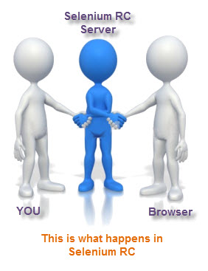
Selenium Webdriver vs RC

Slide 12
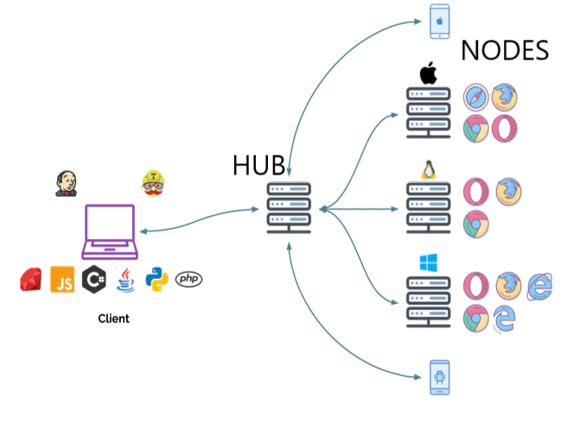
Selenium Grid

Slide 13
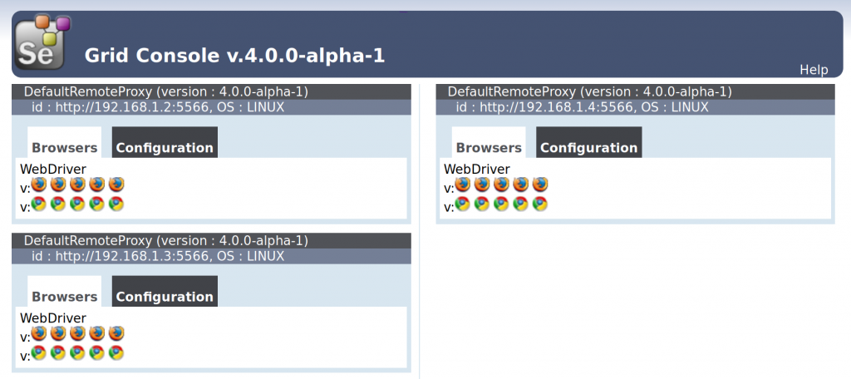
Selenium Grid

Slide 14
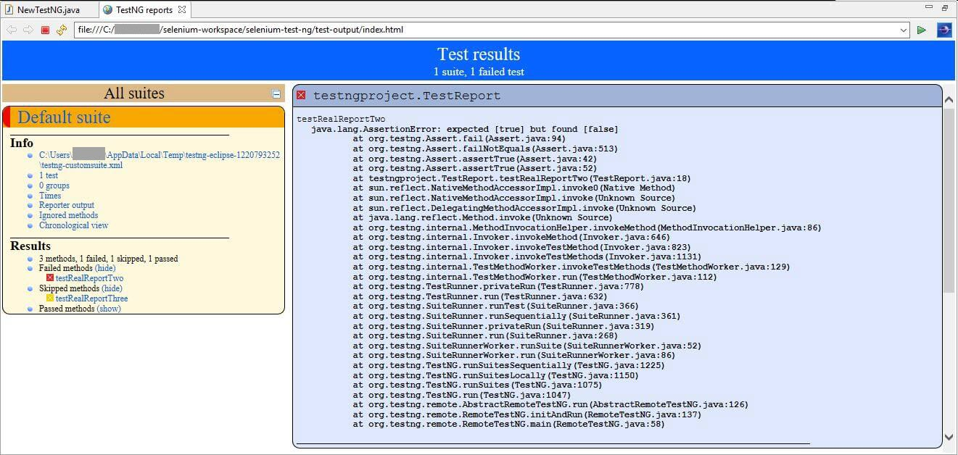
Selenium Report

Slide 15
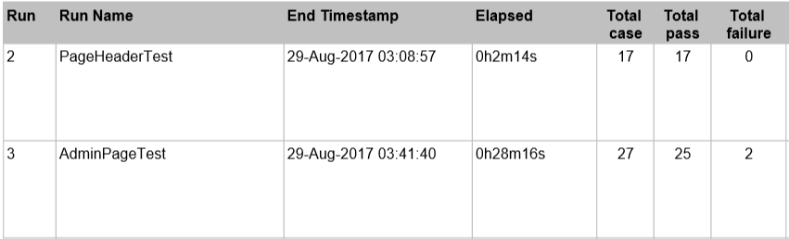
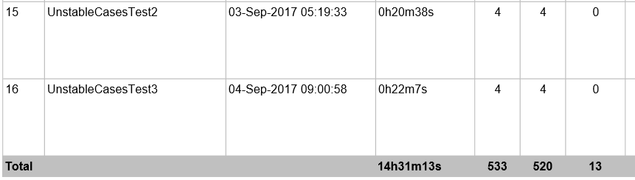
Selenium Report

Slide 16
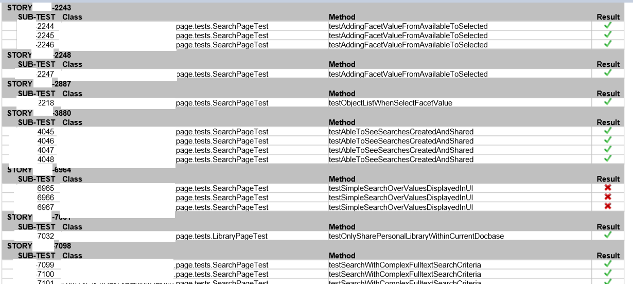
Selenium Report

Slide 17
Extra topics
Selenium vs other automation testing framework?
Programming language for Selenium?
Required skills for Selenium automation testers?
Work process in automation testing project?

Slide 18
Q&A

