Slide 1
Capstone Project
Bao Quoc Ho

Slide 2
Plan
Introduction
Data
Method
Result Analysis
Conclusion

Slide 3
Introduction
Business problem : California restaurant Investor want to has information to make decision on where he/she can invest for a new restaurant
Collection Data of California County
Analyze
Visualize the results

Slide 4
Data
Population and Income data of the counties
House Price information of the counties
Information about existing restaurants in the counties

Slide 5
Collection Data
Population and Income Data
https://www.california-demographics.com/counties_by_population
House Price data
https://www.zillow.com/research/data/
Geolocator of Geopy libraby to get Geography coordinates
Foursquare to get venues information

Slide 6
Method
Data Preparing
Collection Data
Preparing data for each county with its property (features): population, income (person, family), house price, number of existing restaurants in each county
Clustering
Using Eblow method to identify the best k
Cluster using K-means method
Visualize
Correlation between some features
Map of California
Map for clusters

Slide 7
Highest correlation between per_capita-income and House price
 | Population | Density | Per_capita_income | Household income | Family income | HousePrice
Population | 1 | 0.214050499 | 0.129884571 | 0.213370155 | 0.136798624 | 0.259031604
Density | 0.214050499 | 1 | 0.473252679 | 0.355580361 | 0.338975154 | 0.576834559
Per_capita_income | 0.129884571 | 0.473252679 | 1 | 0.871630465 | 0.935717329 | 0.891512862
Household income | 0.213370155 | 0.355580361 | 0.871630465 | 1 | 0.96200346 | 0.882804865
Family income | 0.136798624 | 0.338975154 | 0.935717329 | 0.96200346 | 1 | 0.874613943
HousePrice | 0.259031604 | 0.576834559 | 0.891512862 | 0.882804865 | 0.874613943 | 1

Slide 8
Highest correlation between population and Number of restaurant
 | Population | Per_capita_income | Family income | HousePrice | NumOfRestaurant
Population | 1 | 0.129884571 | 0.136798624 | 0.259031604 | 0.62715362
Per_capita_income | 0.129884571 | 1 | 0.935717329 | 0.891512862 | 0.185040184
Family income | 0.136798624 | 0.935717329 | 1 | 0.874613943 | 0.161781554
HousePrice | 0.259031604 | 0.891512862 | 0.874613943 | 1 | 0.279481203
NumOfRestaurant | 0.62715362 | 0.185040184 | 0.161781554 | 0.279481203 | 1

Slide 9
Clustering
Using eblow method to get k = 6
Using Folium map to represent clusters on the map

Slide 10
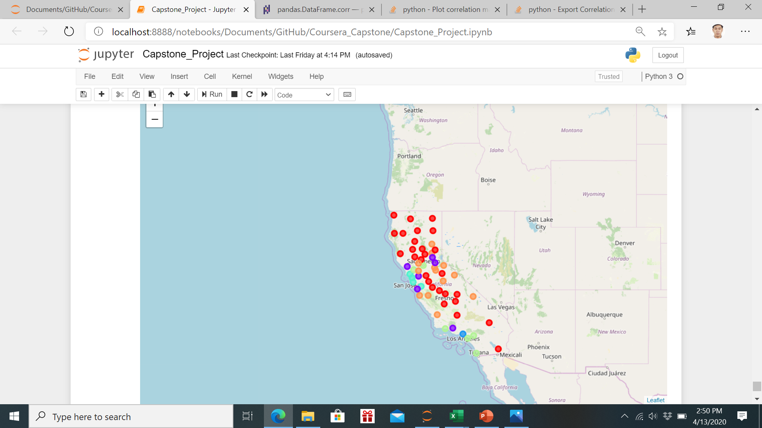

Slide 11
Conclusion
Cleaning, merging, converting data to get a clean data
Using statistic method to analyze the features
Select features for county, scaling and normalize data to cluster
Using k-means to cluster
Visualize cluster on map by Folium

Slide 12
Thank you for your attention

