Slide 1
Ho Chi Minh University of Education and Technology
Faculty of Information Technology
Final report
Group 4: Digit Recognizer
Instructor: MSc. Quach Dinh Hoang
Name Student code
Tran Nguyen Thai Bao 19133010
Le Tuan Hiep 19133023
Dinh Quoc Hung 19133025

Slide 2
Main content
Goal of study
Data
Model evaluation
Predict and submit

Slide 3
Goal of study
The goal of the subject :
For each record on the test file, we need to determine what its correct label.
Model: random forest, K-nn, decision tree

Slide 4
Question
How to compare diﬀerent machine learning models ?
Model evaluation in project
Notes:
Làm thế nào để so sánh thống kê các mô hình học máy khác nhau?
Đánh giá mô hình trong dự án

Slide 5
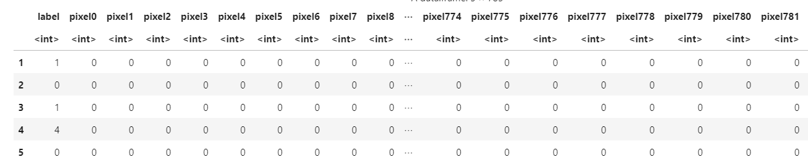
Data
The data files train.csv and test.csv contain gray-scale images of hand-drawn digits, from 0 to 9.
Each image is 28 pixels in height and 28 pixels in width, for a total of 784 pixels in total. Each pixel has a single pixel-value associated with it, indicating the lightness or darkness of that pixel, with higher numbers meaning darker. This pixel-value is an integer between 0 and 255, inclusive.
The training data set, (train.csv), has 785 columns. The first column, called "label", is the digit that was drawn by the user.

Slide 6
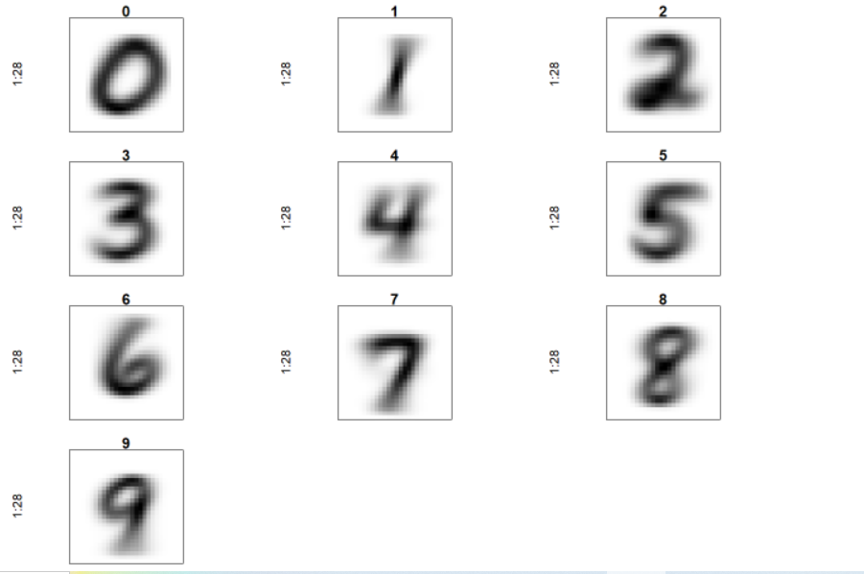
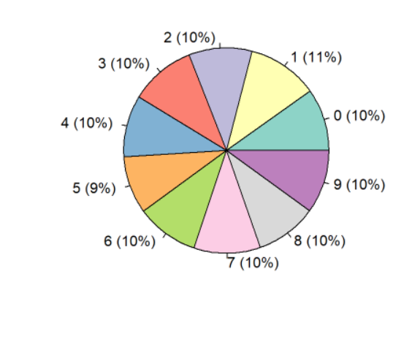
Data Visualization

Slide 7
Task
Student code | Name | Task
19133010 | Trần Nguyên Thái Bảo | Random forest
19133023 | Lê Tuấn Hiệp | Decision Tree
19133025 | Đinh Quốc Hùng | K-nn

Slide 8

Split data set
Divide the train dataset into 2 parts train and test
70 for train and 30 for test

Slide 9
KNN
k = sqrt(n) , n: total attributes
K | Accuracy
25 | 0.9485714
26 | 0.9496429
27 | 0.9488571
28 | 0.9487143
29 | 0.9464285

Slide 10
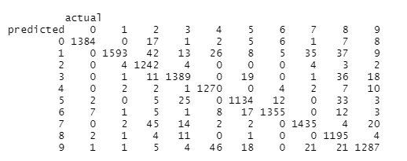


KNN
K = 26

Slide 11
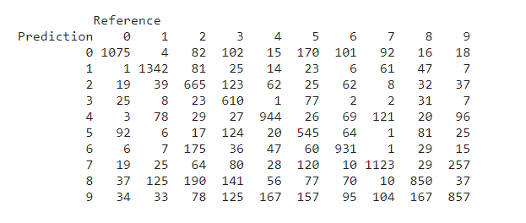

Decision Tree

Slide 12
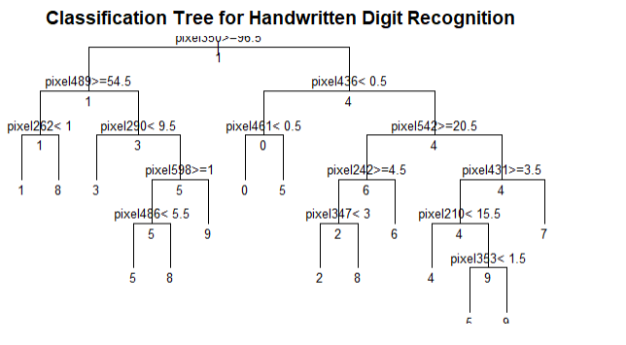
Decision Tree

Slide 13
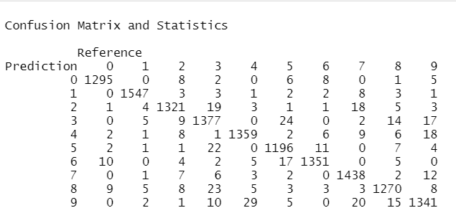
RandomForest
Accuracy: 0.9677

Slide 14
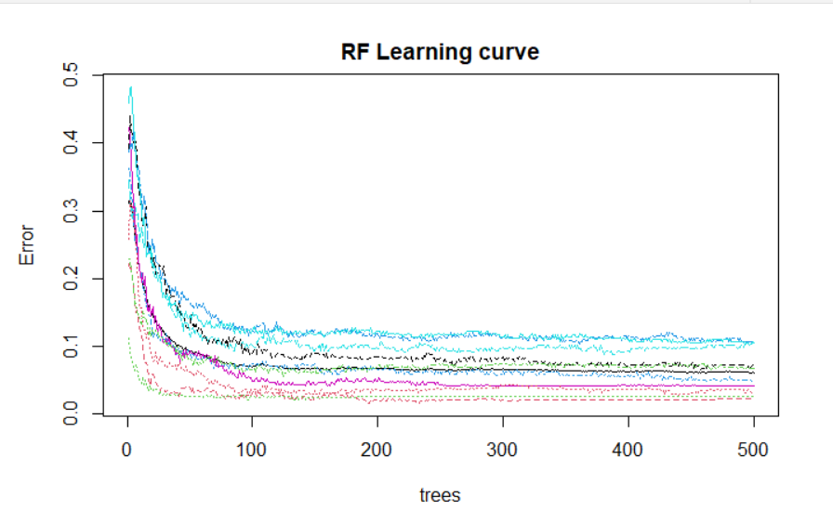
RandomForest

Slide 15
RandomForest
Error rate
0 | 1 | 2 | 3 | 4 | 5 | 6 | 7 | 8 | 9
0.0157308 | 0.01430401 | 0.034235 | 0.053780 | 0.028487 | 0.045322 | 0.020546 | 0.037945 | 0.050947 | 0.057545

Slide 16
Accuracy
ntree=500, mtry=28 | 0.9677
ntree=100, mtry=56 | 0.9633
ntree=100, mtry =28 | 0.9626
ntree=100, mtry=14 | 0.9611

Slide 17
Model | Accuracy
K-nn | 0.9487
Random Forest | 0.9677
Decision tree | 0.63

Slide 18
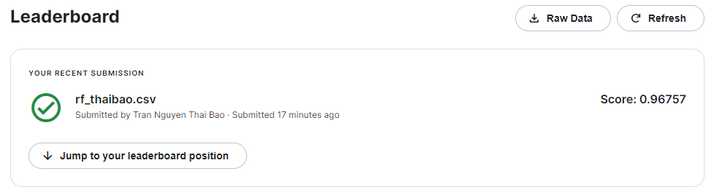
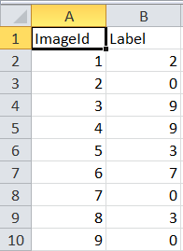
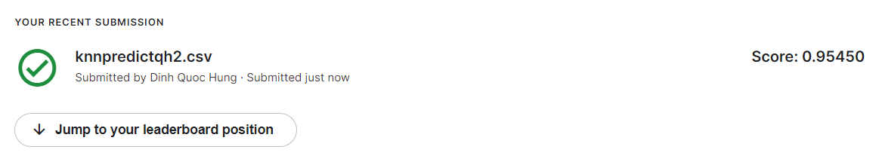
Submit

Slide 19
Summary
Random forest, k-nn are good for predict digit recognize

Slide 20
Thank for watching <3

