Slide 1

AWS Cost Management Boardroom Analytics
Group 2:
Huy Le, Haodi Tu, Huibo Jia, Sourabh Gupta, Peter Broadstone

Slide 2
Agenda
Trends and Anomalies in the Data
Customer Churn/Growth
Clustering Techniques
Modeling Techniques
Modeling Results
Business Insights
Future Improvements

Slide 3
Trends in Billing and Product Usage
 | April | May | June | % Change April-June
Number of Customers | 45,604 | 47,269 | 47,145 | +3.4%
Total Billed Amount | $213,655,391 | $225,292,652 | $225,694,646 | +5.6%
Visualize Usage | 26.0% | 26.1% | 24.7% | -5.0%
Alert Usage | 6.0% | 6.2% | 6.4% | +6.7%
Report Usage | 5.5% | 5.7% | 6.1% | +10.9%

Slide 4
Anomalies in Billing Data
487,999 cases where a product ID had a billed amount <= 0
Only 14 cases where a customer had a total billed amount of zero for a month
The highest billed amount for a customer in a month was $919,031
There were 15 instances where a customer had a billed amount more than $275,000 in a month

Slide 5
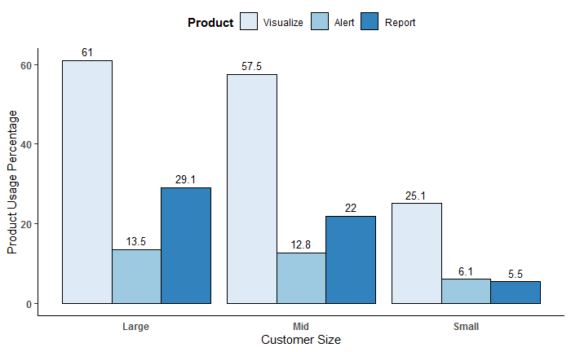
Product Usage by Customer Size

Slide 6
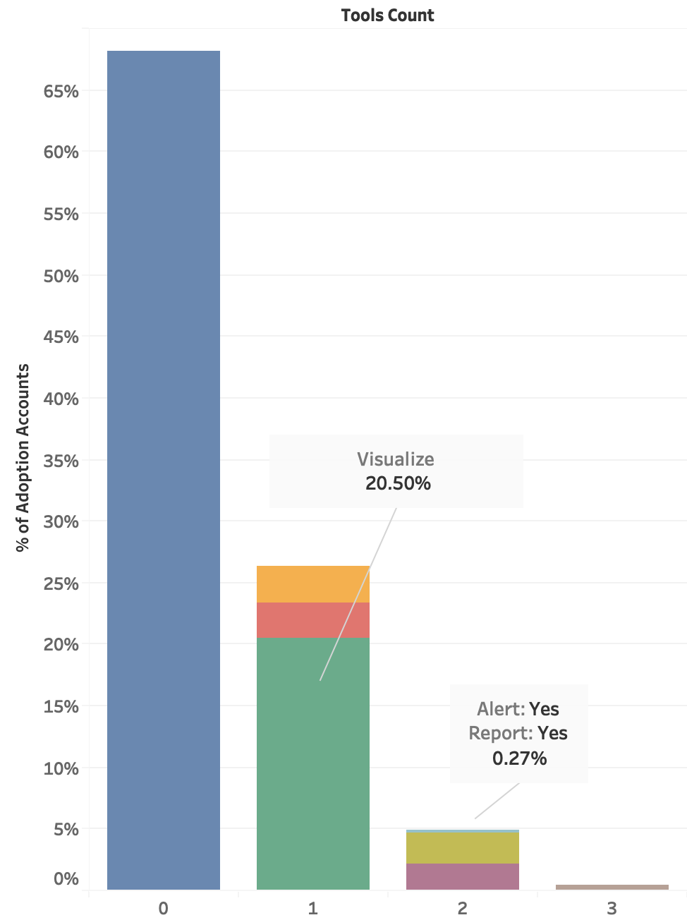
How do customers use three products？
All three products: 0.5%
Two of three products : 4.9%
One of three products : 26.4%
None of three products : 68.2%
Notes:
Nearly 70% of total adoption don't use any of three products in three months.
More than 25% of total customers use only 1 product, which are mainly visualize.
Only 5% of customers choose to use 2 products. And Among these customers, almost all of them use visualize along with either report or alert, only tiny portion choose to use Alert & Report together.
Very few choose to use all three products.
Overall, we can say if a customer decide to use products, he/she tends to choose visualize product first.

Slide 7
Customer Churn/Growth
 | May | June
Existing Customers | 45,604 | 47,269
Existing Churn | 2,519 | 3,376
New Customers | 4,184 | 3,252
Total Customers | 47,269 | 47,145
Churn Rate | 5.50% | 7.10%
New Customer Acquisition Rate | 9.20% | 6.90%
Notes:
In April, there're more than 45 thousand existing customers, and in May, the number changed to more than 47 thousand.
If we take a close look, we can see that 2 thousand 5 hundred customers that were using cost management tool in April left in May.
On the bright side, about 4 thousand new customers enrolled in May.
The churn rate is 5.5% and new customer acquisition rate is 9.2%. Overall, it's not bad.
From May to June, although there’re new customers keep coming, more customers left.
The churn rate reaches to 7.1% and the new customer acquisition rate drop to 6.90%

Slide 8
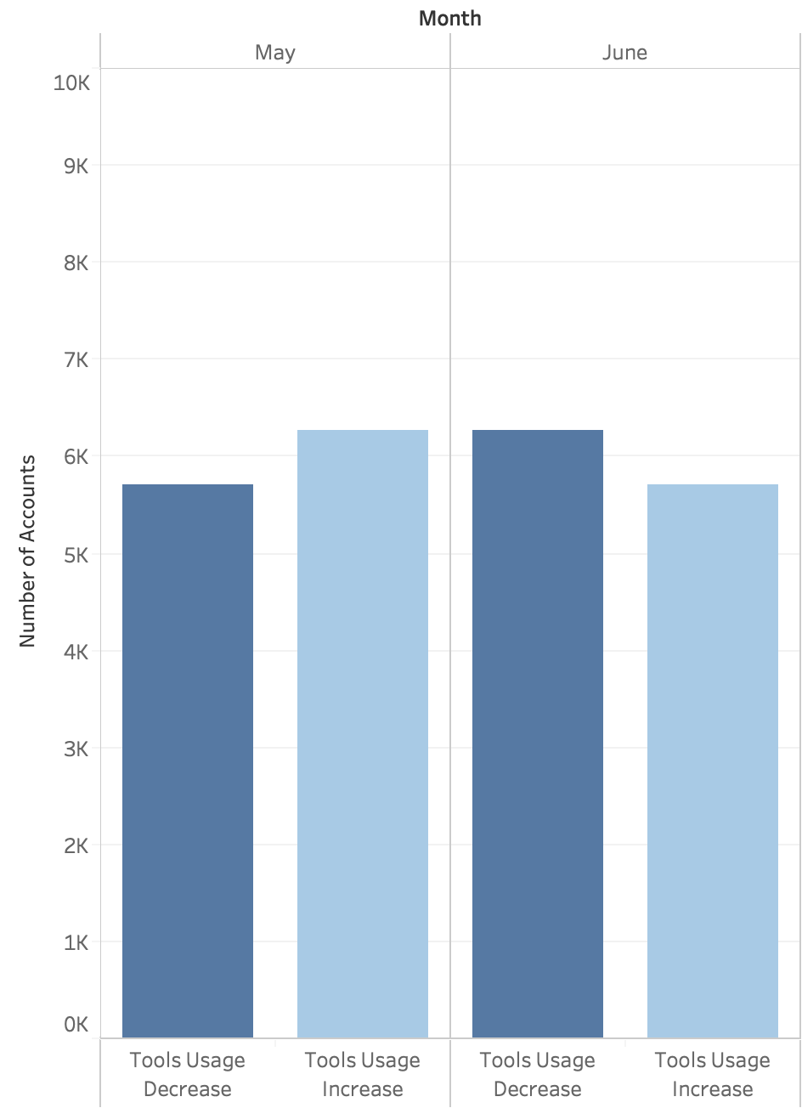
From April to May:
5,706 customers decreased the types of products they were using
6,264 customers increased the types of products they were using
From May to June:
6,271 customers decreased the types of products they were using
5,712 customers increased the types of products they were using
Notes:
To specify how customer behavior changed during these period, we found that more customers are increase the types of products they use from April to May than those who decrease the usage in the same period.
But situation changed in June, more customers reduce the types of products they use than those who increase.
And if you take a look at the bars in the same color, you can tell that there's upward trend for usage decrease and downward trend for usage increase.

Slide 9
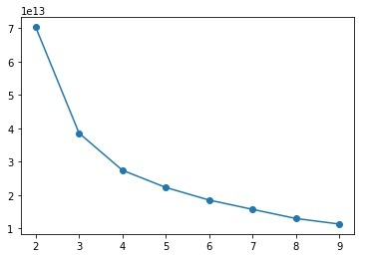
Clustering
Preprocess the data in different ways to find patterns
Determine the number of clusters / run k-means
Choosing variables
Evaluation of models by SSwithin/SSoverall, and SSE
Use Visual Studio SSDT for final clustering model
Notes:
betweenss shows the sum of squared differences between overall mean and cluster means
totss shows the sum of squared differences between each data point and the overall mean.
Now, before we implement classification model, we want to segment customer into groups that share the certain characteristics. This step would help us to form the patterns of data.
There are several ways to cluster the customer data with different characteristic and method. To choose the optimal model for clustering we have to do some experiment beforehand:
Preprocessing
Create new proxies
Determine number of K
Evaluation the model by SSE and ratio Sum square distance within/ and overall

Slide 10
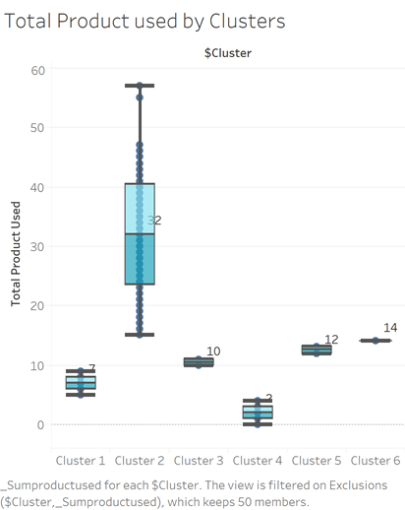
Clustering
6 Clusters
SSwithin/SSoverall ~ 0.5
Number of AWS product used is the key factor to classify customers in distinct clusters
4 < 1 < 3 < 5 < 6 < 2
Product used | Cluster 1 | 2 | 3 | 4 | 5 | 6
Mean | 7.16 | 19.32 | 10.48 | 2.82 | 12.47 | 14
Deviation | 1.38 | 4.4 | 0.5 | 1.09 | 0.5
Notes:
The final model with got has 6 clusters, with the ratio is 0.5, using customer purchase behavior characteristics for classification.
The most interesting is Number of AWS product used is the most useful characteristic to classify customer.
This graph shows the different between clustering by the number of product used. There are clear difference between 6 cluster.
This table show the average product used and standard deviation in each customer cluster
In order of number of product used, the cluster order is 4 < 1 < 3 < 5 < 6 < 2

Slide 11
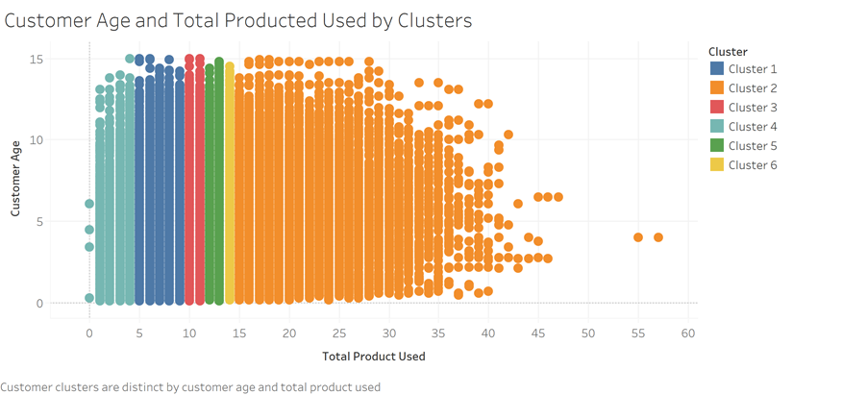
Cluster Characteristics
Notes:
This scatter plot help us to distinguish the clusters.
From then we can easily recognize the groups of customers. So that we can target specific cluster to marketing strategy.

Slide 12
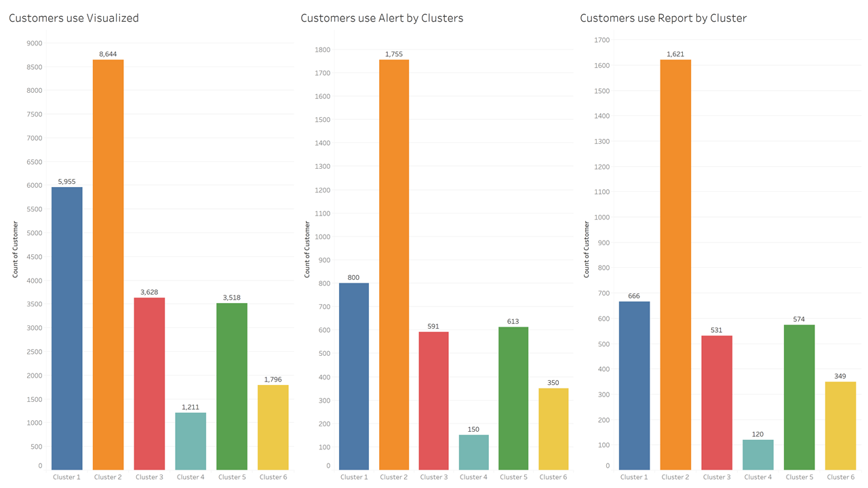
What are the differences in purchase behavior?
Notes:
What is the difference in customer purchase behavior?
These bar graph show the number of customer who used AWS Cost management tool divided into clusters.
From these graph we can see that Cost management primary customers are from cluster 2 who used more than 15 AWS products. It makes sense to us because when we buy too many different service we need to use tool to manage the spend effectively.
Visualize is the most favorite tools with the highest number of customer. The patterns are similar in other tool however the number of customers are significant less than Visualize
Now, after have a good clustering. We move to classification method.
Most of Customers using Cost Management Tool are in cluster 2
Number of Used AWS products affect a lot on Customers Decision on using

Slide 13
Modeling Techniques
Dependent variable: RAV (8 levels of factors)
e.g.
Independent variables:
Geo code, Total products used, Total billed amount, Customer age, Customer size, Cluster group
Random Forest

Slide 14
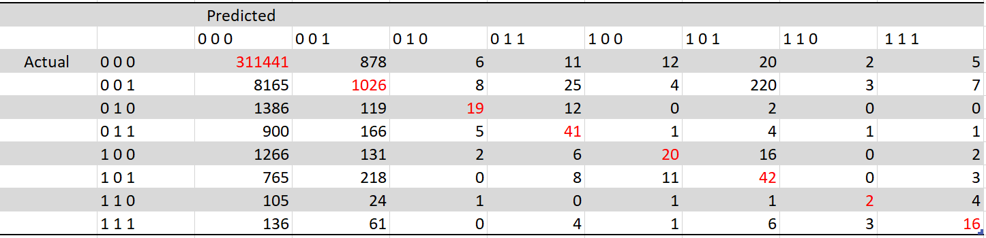
Confusion Matrix

Slide 15
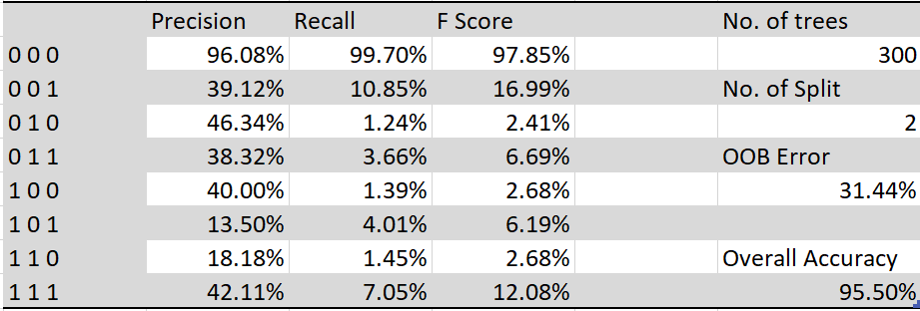
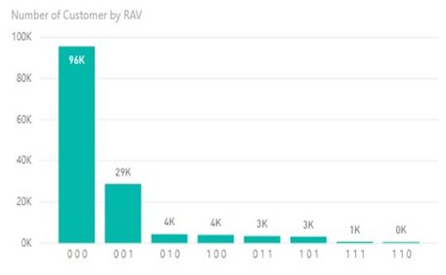
Evaluation Table

Slide 16
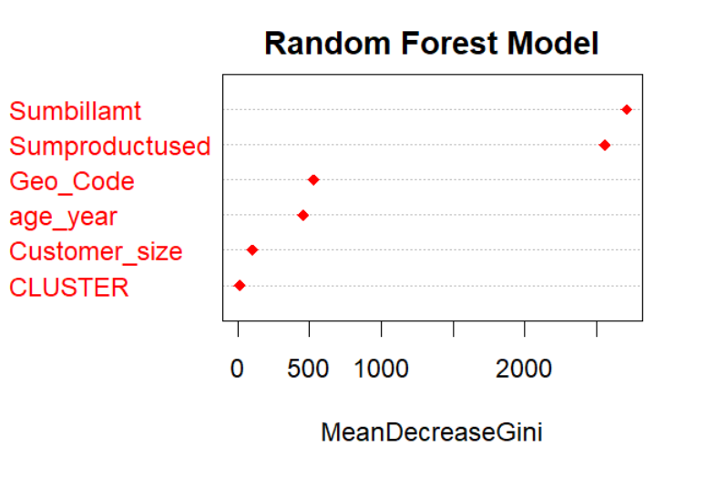
Insights from our Model

Slide 17
Summary & Recommendation
Churn and New Customer Acquisition rate
Visualize is the most popular tool
Prioritize Geo Code and User Age for marketing strategy

Slide 18
Scope for future Improvements
Analysis on types of Amazon products being used by different customers and their impact on usage of these 3 products (A/R/V)
We were given only 3 months of data. Additional historical data may give useful insights
We noticed a change in customer type from size "Small" to "Mid" and "Large"
Data is too much skewed towards "Large" and "Mid" sized customers
Two-Step Clustering
Notes:
There are various types of products in Amazon basket like RDD, EC2, dynamoDB, S3, etc. What all products a specific customer is using which may impact usage of our 3 billing products. This analysis can give us very useful results. We want to see if there is a high relation between a class of products and billing management tools.
Historical data is always useful to create patterns and understand the trend. May be last 6 month data is useful but at the same time, I don’t want to use too old data as trend in technology is changing rapidly.
We came across a set of customers, who were size "Small" in month of April and "Mid" in month of May. We want to do analysis of such customers and look for the trend.
I know generally it is not possible but a Normally distributed data may help us to find detail insights, also algorithms will not weight different customer sizes differently just because of data skewness.
We can try Two-step Clustering on the data. Two step: mixture of K-means and Heirarchical agglomerative clustering process. This will create homogenous clusters. This is done by building cluster feature tree and it can handle both categorical and continous variable by calculating Bayes Information Criterion.

Slide 19

THANK YOU
Q&A

