Slide 1
Inventory Optimization Project
July 22th, 2019
Notes:
Welcome
Agenda
Housekeeping
Participation
Supplier Report Card
Thank them for their attendance and partnership
Have fun…enjoy the day.
Read agenda

Slide 2
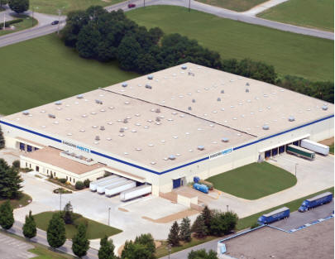
Project Goals
Goal One
What is the current state of our inventory in our Lancaster PDC?
Goal Two
What are your recommendations to optimize our inventory in Lancaster?
Are there opportunities to reduce or increase inventory?
What is the impact to our service level?
Goal Three
Tell us what you liked about this project
Tell us what you would do with more time.

Slide 3



Project Deliverables
Deliverable One
Provide two printed copies of your PowerPoint with 3 slides per page.
Deliverable Two
Submit all code and supporting materials you used to Canvas.

Slide 4

The Data You’re Provided
10 Data Files
Data Dictionary
Demand
Annual
Forecast Error
Forecast
Item Location Data
Lead Time Data
On Time Shipping Data
Part Information Data
Protected Inventory Data

Slide 5
Demand Data
725,401 Records
10 Columns
Data by Month
Data Represents Our Fill Metric
76,505 Records
7 Columns
Table is Demand Quantity

Slide 6
Lead Time Data
309,351 Records
5 Columns
Data by Month
Lead time is the date difference between the issue date and ship date.

Slide 7
Item Data
496,126 Records
30 Columns
Data by DIM
Stock Class & Stock Class Desc
Marketing Category
Velocity
Safety Stock and Buy Days
TRP Ind, MX Ind, NGP Ind, LFNA Ind, LFNA 4C Ind
Natl_Stk_Ind, Whse_Stk_Ind

Slide 8
Forecast Data
266,098 Records
3 Columns
Forecast is for the entire month

Slide 9
Forecast Error Data
956,227 Records
6 Columns
Historical forecast performance

Slide 10
Item Location Data
26,177 Records
2 Columns
Parts that are stored in multiple locations can be thought of as “overstocked”

Slide 11
Protected Inventory Data
25,395 Records
3 Columns
These parts can not be scraped since marketing has them protected in case a customer needs this part.

Slide 12
On Time Shipping Data
38,898 Records
OTS: tracks the supplier shipping performance.
OTS is often seen as a percentage:
(early + on_time + pd_shipped) / (past_due + total_all)

Slide 13
Grading
Presentation (5 pts, 10%)
Flow of presentation
Is the presentation presentable to senior leadership?
Do all the team members talk?
Inventory Insights (15 pts, 30%)
Does the team address the current state of inventory at LAN?
Does the team show how their findings impact PACCAR’s business?
Recommendations (20 pts, 40%)
Does the team provide a plan to increase/decrease parts based on the data provided?
Does the team show how their recommendations impacts PACCAR’s business?
Project Review (10 pts, 20 %)
Do all the team member provide feedback about the project?
Has the team critically thought about other data or business practices that would help their analysis?
Extra Credit (5 pts)
Does the team provide examples of disruptive technologies and how they could use API’s/outside sources to enhance model?

