Slide 1
Alumni Management System
SEGR 5300 19SQ – Milestone 1
Sourabh Gupta Huy Le Sanyukta Ghai

Slide 2
Alumni Management System
What is an alumni management system?
Why is it important?
Case Studies
How we plan to solve it?

Slide 3
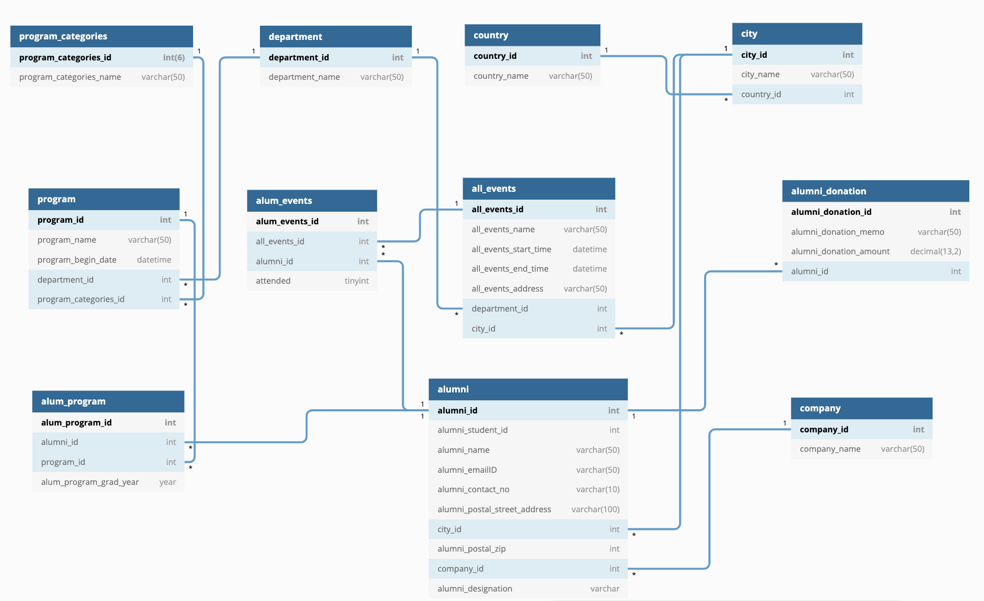
Entity Relationship Diagram

