Slide 1
Magnetic contact switch for door
Embedded System Design

Slide 2
Team members
Do Xuan Vy e1801589
Tran Minh Hien e1601116
Nguyen Quoc Huy e16011

Slide 3

Introduction
Automation
Remotely monitor door in houses and offices
Security
Data from the sensor can be used to trigger alarm in case of intrusion

Slide 4
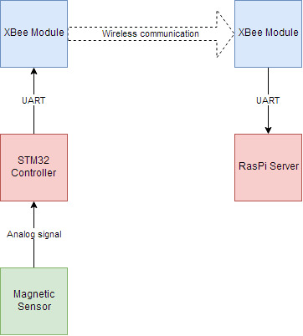
Specification
Sensor
Communication
Magnetic sensor with STM32 controller
Wireless communication via XBee Modules

