Slide 1

BLOCKCHAIN
SCIENTIFIC RESEARCH
REPORT
November
2018

Slide 2
Outline
Blockchain
Ethereum Network
ERC20
Smart Contract
Project Demo

Slide 3
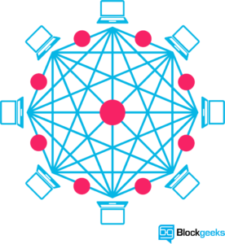
I. BLOCKCHAIN

Slide 4
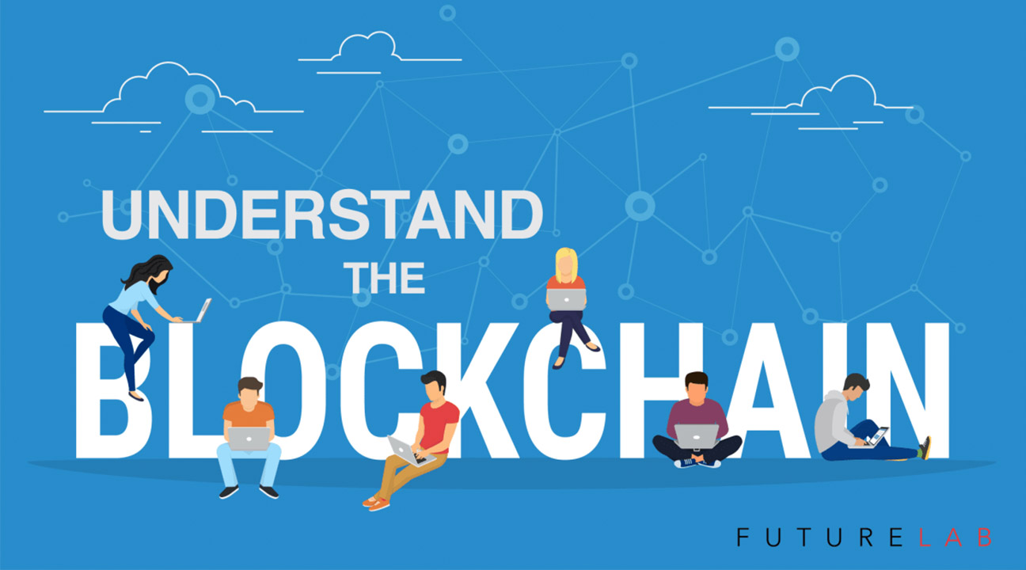
1. What is Blockchain ?
The blockchain data structure is an ordered back-linked list of blocks of transactions.
The blockchain can be stored as a flat file, or in a simple database.
Blocks are linked “back”, each referring to the previous block in the chain.
The blockchain is often visualized as a vertical stack, with blocks layered on top of each other and the first block ever serving as the foundation of the stack.

Slide 5
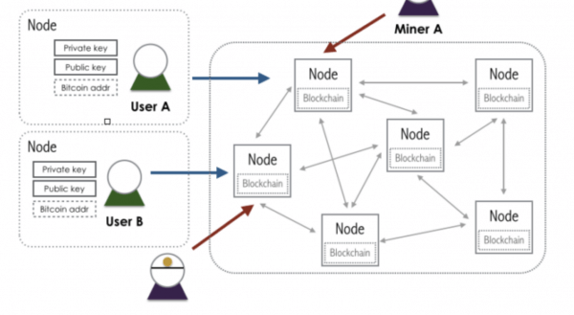
1. What is Blockchain ?
Each block within the blockchain is identified by a hash, generated using the SHA256 cryptographic hash algorithm on the header of the block.
Each block also references a previous block, known as the parent block, through the “previous block hash” field in the block header.
The sequence of hashes linking each block to its parent, creates a chain going back all the way to the first block ever created, known as the genesis block.

Slide 6
2. Type of Blockchain
Public model
Private model
Consortium model

Slide 7
2. Type of Blockchain
Public and open source.
Anyone can join the blockchain to add or store data.
The main benefit of using a public blockchain is that it’s technically more secure.
The risk of a public model, especially for businesses.
The transaction time may be larger
Public model
Private model
Consortium model

Slide 8
2. Type of Blockchain
A private blockchain is closed, and one entit - your company, for instance - controls all the nodes.
Only assets controlled or approved by that single entity can join the network.
Advantages: flexibility, control, and visibility.
Disadvantages : Security
Public model
Private model
Consortium model

Slide 9
2. Type of Blockchain
A consortium model is essentially a hybrid public/private model.
Only approved groups can join the blockchain.
Operating on a hybrid trust model could increase or decrease your blockchain’s security depending on how large or small your consortium.
It minimizes the security risks that come with private blockchains as, by definition, it allows greater access to its network.
Public model
Private model
Consortium model

Slide 10
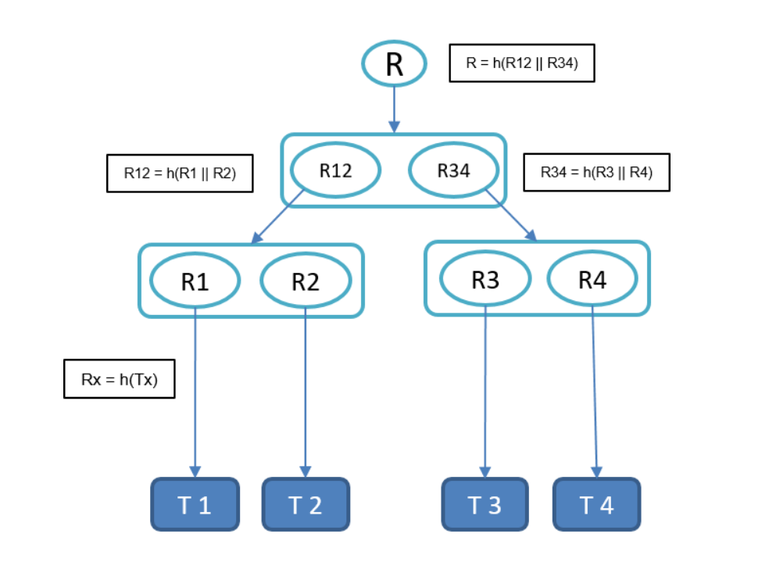
3. Merkle Trees ( Bitcoin)
Each block in the bitcoin blockchain contains a summary of all the transactions in the block, using a Merkle Tree.
A Merkle Tree, also known as a Binary Hash Tree is a data structure used for efficiently summarizing and verifying the integrity of large sets of data.
The cryptographic hash algorithm used in bitcoin’s merkle trees is SHA256 applied twice, also known as double-SHA256

Slide 11
II. ETHEREUM NETWORK
Blockchain platform. Blockchain is decentralized applications
DECENTRALIZED SYSTEM FOR EXCHANGE OF VALUE
ETHEREUM : OPEN SOURCE PUBLIC BLOCKCHAIN NETWORK
  Uses a shared distributed ledger
  Transaction immutability achieved by way of blocks & chaining
  Leverages consensus mechanism for validating the transactions
  Uses cryptography for trust, accountability, security
  Value token = Ether
  De-centralized Turing-complete Virtual Machine
  Smart contracts, excution requires payment : gas.

Slide 12
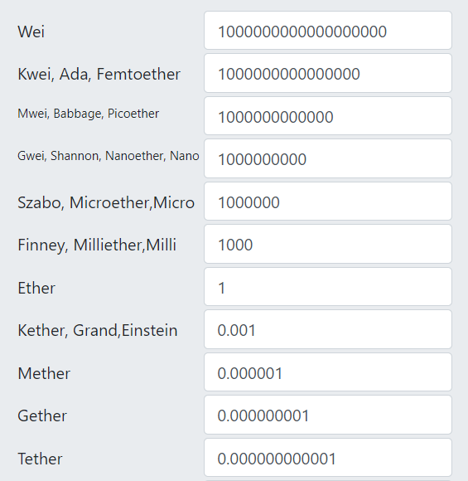
Ether (ETH)

Slide 13
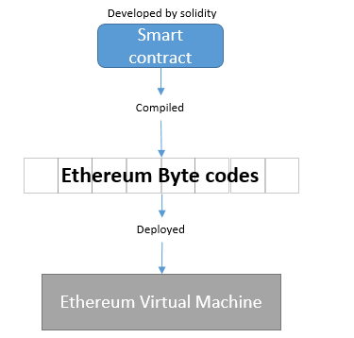
Ethereum Virture Machine (EVM)
An software that can execute Ethereum Bytecode
Follows the EVM specifications (Ethereum protocol)
Runs as a process on a computer/sever
EVM implemented in multiple languages

Slide 14
GAS
Function | Gas | Description
Step | 1 | Default amount of gas to pay for an execution cycle
Stop | 0 | Nothing paid for the SUICIDE operation.
Sha3 | 20 | Paid for a SHA3 operation.
Sload | 20 | Paid for a SLOAD operation.
Sstore | 100 | Paid for a normal SSTORE operation (doubled or waived sometimes).
Balance | 100 | Paid for a BALANCE operation
Create | 100 | Paid for a CREATE operation
Call | 20 | Paid for a CALL operation.
Memory | 1 | Paid for every additional word when expanding memory
Txdata | 5 | Paid for every byte of data or code for a transaction
Transaction | 500 | Paid for every transaction

Slide 15
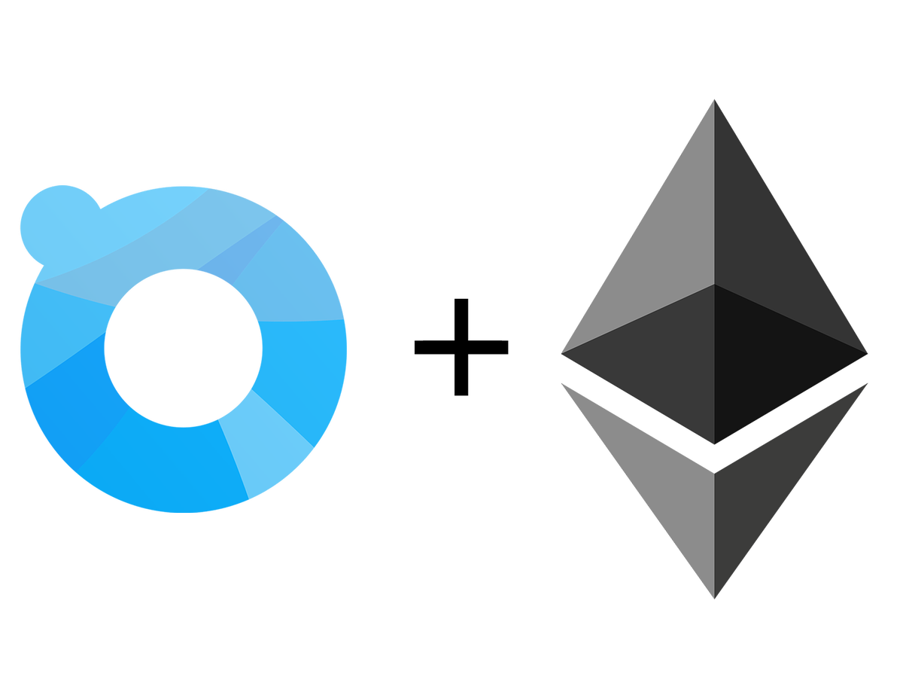
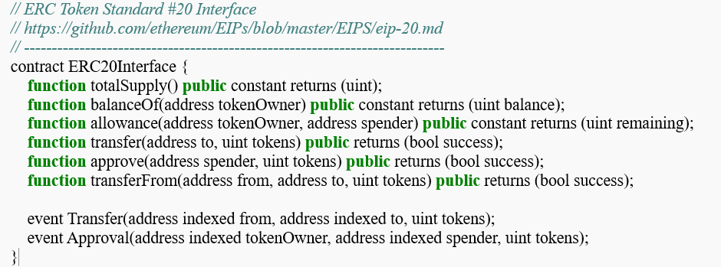
III. ERC20

Slide 16
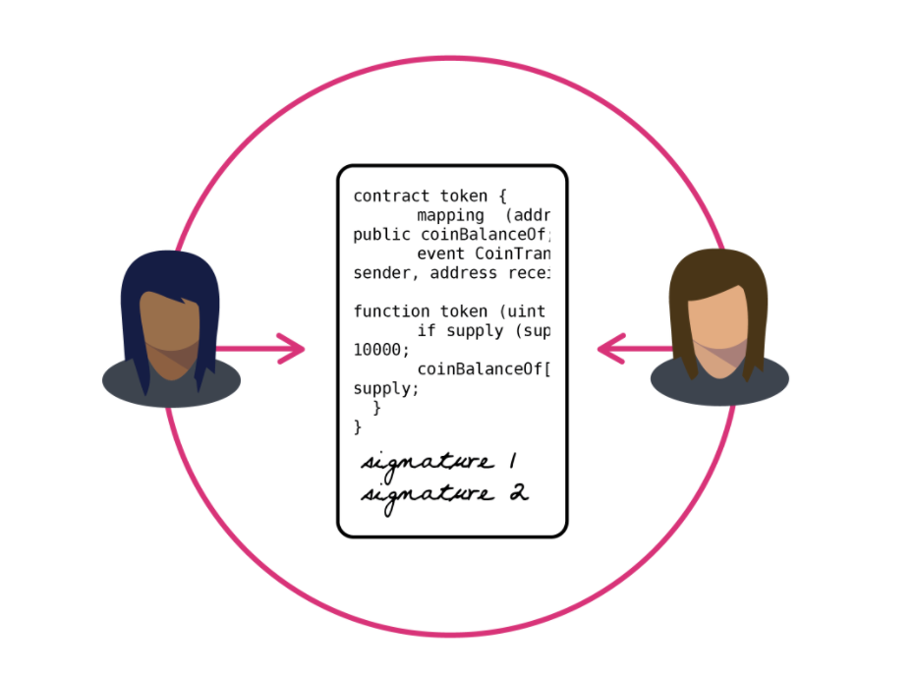
IV. SMART CONTRACT
A smart contract is designed to safely and transparently facilitate the exchange of assets, without the need for a middleman.
Smart contracts are programs that are coded to automatically control the transfer of assets between two or more parties, once predefined conditions have been met

Slide 17
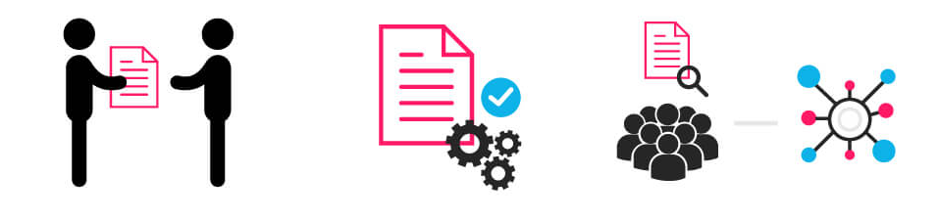
How a basic smart contract work
  Assets are coded
  Contract terms are coded
  Both the terms and assets are entered as a block in the blockchain
  Once the contractual terms are met by both parties, the contract is executed
  Any assets transfers are completed based on the terms of the contract

Slide 18
Advantages of Smart Contract
Transparency
Speed
Security
Trust

Slide 19
References
https://github.com/bitcoinbook/bitcoinbook
https://blog.capterra.com/benefits-of-blockchain-cybersecurity/
https://etherconverter.online/
https://u.today/what-is-gas-in-ethereum-and-how-it-works
https://www.cryptoniam.com/what-is-erc20/
https://theethereum.wiki/w/index.php/ERC20_Token_Standard
https://www.coindesk.com/information/how-ethereum-works/
https://ethereum.org/
https://www.quora.com/What-are-the-advantages-and-disadvantages-of-Ethereum%E2%80%99s-blockchain-architecture
https://www.coindesk.com/information/ethereum-mining-works
https://www.investinblockchain.com/what-is-a-smart-contract/
https://medium.com/@ChainTrade/10-advantages-of-using-smart-contracts-bc29c508691a

Slide 20

THANK YOU!

