Slide 1
2D Game Development Using HTML5 & Javascript
Yin Yang
(synthesized from internet and http://www.slideshare.net/)

Slide 2
Content
Javascript and HTML5 Game
Overview of Canvas
Game Programming
Libraries & Tools
Resources & References
Demo

Slide 3

Javascript and HTML5 Game
- Let’s Get Start

Slide 4
An Overview of HTML5
HTML5
Web Socket
Web Storage
Web Worker
Web Database / Indexed DB
Canvas
Video / Audio
Drag & Drop
History
Offline App
Geolocation

Slide 5

Why Javascript?
Easy to develop
Fast deployment
Easy to debug
Open source
Free tools
Wide support:
Web browers
Mobile devices
Social networking application

Slide 6

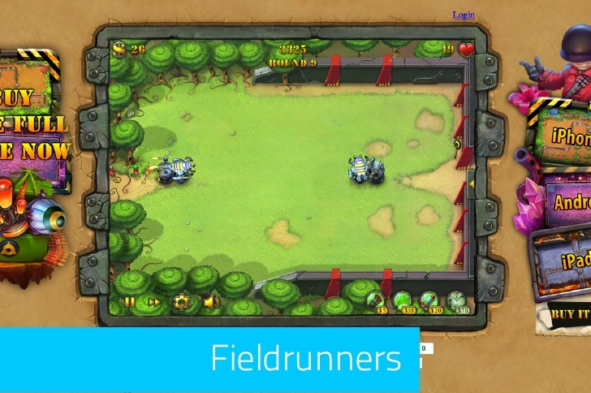
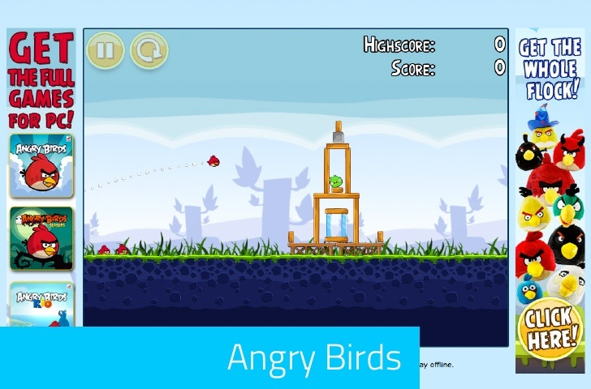
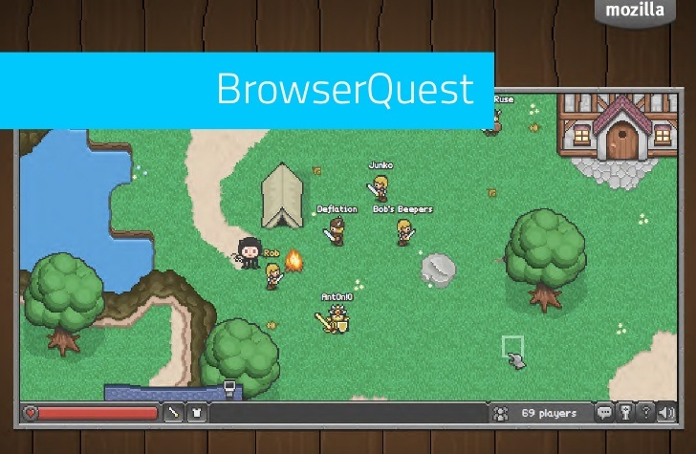




Examples

Slide 7
Anatomy of a Game
Logic
Javascript code
Graphics
<canvas>
Input
Onkeydown, onmousedown, …
Sound / Music
<audio>
Multiplayer
Ajax, WebSocket
Game Assets
Images, Video, File API

Slide 8

HTML5 Canvas Overview
- A Quick Tour of Using Canvas from Javascript

Slide 9
An overview of Canvas
2D drawing platform within the browser
Uses nothing more than JavaScript and HTML – no plugins
Extensible through a JavaScript API
Created by Apple for dashboard widgets
Now openly developed as a W3C spec

Slide 10
What is it for?
Data visualisation
Animated graphics
Web applications
Games

Slide 11
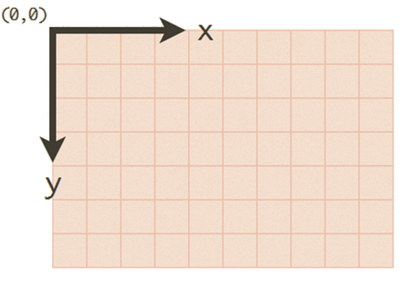
How to use?
<canvas height='600' width='800'></canvas>
Uses the standard screen-based coordinate system

Slide 12
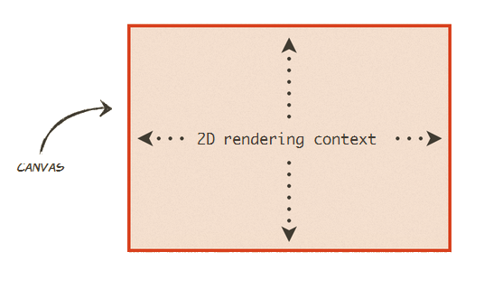
How to use?
Everything is drawn onto the 2D rendering context (ctx)

Slide 13
Using context
var canvas = document.getElementById("canvas");
var ctx = canvas.getContext("2d");
ctx.fillStyle = 'rgb(255, 0, 0)';
ctx.strokeStyle = 'rgba(0, 255, 0, 0.5)';
Method | Action
ﬁllRect(x, y, w, h) | Draws a rectangle using the current ﬁll style
strokeRect(x, y, w, h) | Draws the outline of a rectangle using the current stroke style
clearRect(x, y, w, h) | Clears all pixels within the given rectangle

Slide 14
Using context
Text
Shadows & blurring
Lines, shapes, image
Gradients
Saving state of drawing context
Transformations
Composites
Pixel Manipulation
http://www.html5canvastutorials.com/

Slide 15
The future of canvas
OOP programming allows much to be achieved through canvas
It’ s ﬂexible and powerful
Animation engines
Pseudo 3D graphics
Reading pixel values opens a lot of doors
Integration with other HTML5 elements is a killer feature

Slide 16

Canvas vs. Flash
HTML5 Canvas
More open than Flash
Smaller result.
Javascript is built into browsers
Works on most of platforms
No need to compile.
Adobe Flash
Great authoring tool, easy to go from idea to working product
Better sound support - many JavaScript libraries use SoundManager2, which falls back on Flash and tends to lag
Do not work good in all platforms, for example Linux.

Slide 17

Game Programming
- Get to the Core of the Problem

Slide 18
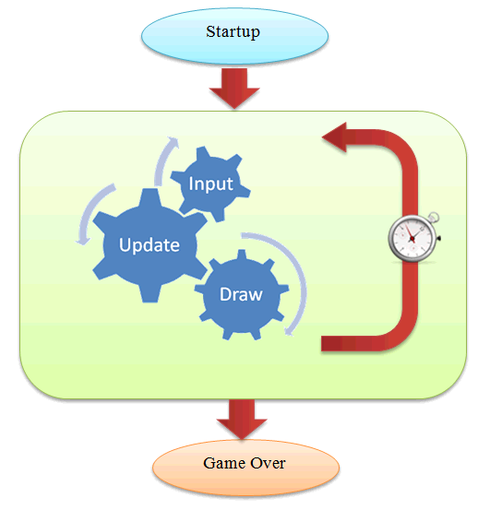
Typical Game Loop
var FPS = 60;
setInterval(gameTick,1000/FPS)
function gameTick()
{
processInput();
updateGame();
draw();
}
don’t always need a game loop

Slide 19
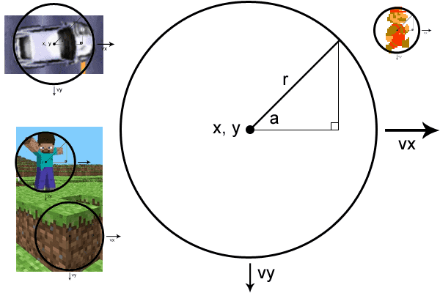
Physics
Euclid
Rotation (known angle)
Rotation (unknown angle)
Rotation (triangle overlay)
Rotation + particles
Newton
Position
Velocity
Acceleration
Collisions

Slide 20
Optimization Techniques
Optimizing game loop, skipping draw.
Use requestAnimationFrame instead of setInterval / setTimeout.
Frame buffering, multiple canvases.
Avoid unnecessary canvas state change.
Dirty rectangle: redraw only those areas that have changed.
Use DOM Elements whenever possible.

Slide 21

Libraries & Tools
– Make everything simple

Slide 22
Javascript Libraries
Box2DJs
SoundManager2
CanvasScript3
A port of Box2D Physics Engine to JavaScript.
Using HTML5 and Flash, provides reliable cross-platform audio under a single JavaScript API.
A Javascript sprite library for HTML5 Canvas similar to FLASH/ActionScript3
Node.js
Built on Chrome's JavaScript runtime for easily building fast, scalable network applications.

Slide 23
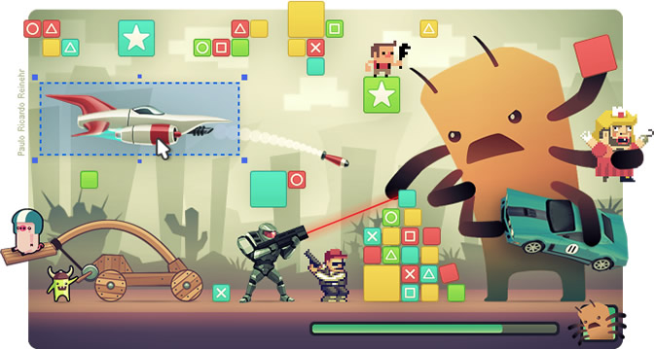
Html5 Game Engines
1. HTML5 Game Engine
High Performance
Fully Documented
2d Physics
Intuitive Interface
Offline Support
http://www.scirra.com/html5-game-engine

Slide 24

Html5 Game Engines
2. Impact Js
Play Everywhere
Flexible Level Editor for Anything 2D
Publish game into the AppStore with almost native performance
Powerful Debug Tools
http://impactjs.com/

Slide 25
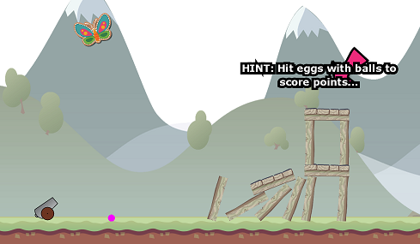
Html5 Game Engines
3. Isogenic Engine
Advanced Realtime Networking
Facebook Integration
High Performance Canvas
Physics system built-in utilising Box2d
http://www.isogenicengine.com/

Slide 26

Demo
- A Two Week Game from Scratch

Slide 27
Mario - Introduction
All the usual gameplay, collect coins and finish the levels.
No need to download any plugins to play.
Online version and source code are available on http://vietgamedev.net/apps/23/mario/

Slide 28
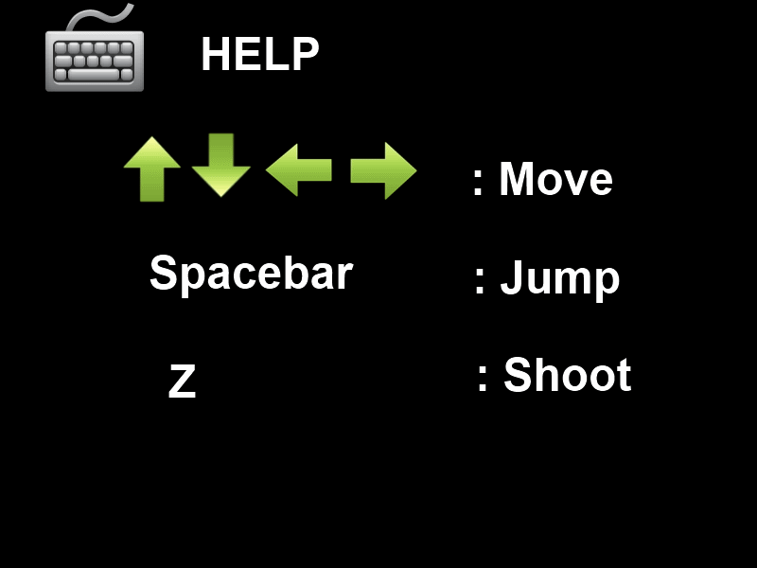
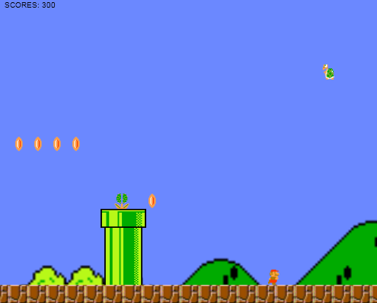
Mario – Help & Gameplay

Slide 29

Resources & References
- For further research

Slide 30
Resources
Learning HTML5
List of HTML5 Presentation Resources – Earlier post with many links for this session
HTML5: Edition for Web Authors – Focused subset of the specification for web devs
HTML5 on the Internet Explorer Learning Site – Videos, tutorials, articles
HTML5 Demos from Giorgio Sardo – HTML5, CSS, JS, etc.
HTML5 Doctor – HTML5 articles, Element Index, and resources
Implementing HTML5
CanIUse.com – Details support by browser for HTML5, CSS3, and other technologies
Modernizr – HTML5 & CSS3 feature detection made easy
HTML5 Cross Browser Polyfills – Helpful for implementing features while supporting a range of browsers

Slide 31
Docs & References
HTML5 Specification
http://developers.whatwg.org/
Dive into HTML5
http://diveintohtml5.info/
Physics for Lazy Game Developers
http://labs.skookum.com/demos/barcampclt_physics/
Developing Your First HTML5 Game
http://www.script-tutorials.com/html5-game-development-lesson-1
HTML5 Canvas Tutorial
http://www.html5canvastutorials.com/
HTML5 Game Development Resources
http://blogs.msdn.com/b/cbowen/archive/2011/12/15/html5-game-development-resources-from-the-game-camps.aspx

Slide 32
Thank you!
Need more? Please go to:
http://vietgamedev.net
http://yinyangit.wordpress.com

