Slide 1
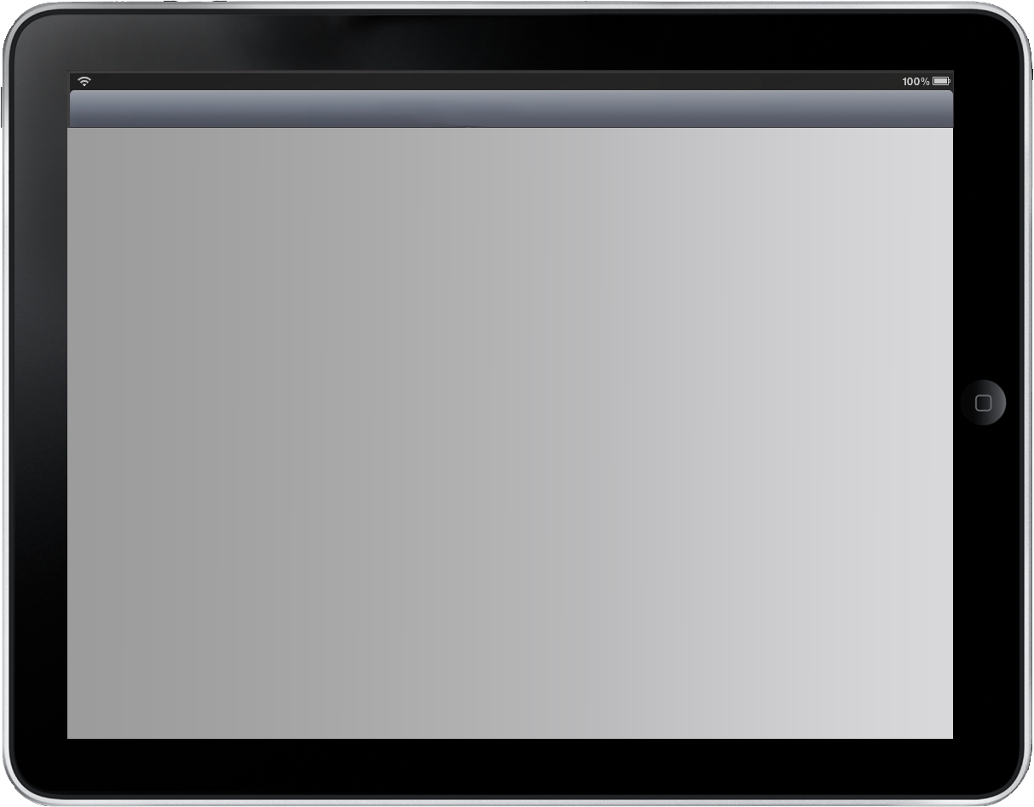

What’s the Big Deal?
Scott Sayre MIDEA 2011
05.04.2011
Slide
HTML5: What’s the Big Deal?

Slide 2
Web Sites, Web Apps and Apps
Scott Sayre MIDEA 2011
05.04.2011
Slide
HTML5: What’s the Big Deal?
1993 - 2006 “www” HTML model
2007 Original iPhone web App model
2008 Apple App store
2009 “Apps are everything”
2010 “The Web is Dead”
2011 HTML5 “App, Web App, Web site, what’s the difference”?

Slide 3

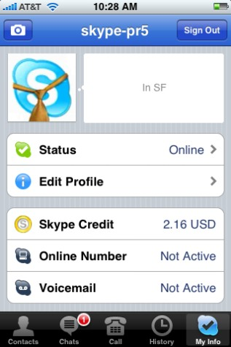
Native App vs. Web App “2010”
Scott Sayre MIDEA 2011
05.04.2011
Slide
HTML5: What’s the Big Deal?
Native App
  Must be downloaded
  Dedicated custom code
  Onboard content
  May use network content
  Can be sold
  Access to hardware

Slide 4

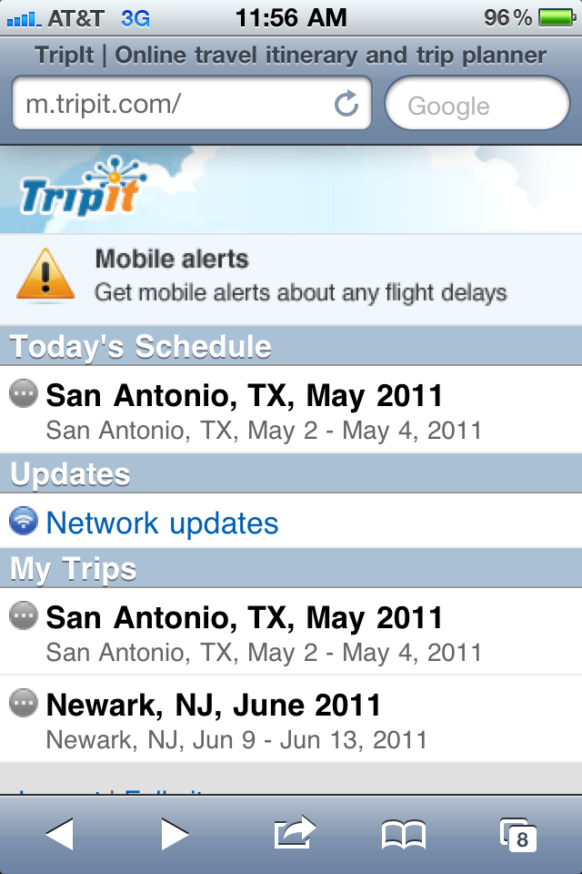
Native App vs. Web App “2010”
Scott Sayre MIDEA 2011
05.04.2011
Slide
HTML5: What’s the Big Deal?
Web App
  Requires network
  Content up to date
  Limited to browser
  Device independent
  No access to hardware
  Access from any device

Slide 5
In 2011...
Native Apps are preferred for distribution and ease of use.
Web Apps are preferred for their universal accessibility, ease of development and maintenance.
Scott Sayre MIDEA 2011
05.04.2011
Slide
HTML5: What’s the Big Deal?

Slide 6



HTML5 someplace in between today’s web apps and native apps.
Scott Sayre MIDEA 2011
05.04.2011
Slide
HTML5: What’s the Big Deal?

Slide 7
HTML5 can make web pages perform like native apps.
Scott Sayre MIDEA 2011
05.04.2011
Slide
HTML5: What’s the Big Deal?
=

Slide 8

HTML5 can make web pages perform like Flash applications.
Scott Sayre MIDEA 2011
05.04.2011
Slide
HTML5: What’s the Big Deal?
=

Slide 9
HTML5 Formal Definition
Scott Sayre MIDEA 2011
05.04.2011
Slide
HTML5: What’s the Big Deal?
HTML 5 is the next revision of the Hypertext Markup Language (HTML), the standard programming language for describing the contents and appearance of Web pages.

Slide 10
HTML5 “Street” Definition
Scott Sayre MIDEA 2011
05.04.2011
Slide
HTML5: What’s the Big Deal?
A web app or site using:
HTML5 - instructions
Cascading Style Sheets 3 - design
Javascript - interactivity

Slide 11
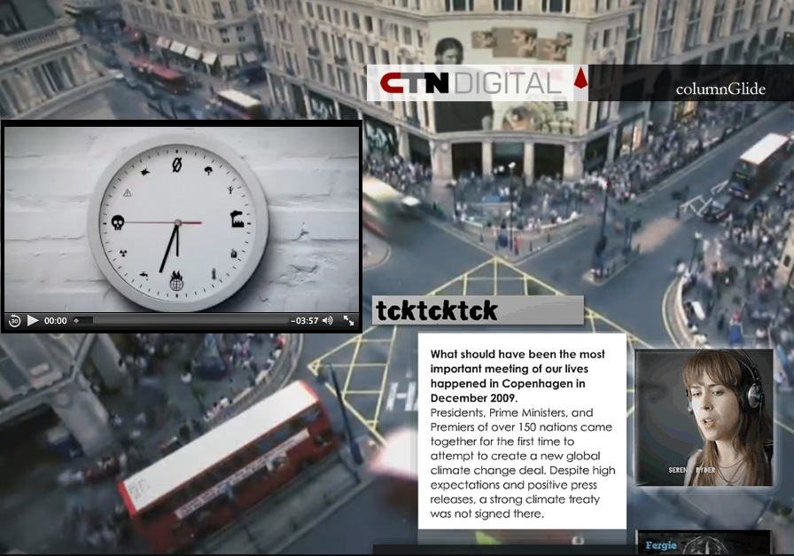
Let’s look at an example:
Scott Sayre MIDEA 2011
05.04.2011
Slide
HTML5: What’s the Big Deal?
http://ipad.lookbookhd.com/glide.htm

Slide 12
Key Features of “HTML5”
Scott Sayre MIDEA 2011
05.04.2011
Slide
HTML5: What’s the Big Deal?
Embedded audio
Embedded video
Canvas drawing tools
Offline web applications
Local storage
Geolocation

Slide 13
Embedded audio
Scott Sayre MIDEA 2011
05.04.2011
Slide
HTML5: What’s the Big Deal?
Audio files in the MP3, WAV and OGG formats can be embedded with the <audio> tag.
No Quicktime or Flash plug-in required

Slide 14
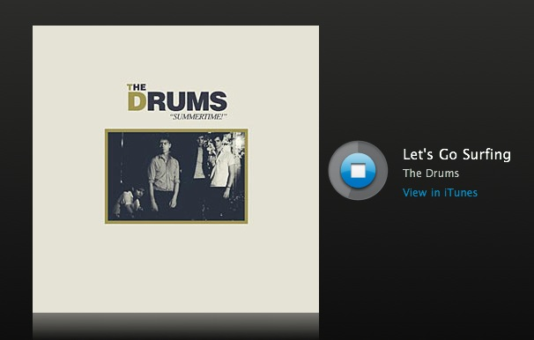
<audio> example
Scott Sayre MIDEA 2011
05.04.2011
Slide
HTML5: What’s the Big Deal?
http://developer.apple.com/safaridemos/showcase/audio/

Slide 15
Embedded video
Scott Sayre MIDEA 2011
05.04.2011
Slide
HTML5: What’s the Big Deal?
Video files in the Theora and MP4 formats can be embedded with the <video> tag.
No Quicktime or Flash plug-in required

Slide 16
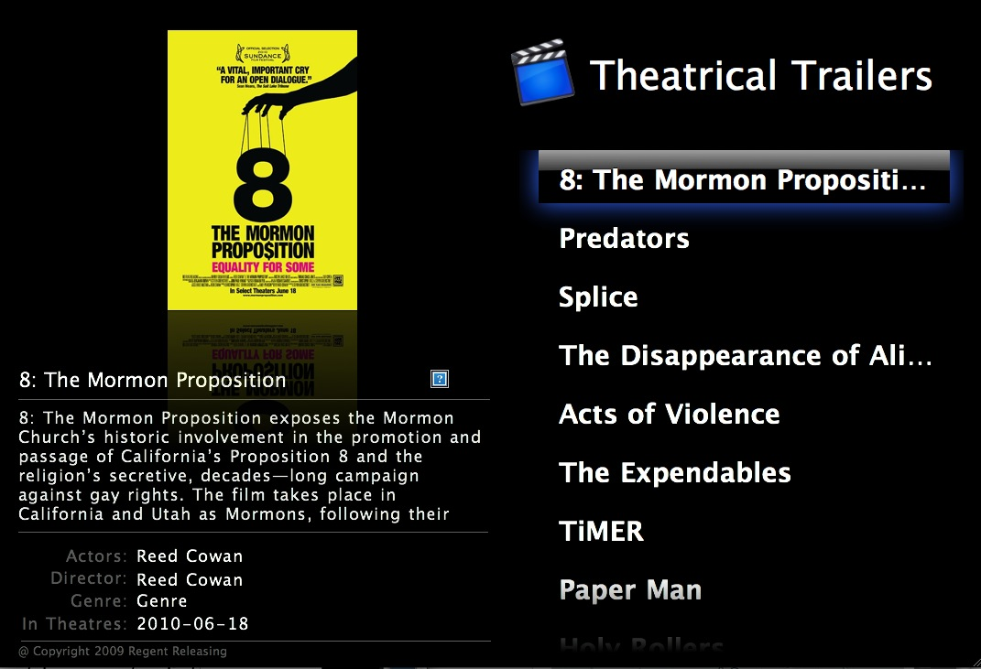
<video> example
Scott Sayre MIDEA 2011
05.04.2011
Slide
HTML5: What’s the Big Deal?
http://developer.apple.com/safaridemos/MovieTrailers/

Slide 17

<video> VR rotation example
Scott Sayre MIDEA 2011
05.04.2011
Slide
HTML5: What’s the Big Deal?
VR Rotation

Slide 18
Canvas drawing tools
Scott Sayre MIDEA 2011
05.04.2011
Slide
HTML5: What’s the Big Deal?
A bitmap <canvas> which can be used for rendering graphs, game graphics, or other visual images on the fly.
No Quicktime or Flash plug-in required

Slide 19
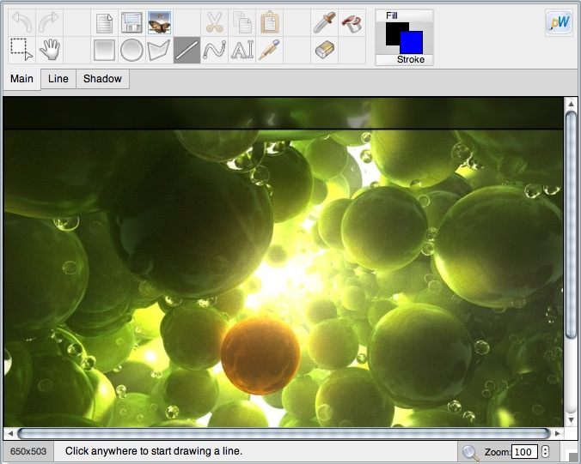
<canvas> example
Scott Sayre MIDEA 2011
05.04.2011
Slide
HTML5: What’s the Big Deal?
http://www.robodesign.ro/paintweb/trunk/demos/demo1.html

Slide 20
Offline web applications
Scott Sayre MIDEA 2011
05.04.2011
Slide
HTML5: What’s the Big Deal?
HTML5 allows applications to store a set of files locally using a manifest list. These files can be accessed automatically when the application senses it does not have a network connection.

Slide 21
Local storage
Scott Sayre MIDEA 2011
05.04.2011
Slide
HTML5: What’s the Big Deal?
Applications can store session information locally on your computer so the application can access it later.
Different from web cookies, this information can not be transmitted back to the web server.

Slide 22
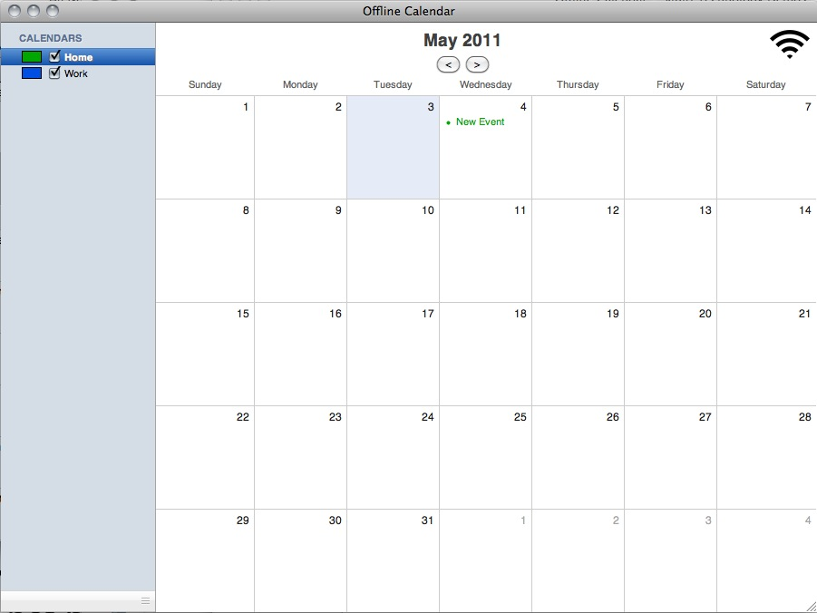
Offline application and local storage example:
Scott Sayre MIDEA 2011
05.04.2011
Slide
HTML5: What’s the Big Deal?
http://developer.apple.com/safaridemos/OfflineCalendar/

Slide 23
Geolocation
Scott Sayre MIDEA 2011
05.04.2011
Slide
HTML5: What’s the Big Deal?
HTML5’s geolocation API can determine your physical location based on your internet access point.
HTML5 applications using geolocation will ask the user’s permission before sharing their location.

Slide 24
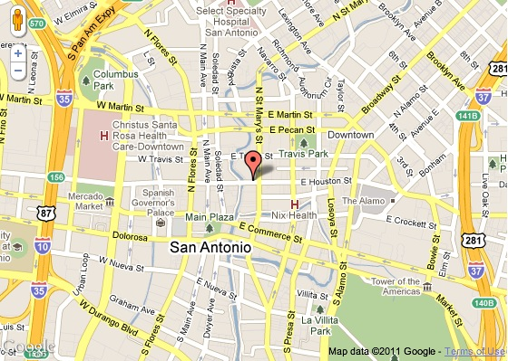
Geolocation Example:
Scott Sayre MIDEA 2011
05.04.2011
Slide
HTML5: What’s the Big Deal?
http://html5demos.com/geo

Slide 25
More Resources
Scott Sayre MIDEA 2011
05.04.2011
Slide
HTML5: What’s the Big Deal?
Demos
  http://developer.apple.com/safaridemos/
  http://html5demos.com/
Reading
  http://diveintohtml5.org
  http://ohtml5.com

Slide 26
Things to consider
Scott Sayre MIDEA 2011
05.04.2011
Slide
HTML5: What’s the Big Deal?
Not compatible with older browsers
Its not all of nothing
Current browsers have different limitations
Capabilities and compatibilities are changing daily.
Mobile browsers compatibility different than desktop browsers

Slide 27

Test your browsers
Scott Sayre MIDEA 2011
05.04.2011
Slide
HTML5: What’s the Big Deal?
http://html5test.com/

Slide 28
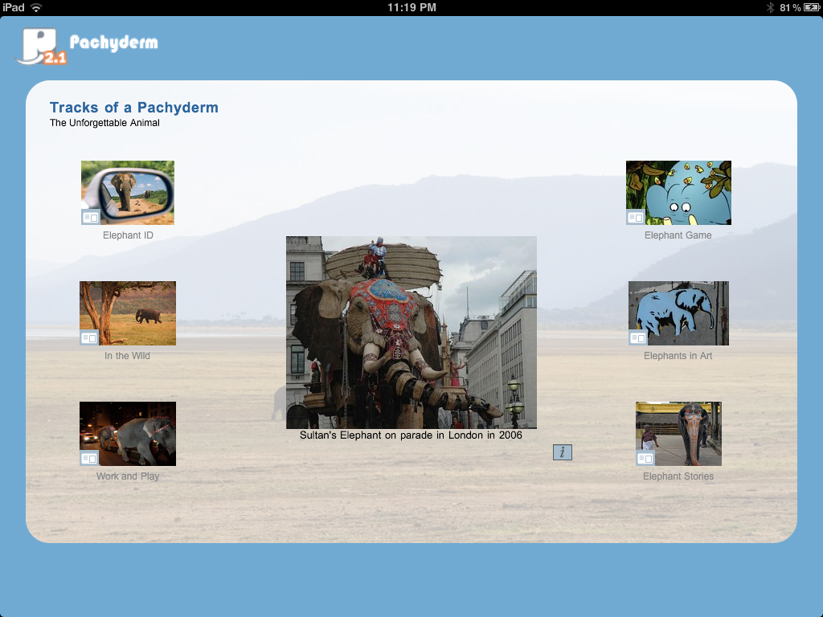
Pachyderm, HTML5 and the iPad
Scott Sayre MIDEA 2011
05.04.2011
Slide
HTML5: What’s the Big Deal?

Slide 29
Progress to date:
Scott Sayre MIDEA 2011
05.04.2011
Slide
HTML5: What’s the Big Deal?
Micro-funded the development of HTML5 versions of the 10 main templates
Prototypes of four templates: Exploration Entry, Commentary, Enlargement and Slider developed
Currently evaluating prototype
Goal is to make templates backwards compatible

Slide 30
Next steps:
Scott Sayre MIDEA 2011
05.04.2011
Slide
HTML5: What’s the Big Deal?
Assess UI and accessibility options
Improve speed and caching
Complete remaining six templates by late summer
Release templates and instructions to community through Pachyforge.org

Slide 31
A Quick Demo
Scott Sayre MIDEA 2011
05.04.2011
Slide
HTML5: What’s the Big Deal?
http://www.pachyforge.org/html5demo/

Slide 32
Advantages:
Scott Sayre MIDEA 2011
05.04.2011
Slide
HTML5: What’s the Big Deal?
Plays on all HTML5 devices (iPhone)
Full screen video
Select and copy text
“Bookmarkable” pages
Customizable sound effects
Easier to modify template design and text
Incorporating gestures (pinching, etc.)

Slide 33
Challenges:
Scott Sayre MIDEA 2011
05.04.2011
Slide
HTML5: What’s the Big Deal?
Closed captioning can not be overlayed
Video must be replaced with MP4
Images can not overlay video
No screen to screen transitions
Can not be saved to iPad

Slide 34
Presentation Conversion
Scott Sayre MIDEA 2011
05.04.2011
Slide
HTML5: What’s the Big Deal?
Drop one folder and two files into presentation
Add or replace any FLV movies with MP4 movies
That’s it!
Presentations can run in both Flash or HTML5!

Slide 35
Support for the Project
Scott Sayre MIDEA 2011
05.04.2011
Slide
HTML5: What’s the Big Deal?
The follow organizations are providing generous support for the project:
  MIDEA / NMC
  California State University
  The Walters Art Museum
  University of Minnesota
  Oregon State University
  SFMOMA
  Tang Museum

Slide 36
Scott Sayre scott@sandboxstudios.org
Scott Sayre MIDEA 2011
05.04.2011
Slide
HTML5: What’s the Big Deal?

