Slide 1
Pre-Thesis Defense
National University of HoChiMinh City
Bach Khoa University
Faculty of Computer Science and Engineering
Answer phone call and automatic read incoming messages while driving application
Students:
Vo Hoang An - 51300197
Dang Quoc Son - 51303399
Supervisor:
Pham Hoang Anh

Slide 2
Contents
Introduction
Related Works
Requirements analysis
Design
Application Development
Front – end development
Back – end development
Conclusions
Demonstration

Slide 3
Introduction
Smartphone is an essential item in daily life right now
The needs of using phone to text or call is increasing
However, using the phone while driving is dangerous
The purpose is to develop an application than can handle the messages and calls to reduce usage of phone while driving

Slide 4
Specific Tasks
Investigate and choosing the development environment
Investigate the libraries for Text-to-speech & Voice recognition
Implement the Front-end
Implement the Back-end
Run & Test application
4

Slide 5
Requirements Analysis
Can get access to messages, calls, and contacts
Uses Text-to-speech libraries to read messages aloud
Uses Voice Recognition libraries to answer or decline the incoming calls
Can run in background
The front-end has to be simple
Has to be easy to use

Slide 6
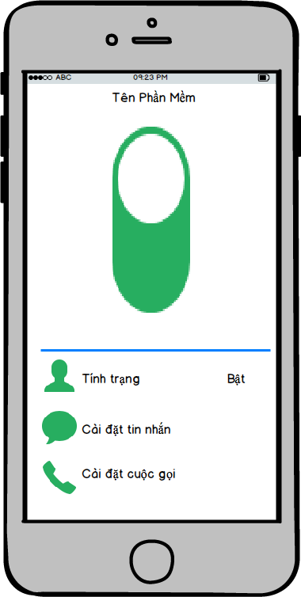
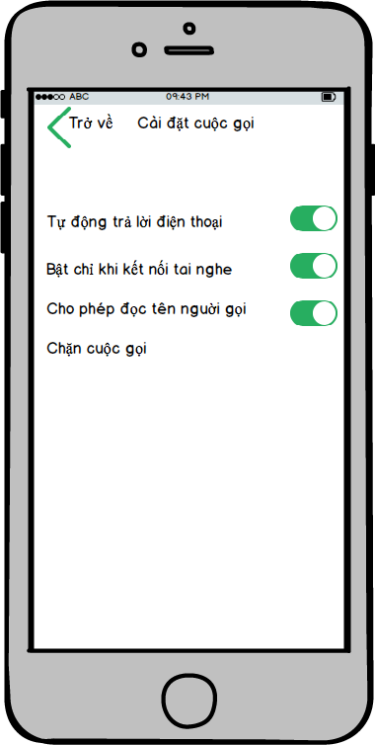
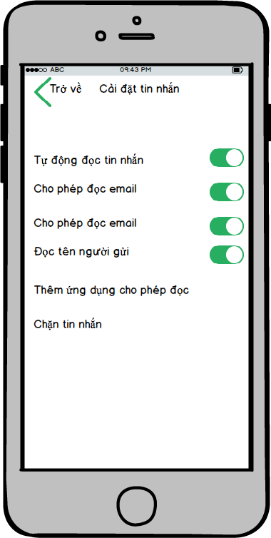
Application Design

Slide 7
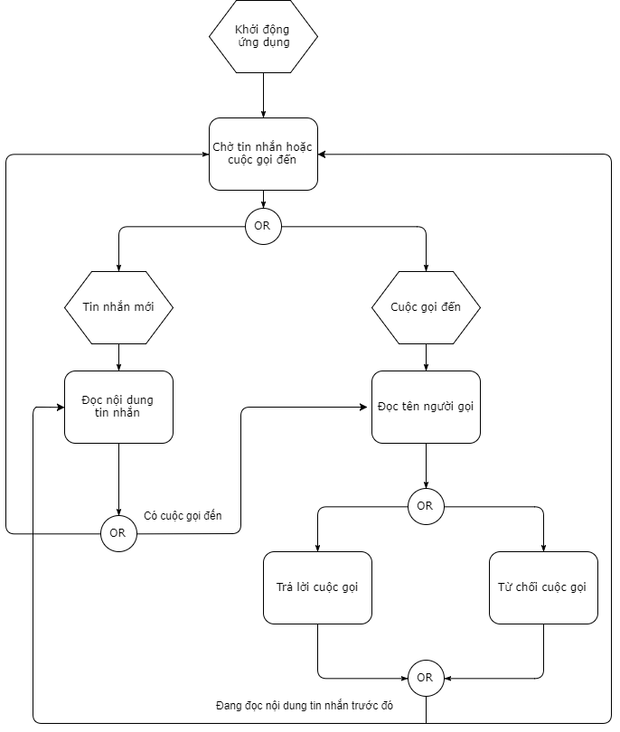
Appication Design

Slide 8
Implementation
Develop application and library on the given platform.
Text-to-speech Processing
Get access to text messages
Read that text aloud
Voice recognition Processing
Get access to phone calls
Recognize the voice and choose what to do with that call
Let the application to run in background

Slide 9
Conclusion
Archievement
Use free library and platforms
Finish implementing the text-to-speech feature
Finish implementing the front-end

Slide 10
Conclusion
Limitation and Constraints
The Voice Recognition feature is in development
Application isn’t running in background
Not yet tested

Slide 11
Future Works

Slide 12
Demostration

