Slide 1
Object Detection
Nguyễn Anh Tú Trần Anh Tú Thái Quốc Tuấn

Slide 2
Challenge 1
Object detection and Classification on First view Cameras in real-time

Slide 3
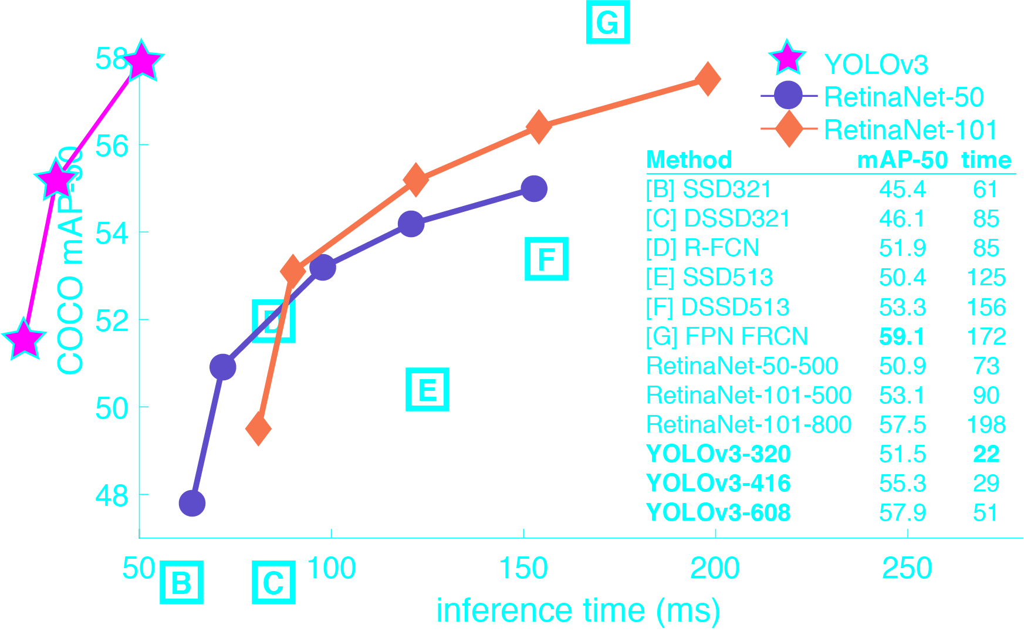
Yolo

Slide 4
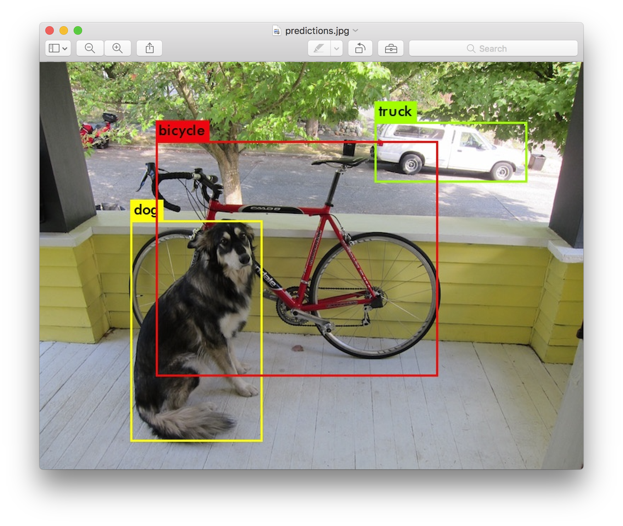
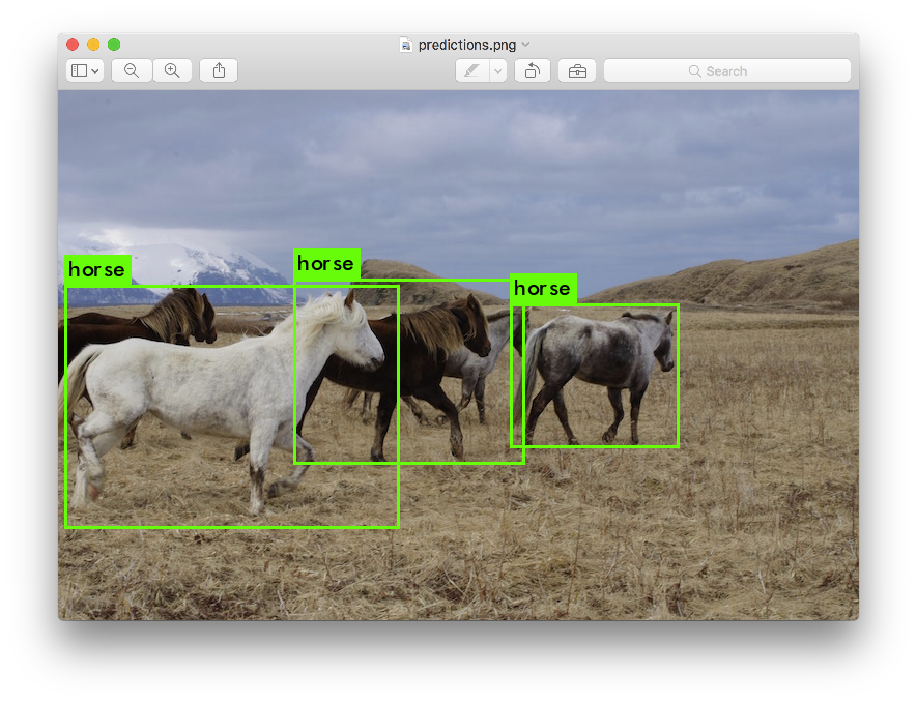
Yolo

Slide 5
Yolo
A deep net with convulational layers and connected layers
Predict for each grid that include the object , predict the object size and find the center point

Slide 6
Idea
Each step the agent move will be recorded and result in a frame
Yolo will use that frame to detect the object inside it using pre-trained weight

Slide 10
End

