Slide 1
4-BIT RISC CPU
Architecture • Datapath • Schematic • Testbench
A Verilog HDL project with a 3-stage pipeline
Focus: how the CPU fetches, decodes, executes, and verifies instructions
IF
ID
EX
MEM
WB
Project presentation • Functional simulation and current test results

Slide 2
ALU VS CPU: WHAT IS THE DIFFERENCE?
ALU — Arithmetic Logic Unit
CPU — Central Processing Unit
• A processing block inside the CPU
• Performs arithmetic: ADD, SUB
• Performs logic: AND, OR, XOR, NOT
• Produces a result and status flags (Zero, Carry)
• Does not fetch or decode instructions by itself
In this project: the ALU is 4-bit wide.
• The complete processor system
• Fetches instructions using the PC and Instruction Memory
• Decodes instructions in the Control Unit
• Uses the Register File, ALU, MUXes and memory
• Updates the PC, flags and registers as instructions run
In this project: a 4-bit RISC CPU with a 3-stage pipeline.
Key idea: The ALU is one part of the CPU. The CPU controls the full instruction flow.
26
Notes:
ENGLISH SPEECH
The ALU is a processing block inside the CPU. It performs operations such as ADD, SUB, AND, OR, XOR, and NOT, and it can produce Zero and Carry flags. The CPU is the complete processor system. It fetches and decodes instructions, controls the ALU, accesses memory, and updates registers and the PC. The key idea is that the ALU calculates, while the CPU coordinates the full instruction flow.
GHI CHÚ TIẾNG VIỆT
ALU là khối xử lý bên trong CPU, thực hiện ADD, SUB, AND, OR, XOR, NOT và tạo cờ Zero/Carry. CPU là hệ thống xử lý hoàn chỉnh: lấy/giải mã lệnh, điều khiển ALU, truy cập bộ nhớ, cập nhật thanh ghi và PC. Ý chính: ALU tính toán, CPU điều phối luồng lệnh.

Slide 3
HOW THE ALU WORKS INSIDE THE CPU
1. FETCH
2. DECODE
3. EXECUTE
4. MEMORY
5. WRITE-BACK
PC + Instruction Memory
get the instruction
Control Unit identifies
opcode and operands
MUX selects inputs;
ALU computes result
Data Memory is used
when required
MUX selects data;
register is updated
Example: ADD R1, R2
Why the CPU needs more than an ALU
The CPU fetches and decodes the ADD instruction.
The ALU adds the values in R1 and R2.
The CPU writes the result back to the destination register.
The ALU cannot choose the next instruction, read the instruction memory, or manage register write-back alone.
The CPU’s control and datapath blocks coordinate these actions.
ALU = calculation unit | CPU = complete instruction-processing system
27
Notes:
ENGLISH SPEECH
For an ADD instruction, the CPU first fetches the instruction using the PC and instruction memory. The Control Unit decodes the opcode and identifies the operands. The operand MUX selects the right inputs, and the ALU adds the values. If required, the datapath selects the result for write-back and updates the destination register. This is why the ALU alone is not a complete CPU.
GHI CHÚ TIẾNG VIỆT
Với lệnh ADD, CPU lấy lệnh bằng PC và instruction memory. Control Unit giải mã opcode và xác định toán hạng. Operand MUX chọn đầu vào, ALU thực hiện cộng. Nếu cần, datapath chọn kết quả để write-back vào thanh ghi đích. Vì vậy ALU riêng lẻ không phải CPU hoàn chỉnh.

Slide 4
PRESENTATION ROADMAP
01
CPU overview
02
Instruction format & registers
03
Main hardware blocks
04
Datapath schematic
05
Pipeline operation
06
Testbench & results
The presentation follows the same path as the data inside the CPU: instruction in → control → result out.
INTRODUCTION
02
Notes:
ENGLISH SPEECH
First, I will introduce the CPU and its instruction format. Next, I will explain the main hardware blocks and the full datapath. Then, I will describe the pipeline and jump control. Finally, I will show the testbench, simulation results, and the problems that still need to be fixed.
GHI CHÚ TIẾNG VIỆT
Đầu tiên là tổng quan CPU và định dạng lệnh; tiếp theo là các khối phần cứng và datapath; sau đó là pipeline và jump; cuối cùng là testbench, kết quả mô phỏng và các lỗi cần sửa.

Slide 5
WHAT IS A 4-BIT RISC CPU?
• 4-bit datapath: the ALU and general-purpose registers process 4-bit values.
• RISC means a small, simple instruction set with a regular instruction format.
• The project is written in Verilog HDL and tested with Vivado/XSim.
• The design uses a 3-stage pipeline: IF, ID, and EX.
• The instruction word is 12 bits wide; the program counter is 4 bits wide.
12-bit instruction
4-bit data / ALU result
4 general-purpose registers
3 pipeline stages
INTRODUCTION
03
Notes:
ENGLISH SPEECH
A CPU processes instructions. In our project, the datapath and ALU handle 4-bit data values. RISC means Reduced Instruction Set Computer, which uses a small and simple instruction set. Our instruction word is 12 bits wide, the program counter is 4 bits wide, and the design has four general-purpose registers. The pipeline has three stages: IF, ID, and EX.
GHI CHÚ TIẾNG VIỆT
CPU xử lý lệnh. Datapath và ALU của dự án xử lý dữ liệu 4 bit. RISC là kiến trúc dùng tập lệnh nhỏ, đơn giản. Lệnh dài 12 bit, PC dài 4 bit, có 4 thanh ghi đa dụng và pipeline gồm IF, ID, EX.

Slide 6
KEY DESIGN SPECIFICATIONS
Datapath
4 bits
Data and ALU result width
Instruction
12 bits
Opcode + register fields + immediate/address
Program Counter
4 bits
Addresses 16 instruction locations
Instruction Memory
16 × 12
16 words, each 12 bits
Data Memory
16 × 4
16 words, each 4 bits
Register File
R0–R3
Four 4-bit registers
Pipeline
3 stages
IF → ID → EX
Note: these are the design dimensions described by the project; actual behavior must be confirmed by simulation.
INTRODUCTION
04
Notes:
ENGLISH SPEECH
This slide summarizes the main dimensions. The datapath is 4 bits. Each instruction is 12 bits. The 4-bit program counter can address 16 instruction locations. Instruction memory contains 16 words of 12 bits, and data memory contains 16 words of 4 bits. The register file has R0 to R3, each four bits wide. These are the design specifications; simulation is needed to confirm the behavior.
GHI CHÚ TIẾNG VIỆT
Datapath 4 bit; mỗi lệnh 12 bit; PC 4 bit có thể địa chỉ hóa 16 vị trí lệnh. Instruction memory là 16 từ × 12 bit, data memory là 16 từ × 4 bit. Register file gồm R0–R3, mỗi thanh ghi 4 bit. Đây là thông số thiết kế; cần mô phỏng để xác nhận hoạt động.

Slide 7
INSTRUCTION SET: 12-BIT FORMAT
Instruction fields are fixed-width, so the decoder reads the same bit positions each time.
opcode
[11:8]
Rd
[7:6]
Rs
[5:4]
imm / addr
[3:0]
4 bit
2 bit
2 bit
4 bit
Register codes
R0 = 00 R1 = 01 R2 = 10 R3 = 11
Instruction
Opcode
Rd
Rs
imm/addr
Hex
ADD R1, R2
0000
01
10
0000
0x060
LDI R3, 10
0110
11
00
1010
0x6CA
JZ 9
1011
00
00
1001
0xB09
Example encodings are shown as documented in the project presentation material.
05
INSTRUCTION SET
Notes:
ENGLISH SPEECH
Every instruction is 12 bits. Bits 11 to 8 are the opcode. Bits 7 to 6 select the destination register, called Rd. Bits 5 to 4 select the source register, called Rs. Bits 3 to 0 contain an immediate value or address. Since there are four registers, each register code uses two bits. For example, R1 is 01 and R2 is 10.
GHI CHÚ TIẾNG VIỆT
Mỗi lệnh dài 12 bit: bit 11 đến 8 là opcode; bit 7 đến 6 là Rd; bit 5 đến 4 là Rs; bit 3 đến 0 là giá trị tức thời hoặc địa chỉ. Có 4 thanh ghi nên mỗi mã thanh ghi dài 2 bit. Ví dụ R1 là 01 và R2 là 10.

Slide 8
INSTRUCTION FAMILIES AND DECODING
• R-type: uses register operands, for example ADD R1, R2.
• I-type: uses an immediate value, for example LDI R3, 10.
• J-type: uses an address for control flow, for example JZ 9.
• The opcode tells the Control Unit which operation and control signals to select.
• The remaining fields identify destination/source registers or an immediate/address.
12-bit instruction
Opcode decoder
ALU / data
control
Jump / branch
control
Decoder outputs include ALU control, register write enable, memory write enable, and branch/jump indicators.
INSTRUCTION SET
06
Notes:
ENGLISH SPEECH
The project groups instructions into three types. R-type instructions use register operands, such as ADD R1, R2. I-type instructions use an immediate value, such as LDI R3, 10. J-type instructions use an address for control flow, such as JZ 9. The opcode tells the Control Unit which operation to select and which control signals to generate.
GHI CHÚ TIẾNG VIỆT
Có ba nhóm lệnh: R-type dùng toán hạng từ thanh ghi, như ADD; I-type dùng giá trị tức thời, như LDI; J-type dùng địa chỉ điều khiển luồng, như JZ. Opcode giúp Control Unit chọn phép toán và tạo tín hiệu điều khiển.

Slide 9
BLOCK 1: PROGRAM COUNTER AND INSTRUCTION MEMORY
Program
Counter (PC)
PC + 1
PC MUX
Instruction
Memory
• PC holds the address of the instruction to fetch.
• PC + 1 calculates the next sequential address.
• PC MUX selects PC+1 or a jump target, depending on pc_sel.
• Instruction Memory stores 16 instructions, each 12 bits wide.
12-bit instruction word
CPU COMPONENTS
07
Notes:
ENGLISH SPEECH
The Program Counter, or PC, stores the address of the instruction to fetch. PC plus one gives the next sequential address. The PC multiplexer chooses between the next address and a jump target. Instruction memory stores 16 instructions, each 12 bits wide. This is how the CPU selects which instruction to read.
GHI CHÚ TIẾNG VIỆT
PC lưu địa chỉ lệnh cần lấy. PC+1 tạo địa chỉ tuần tự tiếp theo. PC MUX chọn giữa địa chỉ kế tiếp và địa chỉ nhảy. Instruction memory lưu 16 lệnh, mỗi lệnh 12 bit.

Slide 10
BLOCK 2: INSTRUCTION REGISTER AND PIPELINE REGISTERS
Instruction
Memory
IF/ID Register
(IR)
Control Unit
ID/EX Pipeline
Register
• IF/ID captures the fetched instruction so the next stage can decode it.
• The decoder reads the opcode and creates control signals.
• ID/EX stores instruction fields and control signals for execution.
• Pipeline registers keep stage-to-stage values stable between clock edges.
• When a jump is taken, the design uses flush control to clear younger instructions.
CPU COMPONENTS
08
Notes:
ENGLISH SPEECH
The IF/ID register captures the fetched instruction for decoding. The Control Unit reads the opcode and creates control signals. The ID/EX pipeline register stores instruction fields and control signals for the execute stage. Pipeline registers keep values stable between clock edges. When a jump is taken, flush control clears younger instructions that belong to the old path.
GHI CHÚ TIẾNG VIỆT
IF/ID giữ lệnh đã lấy để giải mã. Control Unit đọc opcode và tạo tín hiệu điều khiển. ID/EX giữ trường lệnh và tín hiệu cho giai đoạn execute. Khi jump được thực hiện, flush xóa các lệnh phía sau thuộc luồng cũ.

Slide 11
BLOCK 3: CONTROL UNIT
ALU control: alu_ctrl
Opcode + fields
Instruction Decoder
Operand select: alu_src_sel
Write-back: wb_sel / reg_we
Branch Unit
pc_sel / flush
The Control Unit does not calculate the data result. It tells the datapath which operation to perform and where the result should go.
CPU COMPONENTS
09
Notes:
ENGLISH SPEECH
The Control Unit does not calculate the result itself. It decodes the opcode and controls the datapath. It selects the ALU operation, chooses the operand source, controls register write-back, and works with the Branch Unit to control the PC and flush signals.
GHI CHÚ TIẾNG VIỆT
Control Unit không trực tiếp tính kết quả. Nó giải mã opcode, chọn phép toán ALU, chọn nguồn toán hạng, điều khiển ghi thanh ghi và phối hợp Branch Unit để điều khiển PC/flush.

Slide 12
BLOCK 4: REGISTER FILE (R0–R3)
R0
00
R1
01
R2
10
R3
11
Two read ports
qa and qb
One write-back path
wd → destination Rd
• The register file stores temporary 4-bit values used by instructions.
• Rd identifies the destination register; Rs identifies a source register.
• Write-back updates a register when reg_we is enabled.
CPU COMPONENTS
10
Notes:
ENGLISH SPEECH
The register file contains four general-purpose registers: R0, R1, R2, and R3. Each register stores a 4-bit value. The two read ports, qa and qb, provide operands to the datapath. The write-back path sends data to the destination register Rd when the register write enable signal is active.
GHI CHÚ TIẾNG VIỆT
Register file có R0–R3, mỗi thanh ghi 4 bit. Hai cổng đọc qa và qb cung cấp toán hạng. Đường write-back ghi dữ liệu vào Rd khi tín hiệu cho phép ghi được bật.

Slide 13
BLOCK 5: ARITHMETIC LOGIC UNIT (ALU)
Result [3:0]
Operand A
(qa)
4-bit ALU
Zero / Carry flags
Operand B
(qb or imm)
• The ALU performs arithmetic and logic operations selected by alu_ctrl.
• The ALU result may be written to a register or used as a data-memory address.
• Zero indicates that the result is zero; Carry reports a carry/borrow-related condition for arithmetic.
CPU COMPONENTS
11
Notes:
ENGLISH SPEECH
The ALU performs arithmetic and logic operations selected by the alu_ctrl signal. It receives operand A and operand B. Operand B may come from a register or an immediate value. The ALU produces a 4-bit result and status flags, such as Zero and Carry. The result can be written to a register or used as a data-memory address.
GHI CHÚ TIẾNG VIỆT
ALU thực hiện phép toán theo tín hiệu alu_ctrl. Nó nhận toán hạng A và B; B có thể đến từ thanh ghi hoặc giá trị tức thời. ALU tạo kết quả 4 bit và cờ Zero/Carry. Kết quả có thể ghi về thanh ghi hoặc dùng làm địa chỉ bộ nhớ dữ liệu.

Slide 14
BLOCK 6: MULTIPLEXERS AND FLAGS
PC MUX
Operand MUX
WB MUX
PC+1 or jump target
register operand or immediate
ALU result or memory data
Zero flag (Z)
Result equals 0
Carry flag (C)
Arithmetic carry status
A MUX selects one of several inputs. A flag register stores status information so later control logic, such as a conditional jump, can use it.
CPU COMPONENTS
12
Notes:
ENGLISH SPEECH
A multiplexer, or MUX, selects one input from several choices. The PC MUX selects PC plus one or the jump target. The operand MUX selects a register value or an immediate value. The write-back MUX selects the ALU result or memory data. The Zero flag indicates a zero result, and the Carry flag reports arithmetic carry or borrow-related status.
GHI CHÚ TIẾNG VIỆT
MUX chọn một đầu vào. PC MUX chọn PC+1 hoặc địa chỉ nhảy; Operand MUX chọn dữ liệu thanh ghi hoặc immediate; WB MUX chọn kết quả ALU hoặc dữ liệu bộ nhớ. Zero báo kết quả bằng 0; Carry báo trạng thái carry/borrow trong phép

Slide 15
BLOCK 7: DATA MEMORY AND WRITE-BACK
Read data
Data Memory
16 × 4 bits
ALU result
(address)
WB MUX
Register file Rd
mem_we enables a memory write. wb_sel chooses the value sent back to Rd. For a load-like operation, memory data is selected; for an ALU operation, the ALU result is selected.
CPU COMPONENTS
13
Notes:
ENGLISH SPEECH
Data memory contains 16 words, each four bits wide. The ALU result can provide the memory address. The memory write-enable signal, mem_we, controls writing to memory. The wb_sel signal chooses the value sent back to the register file. A load-like instruction selects memory data, while an ALU instruction selects the ALU result.
GHI CHÚ TIẾNG VIỆT
Data memory gồm 16 từ, mỗi từ 4 bit. Kết quả ALU có thể làm địa chỉ bộ nhớ. mem_we cho phép ghi bộ nhớ. wb_sel chọn dữ liệu ghi về thanh ghi: lệnh load chọn dữ liệu bộ nhớ, còn lệnh ALU chọn kết quả ALU.

Slide 16
BRANCH / JUMP CONTROL AND FLUSH
pc_sel
Branch / jump
instruction
Branch Unit
PC MUX
flush
• The Branch Unit evaluates jump/conditional-jump control using instruction flags.
• pc_sel tells the PC MUX whether to use the sequential address or jump target.
• flush clears younger pipeline instructions after a taken jump to reduce wrong-path execution.
• The supplied project material describes the jump decision as occurring in the EX stage.
SCHEMATIC
16
Notes:
ENGLISH SPEECH
The Branch Unit handles jump and conditional-jump control. The pc_sel signal tells the PC MUX whether to use the next sequential address or the jump target. If a jump is taken, flush clears younger instructions from the old path. This helps prevent instructions from the wrong path from changing the CPU state. The project material places the jump decision in the EX stage.
GHI CHÚ TIẾNG VIỆT
Branch Unit xử lý jump và conditional jump. pc_sel cho PC MUX biết chọn địa chỉ kế tiếp hay địa chỉ nhảy. Khi jump xảy ra, flush xóa các lệnh trẻ hơn thuộc luồng cũ để tránh cập nhật sai trạng thái CPU. Tài liệu dự án mô tả quyết định jump ở giai đoạn EX.

Slide 17
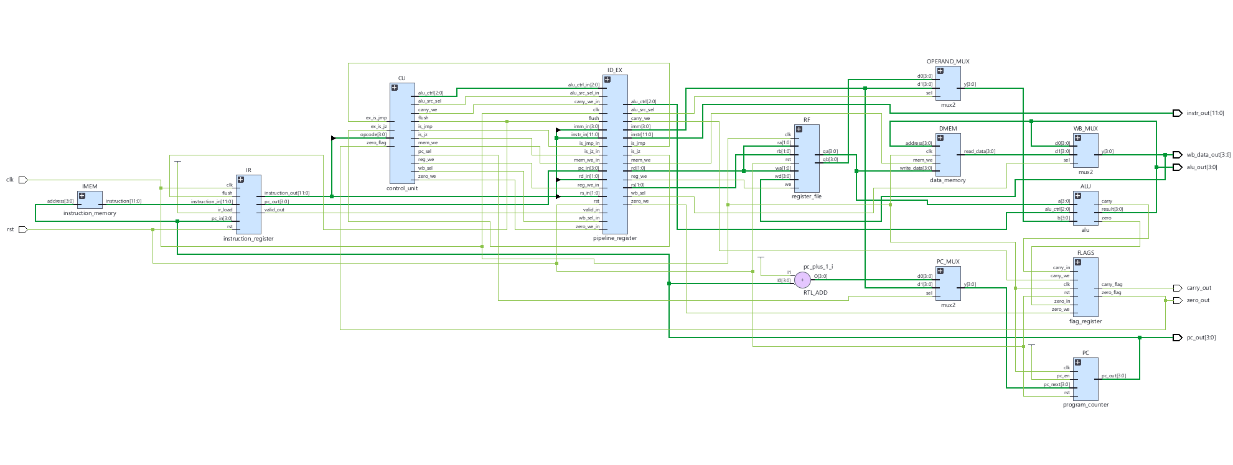
CPU SCHEMATIC: FULL DATAPATH
STAGE 1: IF
STAGE 2: ID
STAGE 3: EX / MEMORY / WB
PC
Instr.
Memory
Decoder
Register
File
Operand
MUX
ALU
IF/ID IR
Data Mem.
ID/EX Reg.
WB MUX
Instruction and control fields move through pipeline registers.
Arrows represent simplified data flow, not every wire.
SCHEMATIC
14

Slide 18
TESTBENCH: WHAT IS BEING CHECKED?
• A testbench is a separate Verilog module that drives clock/reset and checks outputs.
• tb_cpu instantiates cpu_top and observes PC, instruction, ALU result, write-back data, and flags.
• The testbench prints TIME lines to show sampled signal values.
• PASS means a check matched the expected value; FAIL means it did not.
• The current run reports 33 checks and 5 failures.
Clock (clk)
Reset (rst)
DUT: cpu_top
Assertions / checks
TESTBENCH
17

Slide 19
TESTBENCH ABBREVIATIONS AND SIGNALS
TIME
Simulation timestamp, commonly displayed in ns by the simulator.
R0–R3
Four 4-bit general-purpose registers.
PC
Program Counter: address of the instruction being fetched.
Z
Zero flag: 1 when the relevant result is zero.
INSTR
Instruction word read from instruction memory (12 bits, often shown in hex).
C
Carry flag: arithmetic carry/borrow status.
ALU
Arithmetic Logic Unit output (4-bit result).
PASS / FAIL
Comparison result from a testbench check.
WB
Write-back value selected for a destination register.
X
Unknown/uninitialized logic value in simulation.
TESTBENCH
18

Slide 20
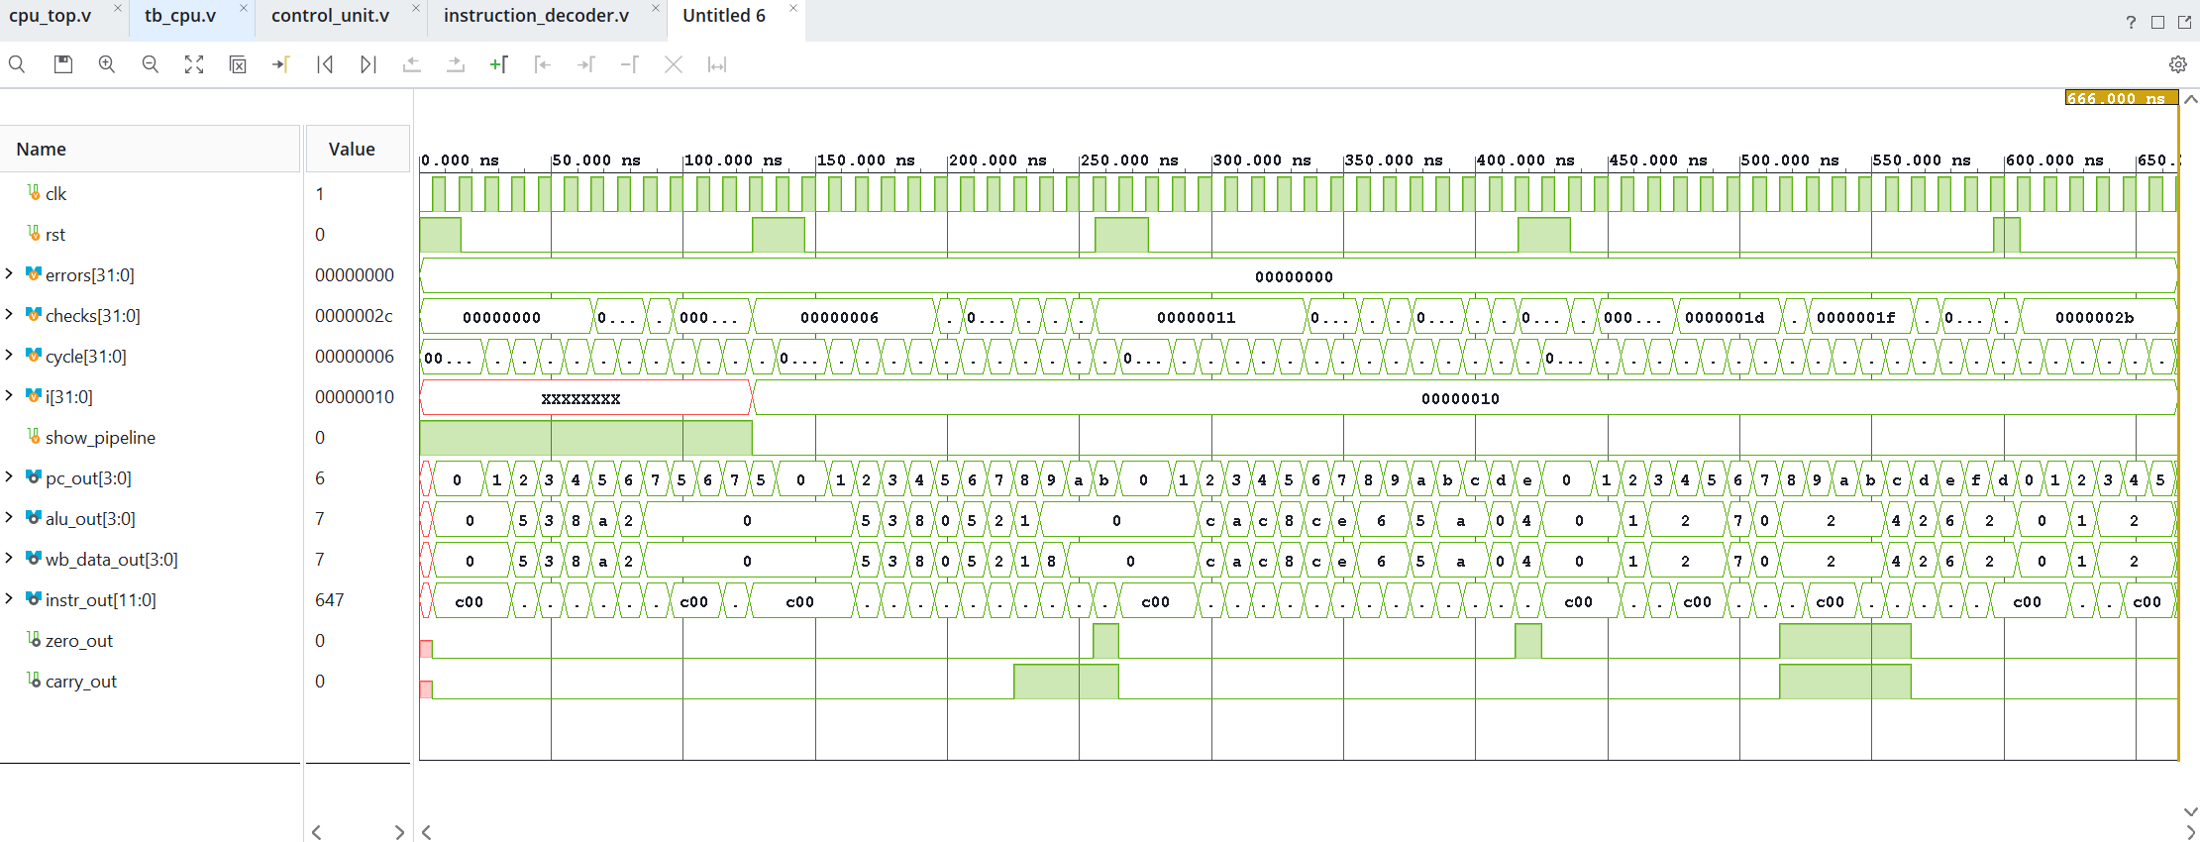
BEHAVIORAL SIMULATION WAVEFORM
Signals shown in the Vivado/XSim waveform include clk, rst, checks, errors, PC, instruction, ALU output, write-back data, and flags.
clk
rst
PC
0
1
2
3
4
5
6
7
5
INSTR
c00
c00
645
683
060
6ca
470
a05
c00
ALU
0
0
5
3
8
a
2
0
0
WB
0
0
5
3
8
a
2
0
0
Waveform helps confirm signal timing, but the testbench's expected-versus-actual checks are needed to judge correctness.
TESTBENCH
22

Slide 21
CONCLUSION
• The design combines a 4-bit datapath with a 12-bit instruction format.
• The main blocks work together through the IF, ID, and EX stages.
• The schematic explains the data path, while the testbench checks behavior over time.
• The current simulation passes many checks but still has 5 failures out of 33.
• The next step is to fix PC reset/update behavior and re-verify LDI and ADD.
Design
Simulate
Debug → Verify
Thank you — Questions?
WRAP-UP
25

