Slide 1
A Library Reckoning
cljs.math
Paula Gearon
@quoll

Slide 2
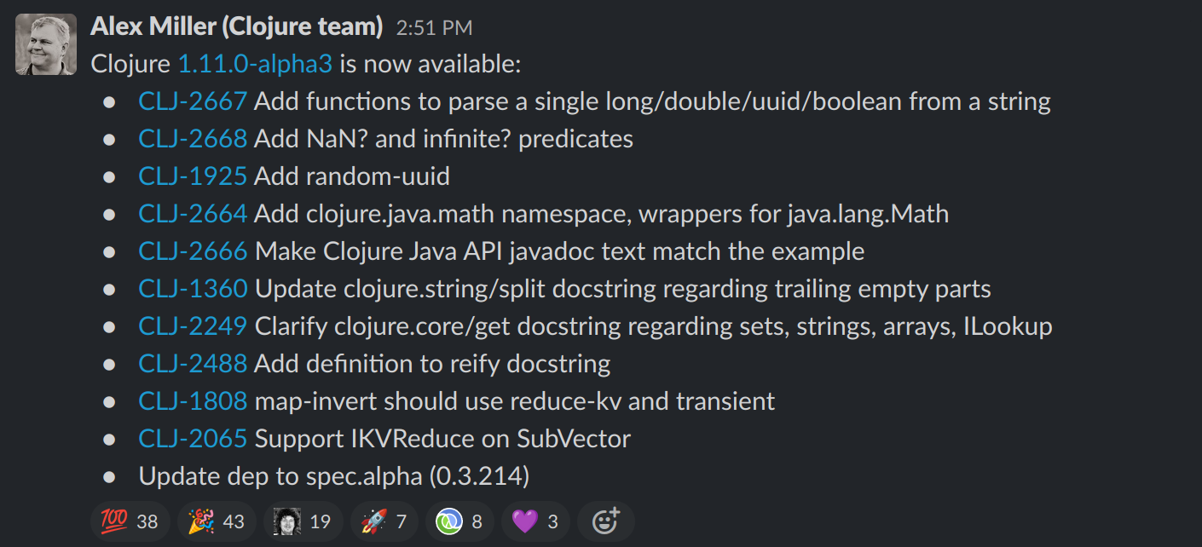
November 23, 2021

Slide 3
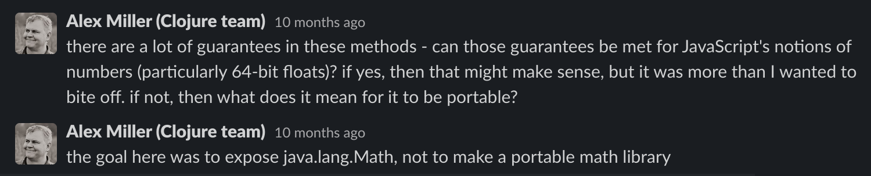
Questions in #clojure-dev

Slide 4
js/Math Constants
E
PI
LN10
LN2
LOG10E
LOG2E
SQRT1_2
SQRT2

Slide 5
js/Math Functions
abs
acos
acosh
asin
asinh
atan
atan2
atanh
cbrt
ceil
clz32
cos
cosh
exp
expm1
floor
fround
hypot
imul
log
log10
log1p
log2
max
min
pow
random
round
sign
sin
sinh
sqrt
tan
tanh
trunc

Slide 6

What About Those Guarantees?
All JavaScript numbers are floating point
  Yes: even integers
64 bit IEEE-754 Floating Point Standard
Mozilla notice
Note: Many Math functions have a precision that's implementation-dependent.
This means that different browsers can give a different result. Even the same JavaScript engine on a different OS or architecture can give different results!

Slide 7
IEEE-754 64 Bit
52 bit significand
sign bit
11 bit exponent

Slide 8
IEEE-754 64 Bit
Special Groups
Zero (±)
0
1
0
0
0
0
0
0
0
0
0
0
0
0
0
0
0
0
0
0
0
0
0
0
0
0
0
0
0
0
0
0
0
0
0
0
0
0
0
0
0
0
0
0
0
0
0
0
0
0
0
0
0
0
0
0
0
0
0
0
0
0
0
0
0
Infinity (±)
0
1
1
1
1
1
1
1
1
1
1
1
1
0
0
0
0
0
0
0
0
0
0
0
0
0
0
0
0
0
0
0
0
0
0
0
0
0
0
0
0
0
0
0
0
0
0
0
0
0
0
0
0
0
0
0
0
0
0
0
0
0
0
0
0
NaN (Quiet, Signaling)
-
1
1
1
1
1
1
1
1
1
1
1
0
1
-
-
-
-
-
-
-
-
-
-
-
-
-
-
-
-
-
-
-
-
-
-
-
-
-
-
-
-
-
-
-
-
-
-
-
-
-
-
-
-
-
-
-
-
-
-
-
-
-
-
-
-1022
non-zero
Subnormal (< 2 )
0
1
0
0
0
0
0
0
0
0
0
0
0
0
1
0
1
0
1
0
1
0
1
0
1
0
1
0
1
0
1
0
1
0
1
0
1
0
1
0
1
0
1
0
1
0
1
0
1
0
1
0
1
0
1
0
1
0
1
0
1
0
1
0
1
0
1
0
1
0
1
0
1
0
1
0
1
0
1
0
1
0
1
0
1
0
1
0
1
0
1
0
1
0
1
0
1
0
1
0
1
0
1
0
1
0
1
0
1
0
1
0
1
0
1
0
1

Slide 9
Integers
12345 => 110000001110012
1.10000001110012 x 2
13 + EXP-BIAS = 13 + 1023 = 1036 = 100000011002
13
0
1
0
0
0
0
0
0
1
1
0
0
1
0
0
0
0
0
0
1
1
1
0
0
1
52+1
53
MAX_SAFE_INTEGER = 2 -1 = 2 -1 = 9007199254740991
MIN_SAFE_INTEGER = -9007199254740991
0
1
1
0
0
0
0
1
1
0
0
1
1
1
1
1
1
1
1
1
1
1
1
1
1
1
1
1
1
1
1
1
1
1
1
1
1
1
1
1
1
1
1
1
1
1
1
1
1
1
1
1
1
1
1
1
1
1
1
1
1
1
1
1
1

Slide 10
Bit Manipulation
Little Endian
Bytes
7
6
5
4
3
2
1
0
HI DWORD
LO DWORD

Slide 11
Recasting
(let [a (js/ArrayBuffer. 8)
d (js/Float64Array. a)
i (js/Uint32Array. a)
hi (if little-endian? 1 0)
_ (aset d 0 n)
hi-dw (aget i hi)
lo-dw (aget i (- 1 hi)]
...)

Slide 12
Bit Operations
bit-and, bit-or
bit-shift-left, unsigned-bit-shift-right
Implicit conversion to signed 32-bit
=> (bit-or 1258160128 0)
1258160128
=> (bit-or 3405643776 0)
-889323520
=> (bit-or 5553127424 0)
1258160128
0x4afe0000
0xcafe0000
0x14afe0000

Slide 13
32-bit Integer Comparisons
All comparisons are signed
(defn u<
[a b]
;; compare the top nybble
(let [ab (unsigned-bit-shift-right a 28)
bb (unsigned-bit-shift-right b 28)]
(or (< ab bb) ;; if the top nybble of a is less
;; then the whole value is less
(and (== ab bb) ;; if the top nybble is equal then
;; compare the remaining bits of both
(< (bit-and a 0x0fffffff) (bit-and b 0x0fffffff))))))

Slide 14
Testing
JVM
Easy comparison to java.lang.Math
Can use generative testing
Requires stubs for js functions and symbols

Slide 15
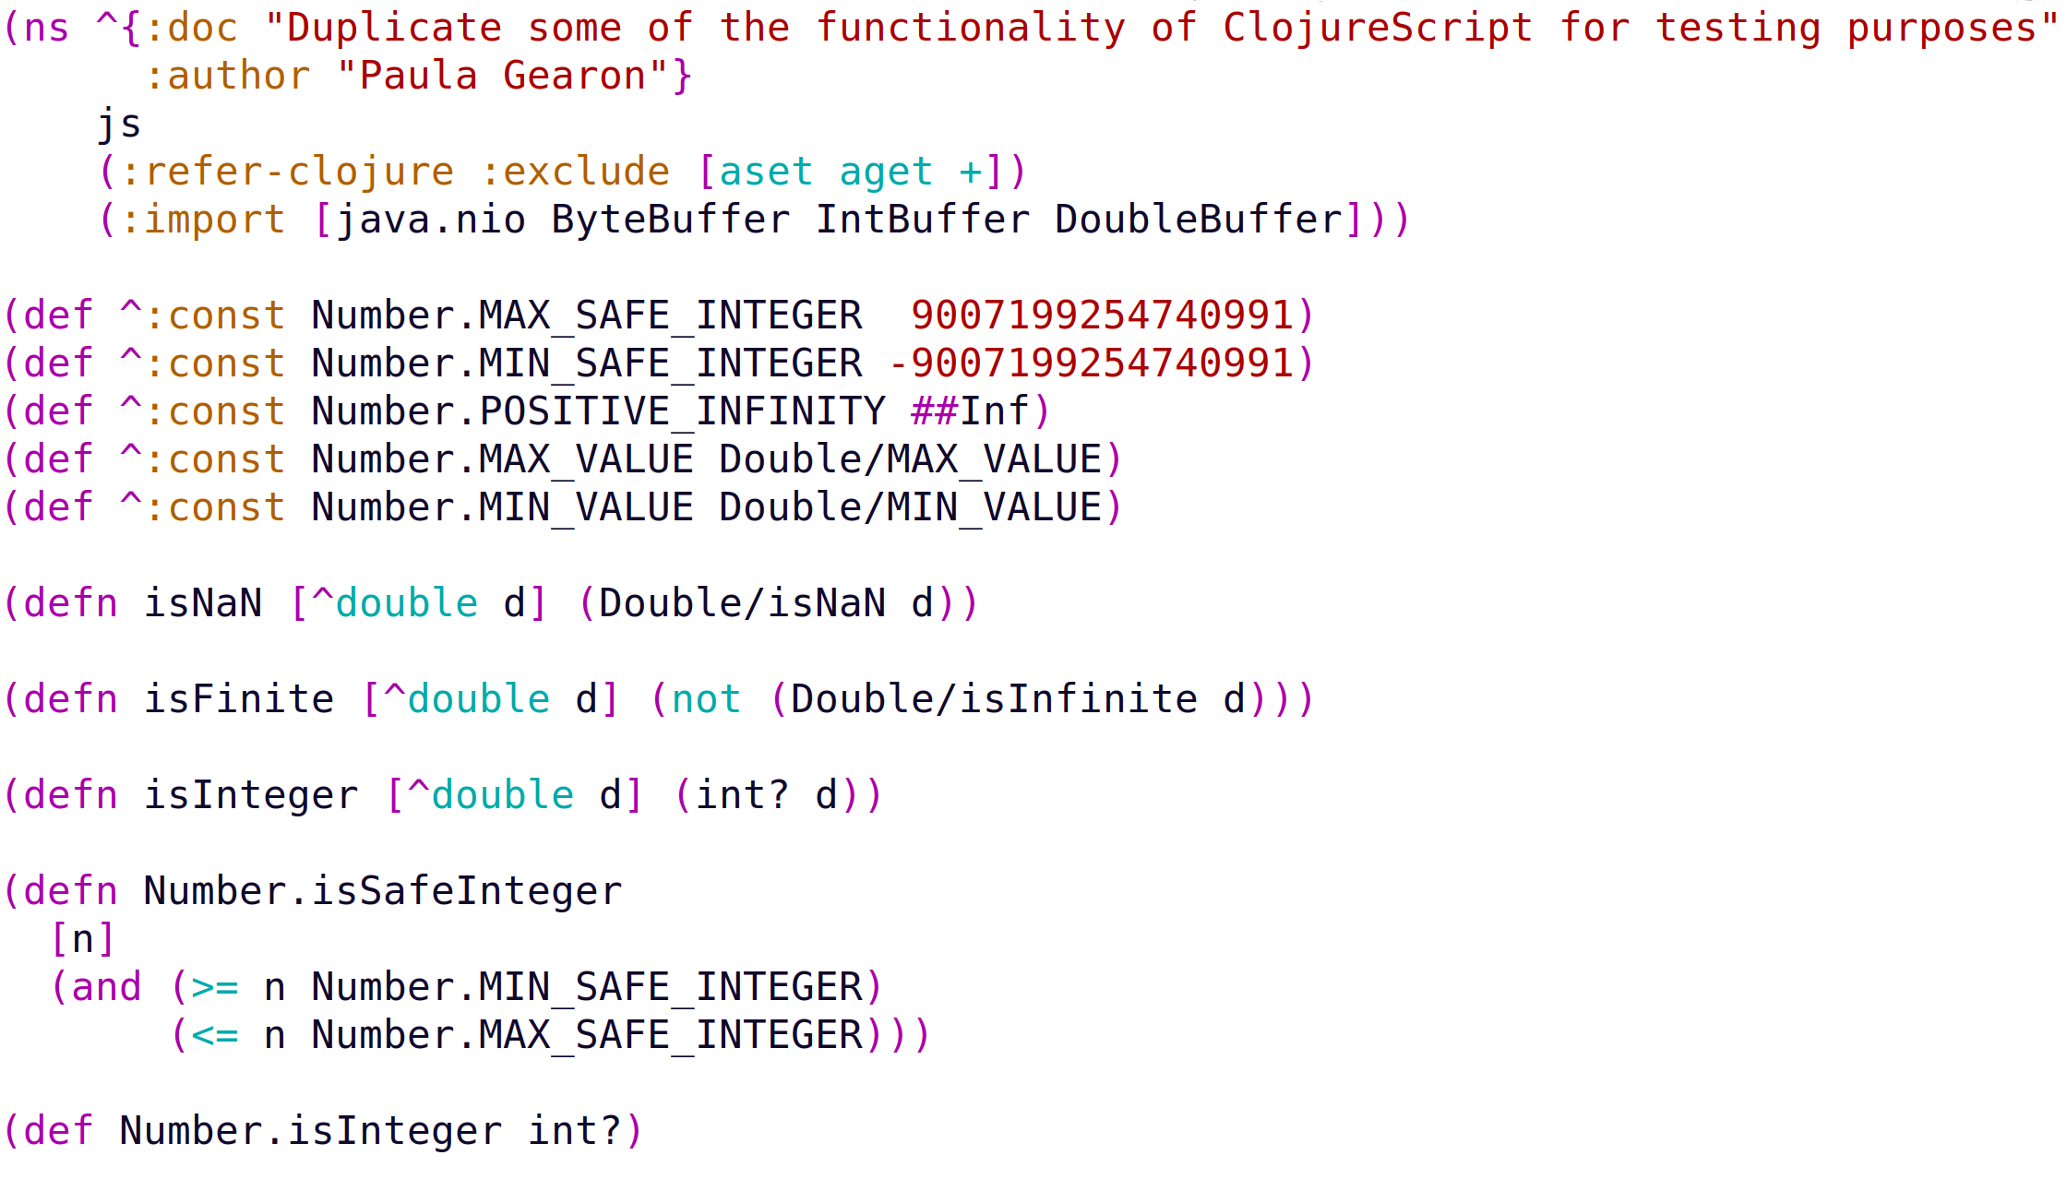
JVM Testing Stubs

Slide 16
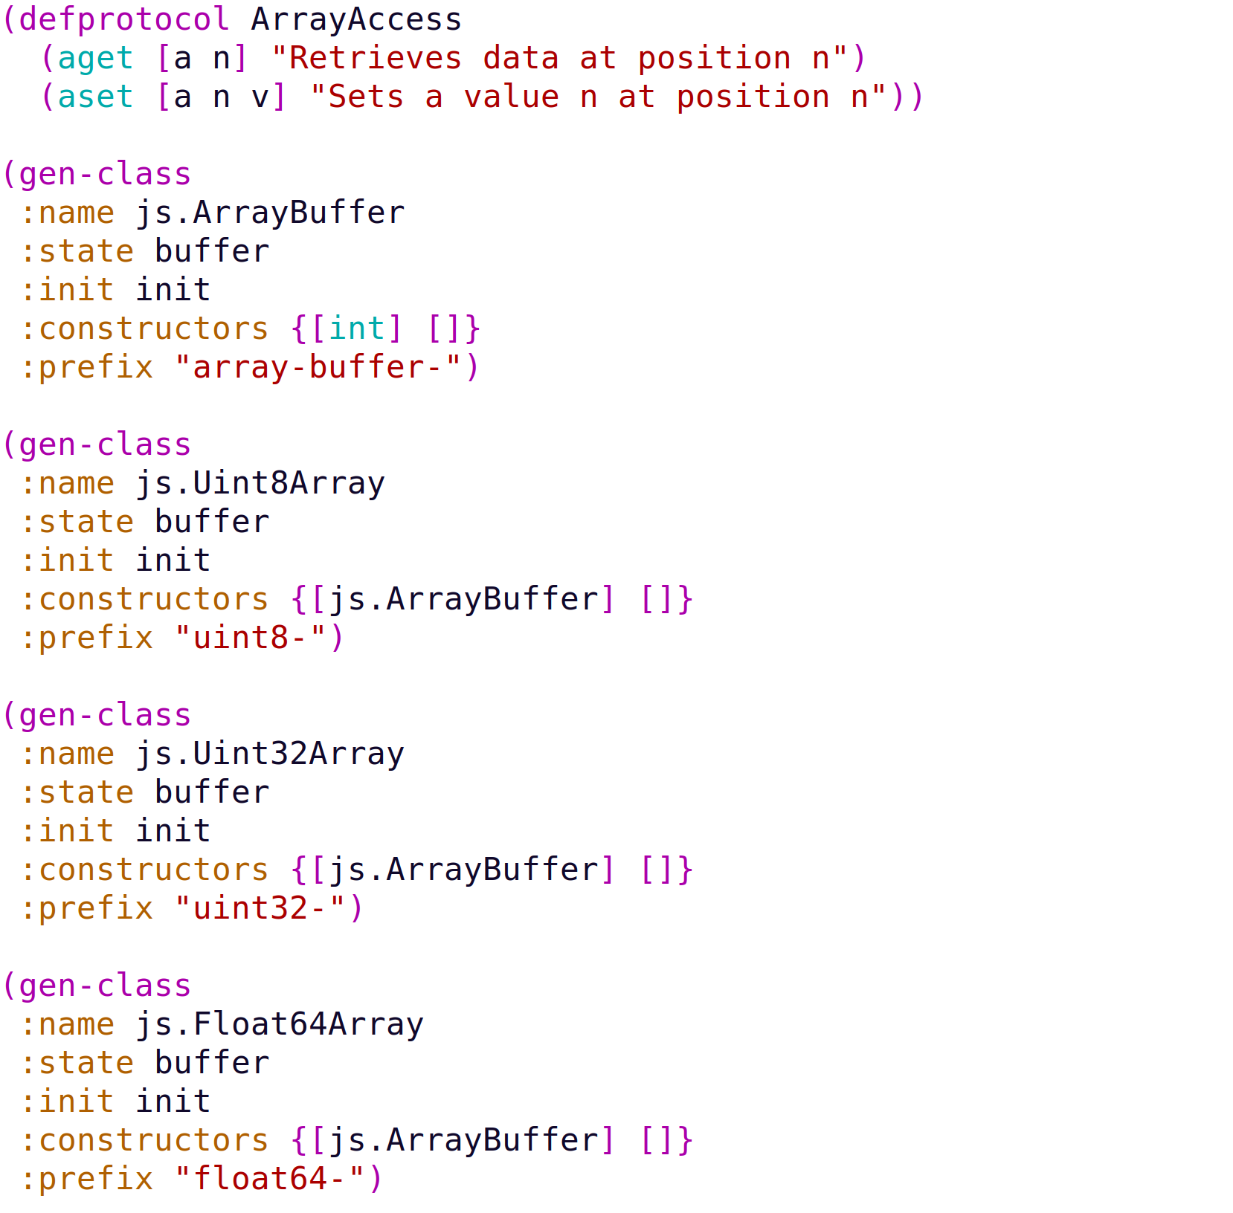
JVM Testing Stubs

Slide 17
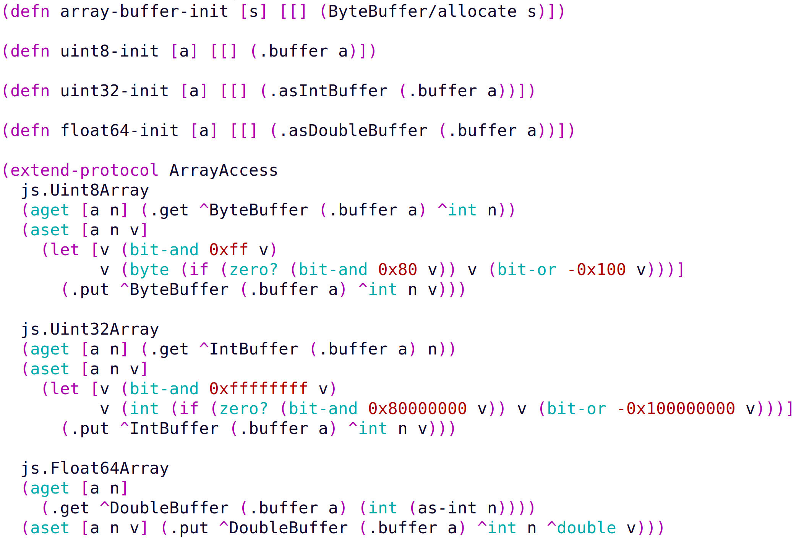
JVM Testing Stubs
Constructors
Override
clojure.core/aget
clojure.core/aset

Slide 18
Testing
Problems!
(Math/floorMod 1 -2147483691) → 1
→ -2147483690
Addressed in CLJ-2413:
Non-deterministic method selection during reflection
Work around:
(Math/floorMod 1 (long -2147483691))

Slide 19
Testing
JavaScript
Can generative testing compare JVM to JavaScript?
Create an nrepl in a JVM
Generative testing via strings

Slide 20
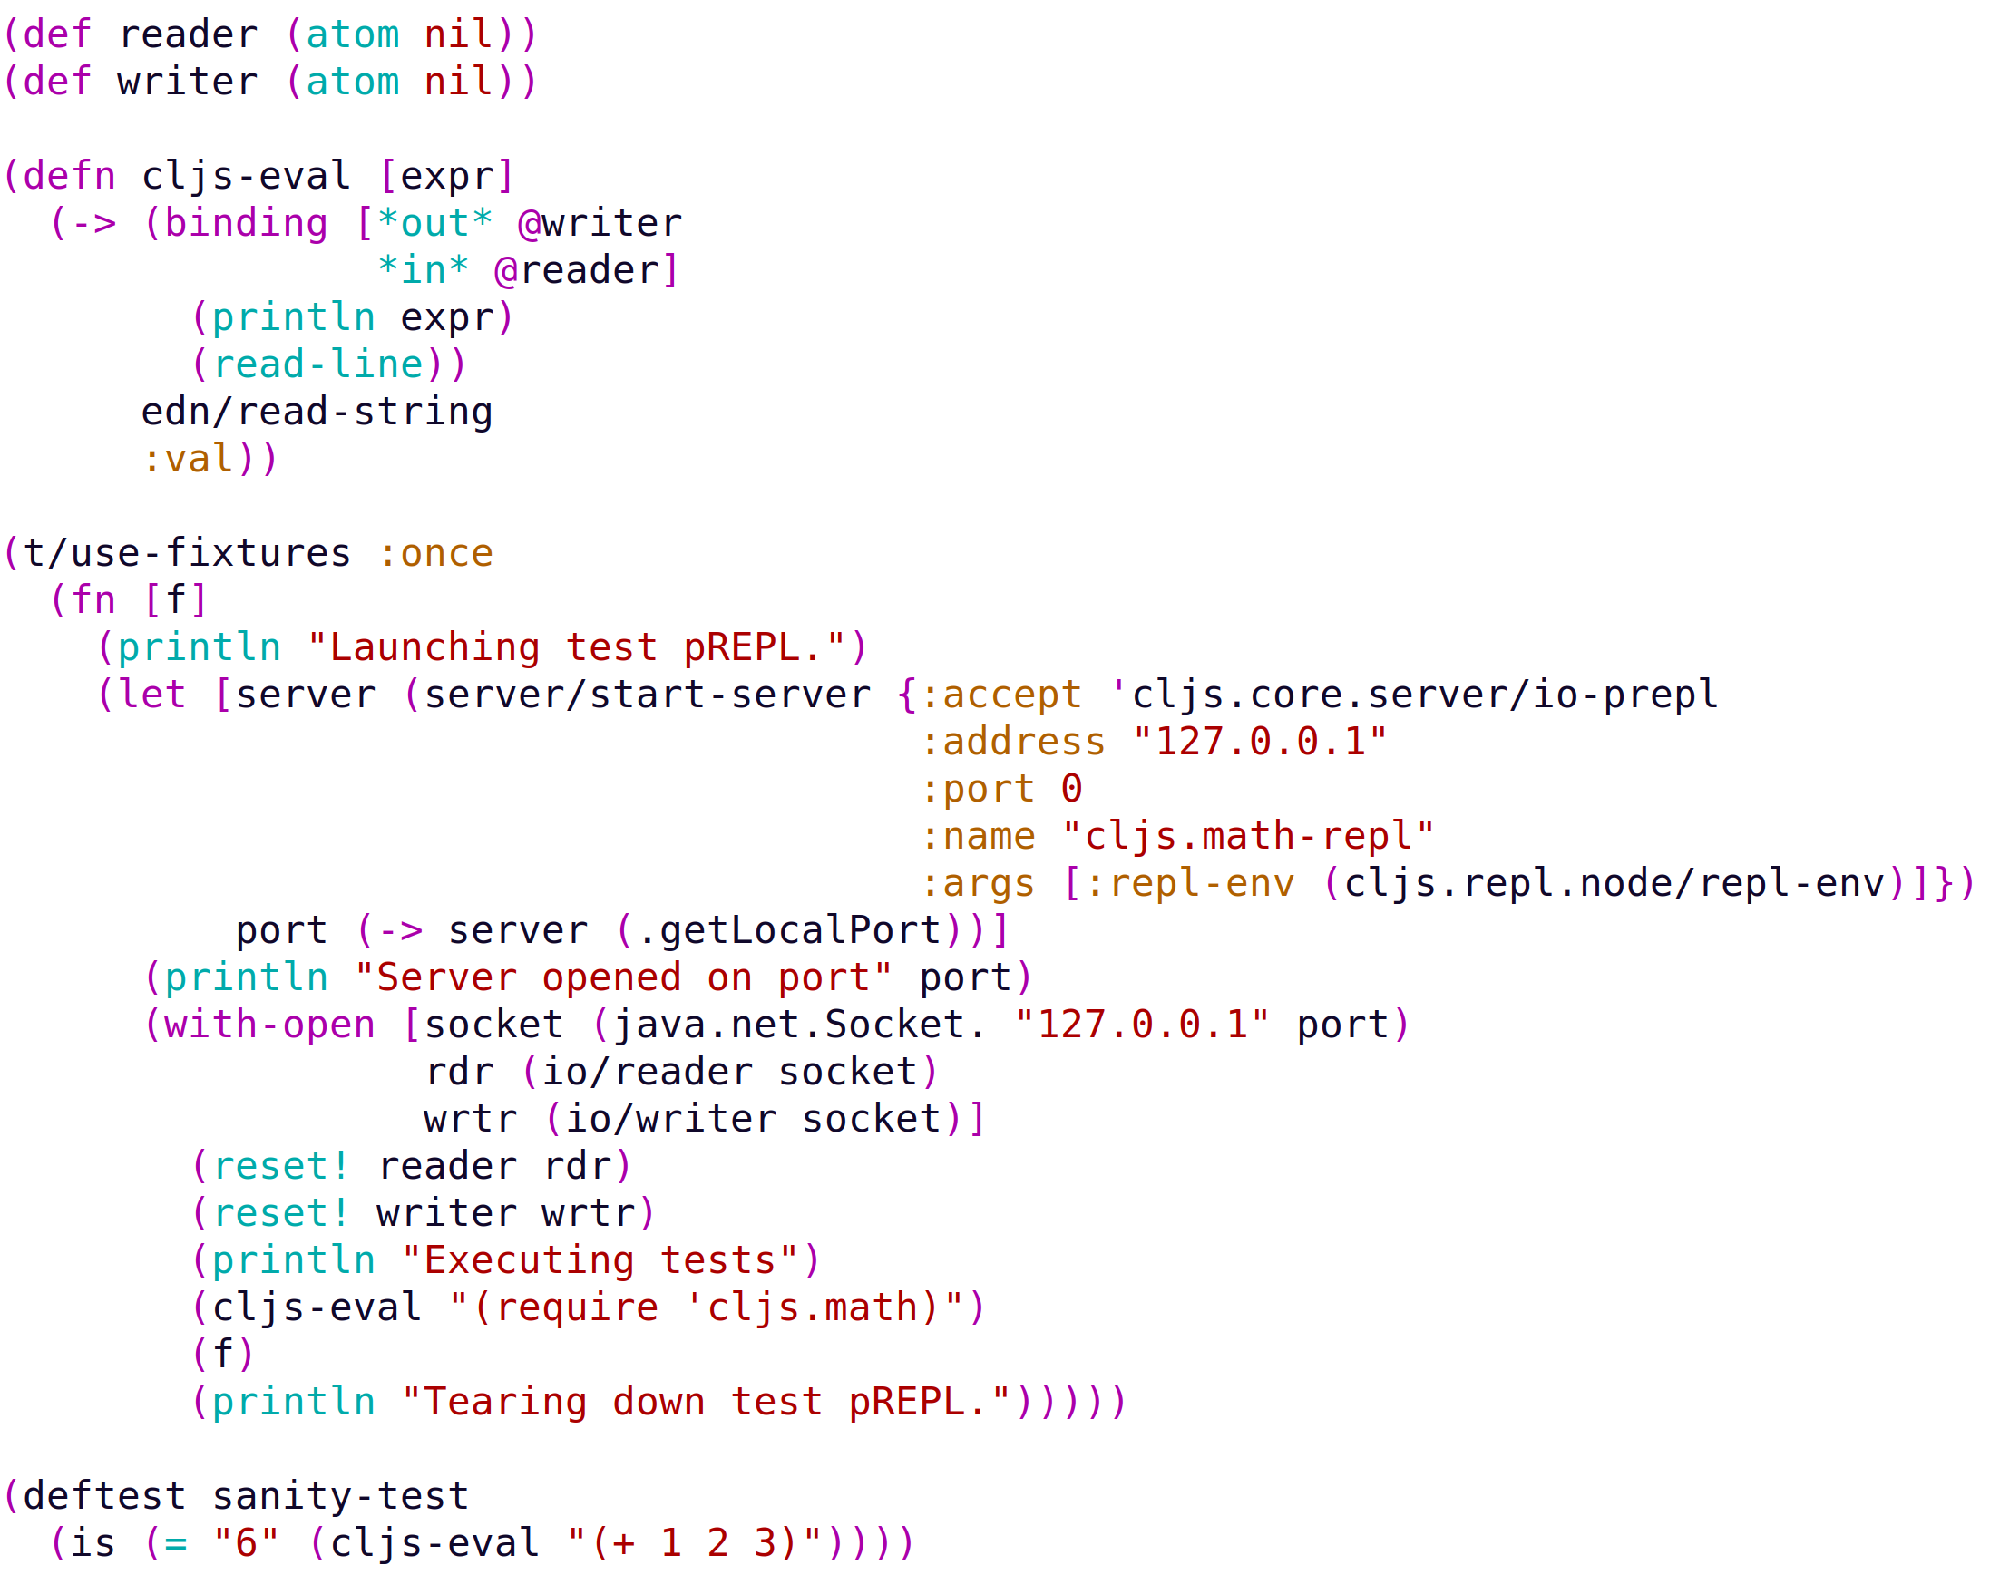
BorkDude

Slide 21
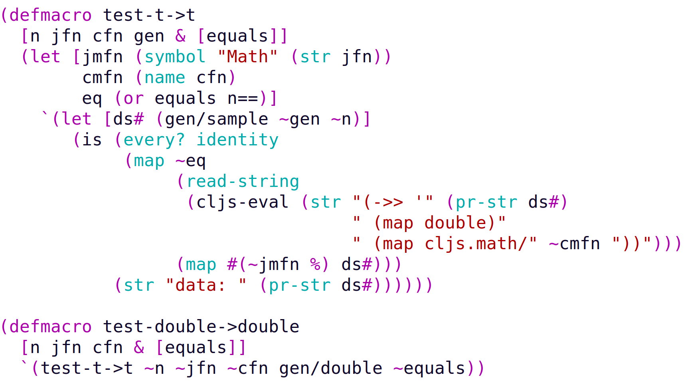
Generative Testing
generate
generate
map the fn over the doubles
compare
seq to string to doubles
map the fn from the JVM
Example

Slide 22
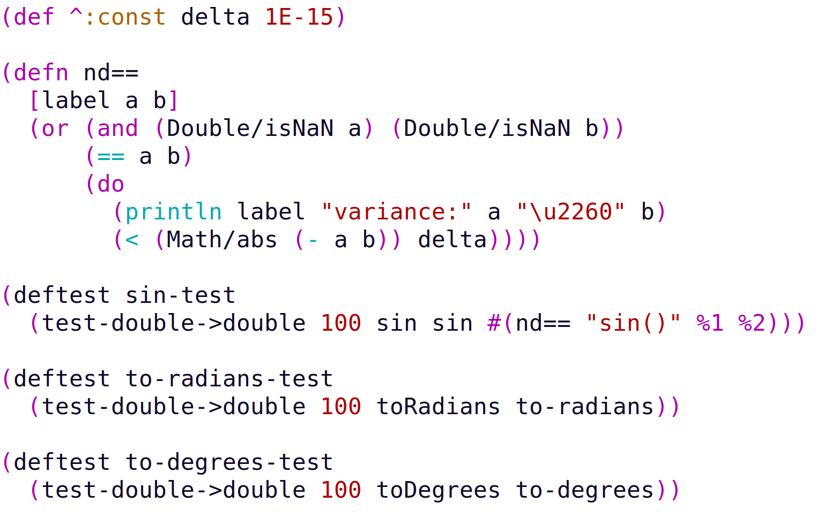
Generative Testing

Slide 23
Integration into ClojureScript
Help via Mike Fikes
Discussion with David
Eventual integration

