Slide 1
Video Classification After Data Augmentation
Comparison of Image Sharpening / Smoothing
EE476 Audio-Visual Perception Model
Term project Proposal
20160042 구인용

Slide 2
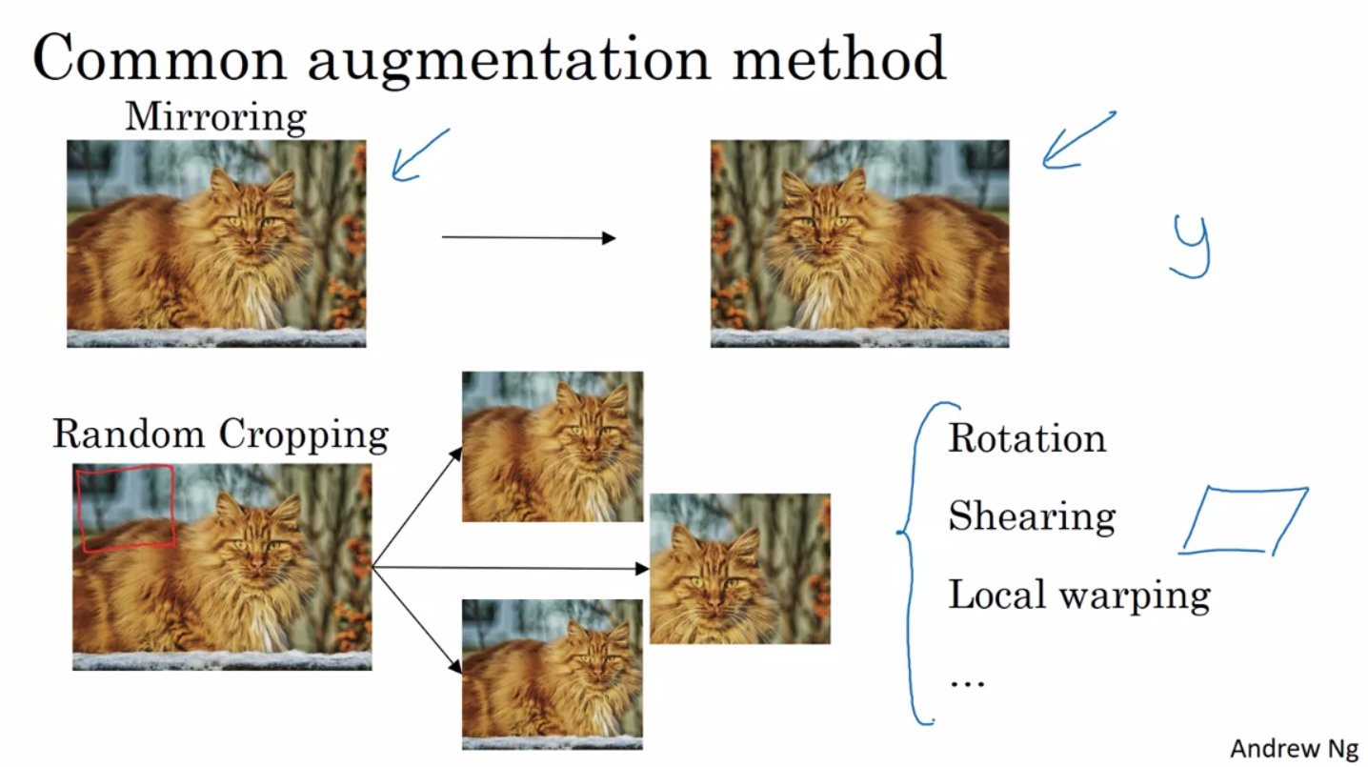
Data Augmentation
A method often used when we have insufficient number of data.
Artificially enlarge the data set by conducting simple transformation to pre-existing data without changing labels.
Common methods
Mirroring
Translation / Rotation / shearing
Random cropping / scaling
Color jittering

Slide 3
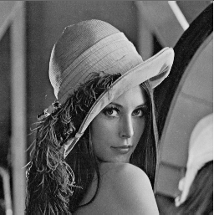
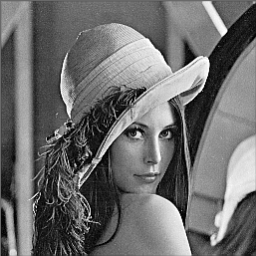
My Idea
EE474 Introduction to Multimedia
Learned various image processing methods
“What if I use image sharpening as augmentation method?”
Original LENA image
Sharpened LENA image

Slide 4

Image Sharpening
-1 | -1 | -1
-1 | 8 | -1
-1 | -1 | -1
Sharpening Filter Kernel
Original LENA Image
Edge Detection Result

Slide 5
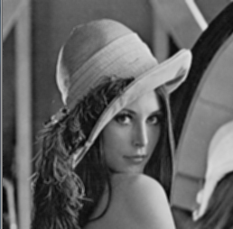
Image Smoothing
1/9 | 1/9 | 1/9
1/9 | 1/9 | 1/9
1/9 | 1/9 | 1/9
Smoothing Filter Kernel
Original LENA Image
Smoothen LENA Image

Slide 6
Data augmentation using Sharpening/Smoothing
48
96
Original Video
Sharpened Video
Smoothen Video

Slide 7
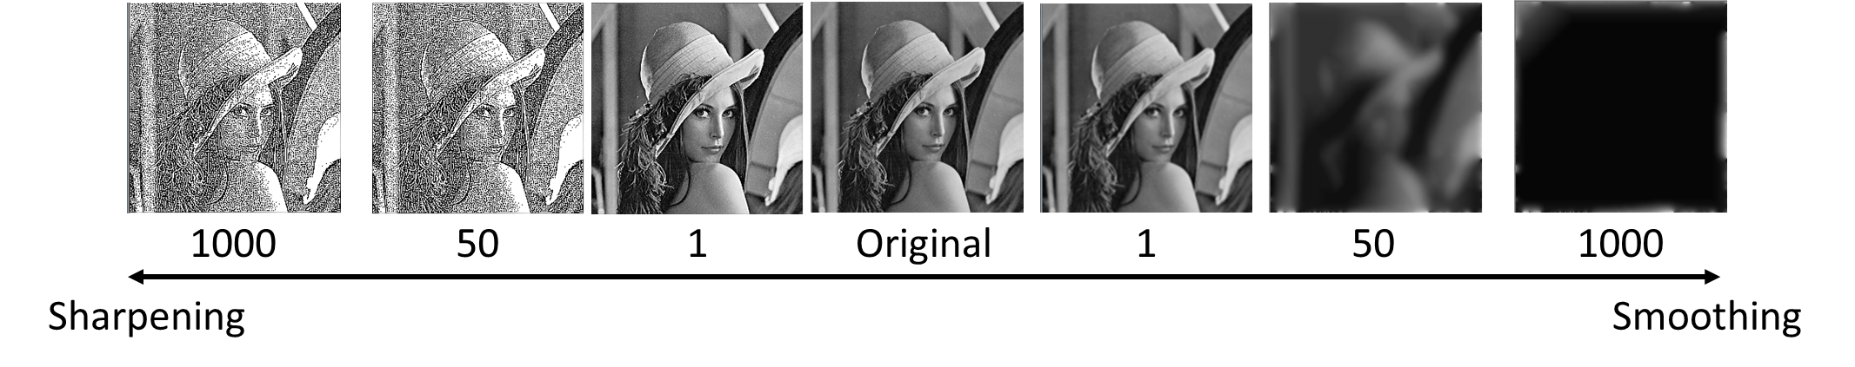
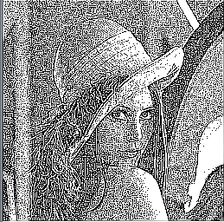


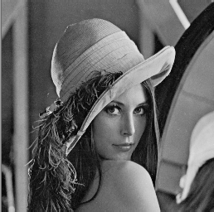


Expected Result
Classification Accuracy: (Sharpening) > (Smoothing) > (Original)
1000
50
1
Original
1
50
1000
Sharpening
Smoothing

Slide 8
Project Schedule
6/8 Project proposal presentation
6/9 – 6/15 FINAL EXAM
6/16 MATLAB coding for image sharpening / smoothing process
6/17 Conduct learning on augmented data set
6/18 Write project report

Slide 9
References
[1] Lecture by Andrew ng, https://www.coursera.org/learn/convolutional-neural-networks/lecture/AYzbX/data-augmentation
[2] Hall, Mark, et al. "The WEKA data mining software: an update." ACM SIGKDD explorations newsletter 11.1 (2009): 10-18.
[3] Luke Taylor, Geoff Nitschke “Improving Deep Learning using Generic Data Augmentation”
[4] https://en.wikipedia.org/wiki/Digital_image_processing
[5] https://en.wikipedia.org/wiki/Edge_detection

