Slide 1


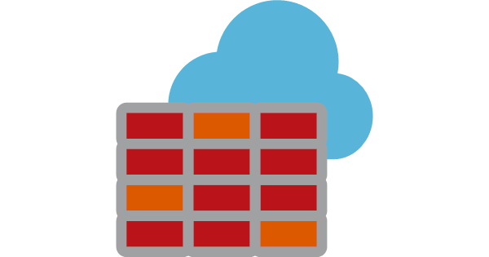











Global Microsoft Backbone
AVD Client to AVD URLs (Link)
Hostpool to AVD URLs (Link)
Internet
Host pool
Subnet 01
192.168.1.0/24
Internet
Reverse Connect
Apps
10.1.0.0/16
Connection
192.168.2.7/8/9/10
Hostpool
Gateway
Broker
Diagnostics
On-premises
Express Route
Initial Feed Discovery (global)
192.168.2.6
ExpressRoute Gateway
Workspace
Private DNS Zones
privatelink-global.wvd.microsoft.com
client, rdweb, www -> 192.168.2.6
privatelink.wvd.microsoft.com
rdweb -> 192.168.2.4, rdbroker -> 192.168.2.7, rddiagnostic -> 192.168.2.8, rdgateway -> 192.168.2.9
Subnet 03
ER Gateway
Subnet 02
192.168.2.0/24
Feed Download (feed)
192.168.2.4
Web
Azure Virtual Desktop
Virtual Network (192.168.0.0/16)

Slide 2
Global Microsoft Backbone
AVD Client to AVD URLs (Link)
Hostpool to AVD URLs (Link)
Internet
Host pool
Subnet 01
192.168.1.0/24
Internet
Reverse Connect
Private
Over Internet only for Initial Feed Discovery
Connection
192.168.2.7/8/9/10
Hostpool
Gateway
Broker
Diagnostics
Express Route Private connections for Broker Gateway and Session Host
ExpressRoute Gateway
Feed Download (feed)
192.168.2.4
Workspace
Web
Subnet 03
ER Gateway
Subnet 02
192.168.2.0/24
Azure Virtual Desktop
Virtual Network (192.168.0.0/16)
Private DNS Zones
privatelink.wvd.microsoft.com
rdweb -> 192.168.2.4, rdbroker -> 192.168.2.7, rddiagnostic -> 192.168.2.8, rdgateway -> 192.168.2.9
Public
*wvd.microsoft.com
client, rdweb, www -> Public ( Global – Initial Feed Discovery)

Slide 3
Global Microsoft Backbone
AVD Client to AVD URLs (Link)
Hostpool to AVD URLs (Link)
Internet
Host pool
Subnet 01
192.168.1.0/24
Internet
Reverse Connect
Private
Over Internet only for Initial Feed Discovery & Feed Download
Connection
192.168.2.7/8/9/10
Hostpool
Gateway
Broker
Diagnostics
Express Route Private connections for Broker Gateway and Session Host
ExpressRoute Gateway
No Private Endpoint
Workspace
Web
Subnet 03
ER Gateway
Subnet 02
192.168.2.0/24
Azure Virtual Desktop
Virtual Network (192.168.0.0/16)
Private DNS Zones
privatelink.wvd.microsoft.com
rdweb -> 192.168.2.4, rdbroker -> 192.168.2.7, rddiagnostic -> 192.168.2.8, rdgateway -> 192.168.2.9
Public
*wvd.microsoft.com
client, rdweb, www -> Public ( Global – Initial Feed Discovery and Feed)

