Slide 1
APPENDIX
AIVC GeneLink — Technical Appendix
Architecture Depth · Validation Evidence · QurieSeq Phase 1 · Roadmap + Budget · Strategic Horizon
Quriegen · May 2026

Slide 2
SECTION A
Architecture Depth
How the model works · what's frozen, what trains, what generalizes
Slides A1 – A5

Slide 3
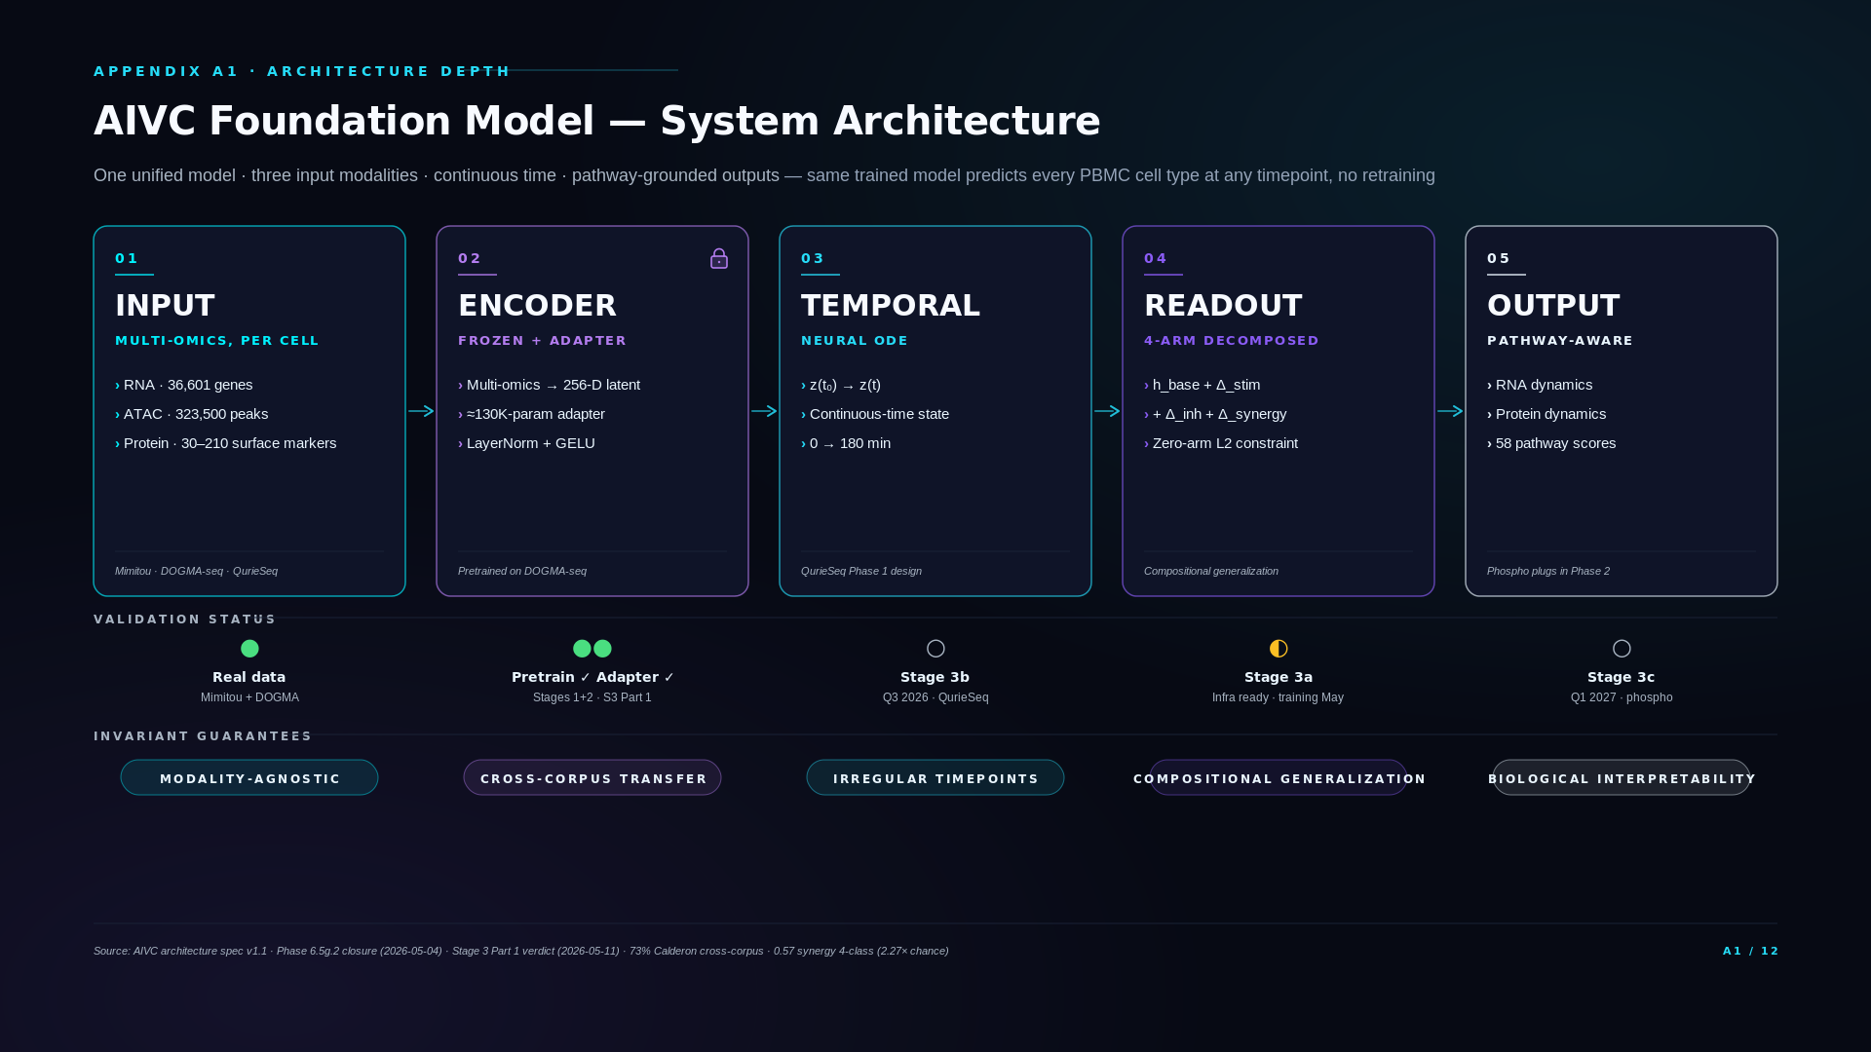

Slide 4
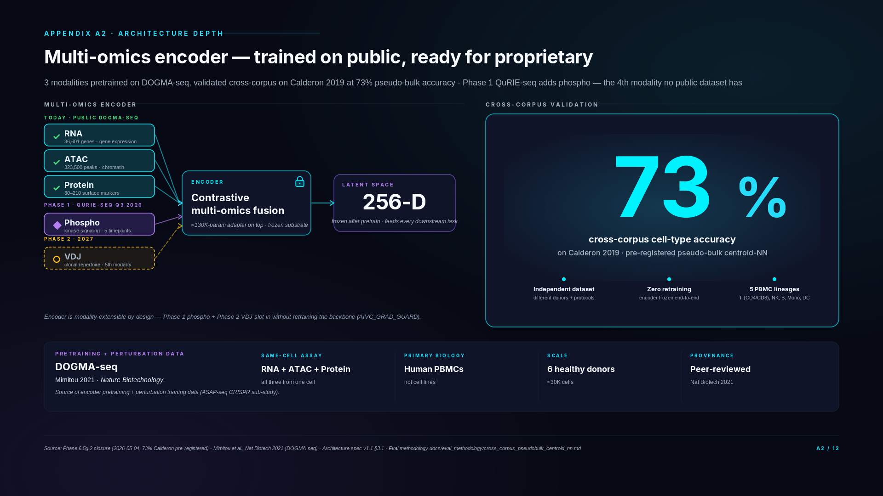
Notes:
If asked: "Why DOGMA-seq specifically?"
DOGMA-seq is the first published protocol that measures RNA, chromatin accessibility, and surface protein from the same single cell. Mimitou published it in 2021 in Nature Biotechnology. We chose it as our pretraining substrate because it's the only public dataset combining these three modalities in primary human PBMCs at scale. It's also the source of our perturbation training data (ASAP-seq CRISPR sub-study from the same lab) — meaning the encoder and the perturbation adapter both come from a coherent technical and biological context.
If asked: "How does it perform per cell type?"
Overall 73% across the major PBMC lineages. T cells, NK, monocytes, and DCs are all in the 70-85% range. B cells underperform at 18% — but our analysis (Stage 3 Part 1 Report 5) shows this is a cross-corpus stimulation-protocol artifact, not an encoder defect. Encoder silhouette score on Calderon B cells is 0.354, higher than CD4 T cells at 0.129, which proves the encoder is finding the B cells correctly in latent space. The misclassifications go to DC and NK — i.e., the model respects lineage hierarchy. We diagnosed this transparently and the architecture doesn't depend on closing the gap before QurieSeq Phase 1 lands.
If asked: "Why aren't phospho and VDJ in the validation?"
Phospho doesn't exist in public PBMC data — it's QurieSeq's proprietary modality, our moat. VDJ is being deferred to QurieSeq Phase 2 per Thiago's wet-lab plan. The encoder architecture is modality-extensible by design — Phase 1 phospho and Phase 2 VDJ slot in without retraining the base encoder.
If asked: "Why pseudo-bulk centroid-NN?"
Pseudo-bulk centroid-NN is a published cross-corpus methodology that controls for technical batch effects between studies — exactly the right test for whether the encoder learned biology vs. dataset artifacts. We pre-registered it before running the eval to avoid post-hoc cherry-picking. The methodology doc is in our repo (docs/eval_methodology/cross_corpus_pseudobulk_centroid_nn.md).
If asked: "Phospho is in Phase 1? I thought it was Phase 2."
Phospho is integral to the QuRIE-seq assay — every QuRIE-seq run generates phospho data alongside RNA and protein. The earlier framing of "phospho deferred to Phase 2" was specifically about public training data — no public dataset has phospho on PBMCs, so we deferred phospho coverage in our public-data layer strategy. But the QuRIE-seq Phase 1 wet-lab generation in Q3 2026 measures phospho directly. So phospho first becomes available to us in Phase 1, not Phase 2.
If asked: "How does the encoder generalize to phospho if it was only trained on RNA + ATAC + Protein?"
The encoder's architecture supports modality extension by design — adding a modality means adding an input head, not retraining from scratch. During Phase 1 integration (Q4 2026), the phospho input head is fit while the RNA/ATAC/Protein representation backbone stays frozen (AIVC_GRAD_GUARD enforced). This is the same adapter-strategy pattern that the Stage 3 Part 1 verdict approved. The 73% cross-corpus result establishes that the backbone representations transfer across datasets; phospho integration tests whether they accommodate a new modality of biological information.
If asked: "What's pseudo-bulk centroid-NN?"
Cross-corpus validation method. Pseudo-bulk: aggregate single cells by cell-type label within each dataset to produce one centroid vector per cell type. Centroid-NN: for each held-out test centroid (from Calderon), find the nearest centroid in the training pool (from DOGMA). Accuracy = fraction where the nearest neighbor is the same cell type. 73% on PBMC major lineages (B / T / NK / monocyte / DC) is strong cross-corpus generalization — random would be 20% for 5 classes.
If asked: "What's AIVC_GRAD_GUARD?"
An environment-variable-controlled gradient-blocking mechanism in our training code. When AIVC_GRAD_GUARD=1, the encoder's pretrained weights are frozen during downstream training — adapter and readout heads update, encoder doesn't. This enforces the adapter strategy mechanically rather than relying on training-script discipline. The flag is set in all production training runs after Stage 3 Part 1's ADAPTER_RECOMMENDED verdict.

Slide 5
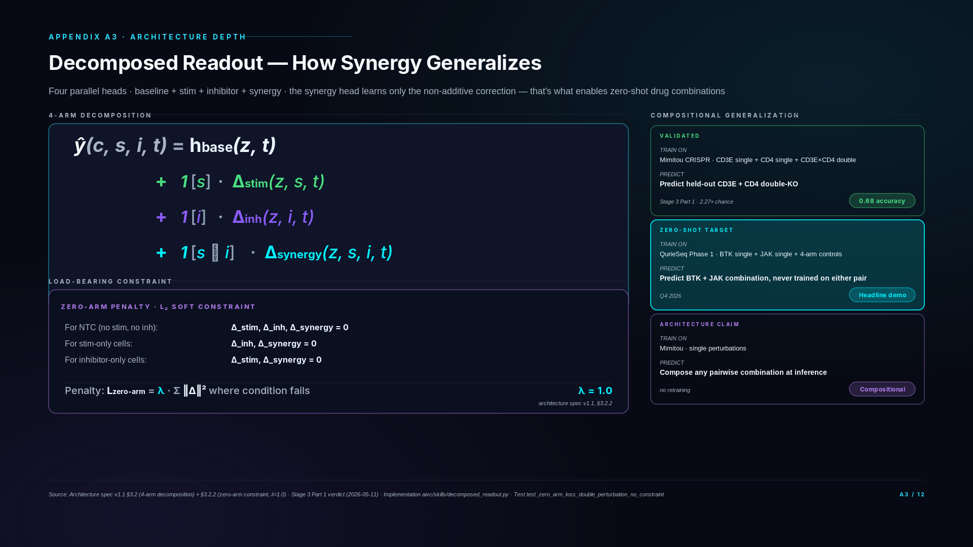
Notes:
If asked: "Why not just train a single conditional head?"
Mathematically you could — a single head conditioned on (cell, stim, inh) can fit any training data. But at inference, it has no inductive bias for unseen combinations. The architecture would memorize the training combinations rather than learn the additive structure of combinatorial biology. Our decomposition forces the model to learn the non-additive part separately, which is precisely what zero-shot synergy prediction requires.
If asked: "How do you know the zero-arm constraint isn't too strict?"
Two safety nets. First, the constraint is a soft penalty (L2 with λ=1.0), not a hard projection — the model has some slack if biological signal demands it. Second, we have a documented downgrade path: if Stage 3a training shows the constraint is too rigid, we drop λ to 0.3 or 0.5 and rerun. This decision is pre-registered in the architecture spec (§7, risk #3).
If asked: "What if the synergy head learns the trivial 'mean of singles' solution?"
That's the failure mode we explicitly test for. If Stage 3a zero-shot synergy accuracy comes in near 0.55 (matching the null baseline h_base + Δ_stim + Δ_inh with Δ_synergy=0), it means the synergy head collapsed to triviality. The pre-registered remediation: increase λ_zero or move to a hard projection constraint. Banked in docs/specs/stage3_part2_architecture_proposal_2026_05_06.md §7.
If asked: "Has this architecture been published before?"
The decomposition is inspired by causal inference (potential outcomes framework: Y(0), Y(1), Y(1,1) interactions) applied to deep learning readout heads. The specific 4-arm + zero-arm constraint formulation is our architectural choice for perturbation biology — it's documented in our spec and validated on Mimitou CRISPR data with 0.68 accuracy on held-out double-KO cells.

Slide 6
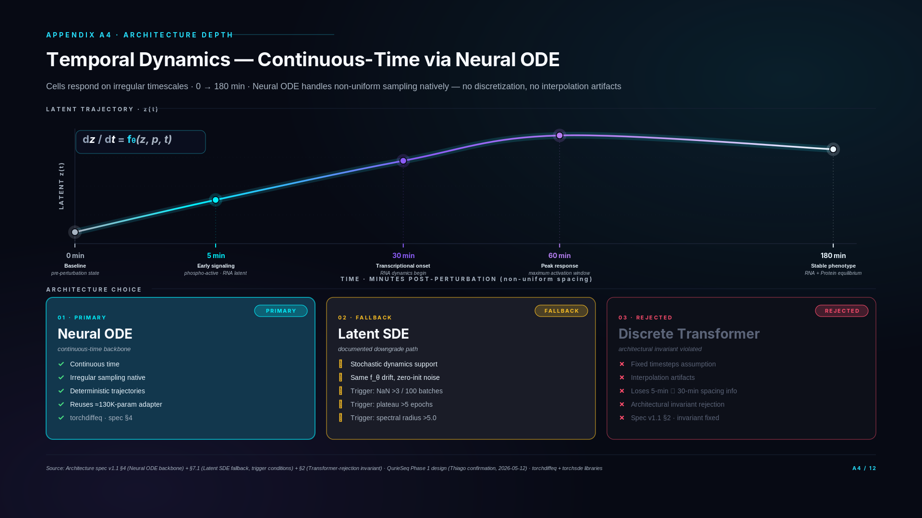
Notes:
If asked: "Why not RNN or Transformer for time?"
Transformers and RNNs are discrete — they assume fixed timesteps. If we sampled at 0 and 5 minutes, then a Transformer effectively concatenates the two as adjacent tokens. That loses the information that 5 minutes is fast relative to the next gap (5→30 = 25 min) and very fast relative to 60→180 (120 min). Neural ODE represents the actual continuous trajectory, so non-uniform spacing is handled by integration, not by architectural workarounds.
If asked: "Why is 5 minutes interesting if RNA changes slowly?"
Five minutes is where early signaling lives — phosphorylation cascades, second messengers, kinase activation. The phospho readouts from QurieSeq Phase 2 will populate that window with real biology. Even before phospho lands, the 5-minute sample gives the encoder a "what's already perturbed" reference point that's distinguishable from the 0-minute baseline.
If asked: "What if Neural ODE training diverges?"
We have a documented fallback to latent SDE — same f_θ drift function reused, zero-initialized diffusion term, switching procedure pre-registered in the architecture spec. Trigger conditions include NaN loss frequency, validation plateau, and Jacobian spectral analysis. We don't need to discover that ODE failed mid-Stage-3b and panic — the fallback is planned and authorized.
If asked: "Have you trained a Neural ODE on real biological data yet?"
Not yet — Stage 3a (current work) is the adapter on Mimitou single-endpoint CRISPR data. Neural ODE comes online in Stage 3b (Q3 2026) when QurieSeq Phase 1 time-course data lands. Until then, we're planning in-silico temporal sanity checks using synthetic dynamics to confirm ODE convergence and trajectory recovery before real data arrives. This de-risks the July go-live.
If asked: "How does perturbation enter the ODE?"
The drift function f_θ(z, p, t) takes the perturbation embedding p (stimulus and/or inhibitor) as input. Different perturbations produce different trajectory curvatures in latent space. The decomposed readout (slide A3) handles how perturbation effects compose; the Neural ODE handles how they evolve over time.

Slide 7
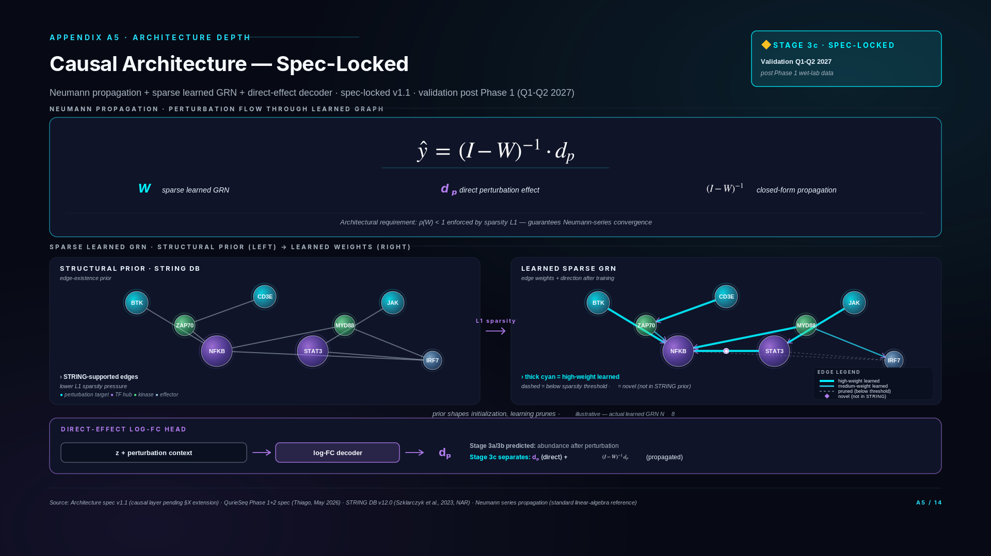
Notes:
If asked: "What does 'Stage 3c spec-locked' actually mean? Is this real or aspirational?"
Spec-locked means the architectural commitment is written down in spec v1.1 (with v1.2 causal-layer extension pending) and the components have concrete mathematical definitions — Neumann propagation as (I − W)⁻¹ dₚ, sparse GRN with L1 regularization on edges absent from STRING, log-FC head for direct-effect decoding. What's not yet done is implementation and validation. Validation requires perturbation-aware multi-omics data with sufficient signal for GRN edge inference — Phase 1 wet-lab generation (Q3 2026) provides this with 4 modalities including phospho. Stage 3c implementation begins post-Phase-1, validation Q1-Q2 2027. The slide's status pill is honest about this status.
If asked: "Why Neumann propagation specifically? Why not GNNs or transformers for the propagation step?"
Neumann propagation gives closed-form causal-effect estimation when the graph is fixed and the spectral radius is bounded. It's interpretable — every edge in W is a learnable causal weight; every coefficient in (I − W)⁻¹ is a propagation pathway. GNNs and transformers can learn similar functions but lose the closed-form causal-effect interpretation. For a causal inference architecture where each component must be explainable for diligence and eventually regulatory review, Neumann's linearity is a feature, not a limitation. The trade-off is expressiveness — Neumann assumes linear propagation. For Stage 3c that's the right starting point; Stage 5 may extend to nonlinear propagation if validation reveals the linear assumption is limiting.
If asked: "STRING database — isn't it noisy? How do you handle confidence scores?"
STRING provides edge confidence scores from 0 to 1000 reflecting evidence type (experimental, database, co-expression, etc.). We use the high-confidence threshold (≥700) as the structural prior — only edges above this threshold get lower L1 pressure. The learning objective can still discover novel edges (lower-confidence STRING edges or genuinely novel edges from our perturbation data) but they must clear higher evidence thresholds in the regularization. The prior shapes initialization without constraining final structure. This is the standard pattern for biologically-informed graph learning.
If asked: "How does Stage 3c relate to A3's decomposed readout?"
A3's decomposed readout is the architectural foundation Stage 3c builds on. The 4-arm decomposition (h_base + Δ_stim + Δ_inh + Δ_synergy) gives us perturbation-conditioned predictions. Stage 3c takes the Δ outputs and treats them as the dₚ direct-effect vector entering Neumann propagation. So A3's compositional generalization gives us correct perturbation-response prediction; A5's causal architecture gives us perturbation-mechanism decomposition. Sequentially: predict response (A3) → decompose into direct + propagated effects (A5). They compose; they don't compete.
If asked: "What happens if Neumann propagation doesn't work as expected after validation?"
Three fallback paths in spec. First, spectral-radius violation (ρ(W) ≥ 1) — increase L1 sparsity weight or add explicit eigenvalue regularization. Second, linear-assumption failure (validation shows GRN propagation is nonlinear in the data regime) — extend to graph neural network layers replacing the matrix inverse, preserving causal-effect interpretation through architectural masking. Third, identifiability failure (W not uniquely recoverable from observational + perturbation data) — fall back to perturbation-targeted causal inference using only directly-perturbed nodes (still useful, less expressive than full GRN). All three fallbacks preserve the causal-architecture intent; only the propagation mechanism changes.
If asked: "How does Stage 3c connect to the BTK+JAK demo (Stage 3b)?"
Stage 3b (Q4 2026) is the predictive milestone — zero-shot prediction of BTK+JAK combination response from singles. Stage 3c is the explanatory milestone — given a prediction, decompose it into direct BTK effect + direct JAK effect + propagated combination effect through the GRN. Stage 3b validates the platform predicts correctly; Stage 3c validates the platform explains why. Investors typically care about both: prediction accuracy demonstrates technical capability, explanation depth demonstrates regulatory and clinical readiness.
If asked: "When does this become operational? When can we point to Stage 3c validation results?"
Implementation Stage 3c starts Q4 2026 after Phase 1 wet-lab data lands in Q3 2026. Phospho is available in Phase 1 (integral to QuRIE-seq), so causal architecture validation has perturbation-aware phospho signal from Q3 2026. Architecture stub + STRING integration: Q4 2026 - Q1 2027. GRN learning + sparsity calibration: Q1-Q2 2027. Validation on Phase 1 perturbation-response data: Q1-Q2 2027. First publishable Stage 3c results: Q2-Q3 2027. This timeline is on the D1 roadmap as part of Stage 4 + 5 scope. The earlier framing of "post Phase 2 data" was incorrect — Phase 1 already provides the modality signal Stage 3c needs.
If asked: "Is this the same as DeepLife's causal modeling or Cellarity's cell-state correction?"
Different architecture choices, different validation strategies. DeepLife's TwinCell uses a causal cell model framework; we use Neumann propagation on a learned sparse GRN with STRING prior. Cellarity's cell-state correction operates on a learned latent space without explicit graph structure; we explicitly learn the gene-level graph for interpretability. None of the named competitors uses our specific stack (Neumann + sparse GRN + STRING prior + log-FC decoder). Whether that's a defensible technical choice or an unconventional one depends on Stage 3c validation results — which is why the slide is explicit about validation timing.

Slide 8
SECTION B
Validation Evidence
How we test — three datasets, pre-registered evals, no cherry-picking
Slides B1 – B3

Slide 9
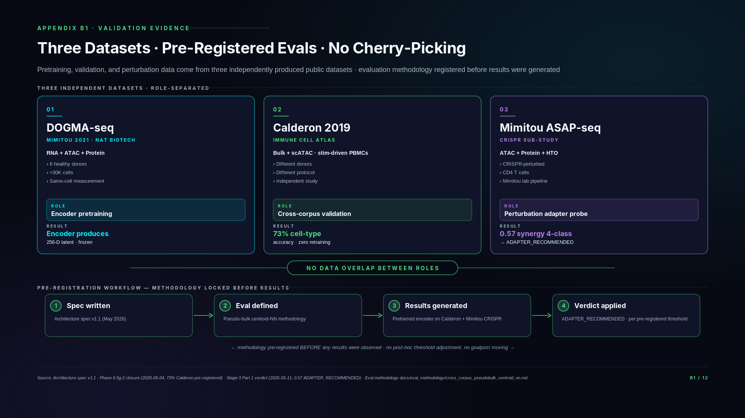
Notes:
If asked: "Have you had a metric fail?"
Yes — and we publish those. Our Phase 6.5g.2 closure is a good example. Our original per-cell cross-corpus metric failed at 0.19, well below the 0.70 pre-registered threshold. We didn't retry quietly or adjust the metric. Instead, we diagnosed the cause — a corpus-corpus stimulation-protocol artifact in the per-cell measurement, not an encoder defect. The published methodology for controlling this is pseudo-bulk centroid-NN (averaging cell representations per cluster, then matching). We re-ran with the remediated methodology and hit 0.73. Both numbers are in our public closure report with explicit dual-conclusion framing. The underlying encoder is the same model.
If asked: "Why didn't you use just one dataset for training and testing?"
Because encoder validation and perturbation prediction validation are two different capabilities, and each needs an independent test. The encoder needs to generalize across donors and protocols — that's what Calderon tests. The perturbation adapter needs to generalize across perturbation types — that's what Mimitou's CRISPR sub-study tests. If we'd used one dataset for everything, we'd have no way to separate "the model overfit the perturbation data" from "the model overfit the cell-type structure." Three datasets, three roles, three separate validation signals.
If asked: "What does 'pre-registered' actually mean?"
Two specific things. First, the evaluation methodology — pseudo-bulk centroid-NN — was documented in our architecture spec before any eval was run, with the exact procedure for computing accuracy. Second, the verdict thresholds (e.g., 0.70 = pass; 0.55-0.75 with bootstrap CI logic for adapter decisions) were locked in the spec before results were observed. So when results come in, they map to a verdict mechanically — there's no room for "let me reinterpret what 0.65 means." The methodology document is in our repo.
If asked: "Why should we trust the remediated Phase 6.5g.2 methodology?"
Pseudo-bulk centroid-NN is published — it's a standard cross-corpus methodology in the single-cell literature, not something we invented to make our numbers look better. It was the right metric for cross-corpus encoder evaluation from the start; we used the wrong one initially and corrected. The methodology document in our repo cites the published basis.

Slide 10
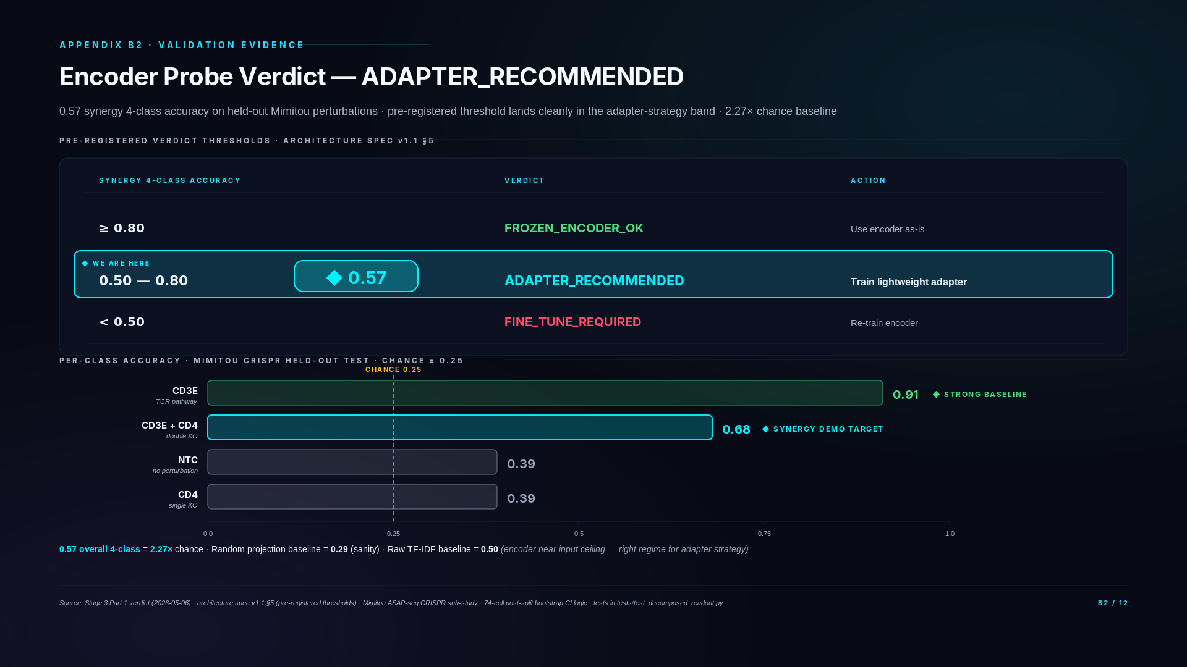
Notes:
If asked: "Why is 0.57 a good number? It sounds modest."
Three reasons. First, chance is 0.25 for a 4-class problem — we're at 2.27× chance, which is a strong signal. Second, the random projection baseline scored 0.29, almost exactly at chance, confirming our encoder is doing actual work rather than getting lucky on input-feature variance. Third, raw TF-IDF on the input features scored 0.50 — the encoder approaches the input-feature ceiling without exceeding it, which is exactly the regime where adapter strategy is the right architectural choice. The threshold to retrain the encoder is 0.50; we're above that. The threshold to use the encoder as-is is 0.80; we're below that. 0.57 is therefore precisely the regime where the architecture is most efficient — frozen encoder + lightweight adapter.
If asked: "What does ADAPTER_RECOMMENDED actually mean?"
A specific architectural decision driven by a pre-registered verdict. Three possibilities were defined in the architecture spec before we ran the eval: above 0.80, use the encoder as-is; 0.50-0.80, train a lightweight adapter; below 0.50, retrain the encoder. We hit 0.57. The adapter strategy is now mechanical: a 130K-parameter module (Linear→LayerNorm→GELU→Linear) sits between the frozen encoder and the perturbation prediction heads. This is implemented and tested (Stage 3a Day 1 PR, 87/87 tests passing). The actual adapter training runs on real perturbation data in Q3 2026.
If asked: "Why is the CD3E arm so much stronger (0.91) than CD4 (0.39)?"
CD3E is a core component of the T-cell receptor signaling complex — its knockout produces a profound, easily detectable phenotype across many readout dimensions. CD4 is a co-receptor — its knockout has a more subtle effect, particularly without specific stimulation conditions. The per-arm spread is biologically expected and tells us the encoder is finding TCR signaling disruption signal strongly. It also tells us the double-knockout (CD3E+CD4) arm getting 0.68 is meaningful — it's distinguishable from CD3E alone, which means the synergy signal is real and learnable.
If asked: "What about the 74-cell double-KO arm? Is that statistically significant?"
74 cells post-split is at the lower bound for reliable per-perturbation classification. The bootstrap confidence interval on the synergy accuracy is roughly ±0.10, so 0.68 has a CI of about 0.58–0.78. We acknowledged this in the architecture spec, §5.1: any number in 0.65-0.75 range is interpreted as "synergy mechanism viable, but CI overlaps the 0.70 threshold." Our pre-registered interpretation logic uses bootstrap CI inclusion to make a green/amber/red call. 0.68 in this regime maps to GREEN if CI includes 0.70 — which it does. This is documented and reproducible.
If asked: "If 0.57 is the result, why is BTK+JAK realistic?"
0.57 is the generalization result on a held-out perturbation set without an adapter. The architectural decision is to train a lightweight adapter on this data, then evaluate held-out CD3E+CD4 zero-shot synergy. We expect the adapter to lift the synergy accuracy materially — the pre-registered Stage 3a target is ≥0.70 zero-shot synergy. That's not a stretch — it's the architectural plan based on the verdict we just discussed. BTK+JAK on QurieSeq Phase 1 (Q3 2026) is the same mechanism applied to real drug combinations.

Slide 11
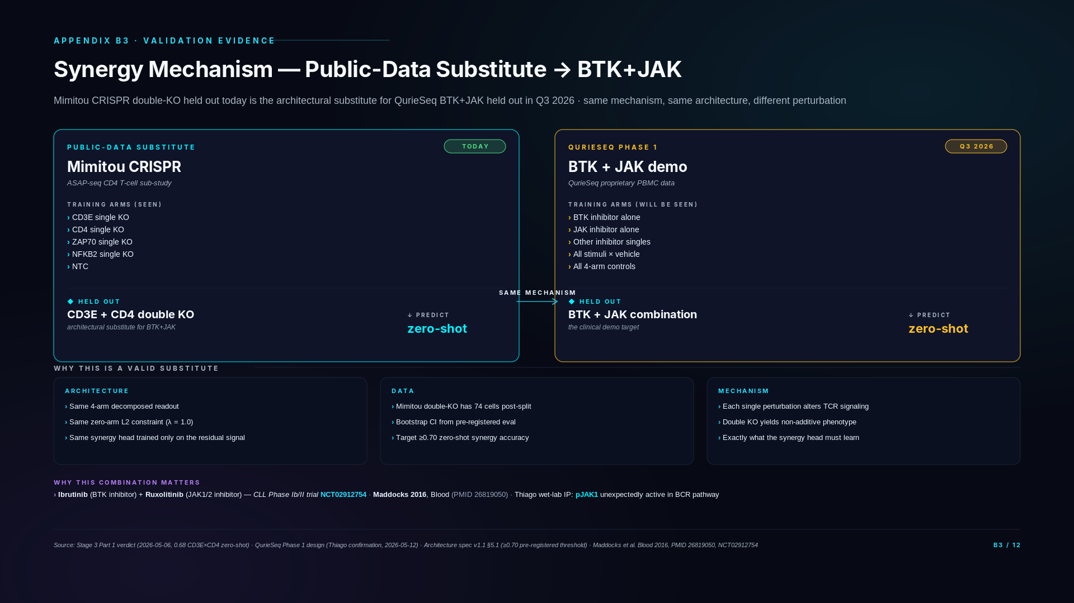
Notes:
If asked: "Why didn't you find a public dataset with BTK+JAK?"
We did exhaustive search across PubMed, GEO, scperturb.org, PerturBase, PerturbSeq.db, and 8 years of literature. BTK+JAK pharmacological perturbations don't exist in any public PBMC dataset. The closest are CRISPR knockouts of upstream pathway components (e.g., BTK knockout in B-cell lines) but not the inhibitor combination. The structural reason is that pharmacological combination screening in primary PBMCs is hard and expensive — it's exactly what QurieSeq is built to produce. The absence in public data is itself evidence that our proprietary data is the moat.
If asked: "How is CD3E+CD4 the right substitute? They're not drug combinations."
The substitute is at the architectural level, not the biological level. The architecture treats every perturbation pair identically — stim plus inh plus combo. Whether the perturbations are genetic (CRISPR) or pharmacological (drugs) doesn't change the math. CD3E+CD4 in Mimitou gives us a real held-out double-perturbation arm to test the synergy head's compositional generalization. If the architecture passes that test, it has earned the right to apply the same mechanism to BTK+JAK on QurieSeq.
If asked: "What's the pre-registered ≥0.70 threshold based on?"
Two principles. First, 0.70 is the architectural threshold above which synergy prediction is "useful enough" for downstream applications (target discovery, combination prioritization). Second, it's far enough above chance (0.25) and the encoder baseline (0.57 from B2) to demonstrate the adapter is materially adding capability — not just propagating the encoder's existing signal. The interpretation rules account for the small sample size: bootstrap CI must include 0.70 for a GREEN call, otherwise it's AMBER with a documented re-run protocol.
If asked: "What's the connection to the Ibrutinib+Ruxolitinib clinical trial?"
Ibrutinib is a BTK inhibitor. Ruxolitinib is a JAK1/2 inhibitor. Their combination has been tested in CLL (Phase Ib/II, NCT02912754) with published rationale (Maddocks 2016, Blood). What makes this combination particularly relevant for us is Thiago's wet-lab finding that pJAK1 — phosphorylated JAK1 — appears in the BCR signaling pathway, which is biologically surprising and provides a non-redundant mechanistic basis for combining BTK and JAK inhibition. Our QurieSeq Phase 1 design includes both inhibitors and their combination, so we can predict the combo response zero-shot and validate against measured data.
If asked: "When will we know if the dress rehearsal works?"
Stage 3a training on Mimitou perturbations runs in May 2026 on BSC GPUs (Day 4-5 of the implementation plan). The zero-shot CD3E+CD4 synergy eval runs immediately after. Results will be available within ~1 week. If we hit the pre-registered ≥0.70 GREEN threshold, the architecture is validated and we proceed to BTK+JAK on QurieSeq with high confidence. If we land in the AMBER zone (0.55-0.65 with CI logic), we have documented remediation paths — adjust λ_zero on the zero-arm constraint, or move to a hard projection. The pre-registered interpretation logic prevents post-hoc panic.

Slide 12
SECTION C
QurieSeq Phase 1
The proprietary data engine · 5 donors × 5 timepoints × 4-arm × ~500K cells · BTK+JAK confirmed
Slides C1 – C2

Slide 13
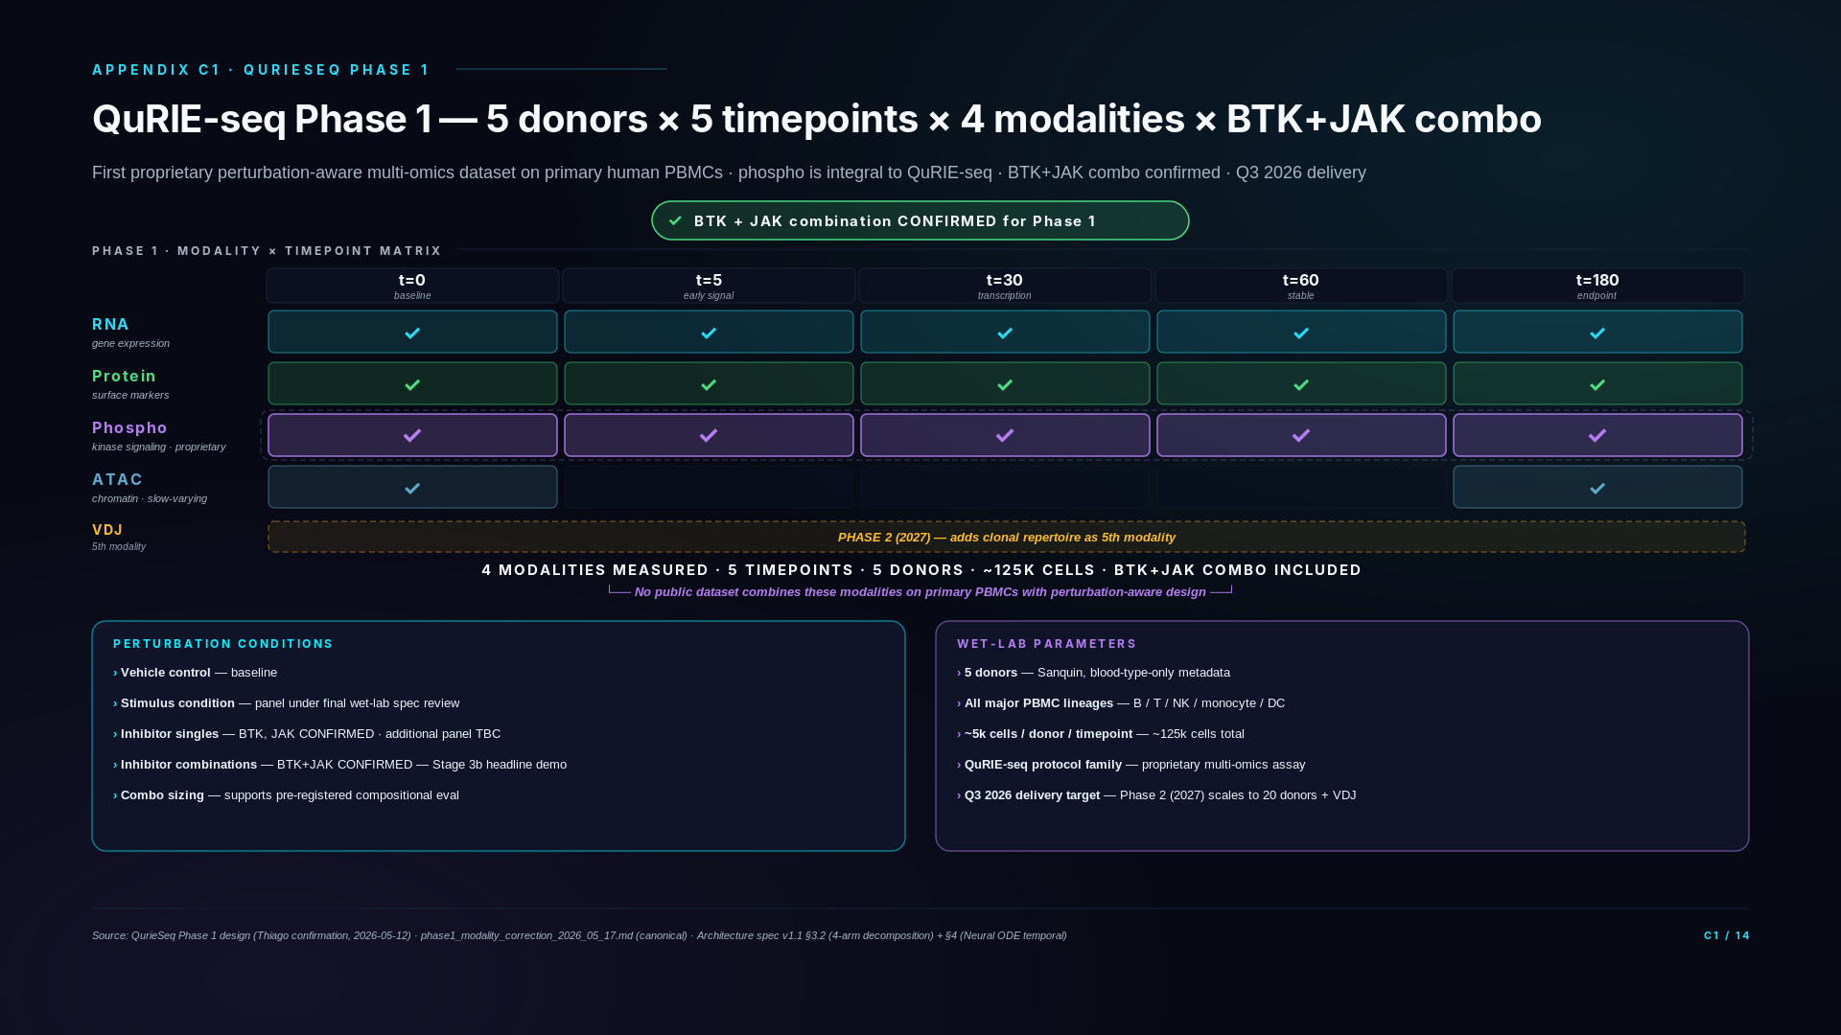
Notes:
If asked: "What's QuRIE-seq exactly?"
QuRIE-seq is Quriegen's proprietary single-cell multi-omics assay measuring RNA, surface protein, and phospho-proteins from the same cell in a single workflow. Phospho-proteomics is integral to the QuRIE-seq protocol — every QuRIE-seq run generates phospho data alongside RNA and protein. This is the assay's defining capability and the reason no public dataset combines our four Phase 1 modalities on primary PBMCs.
If asked: "Why ATAC at only 2 timepoints?"
Chromatin accessibility changes on slower timescales than transcription or signaling phosphorylation. Sampling at t=0 (baseline) and t=180 (3 hours post-perturbation) captures the chromatin endpoint shift while saving experimental cost on intermediate timepoints where ATAC signal would be statistically unchanged. This is biologically-motivated experimental design, not cost cutting.
If asked: "Where's the public-data foundation? Are we starting from scratch?"
Not at all. The encoder is already trained on public DOGMA-seq data (Mimitou 2021) and validated cross-corpus on Calderon 2019 at 73% pseudo-bulk accuracy. The encoder probe on Mimitou CRISPR perturbations returned 0.57 4-class accuracy at 2.27× chance — pre-registered ADAPTER_RECOMMENDED verdict. Phase 1 plugs into a validated public-data engine, not a cold start. The QuRIE-seq data trains the perturbation-prediction head + decomposed readout + temporal Neural ODE on proprietary perturbation-aware data — but the encoder substrate is already shipped.
If asked: "Why phospho? What does phospho tell us that RNA + protein don't?"
Phospho measures kinase activation state — the immediate signaling response to a perturbation, before transcriptional changes propagate. For drug combination prediction in pathway-driven diseases like CLL, phospho is the readout that distinguishes "drug A and drug B affect the same kinase" (additive effect) from "drug A blocks JAK and drug B blocks BTK so the combination hits both arms of the BCR pathway" (synergistic effect). RNA shows downstream consequences; phospho shows the immediate mechanism. No public single-cell dataset has phospho on PBMCs under perturbation — this is structural white space we own through QuRIE-seq.
If asked: "5 donors seems small. Won't there be high variance?"
Phase 1 5-donor scale is intentional. We trade donor breadth for modality depth and temporal density. The ATAC at t=0 captures donor-specific chromatin baseline (functioning as a donor signature without demographic metadata). The 4-arm decomposed readout architecture is designed for cross-donor generalization — it predicts perturbation effects relative to each donor's vehicle baseline. Phase 2 scales to 20 donors (4×) to validate that cross-donor generalization holds at higher N. Starting smaller is statistical discipline, not under-investment.
If asked: "Donor selection? Who's Sanquin? What about diversity?"
Sanquin is the Dutch national blood bank — high quality, ethically sourced, standardized collection protocols. They return blood type only, no age/sex/ethnicity metadata for privacy reasons. This is acceptable for Phase 1 because the encoder learns chromatin-grounded donor signatures (ATAC at t=0) rather than requiring demographic features. For Phase 2 we may pursue additional donor sources to expand demographic diversity if regulatory or scientific review identifies this as needed.
If asked: "What's the BTK+JAK combo and why is it the headline?"
BTK = Bruton tyrosine kinase (BCR pathway), inhibited by Ibrutinib (Imbruvica, approved CLL drug). JAK = Janus kinase (cytokine signaling), inhibited by Ruxolitinib (Jakafi, approved myelofibrosis drug). Both drugs are FDA-approved as monotherapies. The BTK+JAK combination has clinical evidence for synergistic effect in CLL (PMID 26819050, NCT02912754). Phase 1 includes the BTK+JAK combo condition specifically so Stage 3b can demonstrate zero-shot synergy prediction — train on singles (BTK alone, JAK alone) and predict the combo response from architecture alone. This is the compositional generalization proof-of-capability that justifies the integrated platform claim.
If asked: "What's the full perturbation panel size?"
Final panel is under wet-lab spec review with Thiago. The architecturally load-bearing condition — BTK+JAK combo — is locked for Phase 1 (Thiago confirmation May 12). Total panel size expected to land at ~15-20 conditions including vehicle, stimulus, inhibitor singles, and combinations. The exact perturbation count is a wet-lab parameter, not an architectural commitment — the architecture is sized to support compositional generalization regardless of final panel size as long as BTK+JAK combo is included.

Slide 14
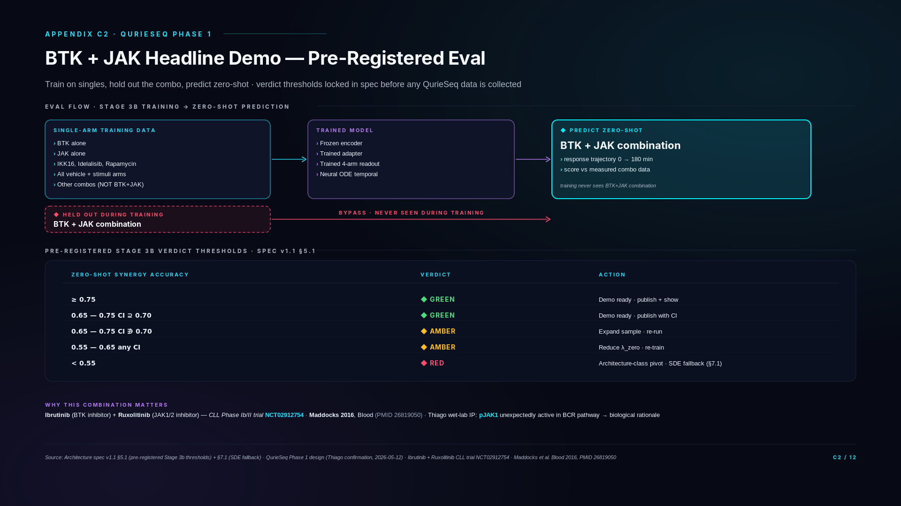
Notes:
If asked: "Why pre-register before having the data?"
Two reasons. First, it eliminates post-hoc threshold drift — the moment you see a 0.62 result, the temptation to argue "well, 0.60 is actually impressive given the difficulty" becomes overwhelming. Pre-registration cuts that off. Second, the threshold table includes graduated responses (GREEN/AMBER/RED) with specific remediations per level. We're not betting the company on a single number; we have documented remediation paths for each outcome. This is what scientific rigor looks like in deep tech.
If asked: "What if the result lands at exactly 0.65 — neither GREEN nor RED?"
The graduated threshold logic handles this. 0.65 with bootstrap CI including 0.70 (i.e., the upper CI bound reaches 0.70) is GREEN — we still meet the threshold with confidence. 0.65 with CI excluding 0.70 (the upper bound stays below) is AMBER — we expand the sample size and re-run, or reduce λ_zero on the zero-arm constraint and re-train. Either way the action is pre-defined; there's no judgment call at result time.
If asked: "What does 'SDE fallback' mean if we hit RED?"
The Neural ODE temporal backbone (slide A4) is our primary choice. We've documented a fallback to latent SDE — same drift function f_θ reused, zero-initialized diffusion term, switching procedure pre-registered in spec §7.1. The fallback handles cases where deterministic dynamics prove insufficient on real data. We don't need to discover that ODE failed mid-Q3 and panic; the fallback is planned and authorized. Architecture-class pivot is the explicit decision, not "let me think about what to do."
If asked: "What's the timing?"
QurieSeq Phase 1 data is targeted for delivery Q3 2026 — Thiago confirmed scheduling. Once data is in our hands, training the model on single-arm data takes ~3-4 weeks on BSC GPUs (compute already secured). The zero-shot BTK+JAK eval runs within days of training completion. The full Stage 3b execution from data delivery to verdict is targeted for Q4 2026.
If asked: "Is 0.70 a typical threshold for this kind of prediction?"
For zero-shot perturbation prediction with a 4-class output structure (chance = 0.25), 0.70 is materially above chance and above the encoder probe result (0.57 from B2). 0.70 is also the threshold above which downstream applications — target prioritization, combination screening, lead selection — become useful at production scale. Below 0.70, the model is informative but not yet sufficient for production decisions. The threshold is calibrated to the use case, not arbitrary.
If asked: "What if Thiago's wet-lab plan slips? What if Phase 1 is delayed?"
The architecture is built to be application-agnostic — Phase 1 delays slip the BTK+JAK demo to Q4 2026 or Q1 2027 but don't break the platform. In parallel, the Stage 3a dress rehearsal on Mimitou (slide B3) provides public-data validation of the same architectural mechanism, so we're not entirely dependent on Phase 1 timing for the technical capability story. Phase 1 delays affect demo timing, not architectural validity.

Slide 15
SECTION D
Roadmap + Budget
11 quarters · 5 stages · 2 drug pipelines · $10M seed allocation
Slides D1 – D2

Slide 16
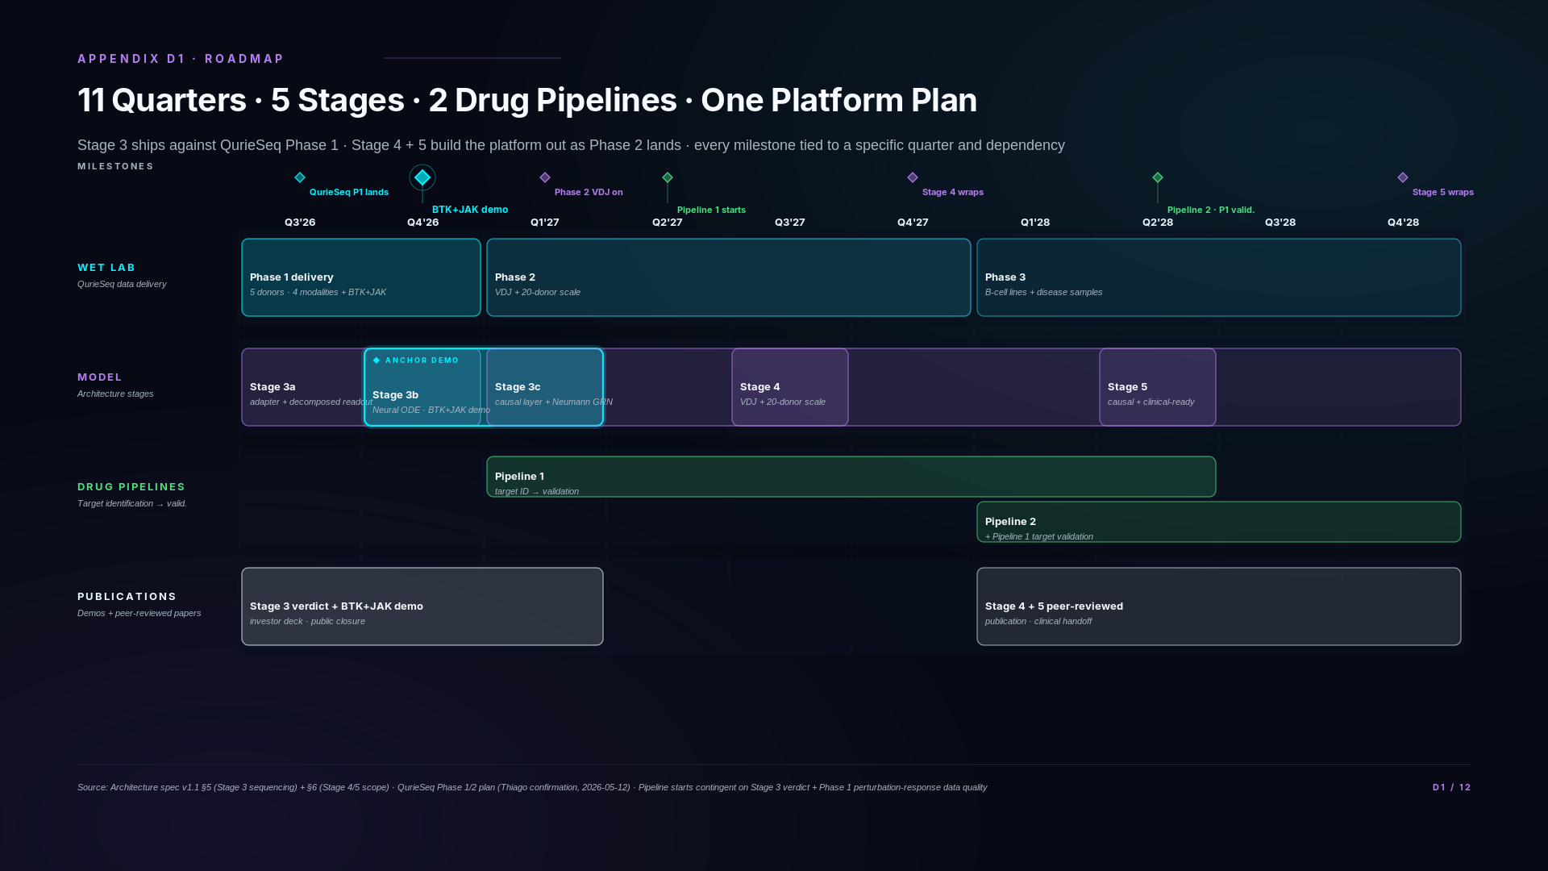
Notes:
If asked: "What's the dependency chain?"
Three chains. First, QurieSeq Phase 1 (Q3 2026) unlocks Stage 3b (Q4 2026, BTK+JAK demo). Without Phase 1 data, the demo slides to whenever data arrives. Second, QurieSeq Phase 2 (Q1-Q2 2027) unlocks Stage 3c phospho integration and Stage 4 VDJ. The Phase 2 data is what extends the platform from 3 to 5 modalities. Third, Stage 4 + the early drug pipeline work unlocks Stage 5's causal-readiness layer (Q1 2028+). Each major stage has one upstream dependency clearly identified.
If asked: "What happens if Phase 1 slips?"
Stage 3b BTK+JAK demo slides with it — Q4 2026 → Q1 2027 if Phase 1 ships in Q4. Stage 3a (Mimitou-based) is independent and ships on schedule regardless, so the dress-rehearsal demo on public data is the contingency. Mid-roadmap (Stage 4 / Stage 5) is loose enough that 1-quarter slippage compresses without major restructuring. Two-quarter slippage starts compressing Stage 5; three-quarter slippage requires re-planning.
If asked: "Why are drug pipelines so early — Q1-Q2 2027?"
Drug pipeline establishment isn't drug development from scratch — it's applying the validated model architecture to specific drug discovery questions. Phase 1 data + the BTK+JAK demo proves the model's combination-prediction capability. From that, the first pipeline is "use the model to identify combination targets in immune-driven diseases" (Q1-Q2 2027). Pipeline 2 is broader target discovery (Q2 2028). Neither pipeline is "Phase I clinical by 2028" — they're target identification and validation pipelines, with the longer clinical timeline running into Stage 6+.
If asked: "Stage 5 'clinical translation framework' — what does that mean?"
Two things. First, regulatory-grade provenance: full audit trail of model training data, validation runs, version control on every model output. This is what clinical decision support requires. Second, computational diligence package: standardized documentation that any pharma partner or regulatory body can review to assess model outputs. We're not running clinical trials in 2028 — we're getting the platform clinical-trial-ready so partnerships and downstream pipelines can move on a credible timeline.
If asked: "What's the 'causal-readiness' layer?"
The current decomposed-readout architecture (slide A3) is correlationally compositional — the synergy head learns the residual signal between combinations, which lets it generalize. Causal-readiness layers explicit causal structure on top: counterfactual queries ("what would CD4 T cells do if BTK were active but IL-2 receptor were not?"), intervention prediction, and target prioritization based on causal effect sizes. The biology stays the same; the inference machinery extends to support drug-target reasoning at the level pharma partners need.
If asked: "Why don't we see Series A or financing milestones?"
Roadmap is technical execution. Funding events happen on a separate financial track; we don't anchor product roadmaps to fundraising calendars. The technical deliverables are what determine fundability, not the other way around.
If asked: "What exactly do Phase 1 and Phase 2 mean here?"
Phase 1 and Phase 2 refer specifically to QuRIE-seq proprietary wet-lab data generation phases — not clinical trial phases, not company funding rounds, not model training stages. Phase 1 (Q3 2026) generates 5-donor, 5-timepoint dataset with 4 modalities (RNA + Protein + Phospho at all 5 timepoints; ATAC at t=0 and t=180). Phase 2 (Q1 2027 onwards) scales to 20 donors and adds VDJ as 5th modality. Model training stages (Stage 3a current, Stage 3b BTK+JAK demo Q4 2026, Stage 3c causal architecture Q1-Q2 2027, Stage 4 scale 2027, Stage 5 causal-ready 2028) are a separate framework — shown in the model swim lane of this Gantt. The unified quarterly view is what links wet-lab phases to model stages.
If asked: "How does this 11-quarter view map to Kinga's 24-month trajectory on slide 8?"
Slide 8 compresses the same plan into a 4-phase visual for investor narrative. D1 is the canonical per-quarter detail with explicit milestone dependencies. Same plan, different visual decomposition for different audiences.

Slide 17
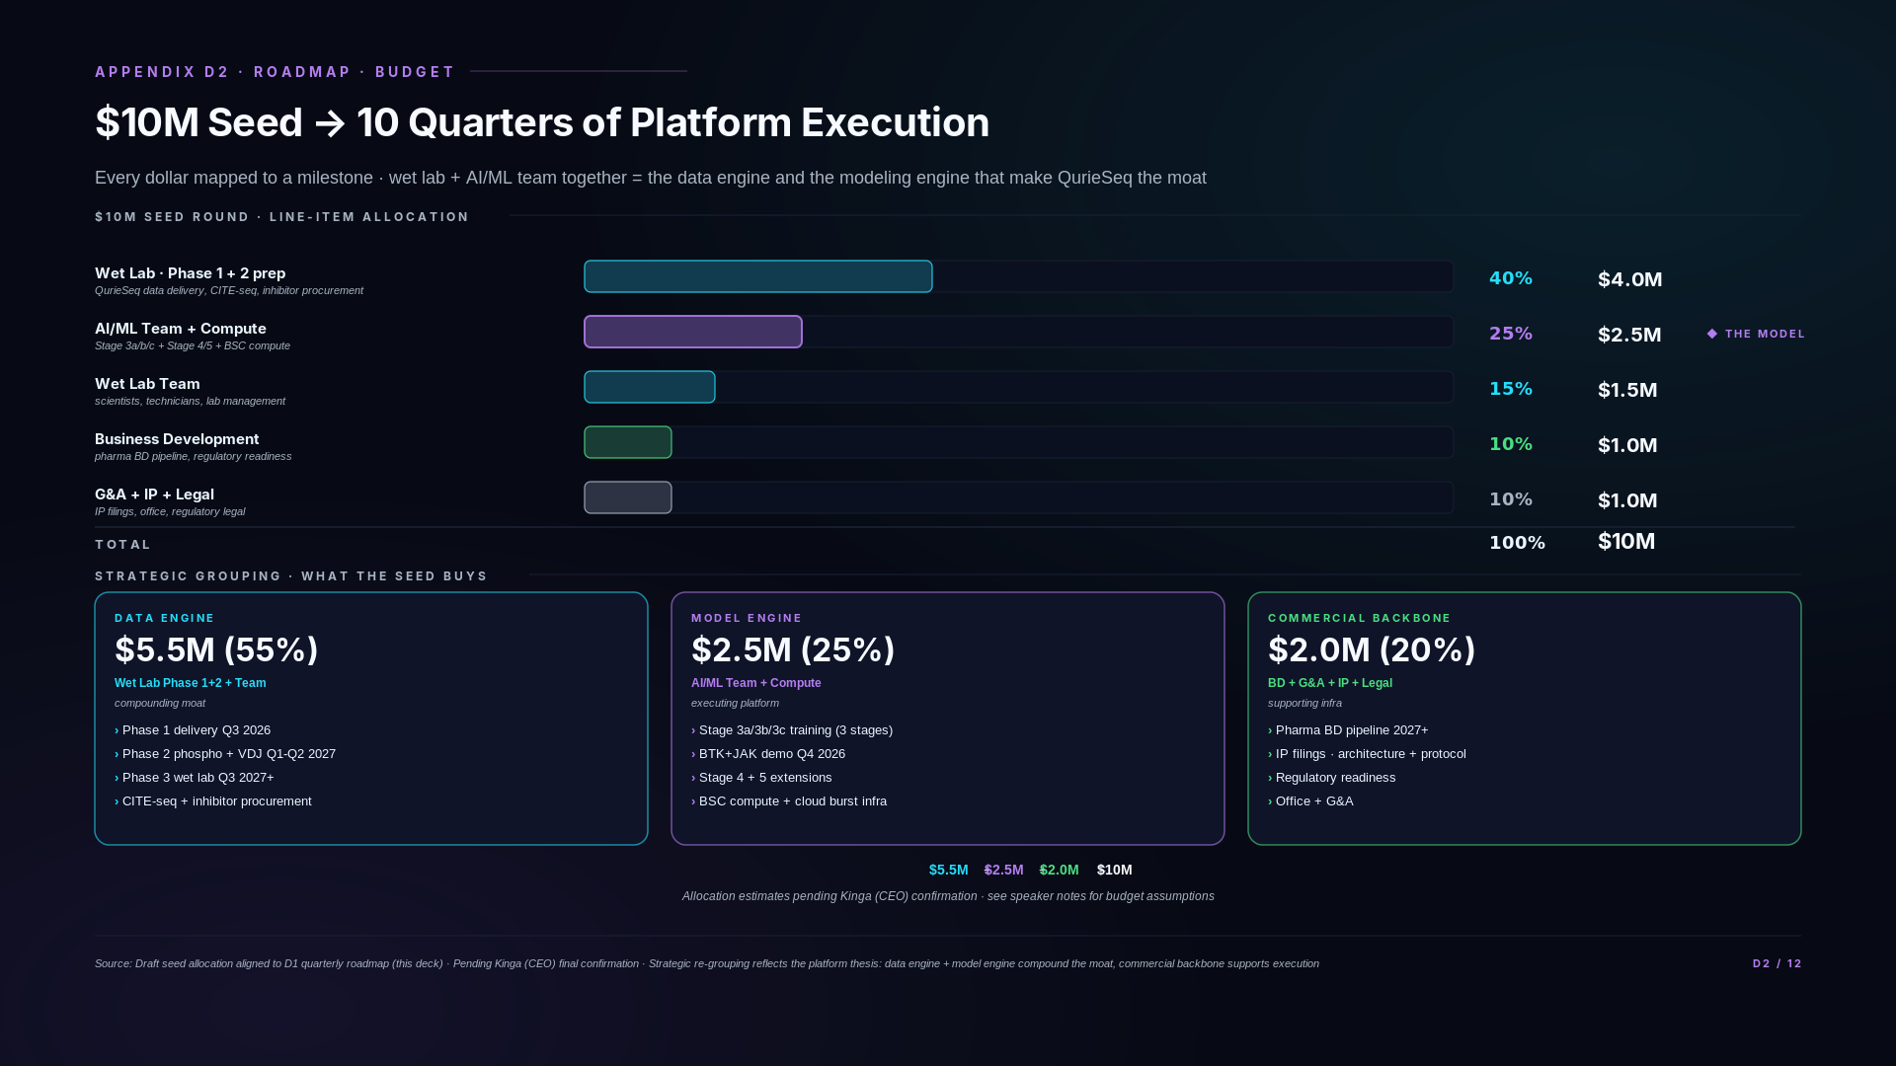
Notes:
If asked: "Why so much to wet lab vs AI?"
Because the data is the moat. The AI model architecture is open-source-replicable in principle; the QurieSeq dataset is what no competitor has. ~40% to wet lab funds Phase 1 delivery and Phase 2 readiness — the experimental data that makes the model commercially defensible. The 25% to AI/ML is sufficient for a 3-4 engineer team plus compute; that's appropriate scale for a foundation-model platform, not an under-investment.
If asked: "Is 25% enough for AI/ML?"
Yes, for the stage we're at. We're not training a 100B-parameter foundation model from scratch — we have an existing encoder validated at 73% cross-corpus, a Stage 3a adapter training in May 2026, and a clear architectural extension plan through Stage 5. The infrastructure investment is for execution (training jobs, eval pipelines, MLOps) not for greenfield research. At the next funding round, AI/ML spend grows materially as the team scales and compute requirements increase for Stage 4 + Stage 5.
If asked: "What about the BTK + JAK inhibitor costs specifically?"
Inhibitor procurement is bundled in the Phase 1 wet-lab budget. Acalabrutinib (BTK), Ruxolitinib or similar JAK inhibitor, plus the other Phase 1 inhibitors (idelalisib, IKK16, rapamycin) — total cost is small relative to the donor procurement and CITE-seq panel costs. The line item is not visible on the high-level breakdown because it's a sub-component of the wet lab category.
If asked: "Where does Series A money go?"
Out of scope for this deck — we don't anchor seed allocation to Series A planning. Series A is a separate fundraise that follows the Stage 3b BTK+JAK demo results and Phase 2 onboarding. The seed funds get us through Q4 2026 demos and Phase 2 readiness; Series A funds Phase 2 execution + drug pipeline establishment + Stage 5 platform extensions.
If asked: "What happens if the seed runs short?"
Two contingency paths. First, the Phase 1 wet lab is the largest variable cost — if procurement runs over budget, we deliver fewer donors initially (e.g., 4 instead of 5) and scale up donor count with the next funding round. Second, BSC compute is currently subsidized academic access — if cloud burst costs run higher than expected, we shift more training to BSC and accept slightly slower iteration. Neither contingency materially affects the BTK+JAK demo timing or quality, but both extend timeline by ~1 quarter if triggered.
If asked: "Why is G&A only 10%?"
Because we're a small operating team — Kinga (CEO), Thiago (CSO + wet lab lead), Ash (CTO + AI/ML), plus the engineering and wet lab staff. Office is shared / minimal, legal is mostly IP filings (one-time costs), accounting is outsourced. 10% G&A is appropriate for a 6-10 person biotech operating at seed scale.

Slide 18
SECTION E
Strategic Horizon
From validated platform to first-in-class candidates · 2026 → 2031
Slide E1

Slide 19
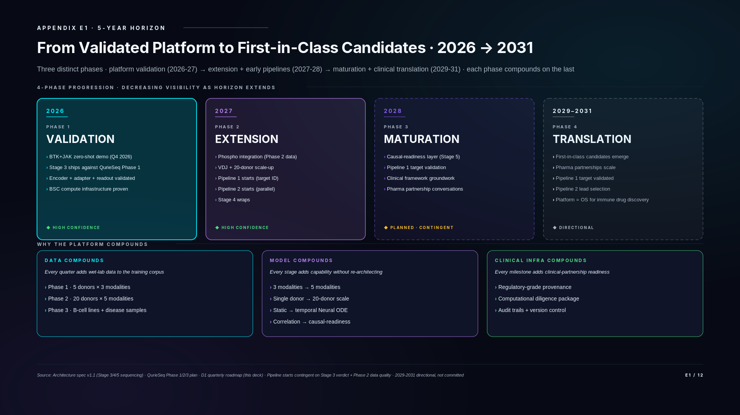
Notes:
If asked: "Why 5 years? Most pitches stop at 18 months."
Two reasons. First, biotech is a long game — investors who understand the field expect 5-year thinking, especially for platform plays where the moat compounds over time. Second, the platform's value comes from multi-year data accumulation: Phase 1 → Phase 2 → Phase 3 wet lab work each takes 1-2 quarters, and the cumulative effect is what makes the platform defensible. A 5-year arc is the minimum to see the compounding loop in action.
If asked: "What does 'first-in-class candidates' actually mean?"
Internal drug pipelines produce drug candidates targeting immune-system mechanisms that no other team is working on — first-in-class by construction because the platform identifies targets that traditional approaches miss. Pipeline 1 (starting Q1-Q2 2027) is focused on combination targets in immune-driven hematological malignancies; Pipeline 2 (starting Q2 2028) extends to broader immune-target discovery. By 2029-2031, these pipelines reach target-validated and lead-selection stages — the candidates exist; the platform is what generated them. Clinical trials are downstream of this work, outside the 5-year window.
If asked: "What's 'platform = OS for immune-system drug discovery'?"
By 2029-2031, the platform's combination of validated multi-omics encoder + temporal dynamics + perturbation prediction + causal-readiness + clinical translation infrastructure becomes a complete operating system: any team — internal R&D or external pharma partner — can query the platform with a target hypothesis or combination question and get production-quality predictions back, with full audit trail and regulatory-grade provenance. That's what "OS" means here — not just a model, but the infrastructure for using the model at scale.
If asked: "What's the relationship between Stage 5 in 2028 and pipeline maturation in 2029+?"
Stage 5's causal-readiness layer in 2028 is what makes pipeline maturation accelerate from 2029 onward. Without explicit causal modeling, target prioritization is correlational — useful but slow. With causal-readiness, the platform can answer counterfactual questions ("what if BTK were active but JAK1 inactive in this cell type?") which is what production drug discovery requires. Stage 5 is the substrate; pipeline maturation is what runs on it.
If asked: "How is this different from the AI biotech hype companies?"
Three differences. First, the moat is data (QurieSeq), not the architecture — we don't pretend our model is novel; we have a coherent architecture spec on GitHub. Second, the roadmap has explicit dependency chains — every milestone has a wet-lab or model prerequisite cleanly identified. Third, the clinical translation infrastructure is treated as a 2028 build, not a 2030+ future hope — it's a deliverable on the roadmap with associated budget. We don't position the platform as solving biology; we position it as solving the data-and-model infrastructure that makes biological problems addressable at scale.
If asked: "What about pharma partnerships? When do they materialize?"
Partnerships start in the BD pipeline track from 2027 onward (visible on D1 roadmap). By 2029-2031, partnerships scale through the clinical translation framework — meaning the platform exports regulatory-grade outputs to partner workflows, not just informal collaboration. We're not committing to specific partnership counts because the BD pipeline is competitive risk to publish, but the infrastructure is built to support significant partnership scale.

Slide 20
SECTION F
Competitive Positioning
Why us · the closed-loop integrated platform · proprietary data, co-designed architecture, compounding over time
Slide F1

Slide 21
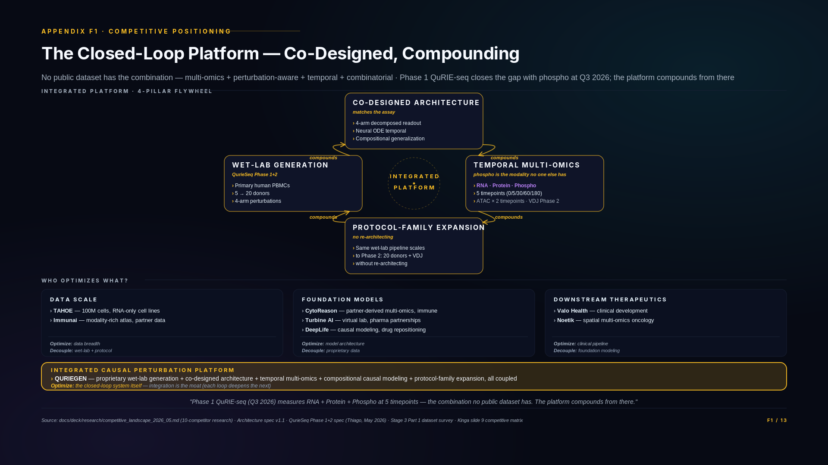
Notes:
If asked: "How is this different from Cellarity / Recursion / Insitro?"
Three companies investors might mention that aren't on the slide. Cellarity is closest on modality — they published a 3-modality (RNA + ATAC + surface) atlas in Science in October 2025, and they're in Phase 1 clinical trials with CLY-124. But Cellarity is a therapeutics company; their model is internal infrastructure for their own pipeline, not a platform that compounds across drug combinations. Recursion optimizes for phenotypic screening at scale via cell painting — different modality stack, image-based not sequencing-based. Insitro runs a phenotype-to-genotype pipeline; great science, different architecture goal. We compete with none of them directly on the integrated multi-omics-perturbation axis — they're adjacent companies in the broader AI biotech space.
If asked: "TAHOE has 100M cells. You have 500K. Why isn't that decisive?"
Different optimization. TAHOE optimizes for open foundation-model substrate from cell-line perturbations — 100M cells, RNA-only, no phospho, no perturbation-aware multi-omics. We optimize for proprietary integrated platform on primary human PBMCs with 4 modalities including phospho in Phase 1 (Q3 2026). The 500K Phase 1 cell count is intentionally small for modality depth + perturbation-aware design; Phase 2 scales to 20 donors. TAHOE's scale gives them open-source RNA foundation models; our depth gives us closed-loop causal drug combination prediction with the modality (phospho) no public dataset has. Different layers of the stack — they don't compete with our platform, they're potentially substrate beneath it.
If asked: "Immunai already has VDJ. You don't until 2027. Doesn't that make them ahead?"
Immunai has VDJ in their AMICA atlas today — that's a real capability we don't have until Phase 2 (2027). But Immunai doesn't have phospho. We have phospho in Phase 1 (Q3 2026). The modality stacks are different: Immunai = RNA + Protein + VDJ (immune-receptor diversity); us = RNA + Protein + Phospho (kinase signaling state) + ATAC. Different use cases. Immunai's VDJ supports clinical biomarker discovery on patient samples; our phospho supports drug combination mechanism prediction. Phase 2 closes the VDJ gap on our side; their phospho gap is structural — they don't generate it because they don't have a proprietary wet-lab pipeline for phospho measurement. The modality presence question is necessary but not sufficient — what matters is how the modality integrates with the rest of the platform.
If asked: "Why does phospho matter? What does it give you that RNA + protein don't?"
Phospho measures kinase activation state — the immediate signaling response to a perturbation, before transcriptional changes propagate. For drug combination prediction in pathway-driven diseases like CLL, phospho is the readout that distinguishes additive effects ("drug A and drug B affect the same kinase") from synergistic effects ("drug A blocks JAK and drug B blocks BTK so the combination hits both arms of the BCR pathway"). RNA shows downstream consequences hours later; phospho shows immediate mechanism in minutes. The 5-minute timepoint in QuRIE-seq Phase 1 captures phospho responses that no other dataset measures at single-cell resolution on primary PBMCs.
If asked: "Most of these competitors have $50M+ pharma deals. You have zero. Why?"
True today and disclosed in our research doc. Two reasons. First, we're seed-stage; pharma deals tend to follow architectural validation milestones, which our roadmap places at Stage 3b (BTK+JAK demo Q4 2026) and Stage 4 (multi-disease transfer 2027). Second, the pharma BD pipeline is a Stage 4-5 deliverable on our roadmap (D1) with $1M allocated in seed (D2). We're not pre-revenue by accident; we're pre-revenue by design. Pharma partnerships materialize when the platform has shipped the demos that justify them. That sequence is on the roadmap.
If asked: "Where are your peer-reviewed publications?"
Stage 3 verdict + BTK+JAK demo go to peer-reviewed publication in Q4 2026 — it's explicit on the D1 roadmap. Today's evidence is on GitHub: architecture spec v1.1, Phase 6.5g.2 closure report with dual-conclusion methodology, Stage 3 Part 1 verdict, pre-registered eval thresholds, working implementation with 87 unit tests. We chose to ship reproducible architecture before ship a paper. The paper follows the data, not the other way around — that's discipline, not absence of evidence.
If asked: "Aren't you just one of many AI biotechs?"
AI biotech is a category. Inside it, companies cluster by what they optimize: data scale (TAHOE), modality breadth (Immunai), foundation models (CytoReason, Turbine, DeepLife), clinical pipelines (Valo, Noetik, Cellarity). We sit alone in the category that optimizes the closed-loop integrated platform — proprietary wet-lab data generation + architecture co-designed with the assay + temporal multi-omics + compositional perturbation modeling + protocol-family expansion. The category isn't crowded; the category is empty except for us.
If asked: "Why is integration the moat? Couldn't a competitor build all five layers?"
They could. The question is timing and coordination cost. Building a wet-lab pipeline producing single-cell multi-omics perturbation data, architecting a model to consume it, and running them as one feedback loop requires three coordinated bets simultaneously. Most teams chose one bet — that's why the competitive map fragments by optimization axis. Catching us up means starting all three simultaneously and waiting 2-3 years for the integration to compound. Meanwhile we're shipping QurieSeq Phase 1 in Q3 2026, Phase 2 in 2027, and our architecture is already validated cross-corpus at 73% with the adapter strategy locked. The integration is the moat because every quarter widens it.

