Slide 1


Slide 2
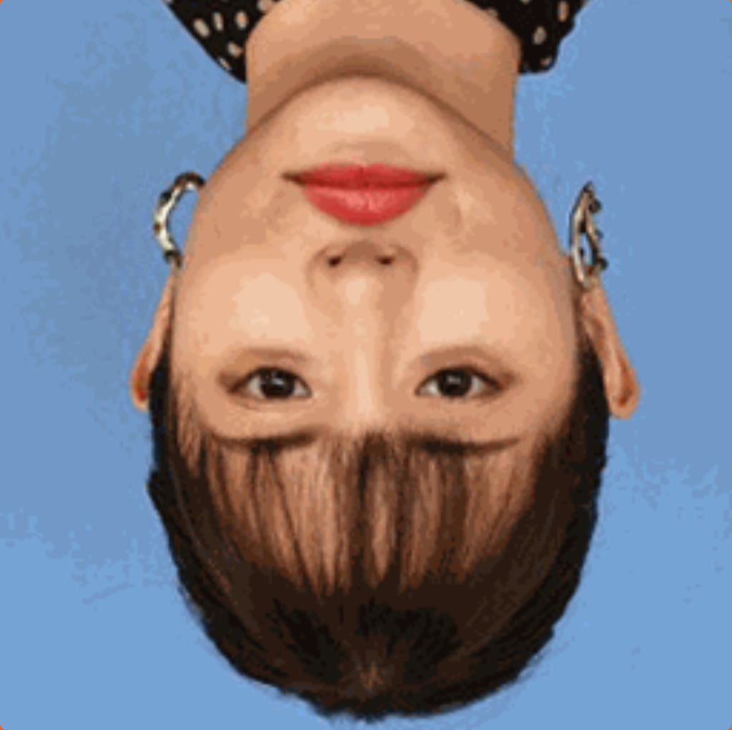

Slide 4
The Thatcher in the Lie
Kazutaka Kurihara

Slide 5
Jump and catch faces, avoid thatcher illusions!

Slide 6
The Thatcher in the Lie
Kazutaka Kurihara

Slide 7
Jump and catch faces, avoid Thatcher illusions!

Slide 8
The Thatcher in the Lie
Kazutaka Kurihara

Slide 9
Jump and catch faces, ignore Thatcher illusions!

Slide 10
← Jump and catch!

Slide 11
← Ignore!

