Slide 1
Effects of Mixed Wood Biochar on Fertilizer Use Efficiency and Growth Performance of Okra
Research Project Presentation
Moazzam Riaz
Soil Science • MNSUAM
Experimental design: Completely Randomized Design (CRD)
1

Slide 2
Research Background
Fertilizer-use efficiency is closely linked with nutrient availability, plant uptake, and crop productivity.
Biochar is a carbon-rich soil amendment that can modify nutrient retention and the soil environment.
Okra provides a practical crop system for evaluating growth, yield, and plant nutrient responses.
This experiment evaluated how mixed wood biochar treatments influenced multiple plant-performance indicators.
2

Slide 3
Research Objectives
Evaluate treatment effects on vegetative growth and biomass.
Assess treatment responses in pod and yield-related traits.
Determine changes in plant and grain N, P, and K concentrations.
Quantify N, P, and K uptake responses.
Identify treatment differences using ANOVA followed by Tukey-adjusted comparisons.
3

Slide 4
Experimental Design
Design
Completely Randomized Design (CRD)
Treatments
5 treatment levels: T0–T4
Replications
3 replications per treatment
Experimental units
15 pots in total
4

Slide 5
Measurements & Statistical Analysis
Growth: plant height, shoot fresh/dry weight, root fresh/dry weight.
Yield components: pod fresh/dry weight, pods per plant, grains per pod, pod length.
Nutrient status: plant and grain N, P, and K concentrations.
Nutrient uptake: N, P, and K uptake.
Statistical workflow: assumption checks → one-way ANOVA → estimated marginal means → Tukey-adjusted pairwise comparisons and compact-letter displays.
Significance threshold: α = 0.05.
5

Slide 6
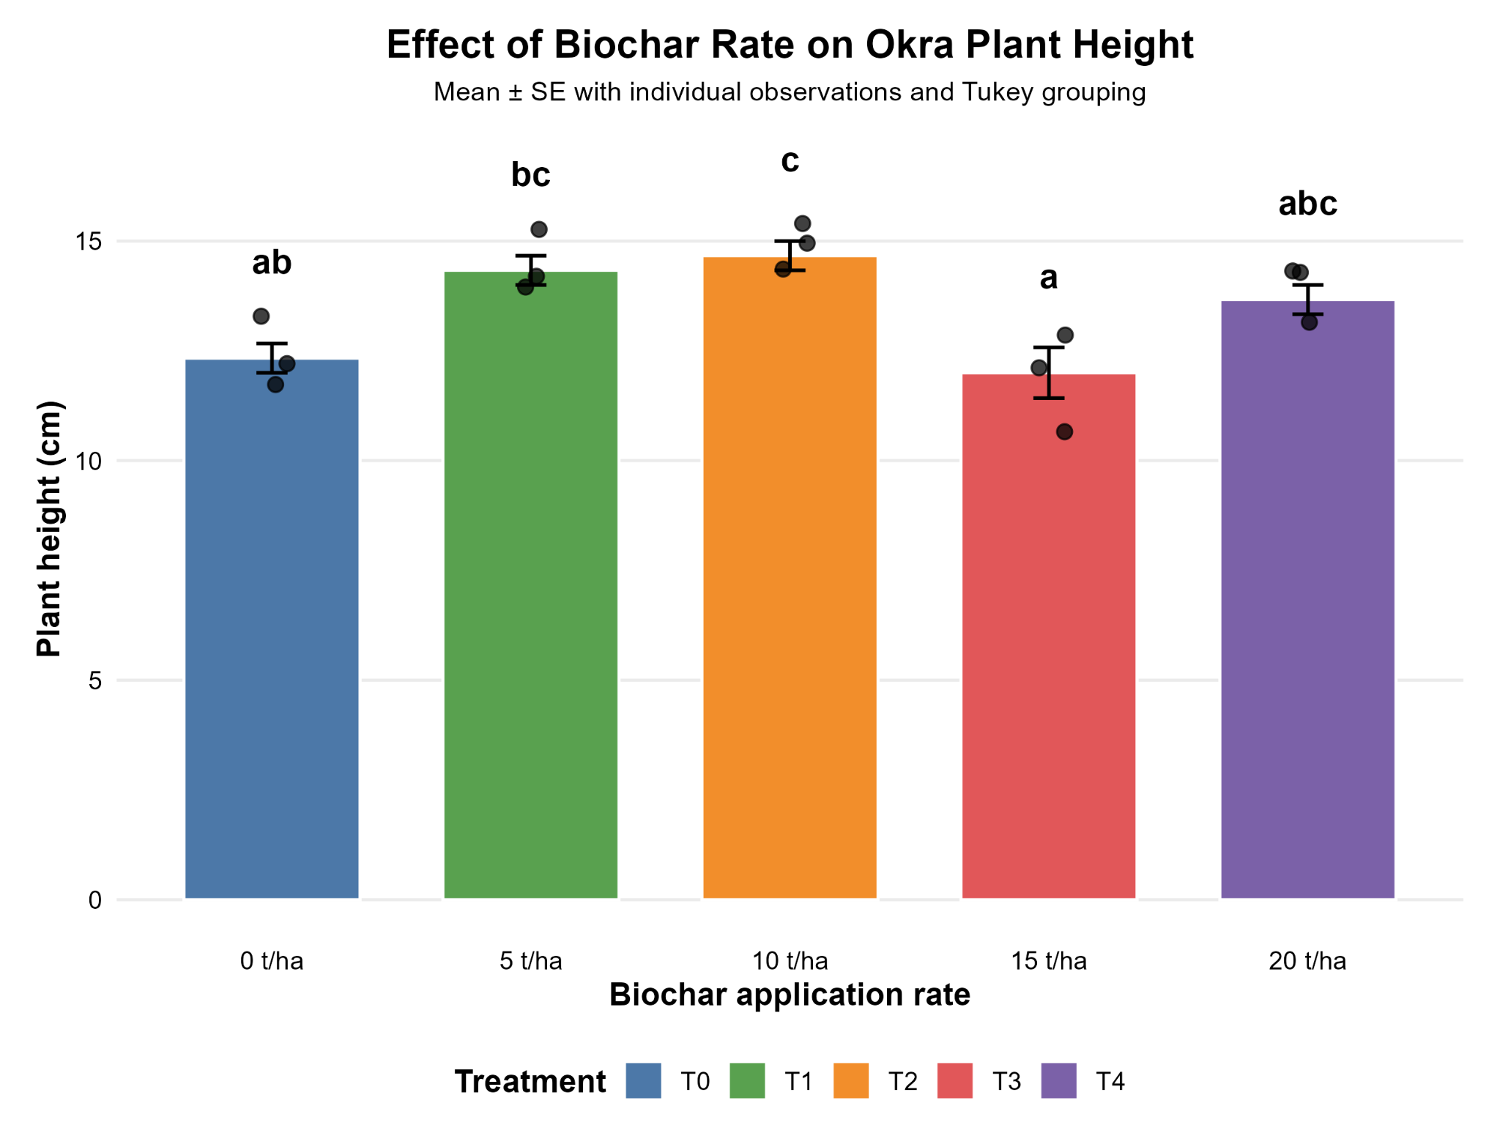
Growth Response: Plant Height
Treatment effect was significant (ANOVA p = 0.00232).
Treatment means ranged from 12.00 to 14.67 cm in the analyzed dataset.
T1 and T2 were higher than T3 in Tukey-adjusted comparisons; the full CLD is retained in the repository.
6

Slide 7
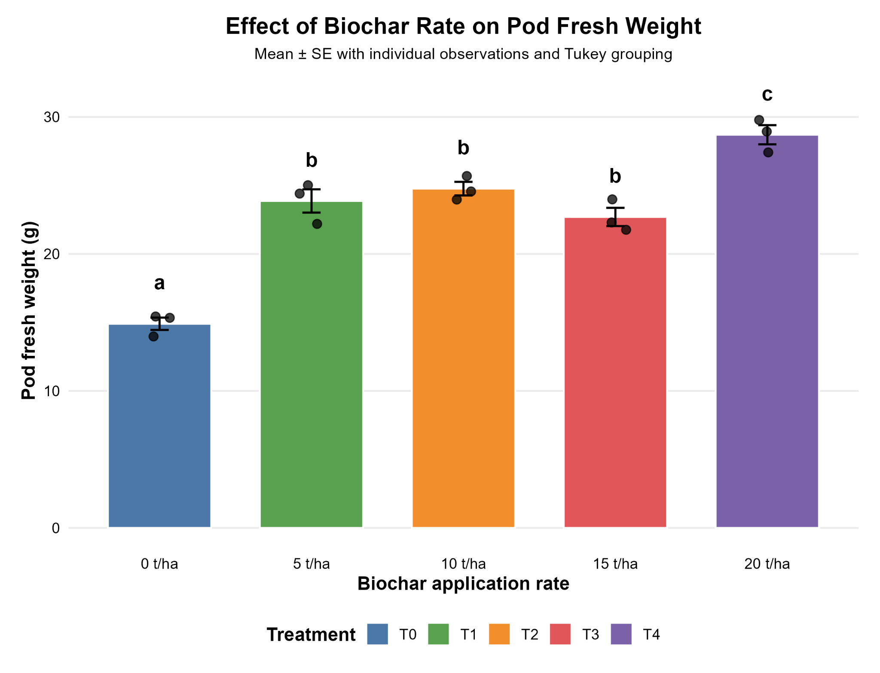
Yield Response: Pod Fresh Weight
Pod fresh weight showed a strong treatment effect (p < 0.001).
Mean pod fresh weight ranged from 14.9 g (T0) to 28.7 g (T4).
T4 formed a distinct higher statistical group than T0 in the CLD.
7

Slide 8
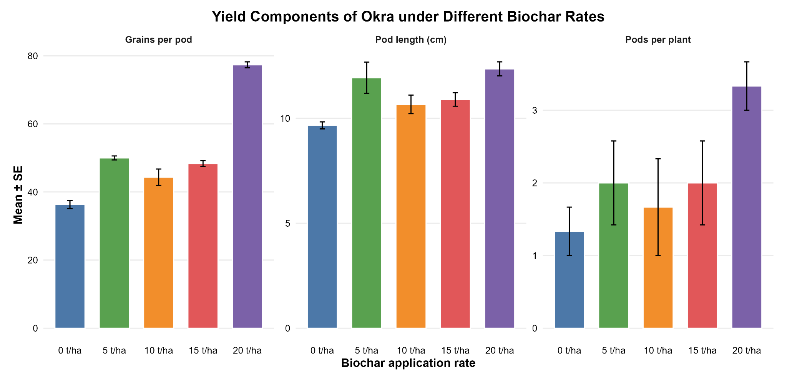
Yield Components
8

Slide 9
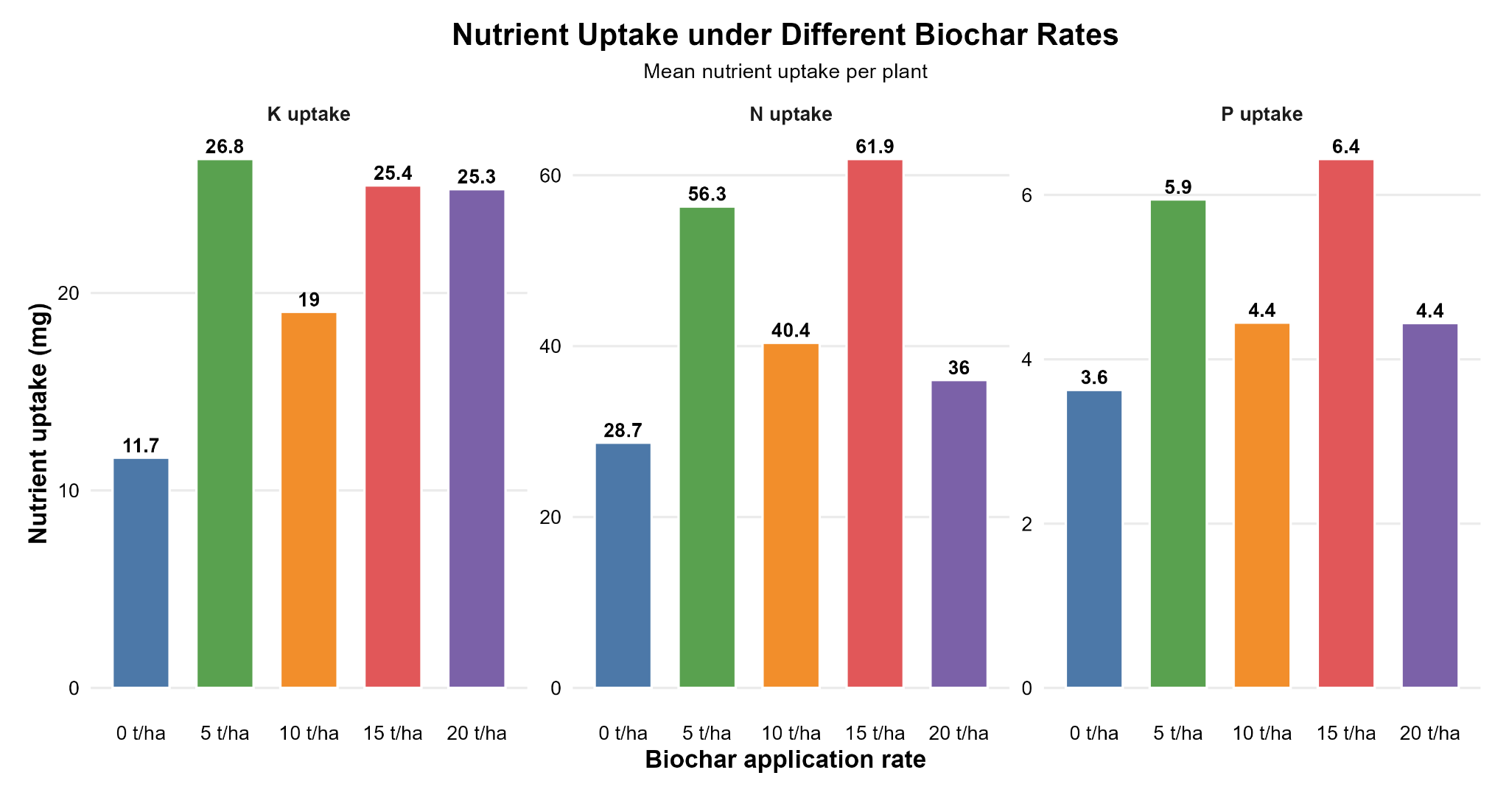
Nutrient Uptake
N uptake: T0 28.7; T1 56.3; T2 40.4; T3 61.9; T4 36.0 mg.
P uptake: T0 3.63; T1 5.95; T2 4.45; T3 6.44; T4 4.44 mg.
K uptake: T0 11.7; T1 26.8; T2 19.0; T3 25.4; T4 25.3 mg.
ANOVA did not detect significant treatment effects for N, P, or K uptake (p = 0.491, 0.721, and 0.516, respectively).
9

Slide 10
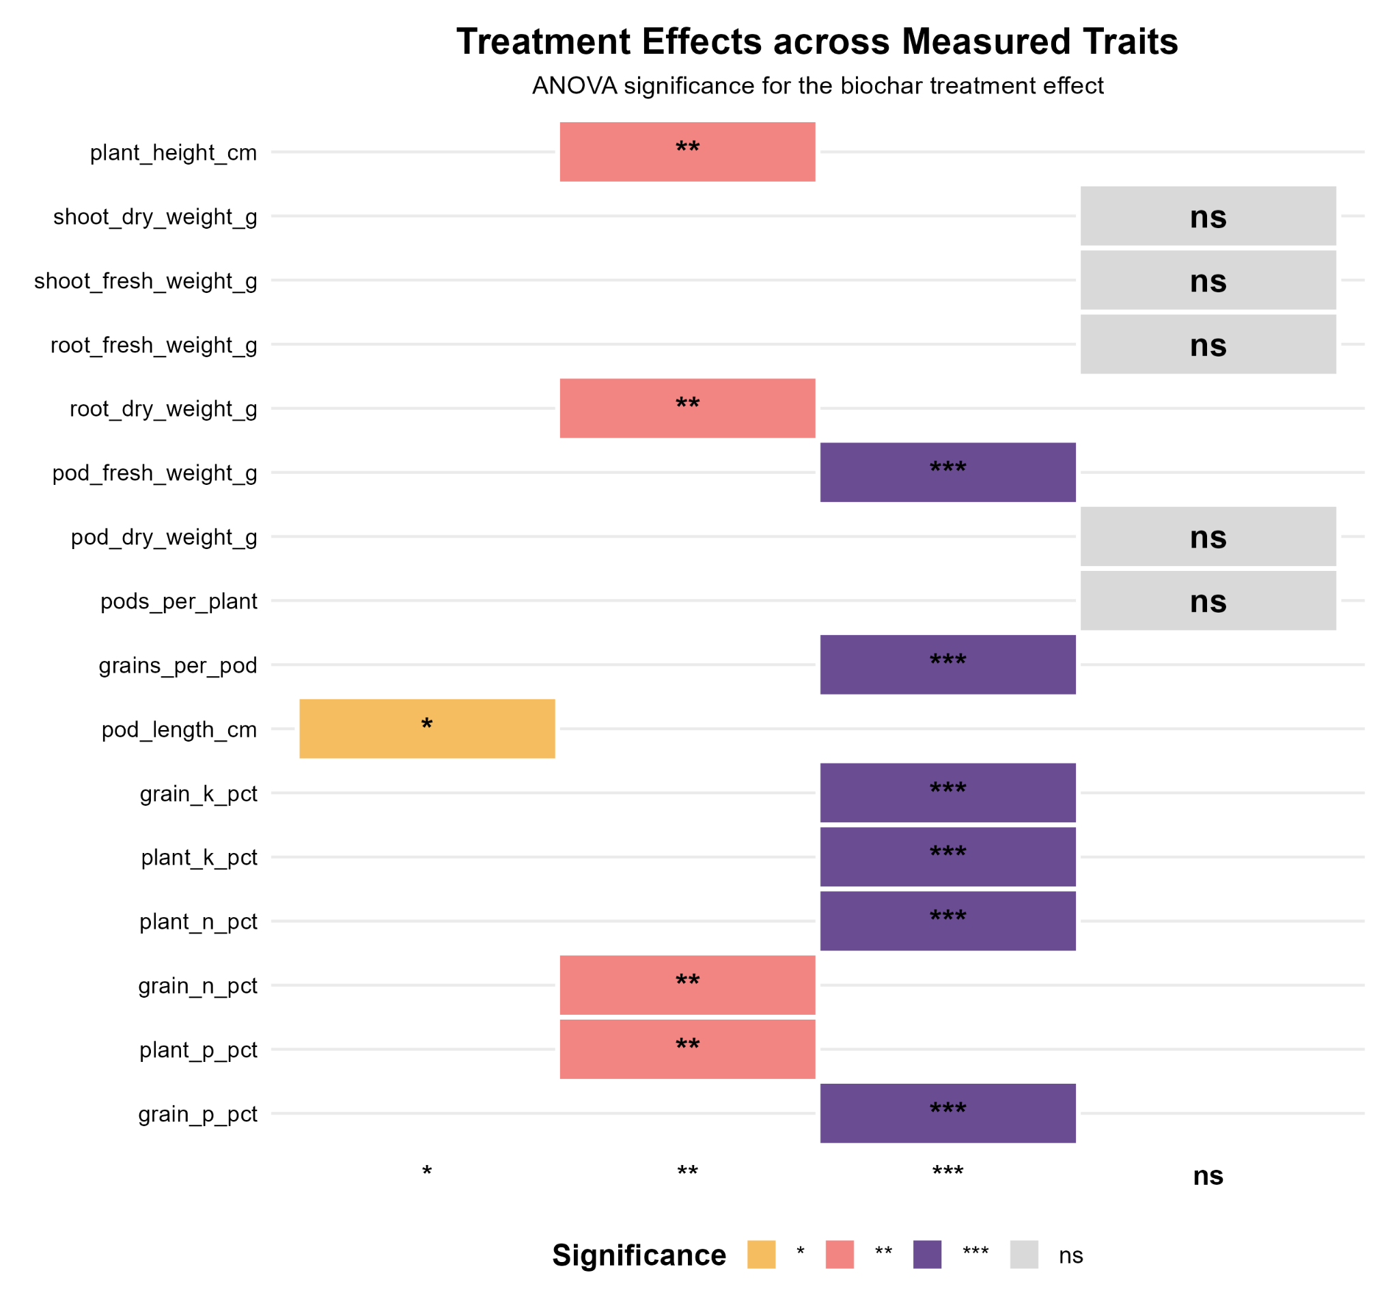
Overall Treatment Significance
Significant responses included plant height, root dry weight, pod fresh/dry weight, grains per pod, pod length, and N/P/K concentration traits.
Non-significant responses included shoot dry/fresh weight, root fresh weight, pods per plant, and nutrient uptake.
The complete ANOVA table is preserved in outputs/tables and outputs/CSV files.
10

Slide 11
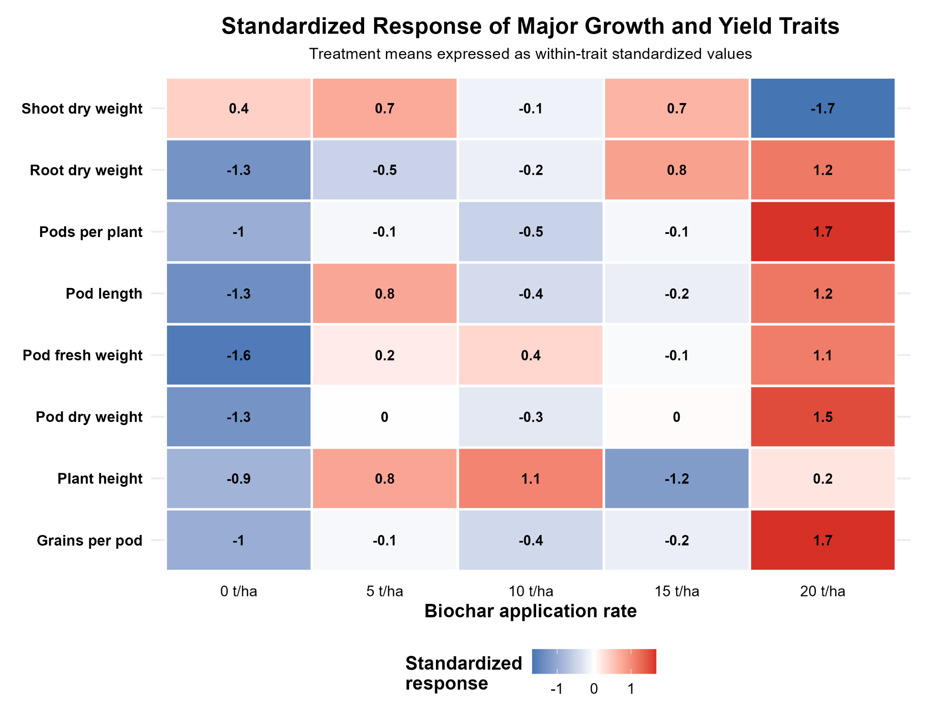
Integrated Response Pattern
11

Slide 12
Key Findings & Research Significance
Treatment effects were trait-specific rather than uniform across all measured variables.
Strong treatment responses were observed for several yield and nutrient-concentration traits.
Pod fresh weight showed one of the strongest treatment responses, with T4 having the highest observed mean.
N, P, and K uptake means differed numerically among treatments, but these differences were not statistically significant in the current ANOVA.
The repository preserves the raw/processed data, analysis scripts, statistical outputs, diagnostics, and presentation figures for reproducibility.
These results provide a foundation for the later manuscript; interpretation should remain limited to the measured experiment and its replication.
12

Slide 13
Reproducible Research Record
Data: experimental dataset and documented variables.
Scripts: sequential R workflow from import and validation through analysis and visualization.
Figures: diagnostic, final-response, and portfolio-ready visualizations.
Outputs: ANOVA, assumptions, estimated marginal means, Tukey comparisons, CLDs, treatment summaries, and nutrient-uptake results.
This presentation summarizes the current analysis record; the full research paper will be developed separately.
13

