Slide 1

Detecting AI-Generated Speech
Using Classical Cepstral & Spectral Features
Qusai Abu Sondos · Laith Shadeh · Mohammad Alabed
Spoken Language Processing — Summer 2026 | Birzeit University
Notes:
Intro: we built a system to tell real human speech apart from AI-generated (TTS/voice-conversion) speech, using classical speech-processing features rather than a big neural network.

Slide 2



MOTIVATION
Why This Matters
Voice cloning is cheap now
Modern TTS and voice-conversion systems can synthesize a convincing voice from a short reference clip.
It defeats biometric security
Automatic speaker verification (ASV) systems can be fooled by synthetic or converted speech — a direct spoofing threat.
It fuels fraud & misinformation
Impersonation calls, fake endorsements, and fabricated audio evidence all rely on the listener not being able to tell.
2
Notes:
Three reasons this matters: cheap voice cloning, ASV spoofing, and fraud/misinformation risk.

Slide 3

Research Question
Can classical, hand-crafted speech features still reliably separate real from AI-generated speech — and does that hold up against synthesis systems the model has never seen?
Extract MFCC, LFCC & spectral features
Train SVM and Random Forest classifiers
Test on known AND unseen attack types
3
Notes:
Our research question and three-part approach: features, classifiers, generalization test.

Slide 4

DATA
Dataset & Experimental Protocol
ASVspoof2019 Logical Access (LA) — official speaker-disjoint train/dev/eval protocol (no data leakage)
TRAIN
DEV
EVAL
3,000
1,000
1,500
1,500/class · 6 known attacks (A01–A06)
500/class · same 6 known attacks
750/class · 11 UNSEEN attacks (A07–A19)
Note: obtained via a Kaggle mirror — the official University of Edinburgh DataShare host was unreachable from our development environment.
4
Notes:
Train/dev share 6 known attacks; eval has 11 completely different, unseen attacks — that's our generalization test.

Slide 5

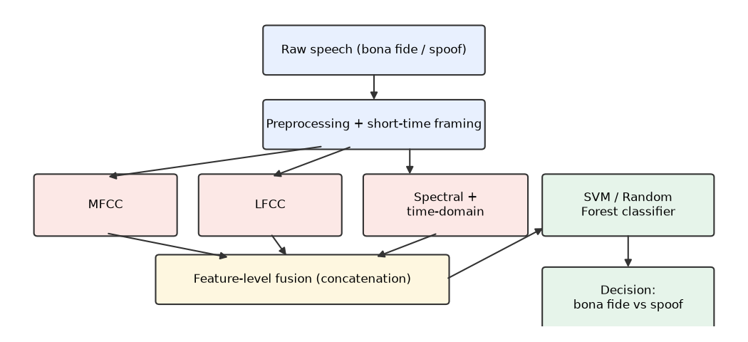
METHODOLOGY
Feature Extraction & Classification Pipeline
MFCC
20 coeffs + Δ+ΔΔ, Mel filterbank → 120-D
LFCC
Same, but custom LINEAR filterbank → 120-D
Spectral/time
Centroid, bandwidth, roll-off, flux, ZCR, energy → 12-D
Classifiers
SVM (RBF, calibrated) & Random Forest (300 trees)
5
Notes:
16kHz mono, 25ms window/10ms hop. Three feature families extracted independently then concatenated before classification.

Slide 6

RESULTS — KNOWN ATTACKS (DEV)
Feature Fusion Wins on Matched Data
BEST: All features + SVM
99.5%
0.3%
accuracy
EER
LFCC alone already beats MFCC alone by a wide margin (98.8% vs. 89.2%) — its linear frequency resolution captures artifacts MFCC's Mel-scale compression smooths over.
6
Notes:
On data matching the training distribution, combining all three feature families gives the best result: 99.5% accuracy, 0.3% EER.

Slide 7
RESULTS — GENERALIZATION (EVAL)
Accuracy Drops on Unseen Attacks — But Not Equally
LFCC alone collapses from 98.8% → 87.5% (spoof recall drops from 98.4% → 76.4%) — it partly memorizes known attack artifacts. The full feature combination stays the most robust: 91.1% accuracy / 6.5% EER on completely unseen attacks.
7
Notes:
The key generalization finding: LFCC looked best on dev but overfits; the fused feature set generalizes best.

Slide 8
RESULTS — PER-ATTACK BREAKDOWN
Failures Are Concentrated in Two Attacks
Best model (All+SVM) on eval: 7 of 11 unseen attacks detected perfectly, bona fide speech recognized 99.1% of the time — but A17 & A18 (likely advanced voice-conversion systems) evade detection almost entirely.
8
Notes:
This is the clearest, most actionable finding: aggregate accuracy hides that 2-3 specific attacks account for almost all failures.

Slide 9

Key Findings
Feature fusion is the most robust choice
Combining MFCC+LFCC+spectral consistently wins on both known and unseen attacks.
Single-feature accuracy can be misleading
LFCC alone tops the dev leaderboard but overfits and drops hardest on unseen attacks.
Vulnerabilities are specific, not general
Two unseen voice-conversion attacks (A17, A18) evade classical features almost completely.
False alarms stay low
Bona fide speech is correctly recognized ~99% of the time across all experiments.
9
Notes:
Four takeaways to remember: fusion is robust, single-feature wins can mislead, failures are concentrated, and false-alarm rate is low.

Slide 10

Live Demonstration
1
2
3
Pick a held-out audio clip
Run the trained pipeline
Show the verdict
One real (bona fide) and one AI-generated (spoof) recording, unseen during training.
Extract MFCC+LFCC+spectral features → feed to the SVM classifier.
Predicted label + confidence score for each clip, live.
10
Notes:
Now switch to the terminal/notebook: run src.evaluate or a small predict script on two held-out clips and show the output live.

Slide 11

CONCLUSION & FUTURE WORK
What We Achieved — and What's Next
Achieved
Future Work
Full classical-feature pipeline: extraction → training → evaluation
99.5% accuracy / 0.3% EER on known attacks
91.1% accuracy / 6.5% EER on 11 unseen attacks
Identified exactly which attacks classical features miss
Cross-dataset test on ASVspoof2021 DF / WaveFake
Add a CNN-on-spectrograms comparison
Feature selection targeted at the A17/A18 failure cases
Scale up from class-balanced subsets to the full corpus
11
Notes:
We met the project's objective; main gaps are a couple of specific attack types and untried deep-learning comparisons.

Slide 12

Thank You
Questions?
Qusai Abu Sondos · Laith Shadeh · Mohammad Alabed
Code, data pipeline & full report: github.com/qusaiAboSondos/spoken
12
Notes:
Thanks and open the floor for questions. AI tool usage is fully disclosed in the written report.

