Slide 1


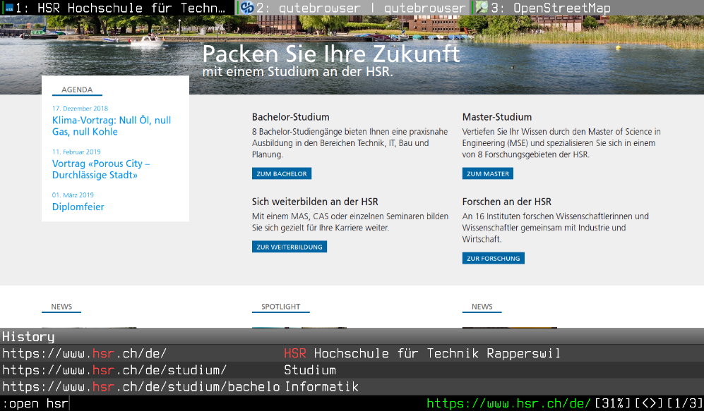
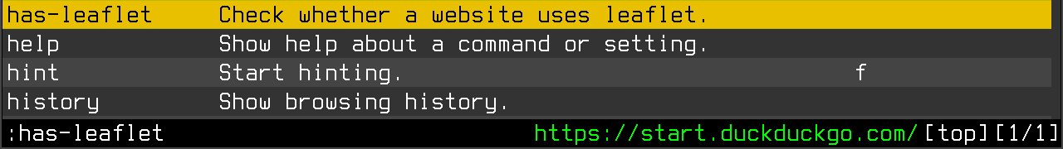
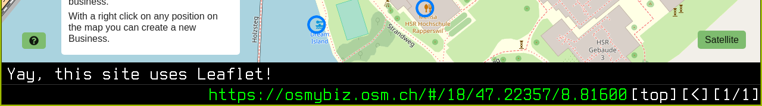
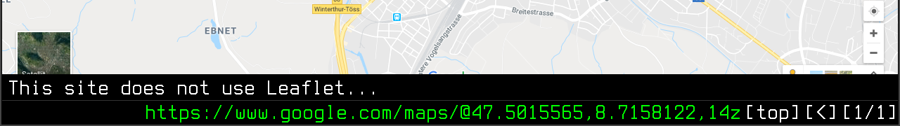
qutebrowser made extensible
Advisor: Prof. Stefan Keller
Term Project Autumn Term 2018/2019
Subject area: Software
Florian Bruhin
The qutebrowser project is a web browser focused on keyboard usage. It was started as an open-source project in 2013.
The goal of this term project was to make qutebrowser extensible by introducing an extension API. That API was then used to move code from qutebrowser‘s core to built-in extensions.
The resulting changes improved the maintainability and simplicity of qutebrowser‘s core.
An example extension was developed for demonstration purposes which adds a new :has-leaflet command to qutebrowser. It checks whether a website uses the „Leaflet“ JavaScript library, which is often used to show OpenStreetMap maps.

