Slide 1
Ethernet Basics (Standards Organizations and CSMA/CD)

Slide 2
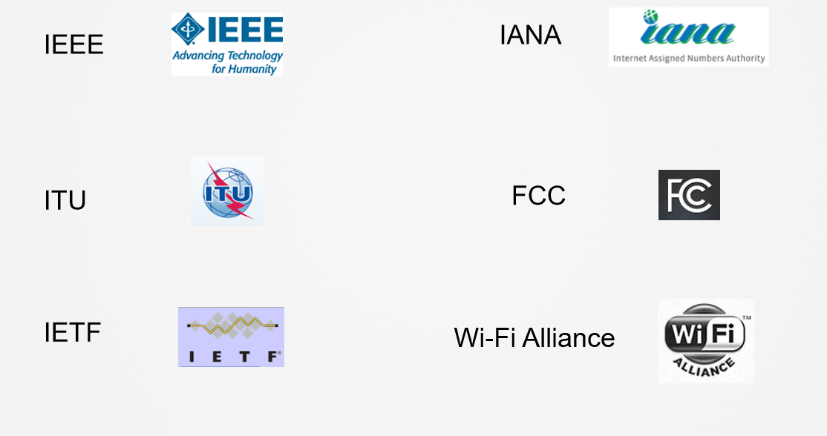
Standards Organizations

Slide 3
Broadcast & Collision Domains
» Broadcast domains
• Everyone sees all frames
» Collision domains
• Collection of devices that all access a shared medium
» How to send traffic on a wire that EVERYONE can access at the same time?
• TDM
• FDM
• Other?

Slide 4
CSMA/CD
» Half Duplex vs. Full Duplex
» Carrier Sense
» Multiple Access
» Collision Detect

Slide 5
Ethernet Basics (Frame Structure and Cabling)
Distance, Cables, & Duplex
The developers of Ethernet had some additional decisions to make:
1. Maximum Speed?
• Originally 2.94Mbps (millions-of-bits-per-second)
2. Maximum distance of transmission?
• They decided on 100 meters.
3. What type of cable?
• They decided on copper (coaxial) cable.

Slide 6
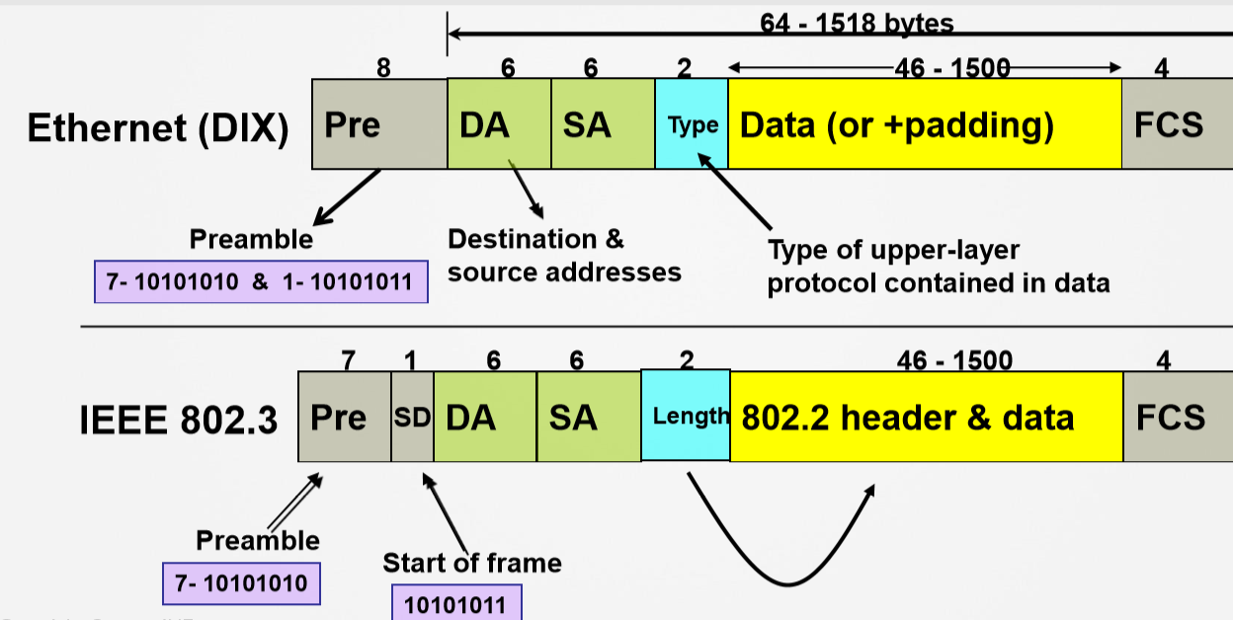
Ethernet Frame Structure

Slide 7
Data Link Layer
» MAC
• 48-bit addressing system
•Example: aaaa.aaaa.aaaa
•First 24 bits are considered OUI
•Remaining 24 bits are considered vendor assigned

Slide 8
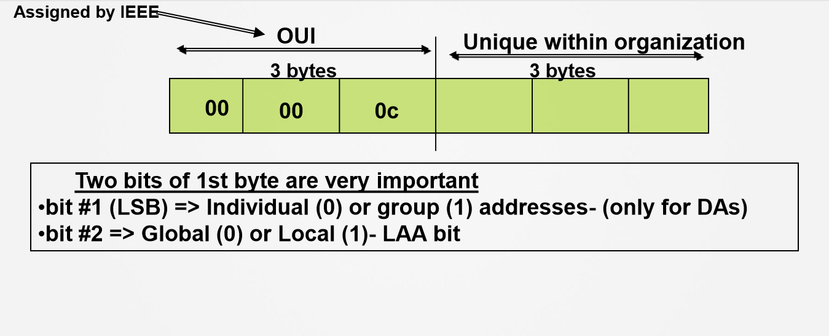
MAC Address

Slide 9
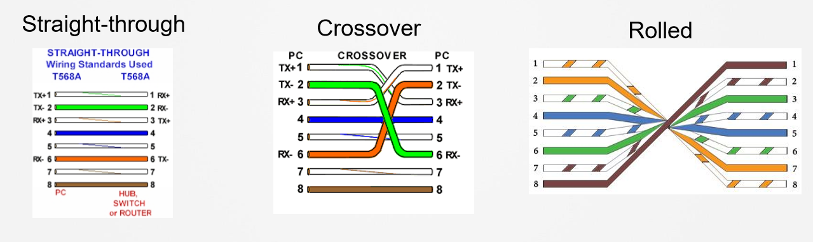
Ethernet Cabling Details
» Twisted-pair cabling comes in three varieties:

