Slide 1
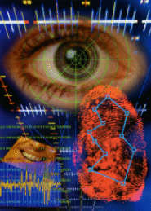
Introduction to
Biometric Authentication
By Norman Poh
Field Supervisor
Prof. Jerzy Korczak
First Supervisor
Dr. Ahmad Tajudin Khader

Slide 2
Outline
The Basics
Biometric Technologies
Multi-model Biometrics
Performance Metrics
Biometric Applications

Slide 3
Section I: The Basics
Why Biometric Authentication?
Frauds in industry
Identification vs. Authentication

Slide 4


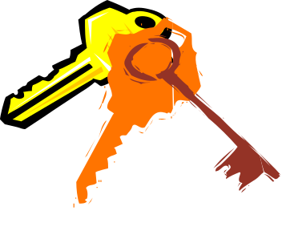
What is Biometrics?
The automated use behavioral and physiological characteristics to determine or veiry an identity.
PIN
Rapid!
Know
Be
Have

Slide 5
Frauds in industry happens in the following situations:
Safety deposit boxes and vaults
Bank transaction like ATM withdrawals
Access to computers and emails
Credit Card purchase
Purchase of house, car, clothes or jewellery
Getting official documents like birth certificates or passports
Obtaining court papers
Drivers licence
Getting into confidential workplace
writing Checks

Slide 6
Why Biometric Application?
To prevent stealing of possessions that mark the authorised person's identity e.g. security badges, licenses, or properties
To prevent fraudulent acts like faking ID badges or licenses.
To ensure safety and security, thus decrease crime rates

Slide 7
Identification vs. Authentication
Identification
Authentication
It determines the identity of the person.
It determines whether the person is indeed who he claims to be.
No identity claim
Many-to-one mapping.
Cost of computation ∝ number of record of users.
Identity claim from the user
One-to-one mapping.
The cost of computation is independent of the number of records of users.
Captured biometric signatures come from a set of known biometric feature stored in the system.
Captured biometric signatures may be unknown to the system.

Slide 8
Section II: Biometric Technologies
Several Biometric Technologies
Desired Properties of Biometrics
Comparisons

Slide 9
Types of Biometrics
Fingerprint
Face Recognition → Session III
Hand Geometry
Iris Scan
Voice Scan → Session II
Signature
Retina Scan
Infrared Face and Body Parts
Keystroke Dynamics
Gait
Odour
Ear
DNA
Notes:
Odour: sensor arrays → sensor descriptors (a set of vocabulary)
Main Obstacles: sensors may drift, of suffer from poisoning, limited lifetime (constantly replaced),
Not as sensitive as human nose.
Complicated by the use of deodorants, perfumes and diets
We are looking for instruments capable of distinguishing invariant components of human odour

Slide 10
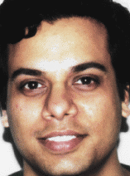
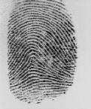

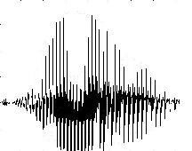
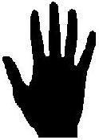
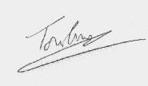
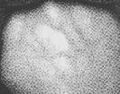
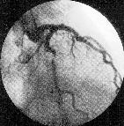
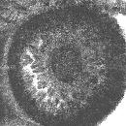
Biometrics
2D Biometrics (CCD,IR, Laser, Scanner)
1D Biometrics

Slide 11
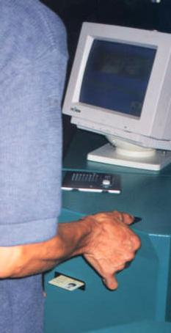
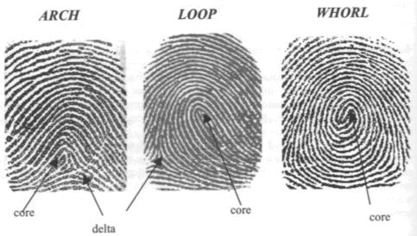
Fingerprint

Slide 12
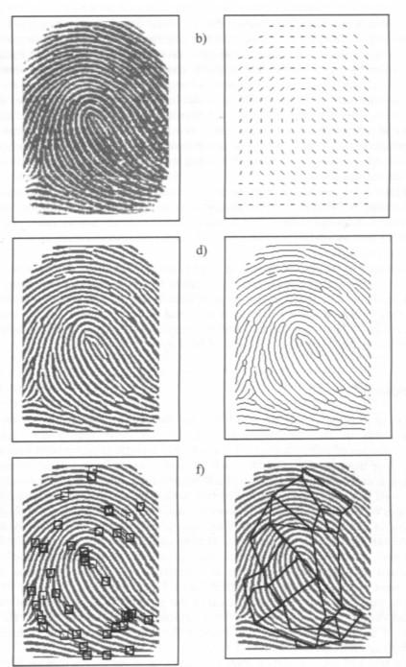
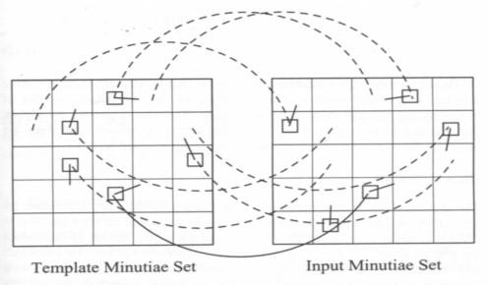
Fingerprint Extraction and Matching

Slide 13
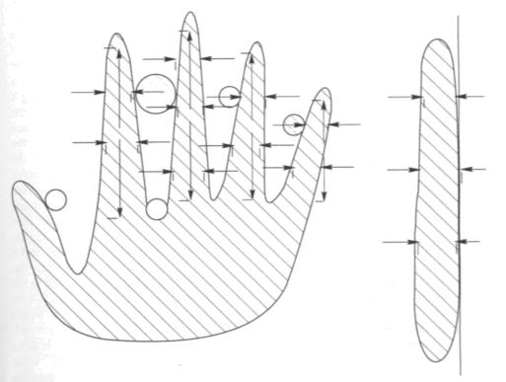
Hand Geometry
Captured using a CCD camera, or LED
Orthographic Scanning
Recognition System’s Crossover = 0.1%
Notes:
CCD = Charged coupled device,
LED = Light Emitting Diodes

Slide 14
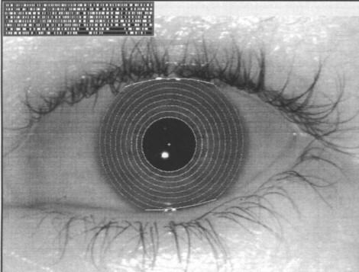

IrisCode
Notes:
2D Gabor wavelets
256 bytes

Slide 15
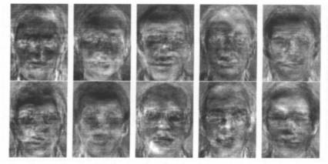
Face
Principal Component Analysis

Slide 16
Desired Properties
Universality
Uniqueness
Permanence
Collectability
Performance
User’s Accpetability
Robustness against Circumvention

Slide 17
Comparison
Biometric Type
Accuracy
Ease of Use
User Acceptance
Fingerprint
High
Medium
Low
Hand Geometry
Medium
High
Medium
Voice
Medium
High
High
Retina
High
Low
Low
Iris
Medium
Medium
Medium
Signature
Medium
Medium
High
Face
Low
High
High

Slide 18
Section III: A Multi-model Biometrics
Multi-modal Biometrics
Pattern Recognition Concept
A Prototype

Slide 19
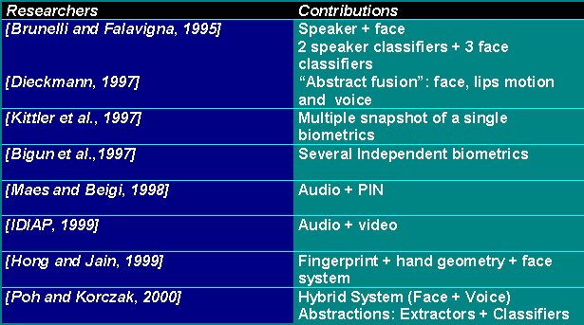
Multimodal Biometrics

Slide 20


Pattern Recognition Concept
Sensors
Extractors
Image- and
signal- pro.
algo.
Classifiers
Negotiator
Threshold
Decision:
Match,
Non-match,
Inconclusive
Biometrics
Voice, signature
acoustics, face,
fingerprint, iris,
hand geometry, etc
Data Rep.
1D (wav),
2D (bmp,
tiff, png)
Feature
Vectors
Scores
Enrolment
Training
Submission

Slide 21





An Example:
A Multi-model System
Sensors
Extractors
Classifiers
Negotiator
ID
Accept/
Reject
Face
Extractor
Face
Feature
Face
MLP
2D (bmp)
AND
Voice
Extractor
Voice
Feature
Voice
MLP
1D (wav)
Objective: to build a hybrid and expandable biometric app. prototype
Potential: be a middleware and a research tool
Notes:
The objective of the project!
The approach: use several algorithms manipulating the same data.

Slide 22
Abstraction
Negotiation
Logical AND
Diff. Combination Strategies.
e.g. Boosting, Bayesian
Learning-based
Classifiers
Voice MLP
Face MLP
…
Cl-q
NN, SVM,
Extractors
Voice Ex
Face Ex
Ex-q
…
Different Kernels (static or dynamic)
Basic Operators
{LPC, FFT, Wavelets,
data processing}
{Fitlers, Histogram Equalisation,
Clustering, Convolution, Moments}
Signal Processing, Image Procesing
Data Representation
1D
2D
3D
Biometrics
Voice,
signature acoustics
Face, Fingerprint,
Iris, Hand Geometry, etc.
Face

Slide 23
An Extractor Example: Wave Processing Class
fWaveProcessing
cWaveProcessing
cWaveOperator
1
1
Operators
1
1
1
1
1
1
cWaveStack
cPeripherique
Audio
cFFT
cFFilter
cWavelet
cLPC
cDataProcessing
Input data
Output data
Operants
1
1
*
cWaveObject

Slide 24





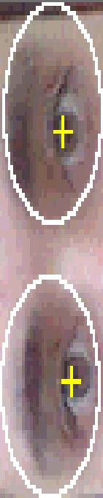








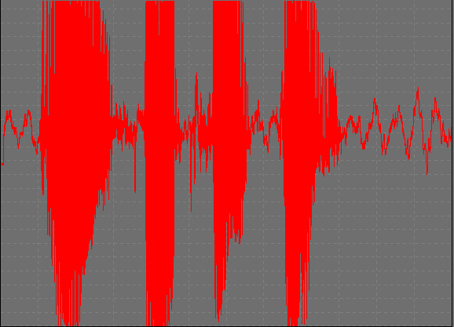
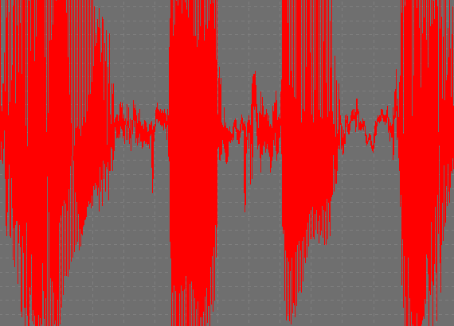
System Architecture in Details
LSIIT, CNRS-ULP, Groupe de Recherche en Intelligence Artificielle
USM
Visage
Normalisation
+ Codage
Apprentissage et
Reconnaissance
Détection des yeux
Décision
Moment
Vert
Bleu
Hue
Filtre de base
Trouver Y
Trouver X
Inondation +
Convolution
Saturation
Réseau des
neurones
Intensité
Extraction
w1
Base des données
Accepter,
Rejeter
Identité
Voix
Normalisation
+ Codage
Apprentissage et
Reconnaissance
w2
Transformation de l’ondelette
Effacer les
silences
C₀ C₁ C₂ C₃ C₄ C₅ C₆ C₇
Fréquence
C₉ C₁₀ C₁₁ C₁₂
C₁₃ C₁₄
Temps
C₁₅
Réseau des
neurones
Pour plus de renseignements : Pr J. Korczak, Mr N. Poh <jjk, poh>@dpt-info.u-strasbg.fr

Slide 25
Section IV: Performance Metrics
Confusion Matrix
FAR and FRR
Distributed Analysis
Threshold Analysis
Receiver Operating Curve

Slide 26
Testing and Evaluation: Confusion Matrix
ID-1
ID-2
ID-3
Correct
Wrong
Cl-1
0.98
0.01
0.01
0.90
0.05
0.78
Cl-2
…
…
…
Threshold =
0.50
Cl-3
…
…
…
False Accepts
False Rejects

Slide 27
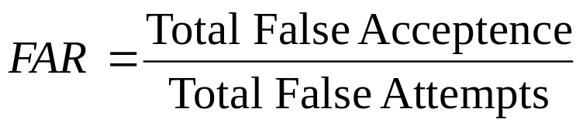
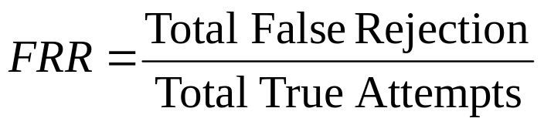
A Few Definitions
EER is where FAR=FRR
Crossover = 1 : x Where x = round(1/EER)
Failure to Enroll, FTE
Ability to Verify, ATV = 1- (1-FTE) (1-FRR)

Slide 28
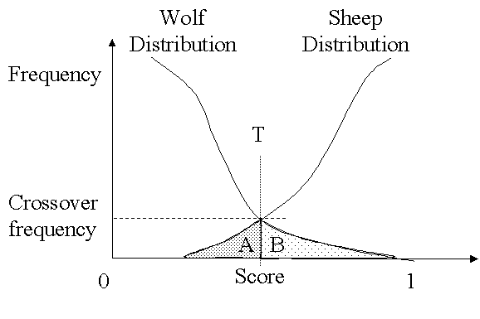
Distribution Analysis
A = False Rejection
B = False Acceptance
A typical wolf and a sheep distribution

Slide 29
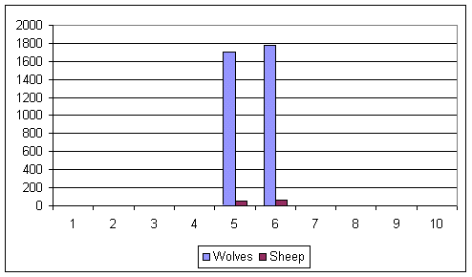
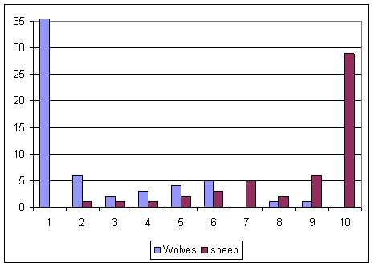
Distribution Analysis: A Working Example
Before learning
After learning
Wolves and Sheep Distribution

Slide 30
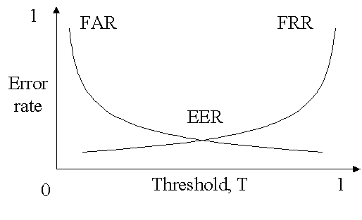
Threshold Analysis
Minimum
cost
FAR and FRR vs. Threshold

Slide 31
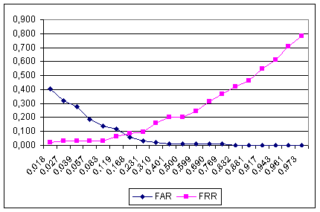
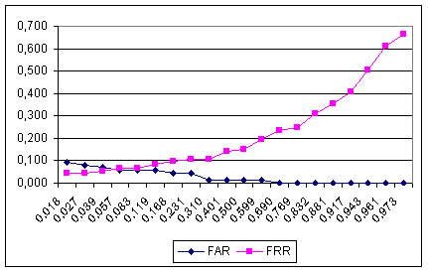
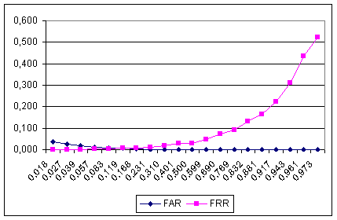
Threshold Analysis : A Working Example
Face MLP
Voice MLP
Combined MLP

Slide 32
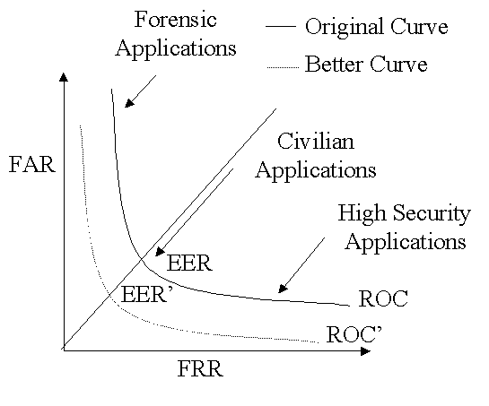
Receiver Operating Curve (ROC)

Slide 33
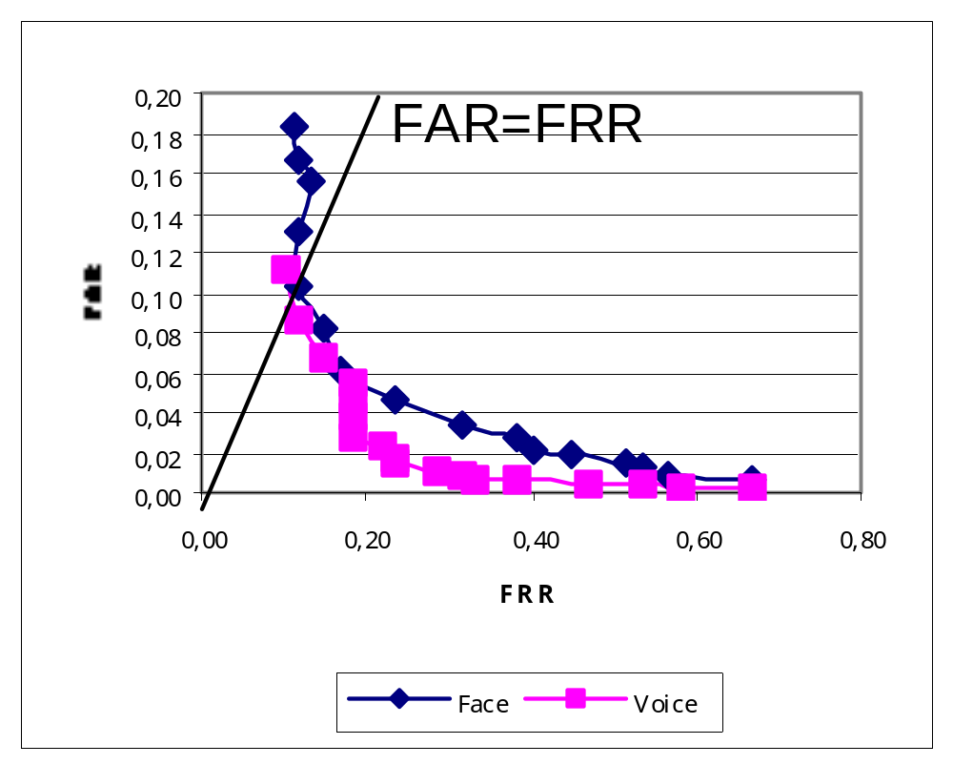
ROC Graph : A Working Example

Slide 34
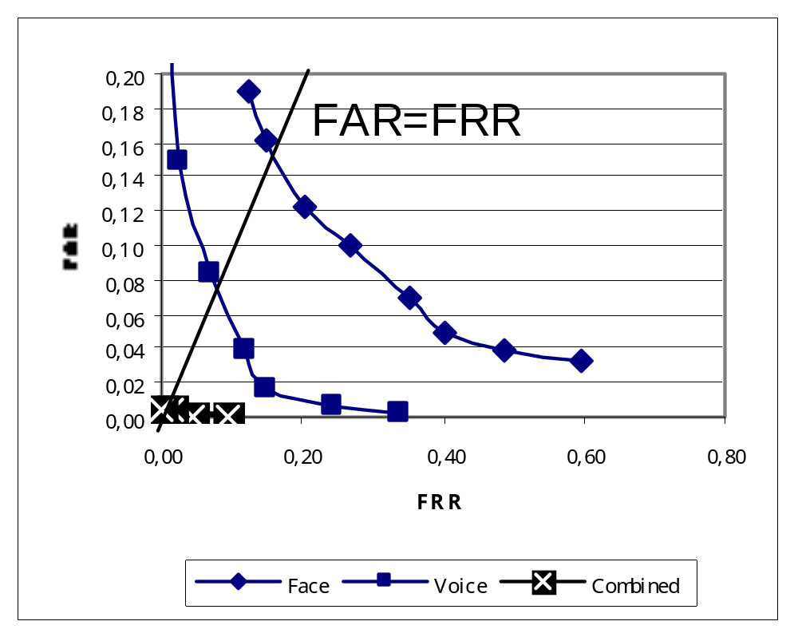
Equal Error Rate
Face : 0.14
Voice : 0.06
Combined : 0.007

Slide 35
Section V: Applications
Authentication Applications
Identification Applications
Application by Technologies
Commercial Products

Slide 36
Biometric Applications
➢ Identification or Authentication (Scalability)?
➢ Semi-automatic or automatic?
➢ Subjects cooperative or not?
➢ Storage requirement constraints?
➢ User acceptability?

Slide 37

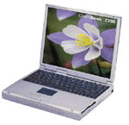
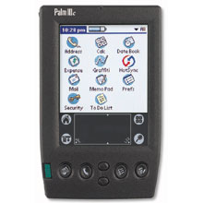
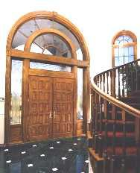


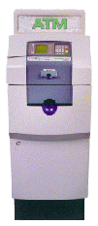
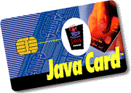

Biometrics-enabled Authentication Applications
Cell phones, Laptops, Work Stations, PDA & Handheld device set.
2. Door, Car, Garage Access
3. ATM Access, Smart card
Image Source : http://www.voice-security.com/Apps.html

Slide 38
Biometrics-enabled Identification Applications
Forensic : Criminal Tracking
  e.g. Fingerprints, DNA Matching
Car park Surveillance
Frequent Customers Tracking

Slide 39
Application by Technologies
Biometrics
Vendors
Market Share
Applications
Fingerprint
90
34%
Law enforcement; civil government; enterprise security; medical and financial transactions
Hand Geometry
-
26%
Time and attendance systems, physical access
Face Recognition
12
15%
Transaction authentication; picture ID duplication prevention; surveillance
Voice Authentication
32
11%
Security, V-commerce
Iris Recognition
1
9%
Banking, access control

Slide 40
Commercial Products
The Head
The Eye
The Face
The Voice
Eye-Dentify
IriScan
Sensar
Iridian
Visionics
Miros
Viisage
iNTELLiTRAK
QVoice
VoicePrint
Nuance
The Hand
The Fingerprint
Hand Geometry
Behavioral
Identix
BioMouse
The FingerChip
Veridicom
Advanced Biometrics
Recognition Systems
BioPassword
CyberSign
PenOp
Other Information
Bertillonage
International Biometric Group
Palmistry
Notes:
Source: http://library.thinkquest.org/28062/link.html
Biometric Authentication Percentages
By Chris DeVoney & David Hakala, Sm@rt Partner
http://www.zdnet.com/sp/stories/issue/0,4537,2664300-8,00.html

Slide 41
Main Reference
[Brunelli et al, 1995] R. Brunelli, and D. Falavigna, "Personal identification using multiple cues," IEEE Trans. on Pattern Analysis and Machine Intelligence, Vol. 17, No. 10, pp. 955-966, 1995
[Bigun, 1997] Bigun, E.S., J. Bigun, Duc, B.: “Expert conciliation for multi modal person authentication systems by Bayesian statistics,” In Proc. 1st Int. Conf. On Audio Video-Based Personal Authentication, pp. 327-334, Crans-Montana, Switzerland, 1997
[Dieckmann et al, 1997] Dieckmann, U., Plankensteiner, P., and Wagner, T.: “SESAM: A biometric person identification system using sensor fusion,” In Pattern Recognition Letters, Vol. 18, No. 9, pp. 827-833, 1997
[Kittler et al, 1997] Kittler, J., Li, Y., Matas, J. and Sanchez, M. U.: “Combining evidence in multi-modal personal identity recognition systems,” In Proc. 1st International Conference On Audio Video-Based Personal Authentication, pp. 327-344, Crans-Montana, Switzerland, 1997
[Maes and Beigi, 1998] S. Maes and H. Beigi, "Open sesame! Speech, password or key to secure your door?", In Proc. 3rd Asian Conference on Computer Vision, pp. 531-541, Hong Kong, China, 1998
[Jain et al, 1999] Jain, A., Bolle, R., Pankanti, S.: “BIOMETRICS: Personal identification in networked society,” 2nd Printing, Kluwer Academic Publishers (1999)
[Gonzalez, 1993] Gonzalez, R., and Woods, R. : "Digital Image Processing", 2nd edition, Addison-Wesley, 1993.

