Slide 1

Part III: Data Processing & Information Systems
By Dr. Alvin Chan
Dept. of Computing

Slide 2
Assessment
Examination 60%
Continuous Work 40%
  Part I&II 25%
  Part III 15%
  1 Quiz (Tutorial): 5%
  1 Lab Exercise: 5%
  1 Assignment: 5%
  15%
Introduction

Slide 3
Operations of Part III
Please use the Blackboard (http://learn.polyu.edu.hk) for downloading the lecture notes and lab materials!
Lecturer: Dr. Alvin Chan
  Room: PQ836
  Phone: 27667244
  Email: cstschan@comp.polyu.edu.hk
Tutors: Dr. Ronald Ip deb44890@inet.polyu.edu.hk and Dr. Kai Yuen Cheong kaiyuen@newserver.eie.polyu.edu.hk
Lab Tutors: Mr. Zhang Kunai and Mr. Qu Xiaofeng
Introduction

Slide 4
References for Part III
Carlos Coronel (Author), Steven Morris (Author), Peter Rob (Author),
Database Principles: Fundamentals of Design, Implementation, and Management, 10th Edition, Course Technology.
Carlos Coronel (Author), Steven Morris (Author), Peter Rob (Author),
Database Systems: Design, Implementation, and Management, 9th Edition.
Michael Mannino,
Database Design, Application Development, & Administration. 3rd Ed.,
McGraw-Hill, 2007.
Wikipedia and other web resources!
Introduction

Slide 5
Topics to be covered in Part III
Introduction to Database
Data Models
Relational Database Model
ER Modeling
SQL (Structural Query Language)
Information Systems
Introduction

Slide 6
Teaching Schedule for Part III
Week | Lecture | Tutorial* | Lab
10 | Introduction | - | No lab
11 | Data Models and Relational Data Model | - | MS Access
12 | ER Modeling | RDM, ER Modeling | -
13 | SQL | - | MS Access
14 | Information Systems | SQL | No lab
* Please follow the instruction of your tutors (Dr. Cheong and Dr. Ip). The schedule here is only for reference only.
Introduction

Slide 7
Introduction to Database
IT, Database & Information Systems
Why do we need a database?
Some Database applications
Introducing database (DB) and database management system (DBMS)
Types of databases
Preliminary database design
Database system components and environment
Introduction

Slide 8

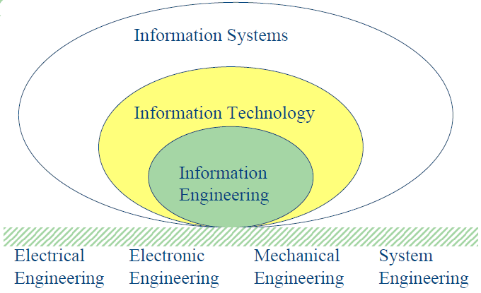
IT: An infrastructure to support various business operations
IT, Database & Information Systems
Components of IT:
Computer
Networking
Data Processing
Database
Introduction

Slide 9
Information Systems
An information system (IS) is similar to a physical system (such as the circulatory system) except that it manipulates data rather than a physical object like blood.
An IS accepts data from its environment, processes data, and produces output data for decision making.
Databases (DB) are essential components of many IS. The role of a DB is to provide long-term memory for an IS.
Introduction

Slide 10
Information Systems
The term information system (IS) sometimes refers to a system of persons, data records and activities that process the data and information in an organization, and it includes the organization's manual and automated processes.
Computer-based information systems are the field of study for information technology, elements of which are sometimes called an "information system" as well.

Slide 11
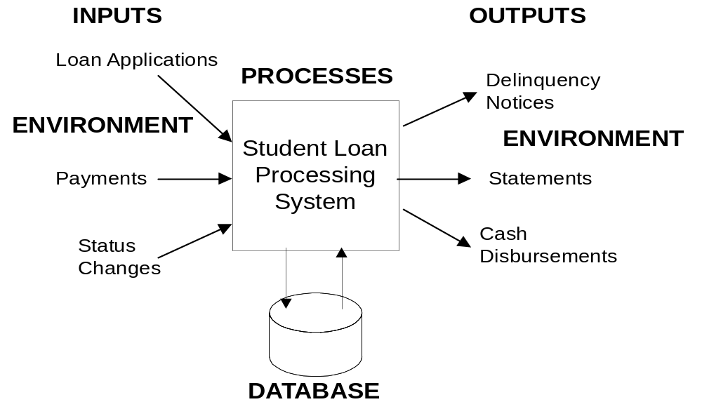
Information Systems: An Example
Notes:
Information system:
- Accepts data from its environment, processes data, and produces output data
for decision making
- Interacts with environment
- Database provides the long-term memory
- Database is a key component but not the only component
- Other components: inputs, outputs, processes, software, hardware, people
- Developing info system more than db development
Student Loan System:
- Full case study in Chapter 13
- Environment: lenders, students, government agencies

Slide 12
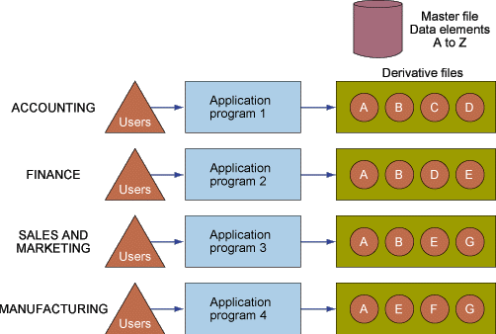
Storing Data In Files (not DB)
Why do we need a database?
Introduction

Slide 13
Storing Data In Files (not DB)
Problems (1)
Data redundancy and inconsistency
  Multiple file formats, duplication of information in different files (e.g. A, B, E, etc.)
Program-Data dependence
  Need to write a program to carry out each task -> More programming effort!
Lack of flexibility
  Not straightforward to introduce new applications and to scale up the existing ones
Poor security
  Program bugs in different programs may reveal the sensitive data
Introduction

Slide 14
Storing Data In Files (not DB)
Problems (2)
Lack of data-sharing and availability
  Concurrent access by multiple users (e.g. web booking of movie tickets)
  Uncontrolled concurrent access can lead to inconsistencies (e.g. multiple persons claiming the same movie seat)
Atomicity
  Failure of some steps may lead to inconsistencies
  E.g., transferring funds between accounts (You don’t want to have your credit card/bank account debited without crediting your Octopus card!)
Introduction

Slide 15
Octopus – EPS problem
Use EPS (electronic payment system) to add value to Octopus
  EPS deducted, value not added to Octopus!
System consists of:
  2 databases (EPS, Octopus) and
  a network
The many steps involved constitute one “transaction”
  If a problem occurs at any step
  The transaction should be aborted
  → atomicity issue
Introduction

Slide 16
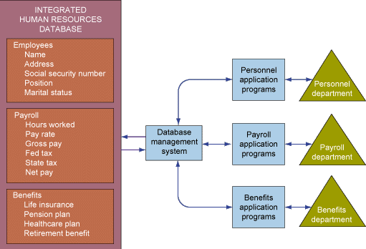
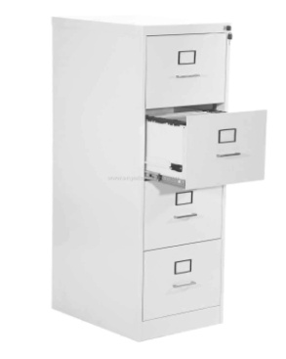


Storing Data in
Modern Database Management Systems
Introduction

Slide 17
Database Example 1
Some Database Applications
  Mary Richards Housepainting
  Self-employed Entrepreneur
  Single User
  3 Tables (Customers, Jobs, Source)
  Data Needs:
    Track how customers, jobs, and referrals relate
    Track referral sources
    Record bid estimates
    Produce mailing labels

Slide 18

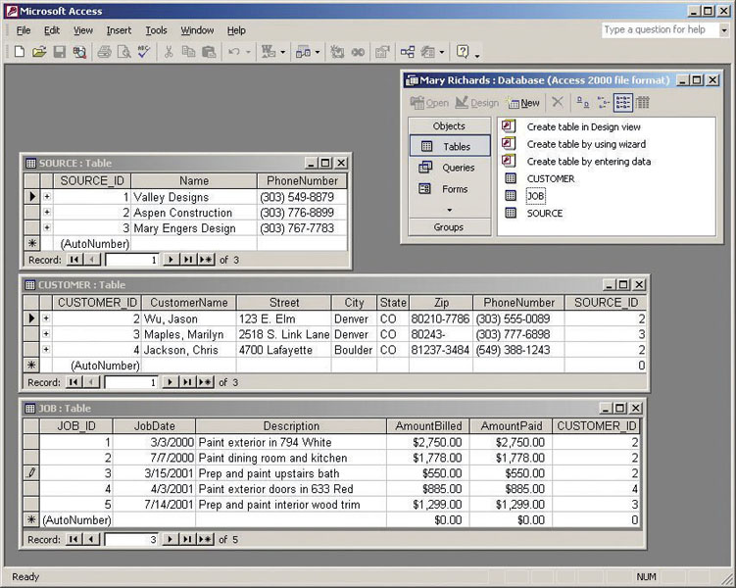
SOURCE
CUSTOMER
JOB
Introduction

Slide 19
Database Example 2
Treble Clef Music
Multi-User database on LAN
3 Tables (Customers, Instruments, Rentals)
Data Needs:
  Track instrument rentals
  Handle multi-user issues
Introduction

Slide 20

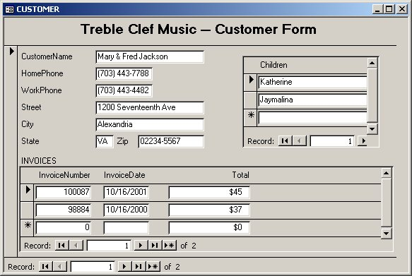
Introduction

Slide 21

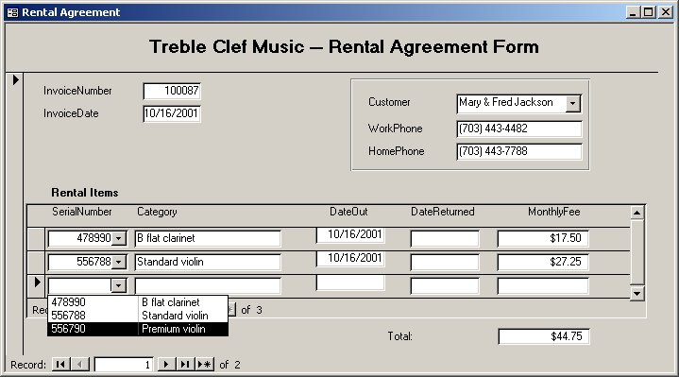
Introduction

Slide 22

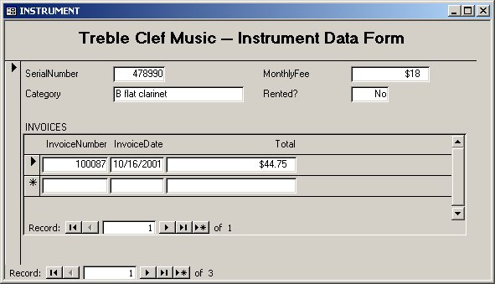
Introduction

Slide 23
Database Example 3
State Licensing & Vehicle Registration Bureau
52 Centers, 37 Offices, Hundreds of Users
40 Tables (complex problem, large number of tables!)
Data Needs:
  Track drivers licensing issues
    traffic violations, accidents, arrests, limitations
  Track auto registration issues
    revenue, law enforcement
  Integrate the needs of many departments
Introduction

Slide 24
Database Example 4
Calvert Island Reservations Centre
Chamber of Commerce
Promotional database provides access to data
Customer and reservation database processes
Data Needs:
  Store multimedia data (photos, video clips, sound clips)
  Must be Web / browser accessible
  Uses Web technologies including HTTP, DHTML, and XML
Introduction

Slide 25

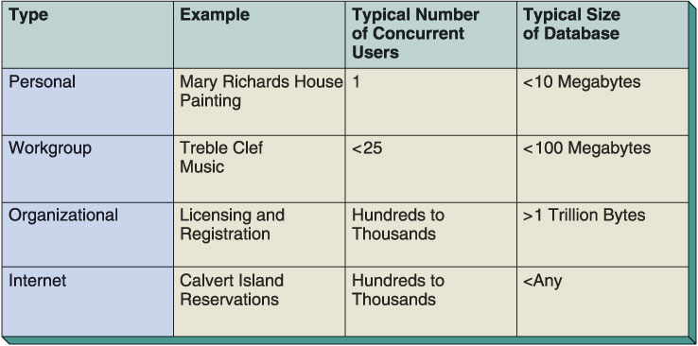
Introduction

Slide 26
Introducing the Database
Introducing DB and DBMS
Database—shared, integrated computer structure that stores:
  End user data (raw facts)
  Metadata (data about data)
Models real-world enterprise.
  Entities, e.g., students, subject, program
  Relationships, e.g., a student (Jacky Cheung) is taking a subject (ENG2003), which is part of a program (B.Eng.)
  ⇒ requires proper Data Modeling
Introduction

Slide 27
Introducing the DBMS
A DBMS (database management system) is:
  a collection of programs that manages database structure and controls access to data
  a software package designed to store and manage databases.
DBMS
  creates and maintains databases
  acts as interface between application programs and physical data files
  separates logical and design views of data
  allows sharing of data among multiple applications or users
  makes data management more efficient and effective
Major part of information technology infrastructure
Introduction

Slide 28
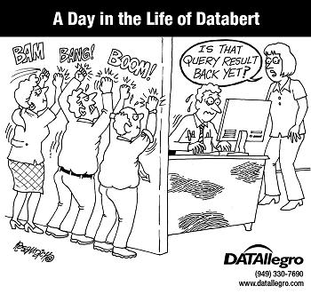
Role and Advantages of the DBMS
End users have better access to more and better-managed data
  Promotes integrated view of organization’s operations
  Probability of data inconsistency is greatly reduced
  Possible to produce quick answers to ad hoc queries
Introduction

Slide 29
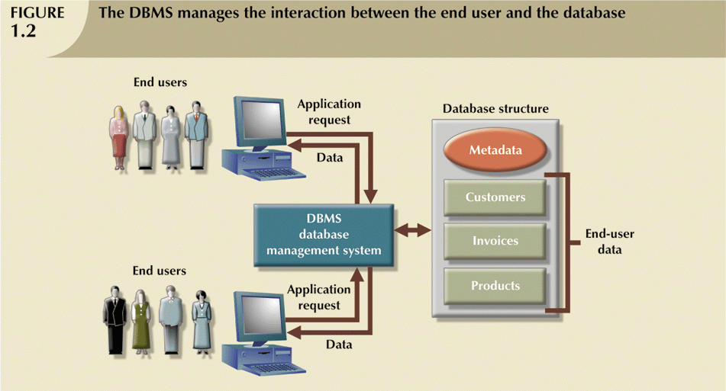
Role and Advantages of the DBMS (continued)

Slide 30
Types of Databases
Types of databases
Single-user:
  Supports only one user at a time
Desktop:
  Single-user database running on a personal computer
Multi-user:
  Supports multiple users at the same time
Workgroup:
  Multi-user database that supports a small group of users or a single department
Enterprise:
  Multi-user database that supports a large group of users or an entire organization
Introduction

Slide 31
Types of Databases (continued)
Can be classified by location:
Centralized:
  Supports data located at a single site (scientific DB)
Distributed:
  Supports data distributed across several sites (retail DB)
Can be classified by use:
Transactional (or production):
  Supports a company’s day-to-day operations (supermarket DB)
  Time sensitive gathering of data, e.g. product sales, bank transactions, etc.
Data warehouse:
  Stores data used to generate information required to make tactical or strategic decisions. Popularly used in Business Intelligence.
  Often used to store historical data
  Attached with data mining functionality
Introduction

Slide 32

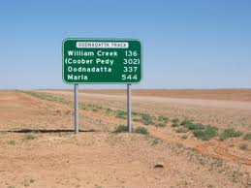
Types of Databases (continued)
Product | Number of Users |  |  | Data Location |  | Data Usage
 | Single User | Multiuser |  | Centralized | Distributed | Transactional | Data Warehouse
 |  | Workgroup | Enterprise
MS Access | X | X |  | X |  | X
MS SQL Server | X | X | X | X | X | X | X
IBM DB2 | X | X | X | X | X | X | X
Oracle RDBMS | X | X | X | X | X | X | X
Introduction

Slide 33


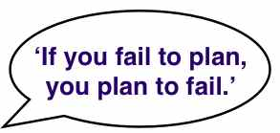
Why Database Design is Important?
Preliminary Database Design
Defines the database’s expected use
Different approach needed for different types of databases
Avoid redundant data (with good DB design)
Poorly designed database generates errors → leads to bad decisions → can lead to failure of organization
Introduction

Slide 34
Database Design
Define database before using
Tables and relationships
SQL CREATE TABLE statement
Graphical tools
Introduction
Notes:
Fundamental difference to other productivity software: amount of planning before using; defined database before using
Table: 2 dimensional arrangement of data; relationship: linking column among tables
SQL: industry standard database language

Slide 35
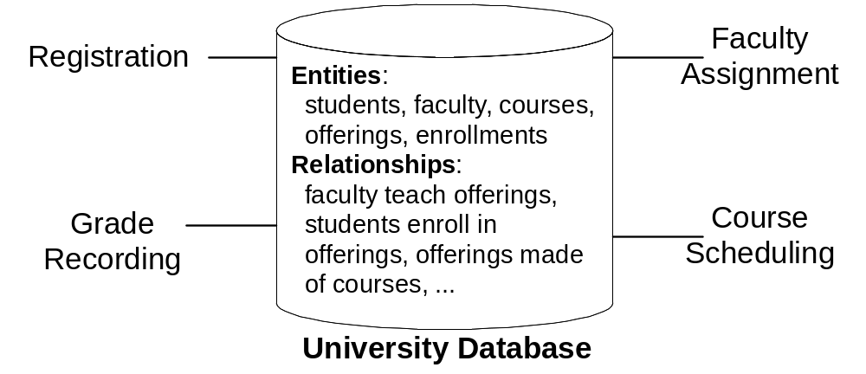
DB Example:
University Database
Expected Usage:
Expected Usage:
Introduction
Notes:
To depict these characteristics, let us consider a number of databases. We begin with a simple university database (Figure 1) since you have some familiarity with the workings of a university. A simplified university database contains data about students, faculty, courses, course offerings, and enrollments. The database supports procedures such as registering for classes, assigning faculty to course offerings, recording grades, and scheduling course offerings. Relationships in the university database support answers to questions such as
• What offerings are available for a course in a given academic period?
• Who is the instructor for an offering of a course?
• What students are enrolled in an offering of a course?

Slide 36
DB Example:
University Database (cont.)
A simplified university database contains data about students, faculty, courses, course offerings, and enrollments, as defined by entities.
  Entity - anything about which data are to be collected and stored
The database supports procedures such as registering for classes, assigning faculty to course offerings, recording grades, and scheduling course offerings.
Relationships in the university database support answers to questions such as
  What offerings are available for a course in a given academic period?
  Who is the instructor for an offering of a course?
  What students are enrolled in an offering of a course?
Introduction

Slide 37
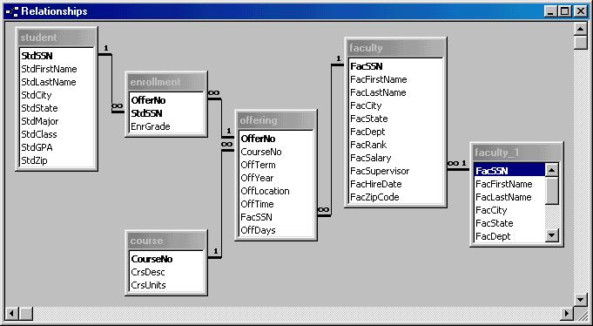
University Database:
MS Access Relationship Window
Introduction
Notes:
Access relationship window
5 tables (student, enrollment, course, offering, faculty): faculty_1 is not a real table (details later)
Relationships: lines connecting tables (faculty to offering); not all tables are directly connected
Must define the tables and relationships before entering data and retrieving data

Slide 38
University Database:
MS Access Relationship Window
5 tables (student, enrollment, course, offering, faculty): faculty_1 is not a real table
Relationships: lines connecting tables (faculty to offering); not all tables are directly connected
Must define the tables and relationships before entering data and retrieving data → DB Design
Introduction

Slide 39


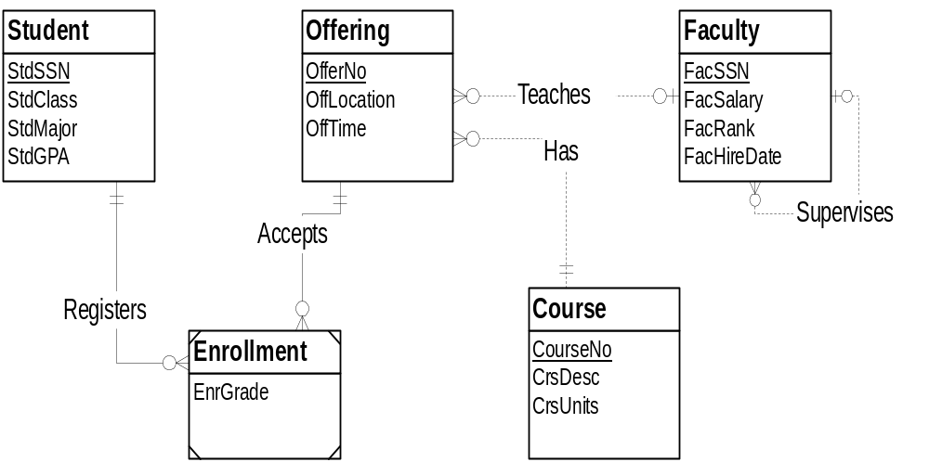
University Database
(Entity-Relationship Diagram)
Relationship: connection among entities with names and connection symbols
Entity: similar to a table
Introduction
Notes:
University Database diagram drawn with an external tool (Visio Professional);
Learn Entity Relationship Diagrams in second part of course
- Entity: similar to a table
- Relationship: connection among entities with names and connection symbols
Can use third party tools for database definition

Slide 40

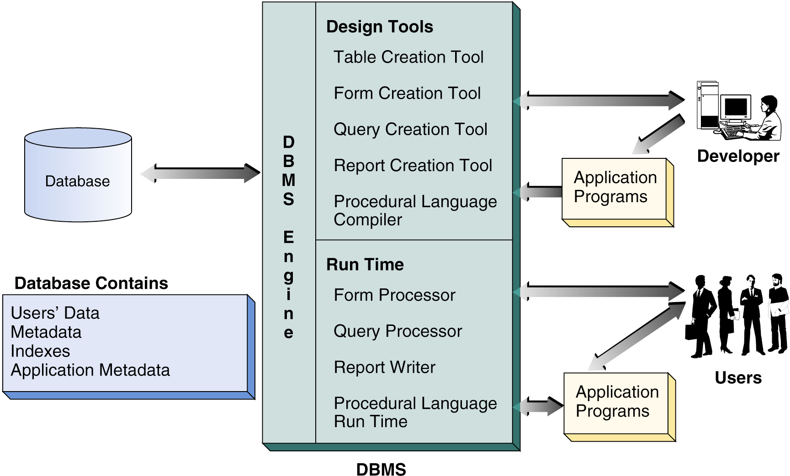
Database system components and environment
Introduction

Slide 41
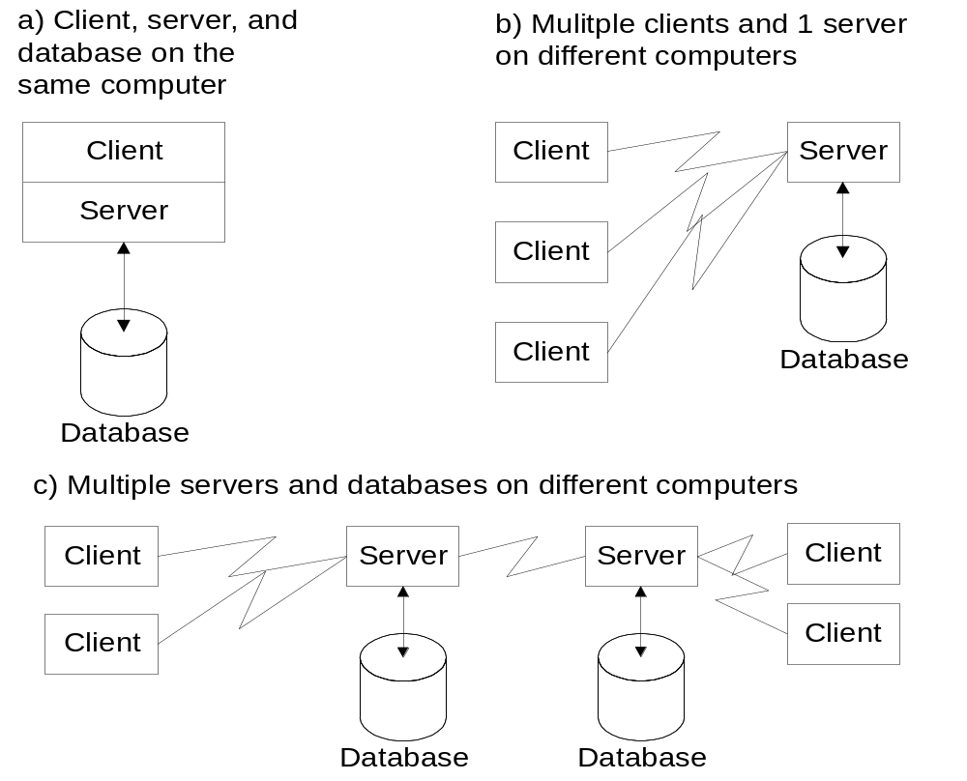
Client-Server Architecture
As in multi-national corporations
Introduction
Notes:
Client-Server Architecture: an arrangement of components (clients and servers) and data among computers connected by a network. The client-server architecture supports efficient processing of messages (requests for service) between clients and servers.
To improve performance and availability of data, the client-server architecture supports many ways to distribute software and data in a computer network. The simplest scheme is just to place both software and data on the same computer (Figure 13(a)). To take advantage of a network, both software and data can be distributed. In Figure 13(b), the server software and database are located on a remote computer. In Figure 13(c), the server software and database are located on multiple remote computers.

Slide 42
The Database System Environment
Database system is composed of five main parts:
  Hardware – physical devices, e.g. PCs, servers, printers,etc
  Software
    Operating system software
    DBMS software
    Application programs and utility software
  People – users of database system, e.g. admin, managers
  Procedures – instructions and rules that governs the design and use of database system.
  Data

Slide 43
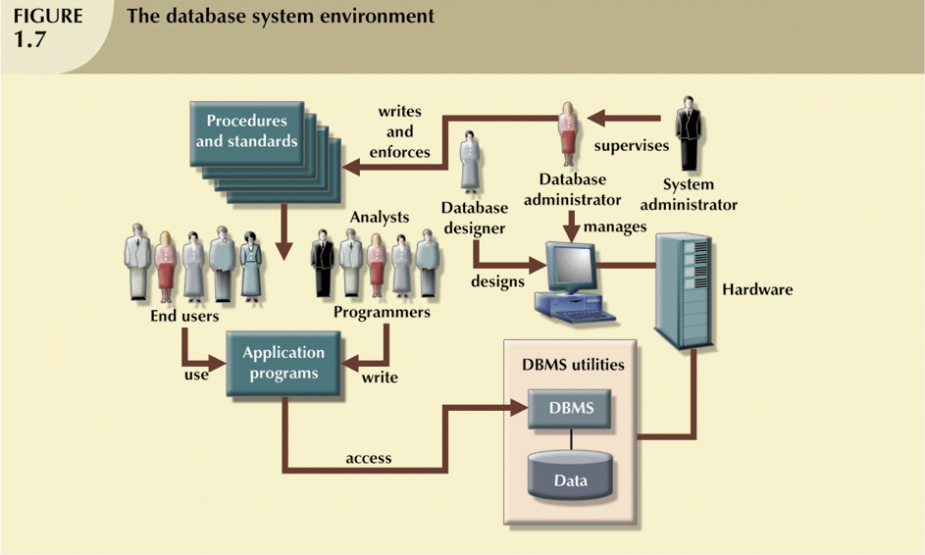
The Database System Environment (continued)

Slide 44
Database Administrator
Database administrator's duties include:
  Schema definition
  Storage structure and access method definition
  Schema and physical organization modification
  Granting user authority to access the database
  Specifying integrity constraints
  Acting as liaison with users
  Monitoring performance and responding to changes in requirements
Introduction

Slide 45
Summary
Here, we have addressed the followings.
Why we need to have databases?
A brief introduction to databases and database technology which are vital to modern organizations
Database technology supports daily operations and decision making
Introduction
Notes:
Working with databases: can be lucrative but very demanding
First part of textbook: fundamentals of relational databases
Other chapters in Part 1:
Chapter 2: relational data model and relational algebra
Chapter 3: basics of query formulation using SQL

