Slide 1
Data Models
ENG2003 Information Technology
Notes:
Chapter 2
Data Models
Database Systems:
Design, Implementation, and Management, Seventh Edition, Rob and Coronel

Slide 2
Data Models
Data Models
Why data models are important?
About basic data-modeling building blocks
Business rules
Data models
  Relational Data Model
  Entity Relationship Model

Slide 3
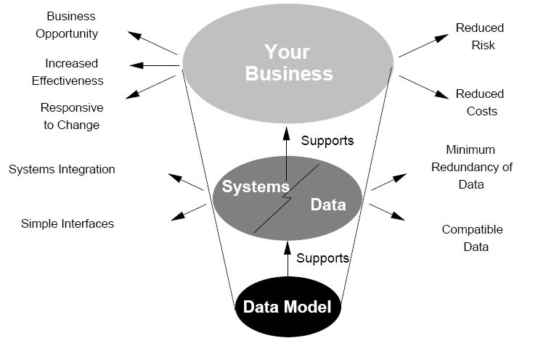
Aim of data models
Why data models are important?
Data Models
The main aim of data models is to support the development of information systems by providing the definition and format of data.

Slide 4
The Importance of Data Models
Why data models are important?
Data Models
Data models
Use relatively simple representations (usually graphical) to model the complex real-world data structures
Organize data for various users and based upon which database is designed and implemented.
Facilitate interaction among the database designer, the applications programmer, and the end user
  End-users have different views and needs for data
  The application programmer are more concerned with data location, formatting and specific reporting requirements.

Slide 5
Data Model Basic Building Blocks
About basic data-modeling building blocks
Data Models
Entity - anything about which data are to be collected and stored
Attribute - a characteristic of an entity
Relationship - describes an association among entities
  One-to-many (1:M) relationship
  Many-to-many (M:N or M:M) relationship
  One-to-one (1:1) relationship
Constraint - a restriction placed on the data

Slide 6
Entity & Attribute
Data Models
Entity
Physical objects
  A person, a place, a thing
Abstractions
  Flight routes, course offering, musical concert
Attribute
A characteristic of an entity
Attributes of a CUSTOMER entity
  First name, last name, phone, address, credit limit

Slide 7
Relationship: One-to-Many (1:m)
Data Models
Painter-Paintings
  A painter paints many different paintings
  Each of the paintings is painted by one painter
Customer-Invoices
  A customer generates many invoices
  Each of the invoices is generated by one customer.

Slide 8
Relationship: Many-to-Many (M:N)
Data Models
Employee-Skill
  An employee learns many job skill
  A job skill is learned by many employees
Student-Class
  A student takes many classes
  A class is taken by many students

Slide 9
Relationship: One-to-one (1:1)
Data Models
Employee-Store
  A manager manages a store
  A store is managed by a manager.

Slide 10
Constraint
Data Models
Help to ensure data integrity
In the form of rules
  Salary range
  GPA range (0.0-4.0)
  Age range (18-60)
  A class must have one and only one teacher.

Slide 11
Data Models
Data Models
Hierarchical (1st Generation)
Network (2nd Generation)
Relational
Entity relationship
Object oriented (OO) (4th Generation)
XML (5th Generation)
(3rd Generation)

Slide 12
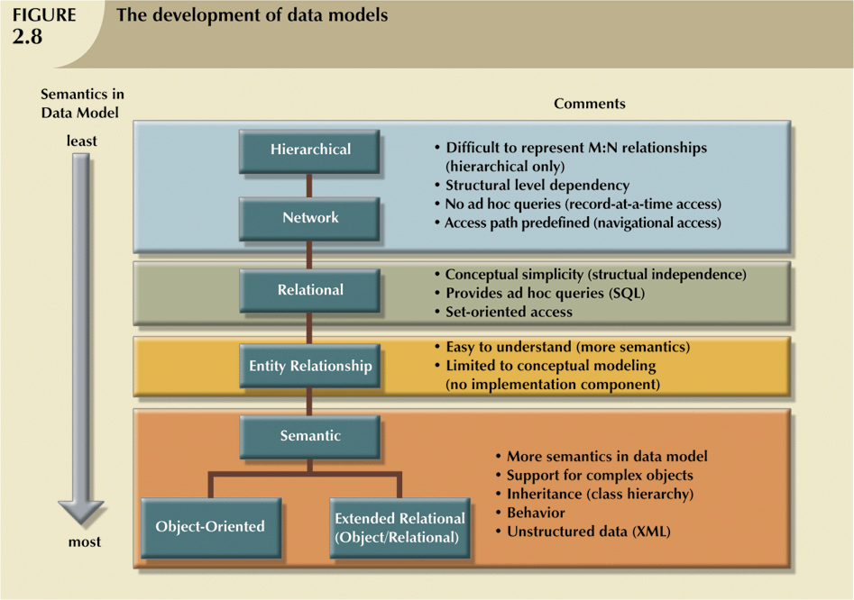
Development of data models
Data Models

Slide 13
The Relational Model
Data Models
Developed by Codd (IBM) in 1970
Considered ingenious but impractical in 1970
Conceptually simple
Computers (in 70’s) lacked power to implement the relational model
Today, microcomputers can run sophisticated relational database software!

Slide 14
The Relational Model (continued)
Data Models
Is implemented through a very sophisticated Relational Database Management System (RDBMS)
Most important advantage of the RDBMS is its ability to hide the complexities of the relational model from the user

Slide 15
The Relational Model (continued)
Data Models
Table (also called relation)
  Is a matrix consisting of a series of row/column intersections
  Tables are related to each other through sharing a common entity characteristic (attribute value), e.g. customer_ID=2 in the housepainting DB example
  hence also called relational table
Relational diagram (cf. MS Access Relationship window of slide 37, Introduction)
  Representation of relational database’s entities, attributes within those entities, and relationships between those entities

Slide 16
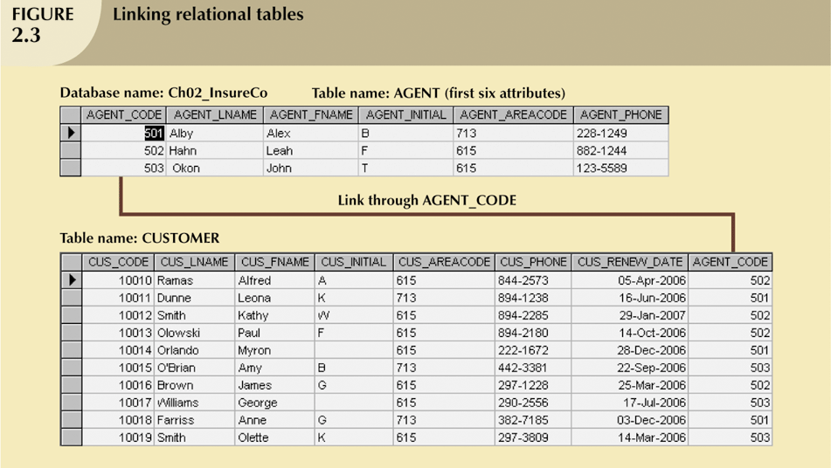
The Relational Model (continued)
An Insurance Company Example

Slide 17
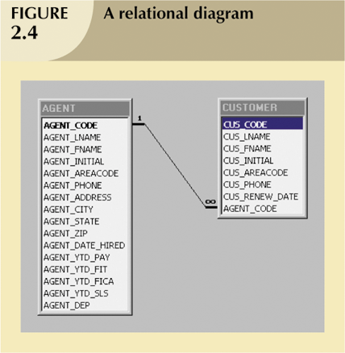
The Relational Model (continued)

Slide 18
The Relational Model (continued)
Data Models
Rise to dominance (over 90% of DB products are based on the relational model) due in part to its powerful and flexible query language
Structured Query Language (SQL) allows the user to specify what must be done without specifying how it must be done
SQL-based relational database application involves:
  User interface
  A set of tables stored in the database
  SQL engine

Slide 19
The Entity Relationship Model
Data Models
Widely accepted and adapted graphical tool for data modeling (not exactly another data model)
Complemented the relational data model concepts
Introduced by Chen in 1976
Graphical representation of entities and their relationships in a database structure
Is an abstract and conceptual representation of data

Slide 20
The Entity Relationship Model (continued)
Data Models
Normally represented in an Entity relationship diagram (ERD)
  Uses graphic representations to model database components
  Entity is mapped to a relational table
Entity instance (or occurrence) is row in table
Connectivity labels types of relationships
Many diagramming conventions have been suggested:
  Chen’s ERD
  Crow’s foot notation

Slide 21
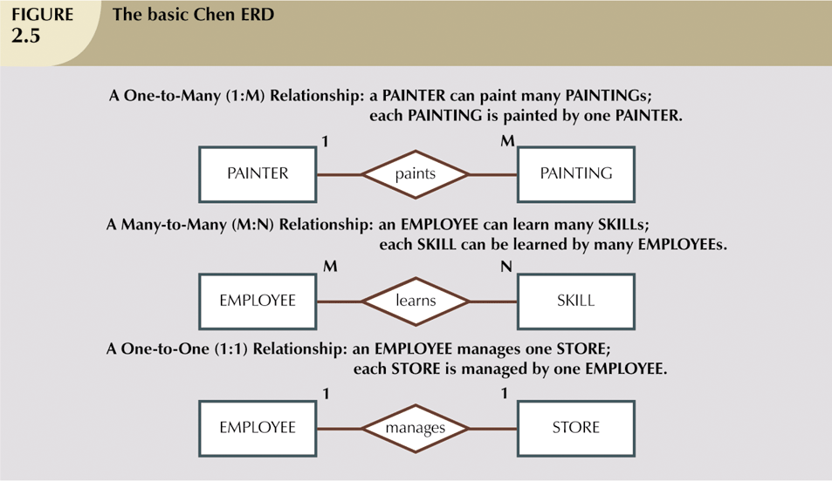
The Entity Relationship Model (continued)

Slide 22
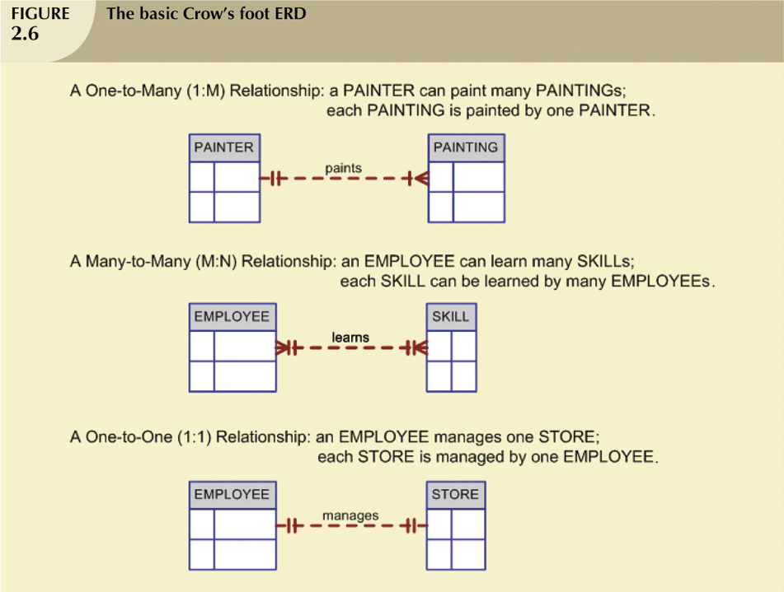
The Entity Relationship Model (continued)

Slide 23
Summary
Data Models
Why data modeling? – support the development of IS
Data model building blocks: entity, attribute, relation and constraint
Introduction to data models
  Relational data model (RDM)
  Entity-Relationship model (ERM)
These slides serve as an overview of RDM and ERM (ER Diagram)

