Slide 1
Entity Relationship (ER) Modeling
ENG 2003 Information Technology
Notes:
Ch 4
Entity Relationship (ER) Modeling
Database Systems:
Design, Implementation, and Management, Seventh Edition, Rob and Coronel

Slide 2
Entity Relationship Modeling
ER Model
  Entity and attribute
  Domain
  Relationship
    Connectivity and Cardinality
  Composite Entity
ER Diagram: Basic Symbols
Understanding Relationship
Developing an ER Diagram: An example
Diagramming Rules

Slide 3
The Entity Relationship (ER) Model
ER model forms the basis of an ER diagram (ERD)
ERD represents conceptual database as viewed by end user
ERDs depict database’s main components:
  Entities
  Attributes
  Relationships

Slide 4
Entities & Attributes
Entity:
Corresponds to table and not to row in relational environment
In Crow’s Foot models, entity is represented by rectangle containing entity’s name
Entity name, a noun, is usually written in capital letters
Attributes:
In Crow’s Foot model, attributes are written in attribute box below entity rectangle

Slide 5
Domains
Attributes have domain
  Domain is attribute’s set of possible values
  Example
    GPA: (0,4)
    Gender: M or F
Attributes may share a domain
  Example
    PROFESSOR and STUDENT share ADDRESS

Slide 6
Relationships
Association between entities
Participants are entities that participate in a relationship
Relationships between entities always operate in both directions
  A customer may generate many invoices
  Each invoice is generated by one customer
Relationship can be classified as 1:M, 1:1, and M:N
Relationship classification is difficult to establish if know only one side of the relationship

Slide 7
Connectivity and Cardinality
Connectivity
  Used to describe the relationship classification
Cardinality
  Expresses min and max number of entity occurrences associated with one occurrence of related entity, in the form of (min, max)

Slide 8
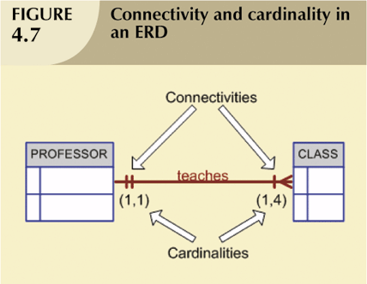
Connectivity and Cardinality (continued)

Slide 9
Relationship Participation
Optional participation
  One entity occurrence does not require corresponding entity occurrence in particular relationship
Mandatory participation
  One entity occurrence requires corresponding entity occurrence in particular relationship

Slide 10
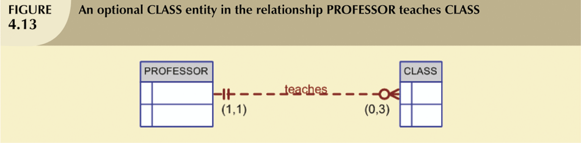
Relationship Participation (continued)
CLASS is optional to PROFESSOR
PROFESSOR is mandatory to CLASS

Slide 11

Relationship Participation (continued)
CLASS is optional to COURSE

Slide 12

Relationship Participation (continued)
CLASS is mandatory to COURSE

Slide 13
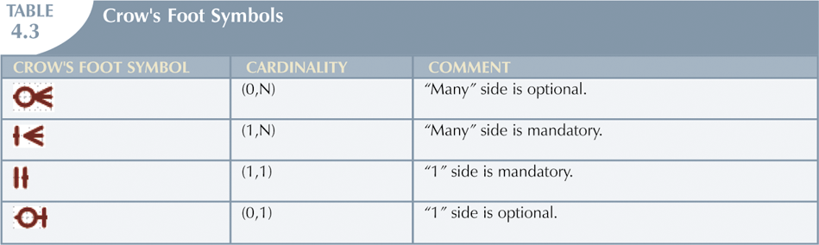
Relationship Participation (continued)

Slide 14
Composite Entities
Also known as bridge entities
Composed of primary keys of each of the entities to be connected
May also contain additional attributes that play no role in connective process

Slide 15
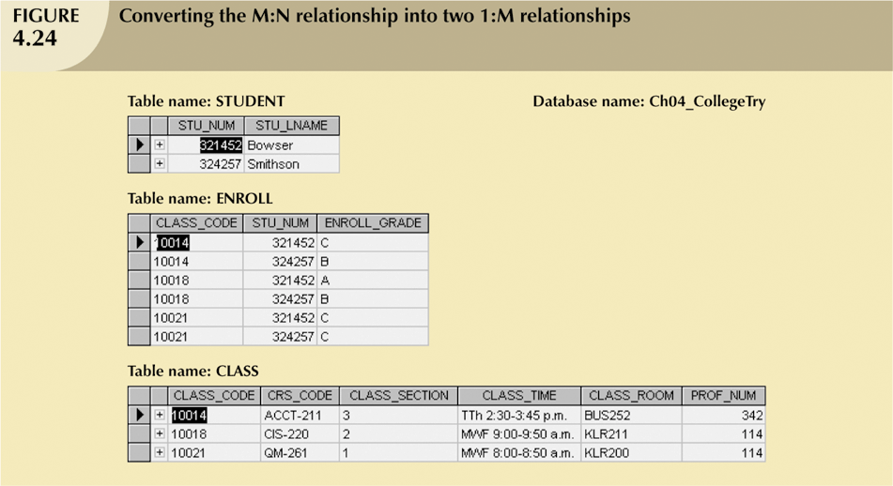
Composite Entities (continued)
plays no role in the connective process

Slide 16
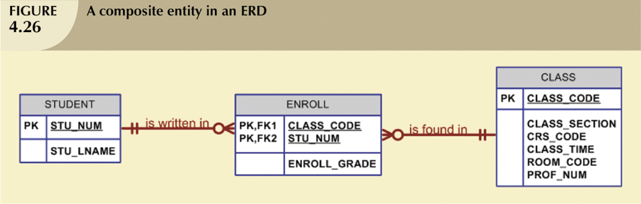
Composite Entities (continued)

Slide 17
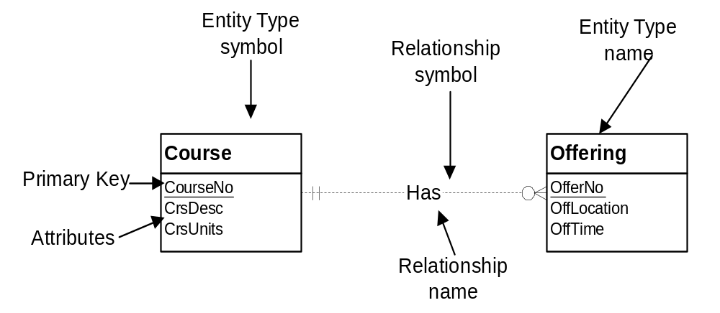
ER Diagram: Basic Symbols
Mainly based on Crow’s Foot Model !!
Notes:
Entity type:
- Collection of things of interest: persons, places, things, events
- Contains attributes: like columns
- Primary key
- Entity: instance or member of an entity type
Relationship:
- Named association among entities: name is significant (gives it more status)
- Similar to a foreign key in relational model except for name and cardinalities
- Usually between two entity types: can involve multiple entity types and one
- Bidirectional:
- Can be used to navigate in both directions
- Two names
- Course to Offering: Has, Provides
- Offering to Course: IsProvidedFor
- Which name to use: try to use active verb; not always possible
Attribute:
- Properties of entity types or relationships
- Data type to indicate the kind of values and permissible operations on the attribute
- Shown inside entity type or next to relationship

Slide 18
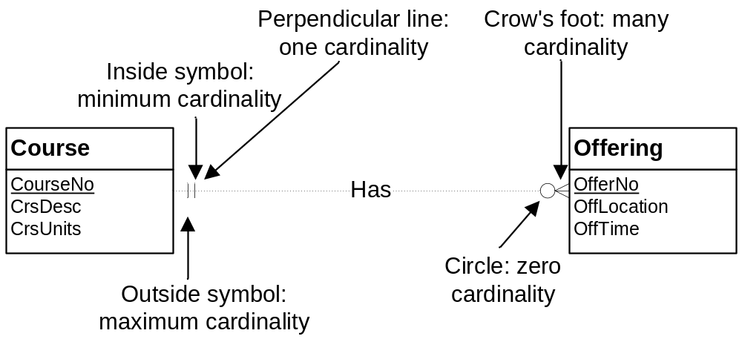
Cardinality Notation
Notes:
Symbols:
- Oval: means 0
- Perpendicular line: means 1
- Crow's foot: means many (0 or more); unconstrained
- Some drawing tools support exact cardinalities (numbers)
Placement:
- Inside symbol: minimum cardinality
- Outside symbol: maximum cardinality
- Interpret the far cardinality symbols: near the other entity type
- Course is related to a min of 0 and max of many offerings
- Offering is related to a min of 1 and max of 1 courses (exactly one)

Slide 19
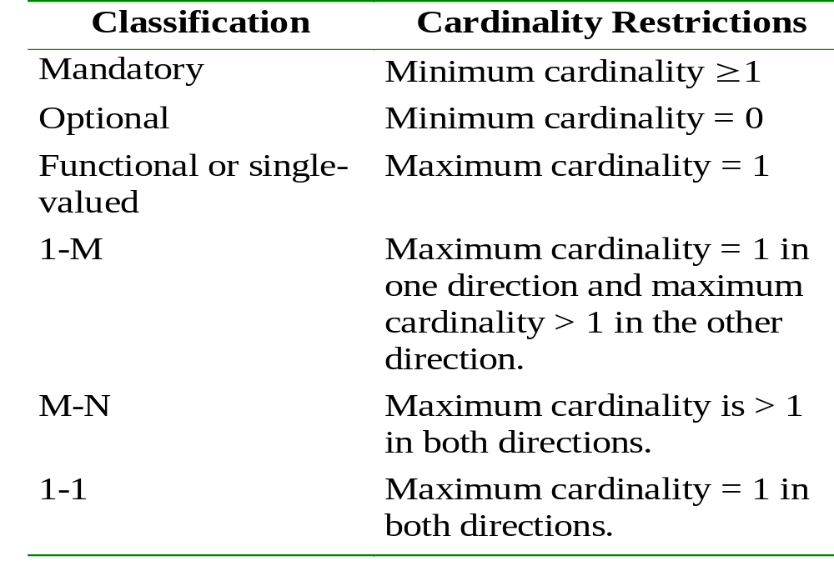
Summary of Cardinalities
Notes:
Existence dependency: an entity that cannot exist unless another related entity exists. A mandatory relationship produces an existence dependency.

Slide 20
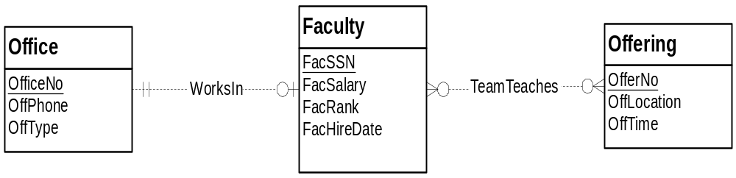
More Relationship Examples
TeamTeaches:
- M-N relationship
- Optional in both directions
WorksIn:
- 1-1 relationship
- Optional: office can be empty
- Mandatory: faculty must be assigned to an office
Notes:
TeamTeaches:
- M-N
- Optional in both directions
WorksIn:
- 1-1
- Optional: office can be empty
- Mandatory: faculty must be assigned to an office

Slide 21
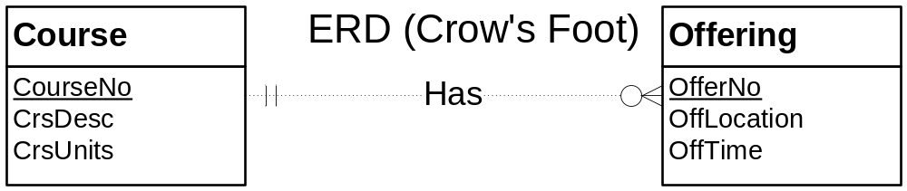
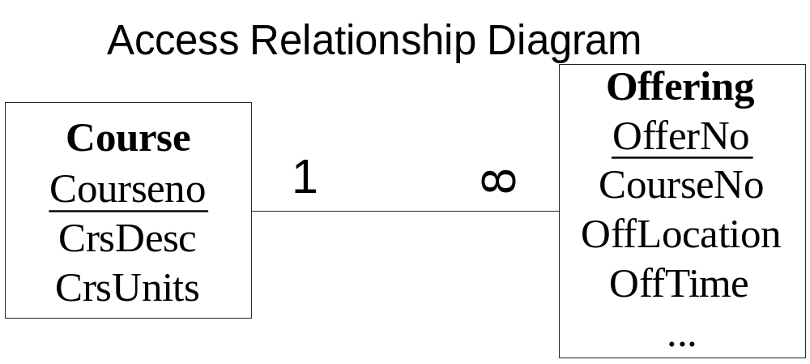
Comparison to MS Access Notation
Notes:
Skip slide if class has not yet covered chapter 3 on the relational data model
Differences:
- Preference rather than one model being more powerful
- Named relationships: no name in relational model (FKs instead)
- ERD does not need FKs: redundant with relationship
- No maximum cardinalities in relational model: M cardinality is implied by lack of FK
- Relationships with attributes: not permitted in the relational model

Slide 22
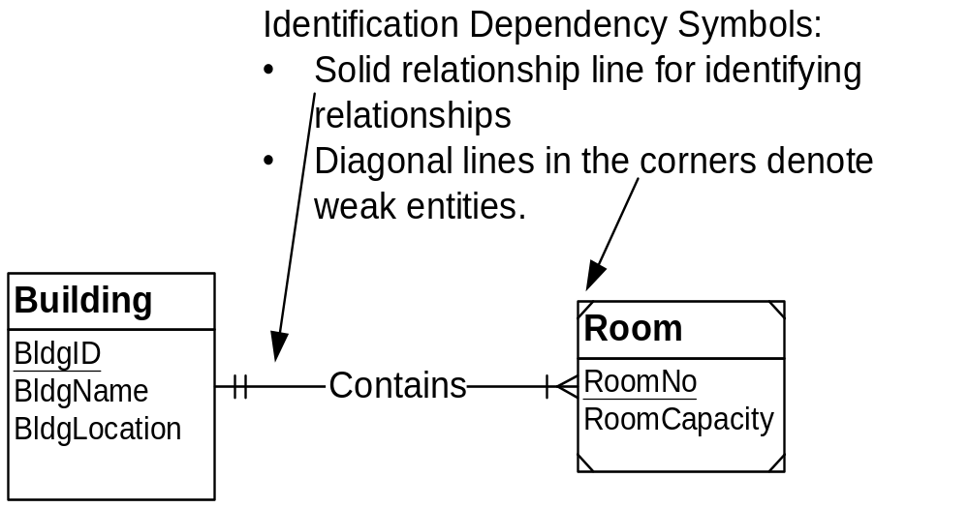
Understanding Relationships:
Identification Dependency
(Optional!)
Notes:
Concept:
- Some entity types borrow part or entire PK
- Specialized concept: important when it occurs but not too common
- Similar to FK part of PK in relational model
- Closely related entities: physical containment
- Room is physically contained in a building
- Identification of room includes building
- Others: country-state, order-orderline
Symbols:
- Weak entity:
- Borrows part or all of PK
- Diagonal lines in the corners
- Identifying relationship:
- Solid line
- Indicates the source of PK
- Ambiguity if entity type participates in more than one relationship
Example:
- PK of Room is a combination of RoomNo (local key) and BldgID (borrowed attribute)
- Cardinality of weak entity in the identifying relationship must be 1-1
- Room cannot exist unless associated building exists
- Identification dependency involves existence dependency:
- Weak entity is existent dependent on other entity
- Also borrows part of all of PK

Slide 23
Concepts behind
Identification Dependency
Existence dependence
  Entity exists in database only when it is associated with another related entity occurrence
Insurance company insures an employee and dependents. However, an employee may or may not have a dependent
  A dependent must be associated with an employee
More examples: building---room, country---state, order---orderline, invoice---invoiceline, etc.
Sometimes refers to such an entity as weak entity
Existence independence
Entity can exist apart from one or more related entities
Sometimes refers to such an entity as strong or regular entity

Slide 24
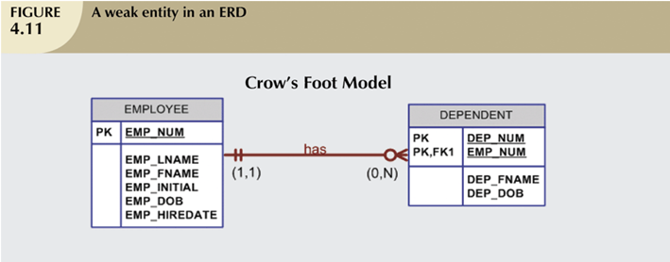
Weak Entities (continued)
Weak Entity = Strong dependency
You can tell if the foreign key of the weak entity is used to form part of the primary key.

Slide 25
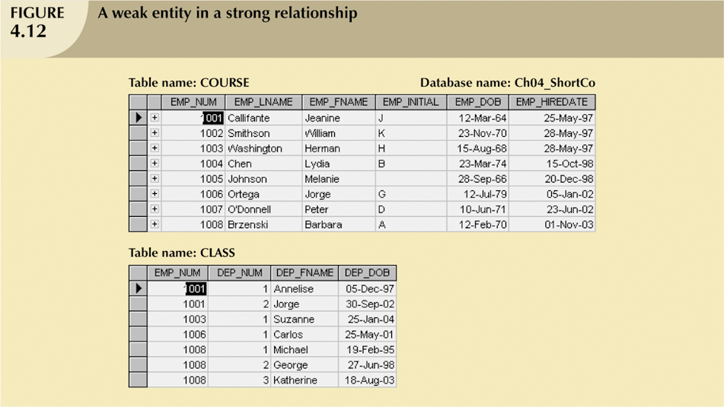
Weak Entities (continued)
EMPLOYEE
Primary Key: EMP_NUM
DEPENDENT
Primary Key: EMP_NUM+DEP_NUM
Foreign Key: EMP_NUM

Slide 26

Concepts behind
Identification Dependency
Relationship Strength
Strong (Identifying) Relationships
  Exists when PK of related entity contains PK component of parent entity
  Use solid line notation
Weak (non-identifying) relationships
  Exists when PK of related entity does not contain PK component of parent entity
  Use dash line notation
Daddy
Mummy
Daddy, mummy!
Daddy, mummy!

Slide 27
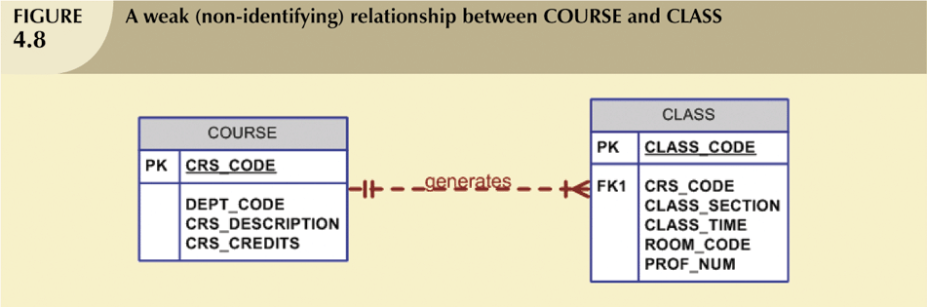
Concepts behind Identification Dependency:
Weak (Non-Identifying) Relationships

Slide 28

Concepts behind Identification Dependency:
Weak (Non-Identifying) Relationships (cont.)
Course
Primary Key: CRS_CODE
Primary Key: CLASS_CODE
Foreign Key: CRS_CODE

Slide 29
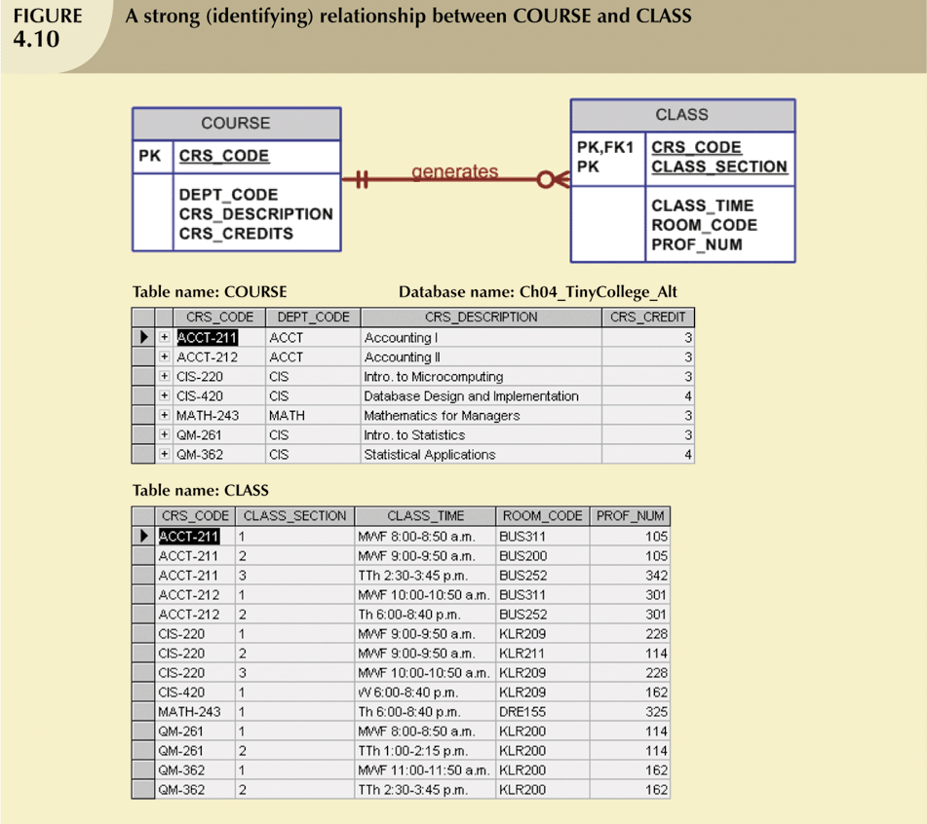
Strong (Identifying) Relationships
PK of related entity (CLASS) contains PK component (CRS_CODE) of parent entity (COURSE)

Slide 30


Developing an ER Diagram
Database design is iterative rather than linear or sequential process
Iterative process is based on repetition of processes and procedures
Building an ERD usually involves the following activities:
  Create detailed narrative of organization’s description of operations
  Identify business rules based on description of operations
  Identify main entities and relationships from business rules
  Develop initial ERD
  Identify attributes and primary keys that adequately describe entities
  Revise and review ERD

Slide 31
Developing an ER Diagram:
An Example
Business rules of Tiny College:
  Tiny College is divided into several schools
    Each school is composed of several departments
  Each department may offer courses
  Each department may have many professors assigned to it
  Each professor may teach up to four classes; each class is section of course
  Student may enroll in several classes, but (s)he takes each class only once during any given enrollment period

Slide 32
Developing an ER Diagram:
An Example (continued)
Business rules of Tiny College (continued):
  Each department has several students
    Each student has only a single major and is associated with a single department
  Each student has an advisor in his or her department
    Each advisor counsels several students
  The relationship between class is taught in a room and the room in the building

Slide 33
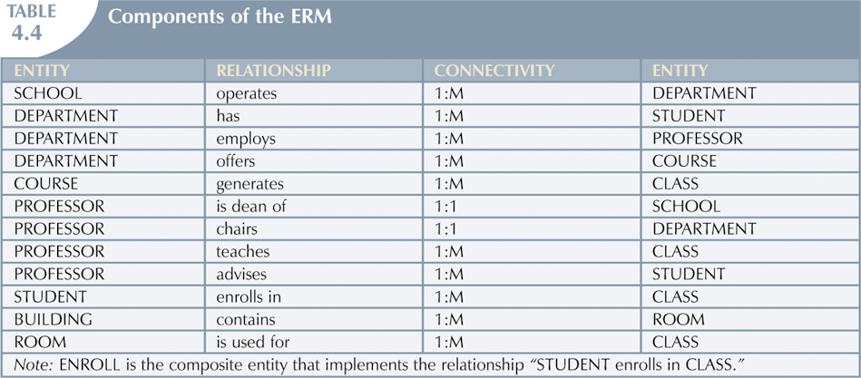
Developing an ER Diagram:
An Example (continued)

Slide 34
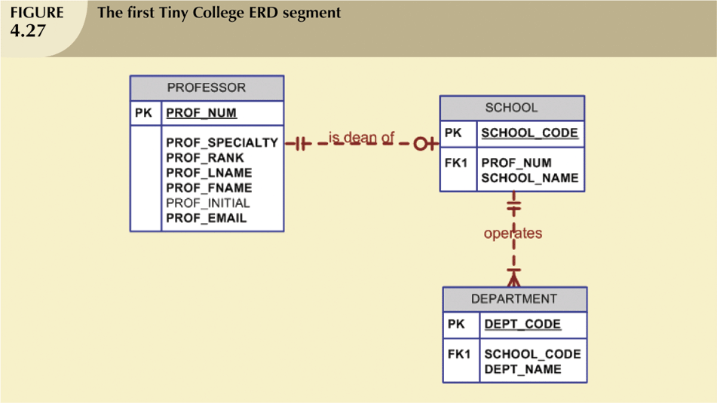
Developing an ER Diagram (continued)

Slide 35
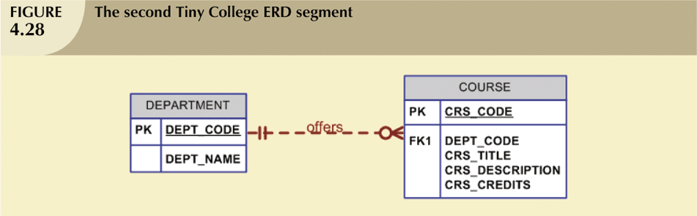
Developing an ER Diagram (continued)

Slide 36
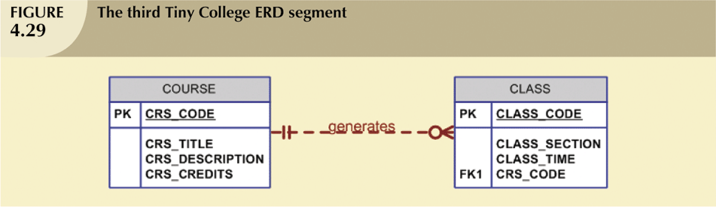
Developing an ER Diagram (continued)

Slide 37
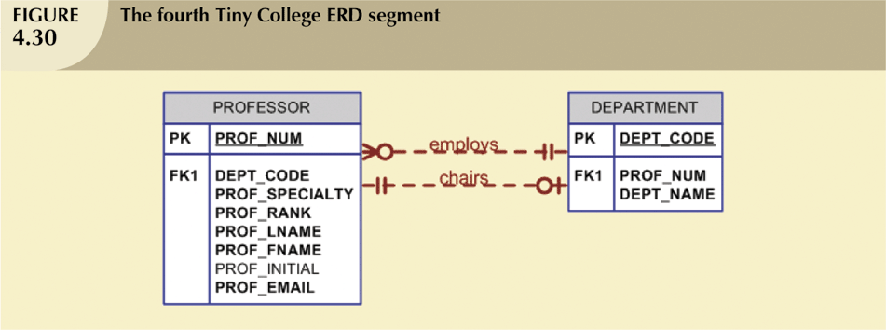
Developing an ER Diagram (continued)

Slide 38
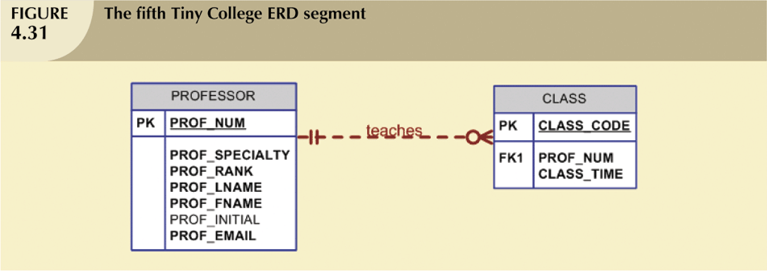
Developing an ER Diagram (continued)

Slide 39
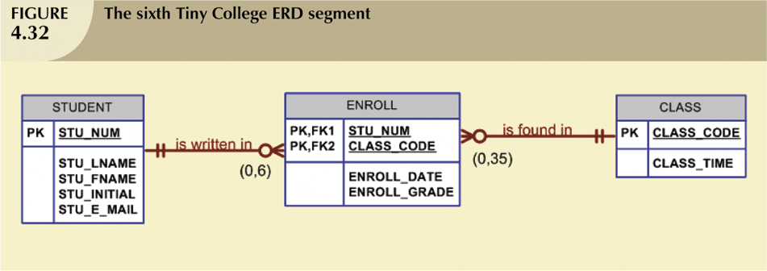
Developing an ER Diagram (continued)

Slide 40
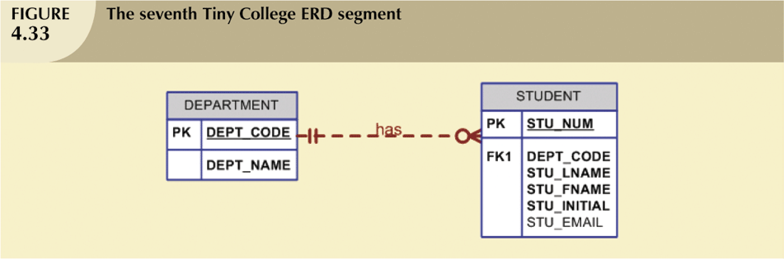
Developing an ER Diagram (continued)

Slide 41
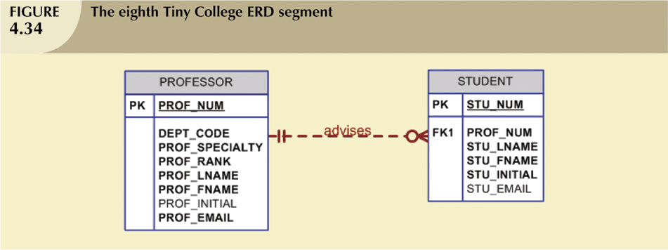
Developing an ER Diagram (continued)

Slide 42
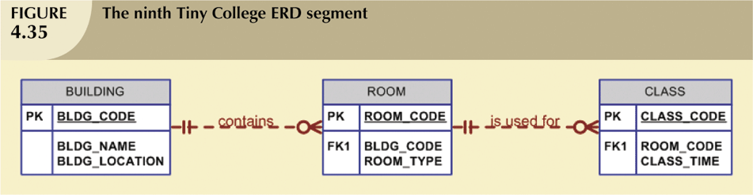
Developing an ER Diagram (continued)

Slide 43
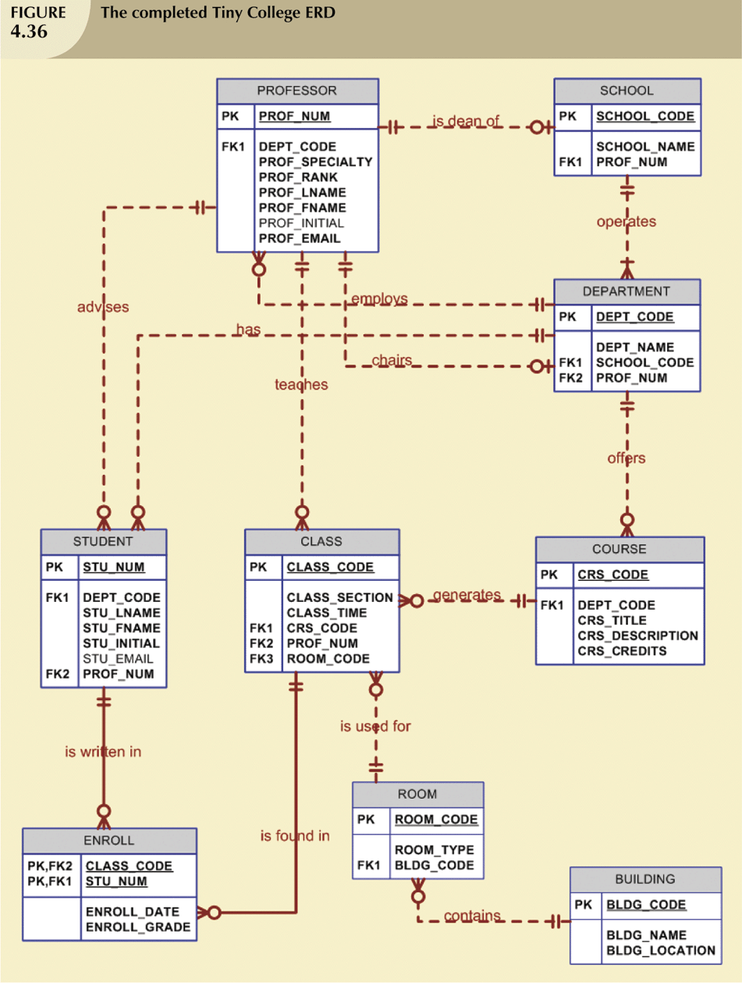
Developing an ER Diagram:
An Example (continued)

Slide 44
Diagram Rules
Ensure that ERD notation is correctly used
Similar to syntax rules for a computer language
Completeness rules: no missing specifications
Consistency rules: no conflicts among specifications
Notes:
Apply these rules when completing an ERD to ensure that there are no notation errors in your ERD
Similar to syntax rules for a computer language:
Ensures proper language structure, not correct meaning
Diagram rules ensure proper structure among symbols
Do not ensure that you have considered multiple alternatives, correctly represented user requirements, and properly documented your design
Completeness rules: no missing symbols or specifications
Consistency rules: no conflicts among symbols or specifications
Second version of ER Assistant supports the diagram rules

Slide 45
Diagram Rules:
Completeness Rules
Primary Key Rule: all entity types have a Primary Key
Naming Rule: all entity types, relationships, and attributes have a name
Cardinality Rule: cardinality is specified in both directions for each relationship
Entity Participation Rule: all entity types participate in an at least one relationship
Notes:
Completeness rules: no missing specifications
The first three rules are mandatory. A finished ERD should not violate the PK, Naming, and Cardinality rules.
PK rule:
Direct: Table contains the primary key attribute(s)
Indirect: Table borrows (id dependent) for part or all of PK
Inherited: Table inherits PK from a supertype
The next two rules are optional. Most ERDs will not violate the Entity Participation and Generalization Hierarchy Participation rules.
Rule 5 applies to an entire generalization hierarchy, not to each entity type in a generalization hierarchy. In other words, at least one entity type in a generalization hierarchy should be connected to at least one entity type not in the generalization hierarchy. In many generalization hierarchies, multiple entity types participate in relationships. Generalization hierarchies permit subtypes to participate in relationships thus constraining relationship participation.

Slide 46
Diagram Rules:
Consistency Rules
Naming Rules:
Entity Name Rule: entity type names must be unique
Attribute Name Rule: attribute names must be unique within each entity type and relationship
Relationship Name Rule:
  No uniqueness requirement
  Participating entities provide a context for relationship names
  Use unique names as much as possible to distinguish relationships
  Must provide unique names for multiple relationships between the same entity types
Notes:
Consistency rules: no conflicting specifications
Naming rules: no conflict among names
Entity names must be unique
Attribute names must be unique within each entity type and relationship
Inherited attribute names (direct or indirect) should not conflict with local attribute names; indirect inheritance is from an ancestor that is not a direct parent

Slide 47
Diagram Rules:
Consistency Rules (cont.)
Connection Consistency Rules:
Relationship/Entity Connection Rule: relationships connect two entity types (not necessarily distinct)
Relationship/Relationship Connection Rule: relationships are not connected to other relationships
Notes:
Connection Consistency rules: no conflicts or redundancies among relationships
Relationship formation rules:
Connect two entity types (not necessarily distinct)
Do not connect relationships directly (connect through entity types)
Self referencing relationships: connect the same entity type two times
Redundant foreign key rule:
Foreign keys are redundant with 1-M relationships
Use FKs in the relational model, not in ERDs
Violation of this rule is common: confusion between the ERDs and relational table design
Conversion replaces relationships with foreign keys
How to detect redundant FKs:
- Column in a child entity type (entity type on the M side of the relationship) for a column name that matches the PK of the parent entity type (entity type on the 1 side of the relationship)

Slide 48


Database Design Challenges:
Conflicting Goals
Database design must conform to design standards
  Develop logical structures that minimizes data redundancies
  Avoid nulls
High processing speeds are often a top priority in database design
  Goal to minimize access time by simplifying relationships
  Use of 1:1 may avoid nulls but at the expense of speed
Quest for timely information might be focus of database design
  Complex data transformations versus simplified data structure. E.g. generate sales reports with thousands of invoices
Speed
Vs
Safety

Slide 49
Summary
Entity relationship (ER) model
  Uses ERD to represent conceptual database as viewed by end user
  ERM’s main components:Entities, Relationships,Attributes
  Includes connectivity and cardinality notations
Connectivities and cardinalities are based on business rules
In ERM, M:N relationship is valid at conceptual level
ERDs may be based on many different ERMs
Database designers are often forced to make design compromises

Slide 50
Summary (cont.)
Here, we have learnt:
The main characteristics of entity relationship components
How relationships between entities are defined and refined and how those relationships are incorporated into the database design process
How ERD components affect database design and implementation

