Slide 1

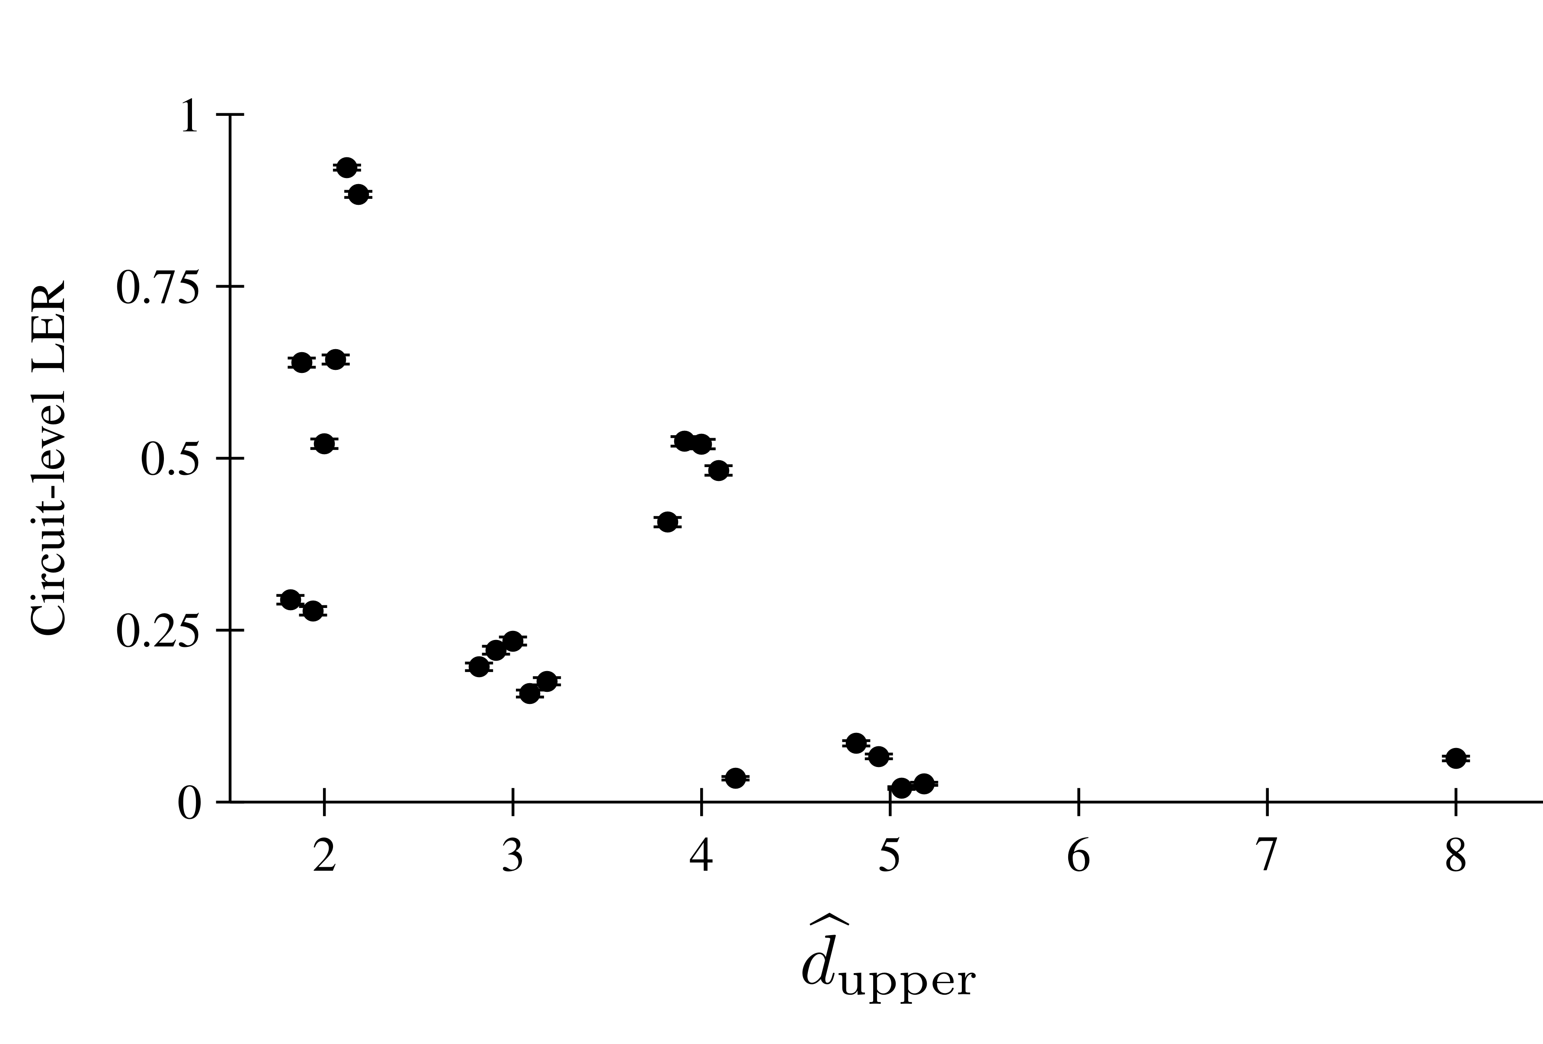
Presentation ID 88
A Prospective Rank Test of a Detector-Error-Model
Weight Screen for Circuit-Level qLDPC Decoding
Hung N. Dang and Quy X. Pham
Faculty of Information Technology · Posts and Telecommunications Institute of Technology (PTIT), Hanoi, Vietnam
1 Motivation and research question
Circuit-level Monte Carlo evaluation is costly across many candidate instances.
We test a DEM-based ranking screen before measuring new logical-block error rates (LERs).
Can DEM structure rank which complete code–circuit–decoder instances
BP+OSD decodes more reliably, before new LER results are known?
Connection to classical LDPC decoding
DEM: Tanner graph for syndrome decoding. Logical-block LER: analogue of FER / word-error rate.
Minimum detector-silent logical weight plays a distance-like role. The screen is a verified upper bound.
2 Building the DEM-weight screen
3 The prospective test
A detector error model (DEM) records which detectors
each fault mechanism triggers and which logical
observables it flips.
Freeze the bank, circuit, decoder, budget and decision
rules before new LER labels. Four development
anchors are excluded from the confirmatory score.
Screen d̂_{upper}: smallest verified mechanism count
found for a pattern that triggers no detectors but
flips a logical observable, if the stability gate passes.
Table I. Frozen experimental settings (summary)
Verified upper bound, not code or exact DEM distance.
Item | Frozen value
Population | 32 complete instances
Development | BB72, BB90, BB144, BB288
Confirmatory | 28 instances; development excluded
Circuit point | p = 0.003; 6 rounds; X-basis memory; SI1000 noise
Schedule | EdgeColoringXZ, smallest-last
Decoder | Product-sum BP, 32 iterations; OSD-CS order 10
Sampling budget | 20,000 shots/instance; 640,000 total; no early stop
Before new LER labels
Flattened DEM (H_{DEM}, O)
Pivoting certificate
Randomized BP+OSD
U_{cert}
FREEZE BOUNDARY
d̂_{upper}
After new LER labels
Fresh BP+OSD sampling → rank test
Fig. 1. Structural results freeze before fresh labels.
Two search phases must agree, otherwise abstain.
4 Ranking agreement and evidence
Logical-block LER is the fraction of sampled blocks with any logical observable decoded incorrectly.
Pairs are ordered only when their Wilson 95% LER intervals do not overlap.
Rank hypothesis: higher screen predicts lower LER.
Table II. Confirmatory pair results (summary)
Lower LER is better
Quantity | Value
Eligible instances | 22
Possible / Wilson-ordered pairs | 231 / 226 (97.8%)
Unordered pairs | 5
Strict concordance | 148 (65.5%)
Screen ties | 45 (19.9%)
Discordance | 33 (14.6%)
Circuit-level LER
Same screen value,
different LER.
Percentages use the 226 ordered pairs.
d̂_{upper}
Screen coverage and abstentions
Fig. 2. Wilson 95% bars. Horizontal jitter separates
equal integer screen values.
Overall: 24/32 ranked, 8/32 abstentions.
Confirmatory: 22/28 ranked (78.6%), 6/28 abstentions.
Abstention = no rank assigned, not a decoding failure.
C = 0.7544 · Ranking agreement with half credit for ties
Positive
C = (148 + 0.5 × 45) / 226. The no-information reference is 0.5.
95% code-resampling stability interval: [0.6262, 0.8382]. Stability to eligible-bank composition.
Positive rule met: ≥20 ordered pairs and lower bound >0.5. Supports coarse instance ranking at this point.
5 Conclusion and future work
Conclusion
Scope
Future work
Coarse ranks: 22 instances, C = 0.75.
Potential use: candidate triage.
No absolute LER prediction.
One point, BP+OSD-dependent screen.
Coarse values 2–8 (45 tied pairs).
6/28 confirmatory instances unranked.
Test new points, decoders and
independent instance banks.
Benchmark unproven cost savings.
Corresponding author: hungdn@ptit.edu.vn
75 × 120 cm · Research poster
Notes:
Source: final_paper_1232964_japluxhwcn2mph76_v2(2).pdf, especially Sections II–IV and Tables I–II. The minimum detector-silent logical mechanism weight plays a distance-like role. The reported screen is a search-dependent verified upper bound and depends on randomized BP+OSD search. It is not code distance or exact DEM distance. There are 45 screen ties among 226 Wilson-ordered pairs. Secondary Kendall tau_b: 0.5627, two-sided p = 0.0007. Code-resampling draws: 20,000 / 20,000. For a question about the isolated screen-8 point: it is one tested instance, not evidence of a statistical outlier; the paper does not establish an instance-specific explanation. Further operating points, decoder transfer and cost savings require separate prospective tests.
Color palette source: official ASIANComNet 2026 presentation template, linked from https://asiancomnet2026.aconf.org/news/8493.html (accessed 7 October 2026). Navy #0B2A4A, blue #1E6FD9, cyan #00B4D8. Existing white background, black body text and earth-orange result frames retained.
Conclusion and future work follow Section IV of the supplied final paper. Original blue ASIANComNet 2026 logo extracted from the official flyer at https://file.aconf.org/conf/hk/2026/01/229273/files/ASIANComNet%202026%20Flyer-0702.pdf. User-supplied images (5) and (6) used as visual branding references. Cost savings remain an untested future question.

