Slide 1
WELCOME TO THE REACT NATIVE TRANING CLASS
SESSION 2

Slide 2
CONTENT
Touchable Highlight
Gesture Responder
Pan Responder
List View
Export Component
Truyền tham số cho Component
Navigators và Navigator IOS

Slide 3

I. Touchable Components
<TouchableHighLight />
<TouchableOpacity />
<TouchableWithoutFeedback />
<TouchableNativeFeedback /> Work only Android

Slide 4
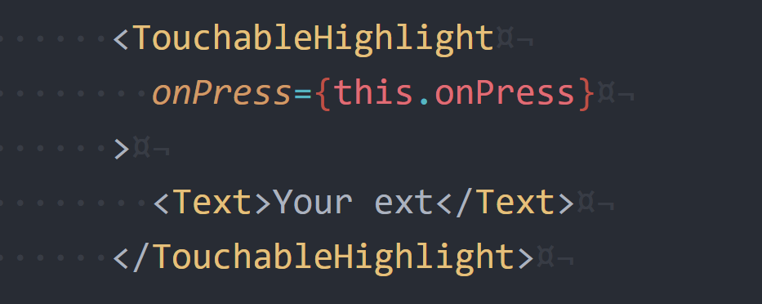
<TouchableHighLight />

