Slide 1
WELCOME TO THE REACT NATIVE TRANING CLASS
SESSION 2

Slide 2
CONTENT
Touchable Highlight
Gesture Responder & Pan Responder
List View
Truyền tham số cho Component
Export Component
Navigators và Navigator IOS

Slide 3

I. Tappable Components
<TouchableHighLight />
<TouchableOpacity />
<TouchableWithoutFeedback />
<TouchableNativeFeedback />
<Button />
v0.37

Slide 4
Tappable Components
KIND | PURPOSE | DIFFERENCE
 |  | UI Feedback | Android | iOS
<TouchableHighLight /> | Handle Touches | ✓ | ✓ | ✓
<TouchableOpacity /> |  | ✓ | ✓ | ✓
<TouchableWithoutFeedback /> |  | ✗ | ✓ | ✓
<TouchableNativeFeedback /> |  | ✓ | ✓ | ✗

Slide 5
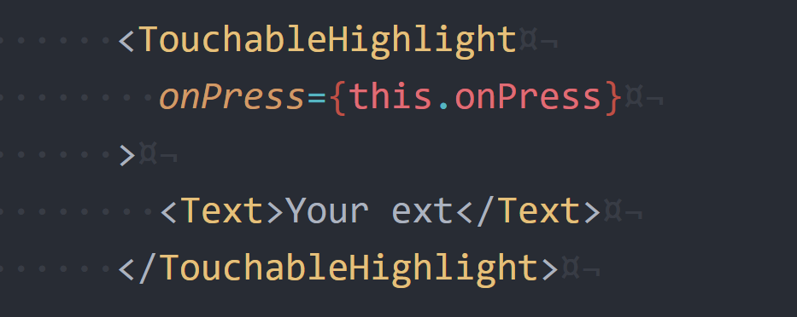
<TouchableHighLight />
Must have one child (not zero or more than one)
If you wish to have several child components, wrap
them in a <View />.

Slide 6
II. Gesture Responder & Pan Responder
Authorized
Responder
Handle
Actions
Authorized
onStartShouldSetResponder: (evt) => true
onMoveShouldSetResponder: (evt) => true
Parent View wants to prevent the child from
becoming responder on a touch start
onStartShouldSetResponderCapture: (evt) => true
onMoveShouldSetResponderCapture: (evt) => true
Responder Lifecycle

Slide 7
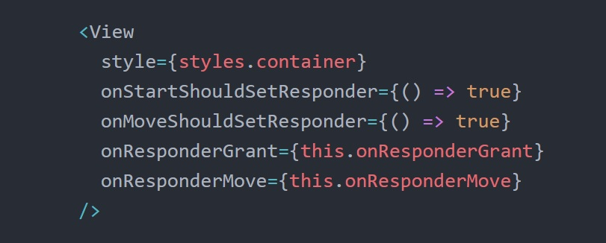
II. Gesture Responder & Pan Responder

Slide 8
III. List View Components
<ScrollView />
<ListView />
<FlatList />
v0.44

Slide 9
<FlatList />

