Slide 1
WELCOME TO THE REACT NATIVE share knowledge
SESSION 2

Slide 2
CONTENT
Touchable Highlight
Gesture Responder & Pan Responder
List View
Component Parameters
Export Component
Navigators and Navigator IOS

Slide 3

I. Tappable Components
<TouchableHighLight />
<TouchableOpacity />
<TouchableWithoutFeedback />
<TouchableNativeFeedback />

Slide 4
Tappable Components
KIND | PURPOSE | SUPPORTS
 |  | UI Feedback | Android | iOS
<TouchableHighLight /> | Handle Touches | ✓ | ✓ | ✓
<TouchableOpacity /> |  | ✓ | ✓ | ✓
<TouchableWithoutFeedback /> |  | ✗ | ✓ | ✓
<TouchableNativeFeedback /> |  | ✓ | ✓ | ✗

Slide 5
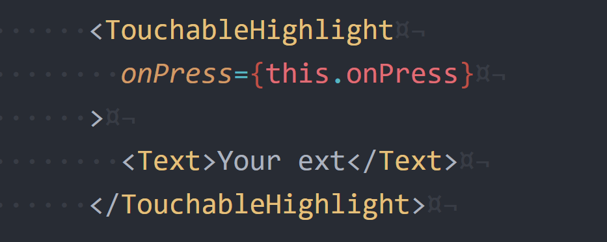
<TouchableHighLight />
Must have one child (not zero or more than one)
If you wish to have several child components, wrap
them in a <View />.

Slide 6
II. Gesture Responder & Pan Responder
Authorized
Responder
Handle
Actions
Authorized
onStartShouldSetResponder: (evt) => true
onMoveShouldSetResponder: (evt) => true
Parent View wants to prevent the child from
becoming responder on a touch start
onStartShouldSetResponderCapture: (evt) => true
onMoveShouldSetResponderCapture: (evt) => true
Responder Lifecycle

Slide 7
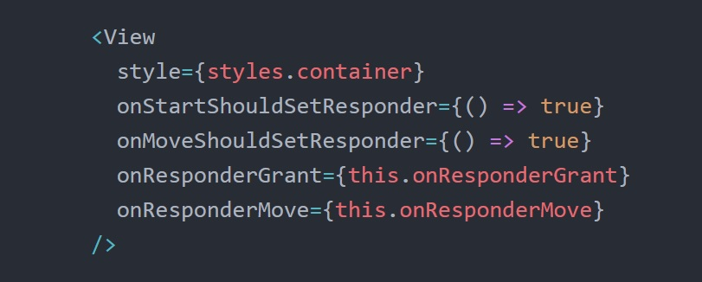
II. Gesture Responder & Pan Responder

Slide 8
III. List View Components
<ScrollView />
<ListView />
<FlatList />
v0.44

Slide 9
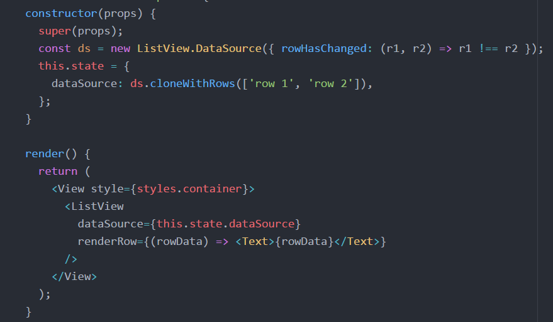
<ListView />

Slide 10
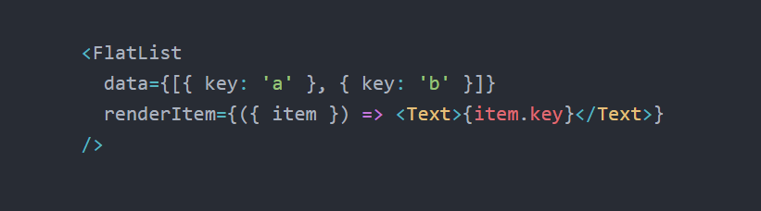
<FlatList />

Slide 11
IV. Component Parameters
Parent Component
Assign value
Child Component
Define params (string, func, …)
Render View

Slide 12
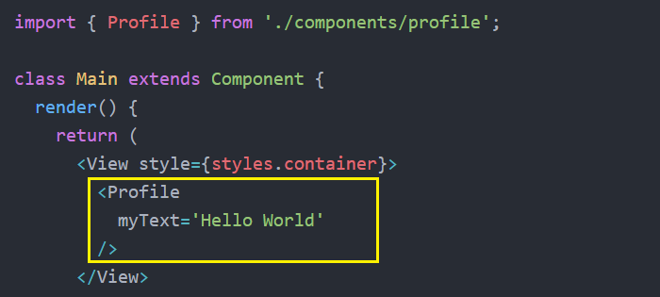
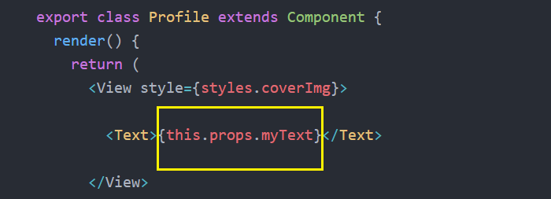

Slide 13
V. Export Component
Export default class ClassName
Import ClassName
Export class ClassName
Import { ClassName }

Slide 14
VI. React Navigation
React Navigation is born from the React Native community's
need for an extensible yet easy-to-use navigation solution
based on Javascript.
Create a Navigator
Config Tab Navigator
Nesting Navigators
Screen Navigation Prop

Slide 15
Navigator
StackNavigator
Provides a way for your app to transition between screens where each new screen is placed on top of a stack
DrawerNavigator
Used to set up a screen with drawer navigation
TabNavigator
Used to set up a screen with several tabs
Default Navigators

Slide 16
DrawerNavigator
StackNavigator
TabNavigator

Slide 17
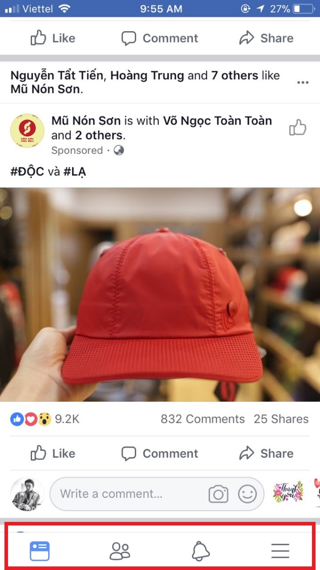
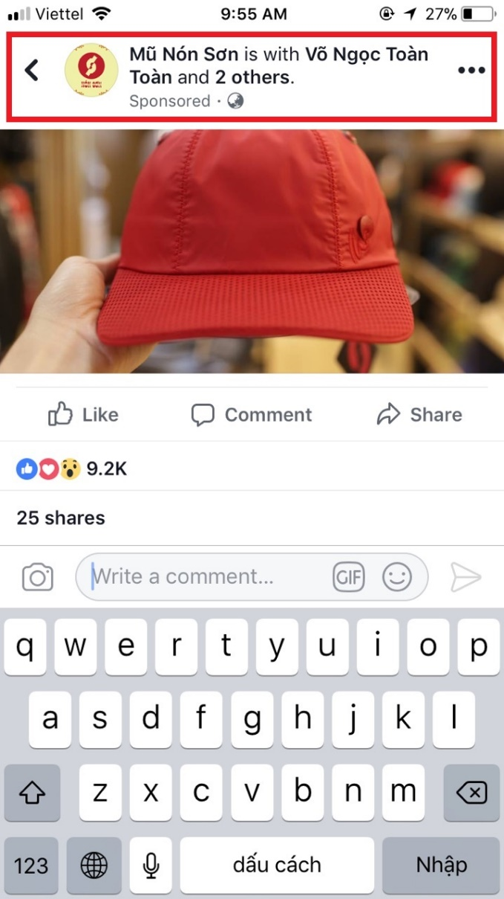
TabNavigator
StackNavigator

Slide 18
THANKS FOR WATCHING !

