Slide 1
BANK CUSTOMER CHURN PREDICTION
Applied Statistic and Experimental Design
Do Nghiem Duc 20214892
Nguyen Huu Nam 20210630
Hoang Tu Quyen 20214929
Pham Duc Thanh 20210795
Tran Van Toan 20214932

Slide 2
Content
Introduction​
Exploratory Data Analysis (EDA)​
Modelling​
Experimental results
Conclusion
References

Slide 3
I. Introduction

Slide 4


I.1. General problem

Slide 5
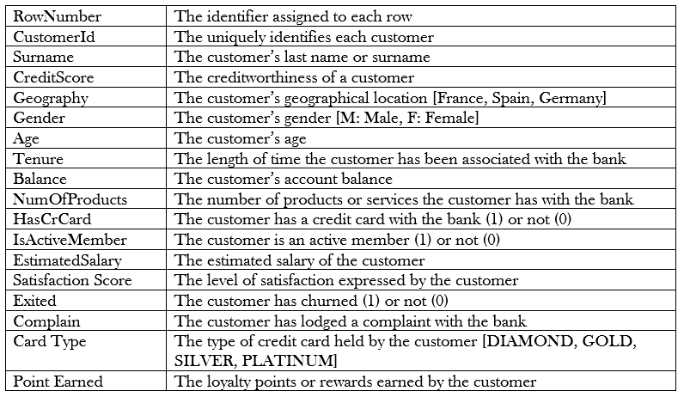
I.2. Attribute information

Slide 6
II. Exploratory Data Analysis (EDA)​

Slide 7
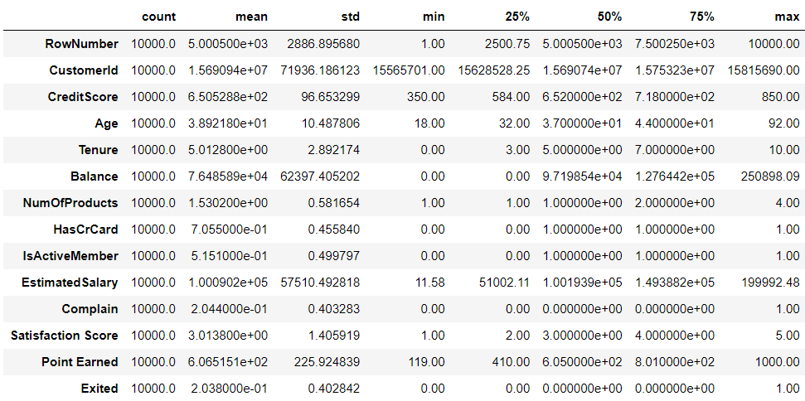
II.1. Data Insight and Visualization:
Numerical value information

Slide 8
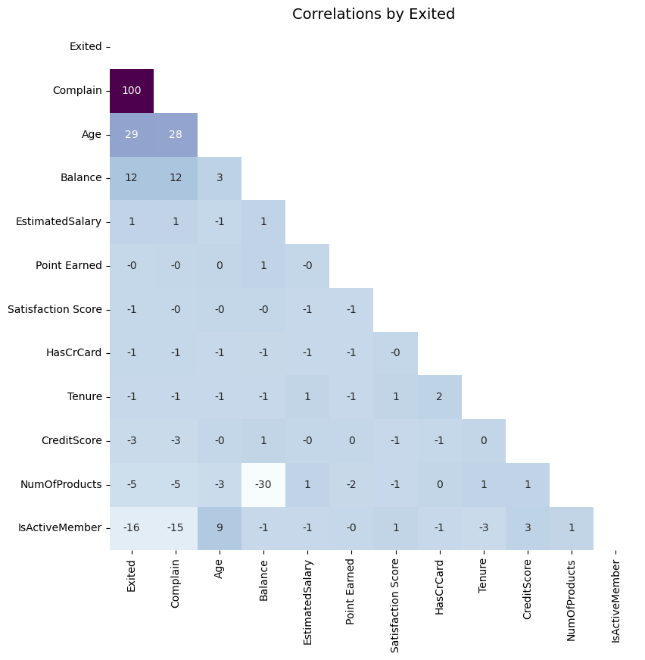
II.1. Data Insight and Visualization:
Correlations heatmap

Slide 9
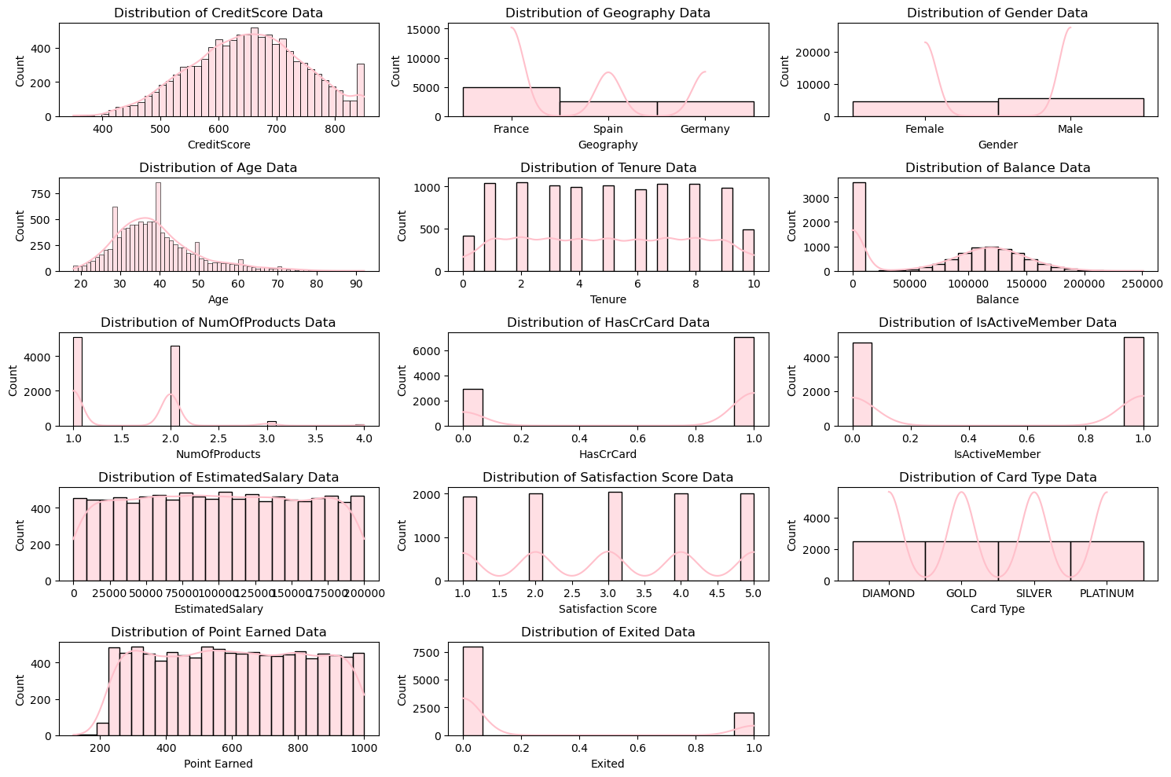
II.1. Data Insight and Visualization:
Data visualization for attributes

Slide 10
II.1. Data Insight and Visualization:
Data visualization for attributes

Slide 11
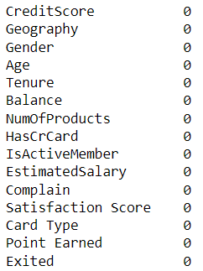
II.2. Data preparation
Data cleansing​
Check for null values

Slide 12
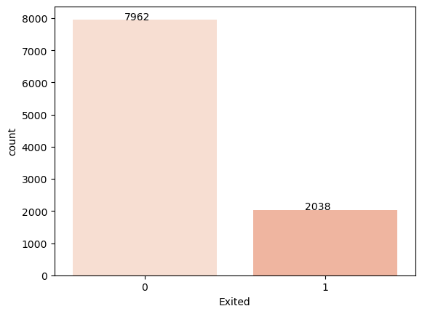
II.2. Data preparation
Analysis the target features​
Target feature

Slide 13
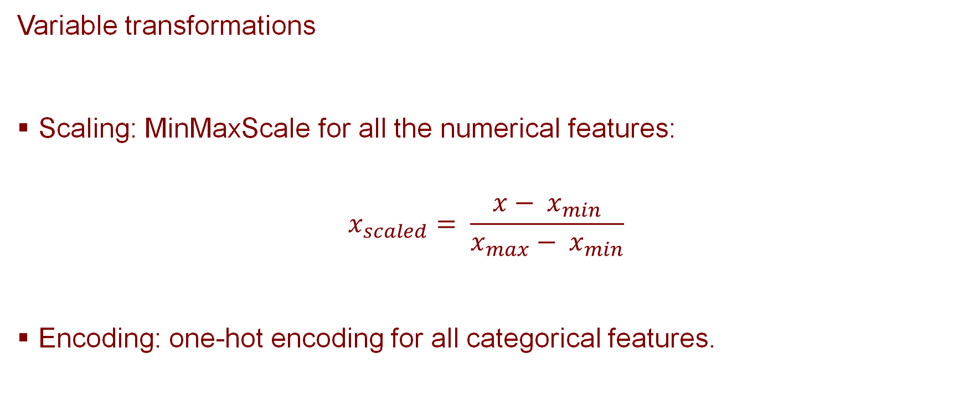
II.2. Data preparation
Variable transformations
Scaling: MinMaxScale for all the numerical features:
$$x_{scaled}= \frac{x− x_{min}}{x_{max}− x_{min}}$$
Encoding: one-hot encoding for all categorical features.

Slide 14
II.3. Data splitting
We randomly split the dataset into 2 parts: train set and test set with the ratio 80%:20%

Slide 15
III. Modelling

Slide 16
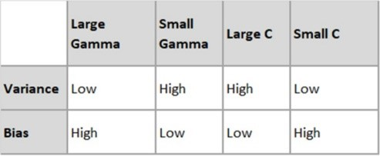
III.1. Support Vector Machines
Training Classifier: The RBF kernel has two important parameters: gamma and C (also called regularization parameter):
Gamma is a parameter that determines the width of the kernel function.
C is a regularization parameter that controls the trade-off between achieving a good fit to the training data and a simple decision boundary.
Gamma controls the distance of influence of a single training point. The behavior(shape) of the model is very sensitive to the gamma parameter

Slide 17
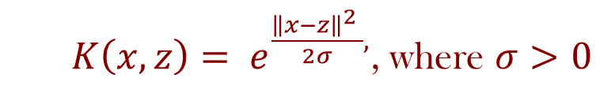
III.1. Support Vector Machines
Our approach only considers RBF, since in general, the RBF (Radial Basis Function) kernel is the better choice when the data is not linearly separable and has a complex pattern (it is also sklearn’s default kernel).
$K\left(x, z\right)= e^{\frac{{\left\|x−z\right\|}^{2} }{2σ},}$, where $σ>0$

Slide 18
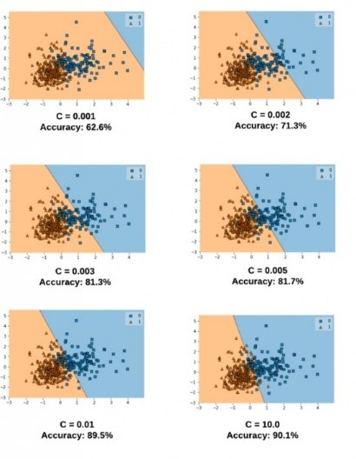
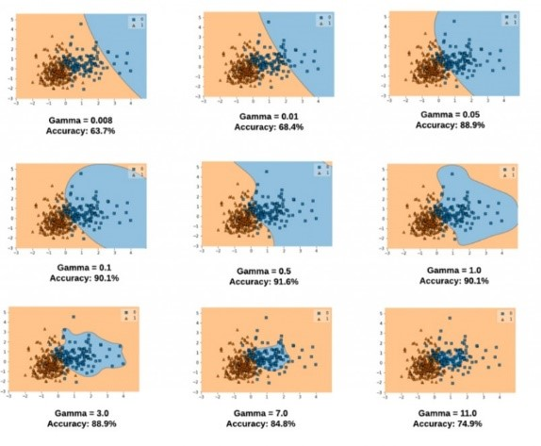
III.1. Support Vector Machines
In order to train parameters: gamma and C, we use 5-folds cross validation and grid search to find optimal values of gamma and C. After testing and training data, it seems that the best combination is gamma=0.01 and C=150.
Effect of Gamma and C on SVM model

Slide 19
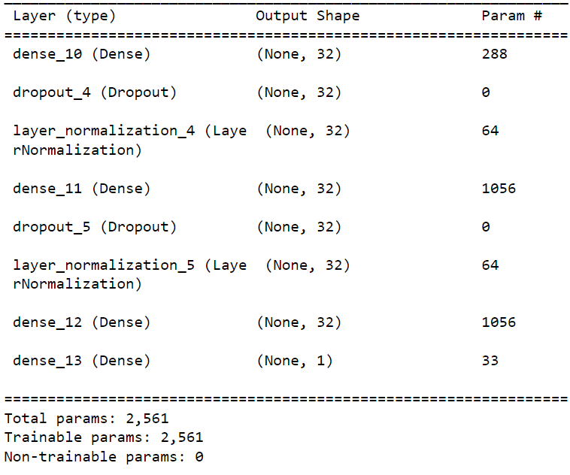

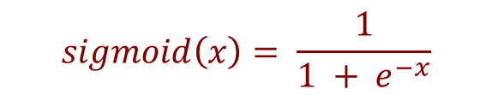
III.2. Neural network
MLP architecture:
ReLU activation:
$$ReLU(x) = max⁡(0, x)$$
Sigmoid activation function:
$$sigmoid\left(x\right)= \frac{1}{1 + e^{−x}}$$
Summary of model

Slide 20
III.2. Neural network
Training Classifier: The RBF kernel has two important parameters: gamma and C (also called regularization parameter):
Gamma is a parameter that determines the width of the kernel function.
C is a regularization parameter that controls the trade-off between achieving a good fit to the training data and a simple decision boundary.
Gamma controls the distance of influence of a single training point. The behavior(shape) of the model is very sensitive to the gamma parameter

Slide 21
III.2. Neural network
Optimizer: Adam
Gradient:
Momentum:
Adaptive learning rate:
Update the parameter:
g(t) = ∇(L(θ))
v(t) = β1 * v(t-1) + (1 - β1) * g(t)
s(t) = β2 * s(t-1) + (1 - β2) * (g(t)^2)
θ(t) = θ(t-1) - {𝜂 / [sqrt(s(t)/(1-β2^t)) + ε]} * [v(t) / (1-β1^t)]

Slide 22
III.2. Neural network
Loss: binary cross entropy
L(y, ŷ) = - (y * log(ŷ) + (1 - y) * log(1 - ŷ))
where:
y is the true binary label (0 or 1).
ŷ is the predicted probability of the positive class (between 0 and 1) obtained from the model.

Slide 23
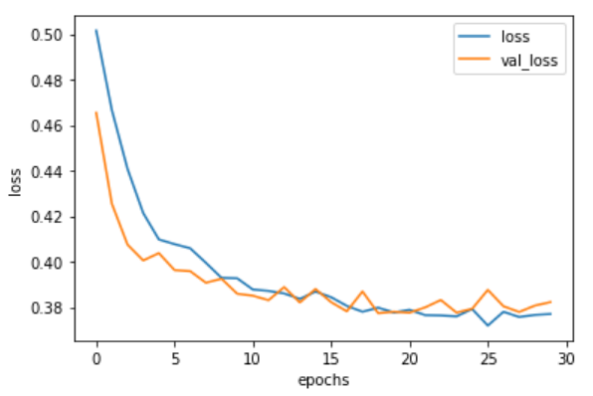
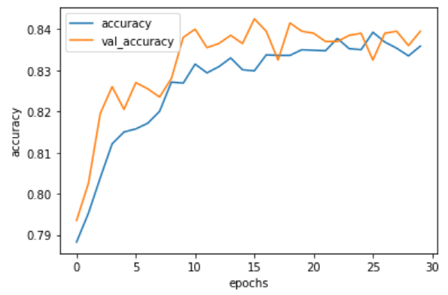
III.2. Neural network
Loss and accuracy after 30 epochs with mini batch size 32:
Loss
Accuracy

Slide 24

III.3. K-Nearest Neighbors
k-Nearest Neighbors Classifier algorithm assumes all instances correspond to points in the n-dimensional space . The nearest neighbors of an instance are defined in terms of the standard Euclidean distance.
$$d\left(x_{i} , x_{j}\right) ≡\sum_{r = 1}^{n}{\sqrt{{\left(a_{r}\left(x_{i}\right)−a_{r}\left(x_{j}\right)\right)}^{2}}}$$

Slide 25
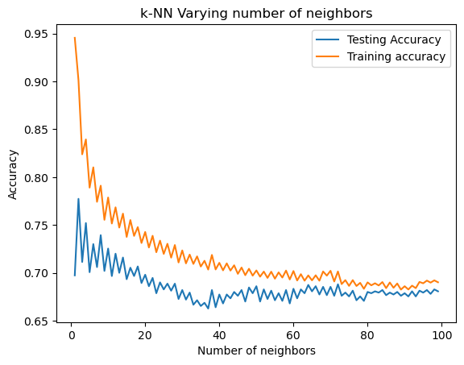
III.3. K-Nearest Neighbors

Slide 26

III.4. Decision tree
Splitting criteria:
Gini index:
$$GiniIndex=1−\sum_{i=1}^{m}{p_{i}^{2}}$$
Entropy:
$$Entropy= −\sum_{i}{p_{i}×\log_{2}{p_{i}}}$$
where $p_{i}$ is the probability of class $i$.

Slide 27
III.5. Random forest
Random forest is an ensemble learning algorithm that combines multiple decision trees by using boostrapting (sampling with replacement) and considering a random subset of the original features to split upon at each node.
Ensemble algorithms: combine multiple individual models (usually weak learners such as decision tree) to improve prediction accuracy and robustness.

Slide 28
III.6. XGBoost
XGBoost is an open-source implementation of boosted trees using gradient boosting, an ensemble algorithm that sequentially adds models to correct previous mistakes.
It incorporates boosting and regularization methods to optimize performance, especially for regression and classification tasks, exhibiting exceptional speed, scalability, and accuracy on large and intricate datasets.

Slide 29
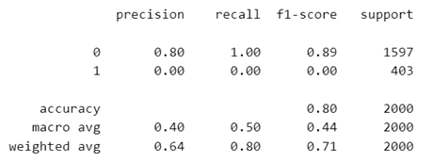
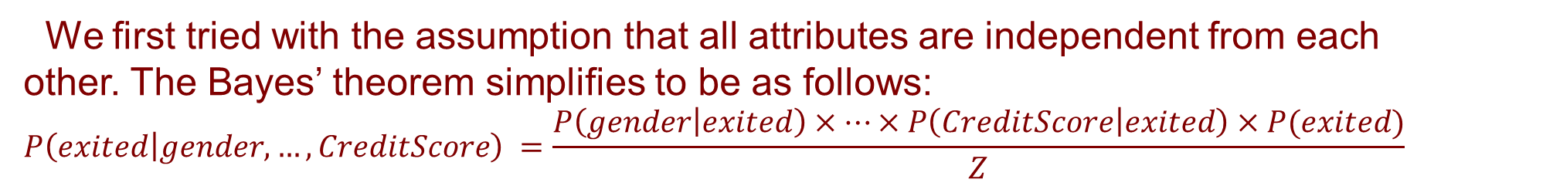
III.7. Bayesian Model
Naive Bayes:
We first tried with the assumption that all attributes are independent from each other. The Bayes’ theorem simplifies to be as follows:
$$P\left(exited | gender, …,CreditScore\right) =\frac{P\left(gender | exited\right)×…×P\left(CreditScore | exited\right)×P(exited)}{Z}$$
However, the model seems to have been overfitted:
Testing result of the model

Slide 30
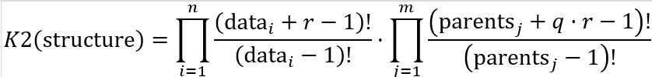
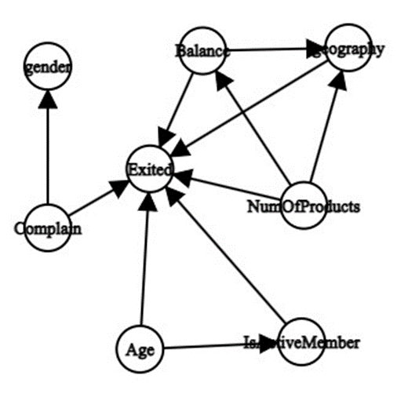
III.7. Bayesian Model
Bayesian network:
We first find a model using Hill Climb Search with K2Score being the loss function:
There are a few edges that should be reversed. And there are some vertices that we thought were related turned out to be not.

Slide 31
IV. Experimental results

Slide 32
IV.1. Performance metrics
Confusion Matrix
Accuracy
Precision, Recall, F1-score
Data splitting
K-fold cross-validation

Slide 33
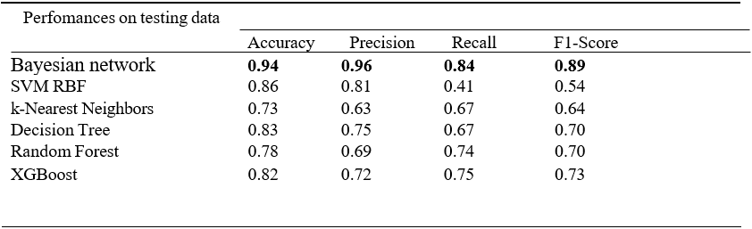
IV.2. Results
Performance of different classifier models

Slide 34
V. Conclusion

Slide 35
V. Conclusion
Conclusion: In our project, we have explained the methodology for building a classifier model that will predict the customer churn from the data from a fixed telephony operator. We have carefully extracted the customers’ behavior within a one-year period, resulting in dataset containing 7043 customers. The results from this study show that predicting the customer churn can be successful with similarly high accuracy. The classification model derived from Bayesian Network have highest performances in recall, F1-Score and ROC in proposed machine learning models.
Future work: we intend to examine some other machine learning models based on essemble learning such as LightGBM to improve performances on testing data and research more to understand the domain of business for featuring engineering.

Slide 36
VI. References
Dataset: Bank Customer Churn Prediction
Libraries used: pandas, sklearn, seaborn, xgboost, pgmpy, …

Slide 37


