Slide 1
Fall 2004, CIS, Temple University
CIS527: Data Warehousing, Filtering, and Mining
Lecture 4
Tutorial: Connecting SQL Server to Matlab using Database Matlab Toolbox
Association Rule MIning
  Lecture slides taken/modified from:
  Jiawei Han (http://www-sal.cs.uiuc.edu/~hanj/DM_Book.html)
  Vipin Kumar (http://www-users.cs.umn.edu/~kumar/csci5980/index.html)

Slide 2

Motivation: Association Rule Mining
Given a set of transactions, find rules that will predict the occurrence of an item based on the occurrences of other items in the transaction
Market-Basket transactions
Example of Association Rules
{Diaper} → {Beer},
{Milk, Bread} → {Eggs,Coke},
{Beer, Bread} → {Milk},
Implication means co-occurrence, not causality!

Slide 3
Applications: Association Rule Mining
* ⇒ Maintenance Agreement
  What the store should do to boost Maintenance Agreement sales
Home Electronics ⇒ *
  What other products should the store stocks up?
Attached mailing in direct marketing
Detecting “ping-ponging” of patients
Marketing and Sales Promotion
Supermarket shelf management

Slide 4

Definition: Frequent Itemset
Itemset
  A collection of one or more items
    Example: {Milk, Bread, Diaper}
  k-itemset
    An itemset that contains k items
Support count (σ)
  Frequency of occurrence of an itemset
  E.g. σ({Milk, Bread,Diaper}) = 2
Support
  Fraction of transactions that contain an itemset
  E.g. s({Milk, Bread, Diaper}) = 2/5
Frequent Itemset
  An itemset whose support is greater than or equal to a minsup threshold

Slide 5



Definition: Association Rule
Association Rule
  An implication expression of the form X → Y, where X and Y are itemsets
  Example:
  {Milk, Diaper} → {Beer}
Rule Evaluation Metrics
  Support (s)
    Fraction of transactions that contain both X and Y
  Confidence (c)
    Measures how often items in Y
    appear in transactions that
    contain X
Example:

Slide 6
Association Rule Mining Task
Given a set of transactions T, the goal of association rule mining is to find all rules having
  support ≥ minsup threshold
  confidence ≥ minconf threshold
Brute-force approach:
  List all possible association rules
  Compute the support and confidence for each rule
  Prune rules that fail the minsup and minconf thresholds
  ⇒ Computationally prohibitive!

Slide 7
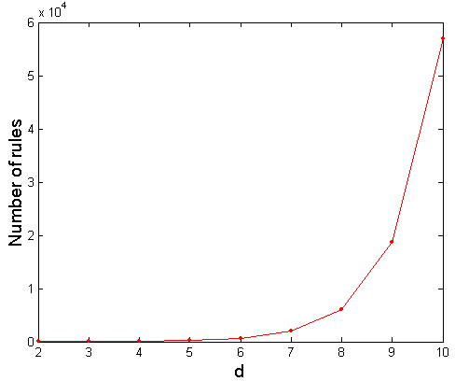
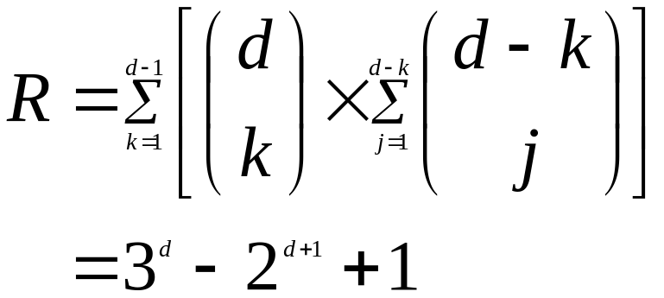
Computational Complexity
Given d unique items:
  Total number of itemsets = 2^{d}
  Total number of possible association rules:
If d=6, R = 602 rules

Slide 8
Mining Association Rules: Decoupling
Example of Rules:
{Milk,Diaper} → {Beer} (s=0.4, c=0.67)
{Milk,Beer} → {Diaper} (s=0.4, c=1.0)
{Diaper,Beer} → {Milk} (s=0.4, c=0.67)
{Beer} → {Milk,Diaper} (s=0.4, c=0.67)
{Diaper} → {Milk,Beer} (s=0.4, c=0.5)
{Milk} → {Diaper,Beer} (s=0.4, c=0.5)
Observations:
All the above rules are binary partitions of the same itemset:
{Milk, Diaper, Beer}
Rules originating from the same itemset have identical support but
can have different confidence
Thus, we may decouple the support and confidence requirements

Slide 9
Mining Association Rules
Two-step approach:
  Frequent Itemset Generation
    Generate all itemsets whose support ≥ minsup
  Rule Generation
    Generate high confidence rules from each frequent itemset, where each rule is a binary partitioning of a frequent itemset
Frequent itemset generation is still computationally expensive

Slide 10

Frequent Itemset Generation
Brute-force approach:
  Each itemset in the lattice is a candidate frequent itemset
  Count the support of each candidate by scanning the database
  Match each transaction against every candidate
  Complexity ~ O(NMw) => Expensive since M = 2^{d} !!!

Slide 11
Frequent Itemset Generation Strategies
Reduce the number of candidates (M)
  Complete search: M=2^{d}
  Use pruning techniques to reduce M
Reduce the number of transactions (N)
  Reduce size of N as the size of itemset increases
  Use a subsample of N transactions
Reduce the number of comparisons (NM)
  Use efficient data structures to store the candidates or transactions
  No need to match every candidate against every transaction

Slide 12
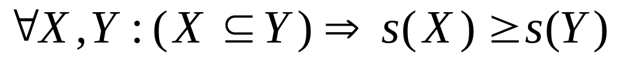
Reducing Number of Candidates: Apriori
Apriori principle:
  If an itemset is frequent, then all of its subsets must also be frequent
Apriori principle holds due to the following property of the support measure:
  Support of an itemset never exceeds the support of its subsets
  This is known as the anti-monotone property of support

Slide 13


Illustrating Apriori Principle
Found to be Infrequent
Pruned supersets

Slide 14

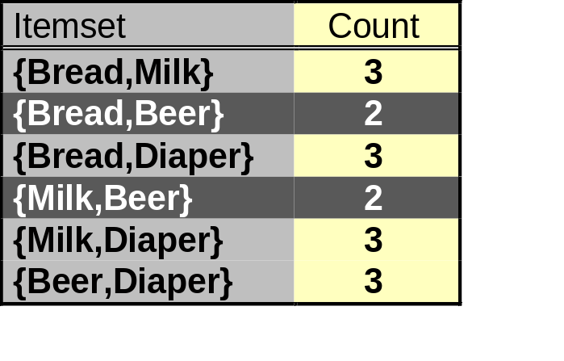
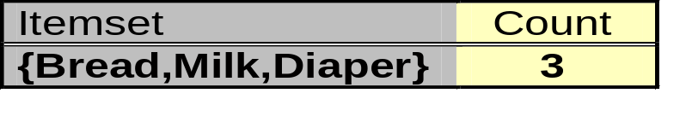
Illustrating Apriori Principle
Items (1-itemsets)
Pairs (2-itemsets)
(No need to generate
candidates involving Coke
or Eggs)
Minimum Support = 3
Triplets (3-itemsets)
If every subset is considered,
⁶C₁ + ⁶C₂ + ⁶C₃ = 41
With support-based pruning,
6 + 6 + 1 = 13

Slide 15
Apriori Algorithm
Method:
  Let k=1
  Generate frequent itemsets of length 1
  Repeat until no new frequent itemsets are identified
    Generate length (k+1) candidate itemsets from length k frequent itemsets
    Prune candidate itemsets containing subsets of length k that are infrequent
    Count the support of each candidate by scanning the DB
    Eliminate candidates that are infrequent, leaving only those that are frequent

Slide 16
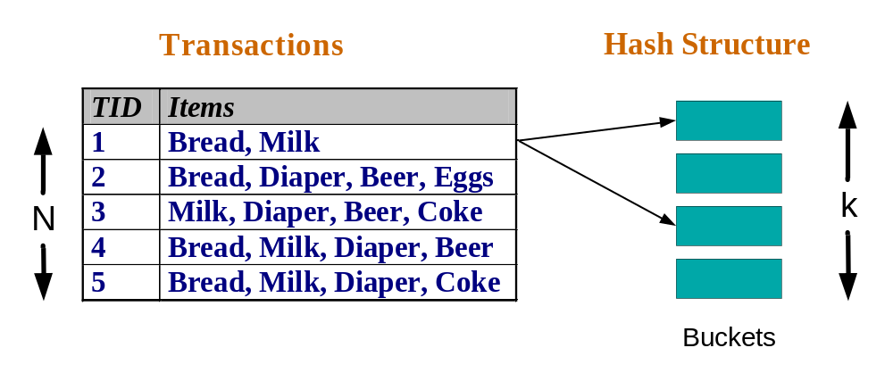
Apriori: Reducing Number of Comparisons
Candidate counting:
  Scan the database of transactions to determine the support of each candidate itemset
  To reduce the number of comparisons, store the candidates in a hash structure
    Instead of matching each transaction against every candidate, match it against candidates contained in the hashed buckets

Slide 17
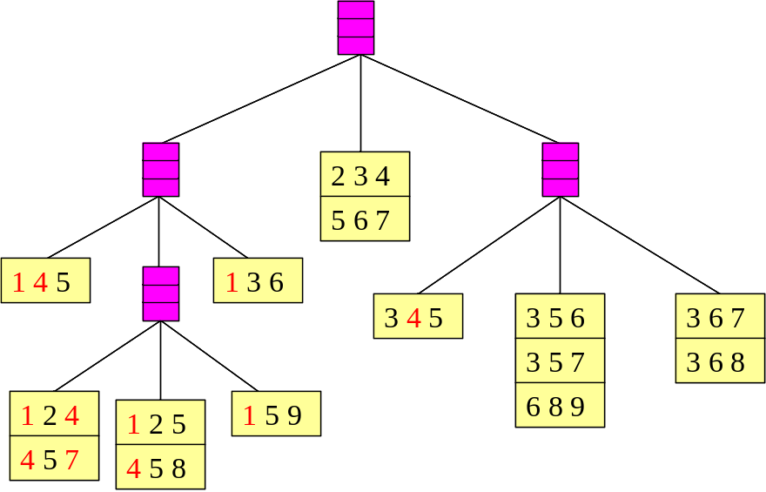
Apriori: Implementation Using Hash Tree
Suppose you have 15 candidate itemsets of length 3:
{1 4 5}, {1 2 4}, {4 5 7}, {1 2 5}, {4 5 8}, {1 5 9}, {1 3 6}, {2 3 4}, {5 6 7}, {3 4 5}, {3 5 6}, {3 5 7}, {6 8 9}, {3 6 7}, {3 6 8}
You need:
Hash function
Max leaf size: max number of itemsets stored in a leaf node
  (if number of candidate itemsets exceeds max leaf size, split the node)
Hash function
3,6,9
1,4,7
2,5,8

Slide 18
Apriori: Implementation Using Hash Tree
1 2 3 5 6
transaction
1 +
2 3 5 6
2 +
3 5 6
1 2 +
3 5 6
3 +
5 6
1 3 +
5 6
2 3 4
1 5 +
6
5 6 7
1 4 5
1 3 6
3 4 5
3 5 6
3 6 7
3 5 7
3 6 8
1 2 4
1 2 5
1 5 9
6 8 9
4 5 7
4 5 8
Match transaction against 11 out of 15 candidates

Slide 19
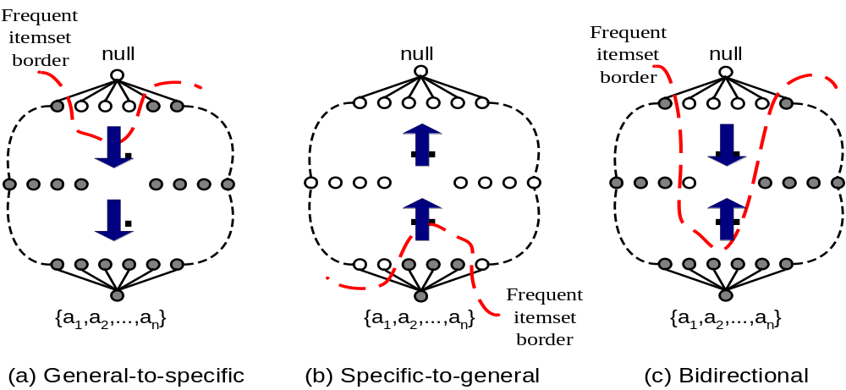
Apriori: Alternative Search Methods
Traversal of Itemset Lattice
  General-to-specific vs Specific-to-general

Slide 20
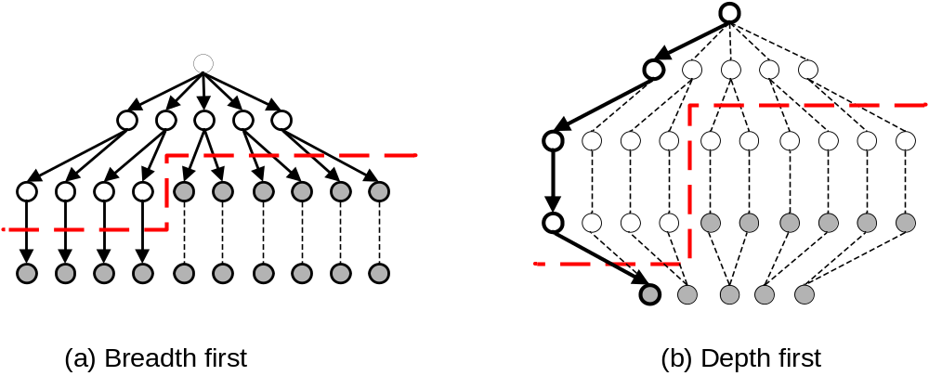
Apriori: Alternative Search Methods
Traversal of Itemset Lattice
  Breadth-first vs Depth-first

Slide 21
Bottlenecks of Apriori
Candidate generation can result in huge candidate sets:
  10⁴ frequent 1-itemset will generate 10⁷ candidate 2-itemsets
  To discover a frequent pattern of size 100, e.g., {a₁, a₂, …, a₁₀₀}, one needs to generate 2¹⁰⁰ ~ 10³⁰ candidates.
Multiple scans of database:
  Needs (n +1 ) scans, n is the length of the longest pattern

Slide 22
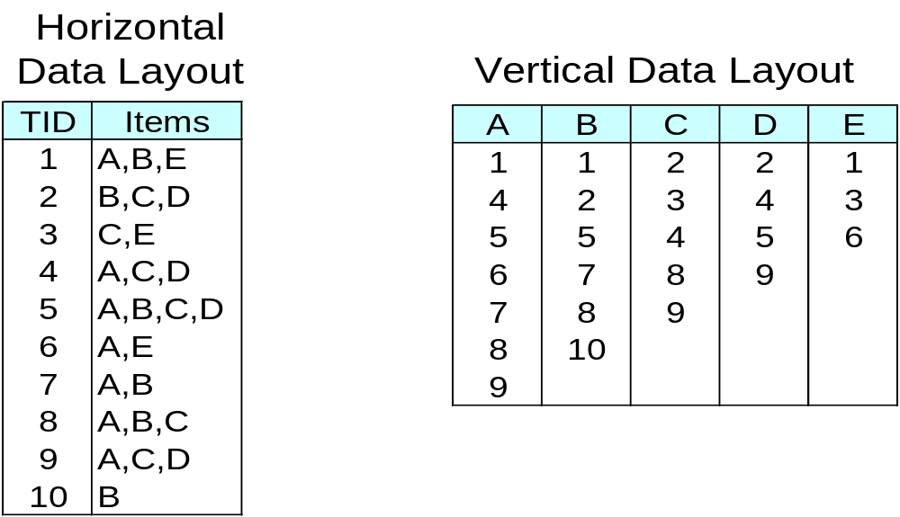
ECLAT: Another Method for Frequent Itemset Generation
ECLAT: for each item, store a list of transaction ids (tids); vertical data layout
TID-list

Slide 23
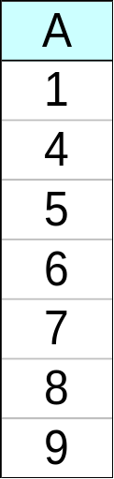
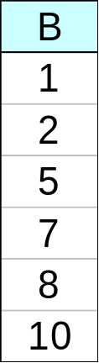
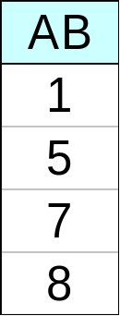
ECLAT: Another Method for Frequent Itemset Generation
Determine support of any k-itemset by intersecting tid-lists of two of its (k-1) subsets.
3 traversal approaches:
  top-down, bottom-up and hybrid
Advantage: very fast support counting
Disadvantage: intermediate tid-lists may become too large for memory
∧
→

Slide 24
FP-growth: Another Method for Frequent Itemset Generation
Use a compressed representation of the database using an FP-tree
Once an FP-tree has been constructed, it uses a recursive divide-and-conquer approach to mine the frequent itemsets

Slide 25
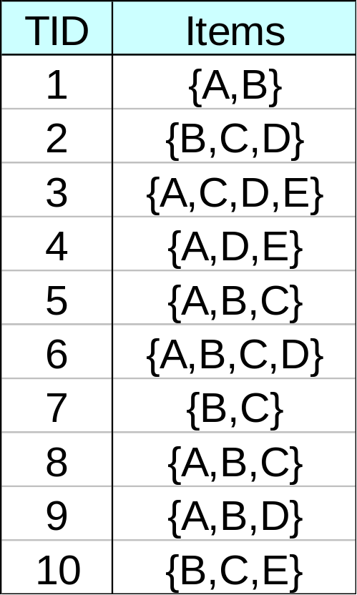
FP-Tree Construction
null
After reading TID=1:
A:1
B:1
After reading TID=2:
null
A:1
B:1
B:1
C:1
D:1

Slide 26
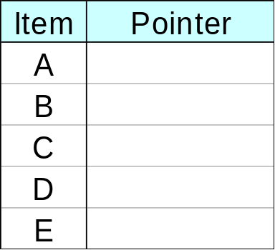
FP-Tree Construction
Transaction Database
null
A:7
B:3
B:5
C:3
C:1
D:1
Header table
D:1
C:3
E:1
D:1
E:1
D:1
E:1
D:1
Pointers are used to assist frequent itemset generation

Slide 27
FP-growth
Build conditional pattern base for E:
P = {(A:1,C:1,D:1),
(A:1,D:1),
(B:1,C:1)}
Recursively apply FP-growth on P
null
A:7
B:3
B:5
C:3
C:1
D:1
C:3
D:1
D:1
E:1
D:1
E:1
E:1
D:1

Slide 28
FP-growth
Conditional tree for E:
Conditional Pattern base for E:
P = {(A:1,C:1,D:1,E:1),
(A:1,D:1,E:1),
(B:1,C:1,E:1)}
Count for E is 3: {E} is frequent itemset
Recursively apply FP-growth on P
null
A:2
B:1
C:1
C:1
D:1
D:1
E:1
E:1
E:1

Slide 29
FP-growth
Conditional tree for D within conditional tree for E:
Conditional pattern base for D within conditional base for E:
P = {(A:1,C:1,D:1),
(A:1,D:1)}
Count for D is 2: {D,E} is frequent itemset
Recursively apply FP-growth on P
null
A:2
C:1
D:1
D:1

Slide 30
FP-growth
Conditional tree for C within D within E:
Conditional pattern base for C within D within E:
P = {(A:1,C:1)}
Count for C is 1: {C,D,E} is NOT frequent itemset
null
A:1
C:1

Slide 31
FP-growth
Conditional tree for A within D within E:
Count for A is 2: {A,D,E} is frequent itemset
Next step:
Construct conditional tree C within conditional tree E
Continue until exploring conditional tree for A (which has only node A)
null
A:2

Slide 32

Benefits of the FP-tree Structure
Performance study shows
  FP-growth is an order of magnitude faster than Apriori, and is also faster than tree-projection
Reasoning
  No candidate generation, no candidate test
  Use compact data structure
  Eliminate repeated database scan
  Basic operation is counting and FP-tree building

Slide 33
Complexity of Association Mining
Choice of minimum support threshold
  lowering support threshold results in more frequent itemsets
  this may increase number of candidates and max length of frequent itemsets
Dimensionality (number of items) of the data set
  more space is needed to store support count of each item
  if number of frequent items also increases, both computation and I/O costs may also increase
Size of database
  since Apriori makes multiple passes, run time of algorithm may increase with number of transactions
Average transaction width
  transaction width increases with denser data sets
  This may increase max length of frequent itemsets and traversals of hash tree (number of subsets in a transaction increases with its width)

Slide 34
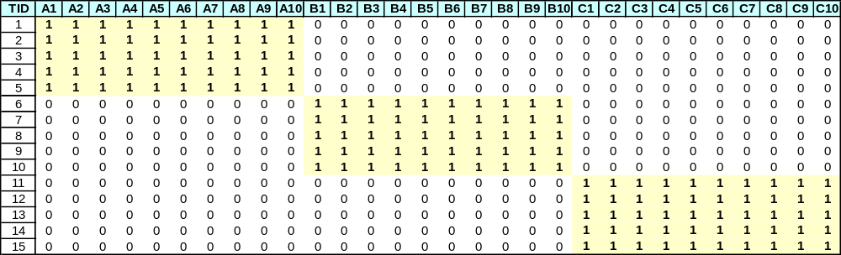
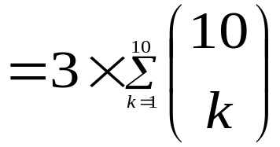
Compact Representation of Frequent Itemsets
Some itemsets are redundant because they have identical support as their supersets
Number of frequent itemsets
Need a compact representation

Slide 35
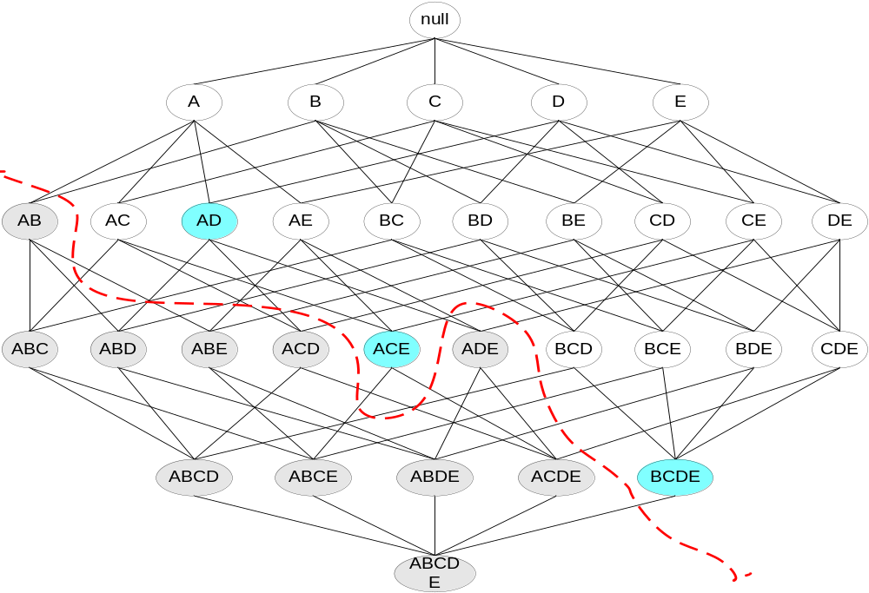
Maximal Frequent Itemset
An itemset is maximal frequent if none of its immediate supersets is frequent
Maximal Itemsets
Infrequent Itemsets
Border

Slide 36
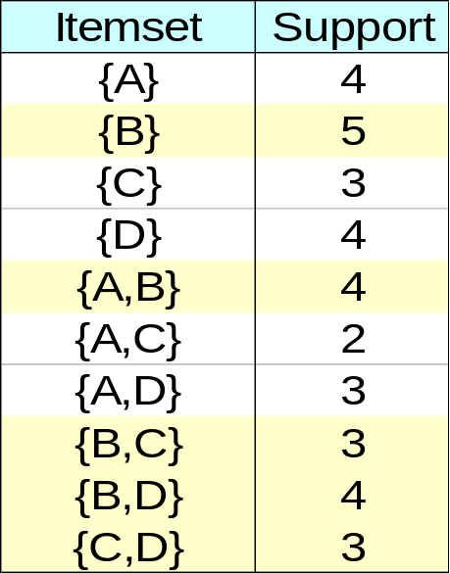
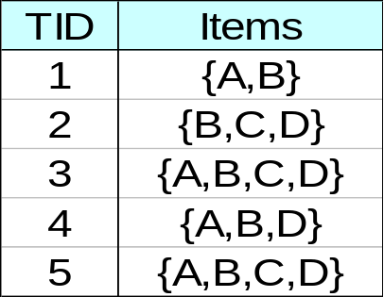
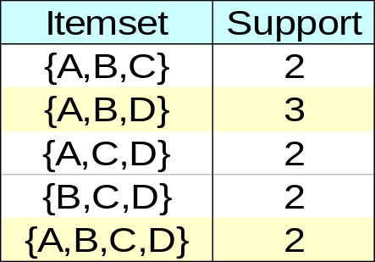
Closed Itemset
Problem with maximal frequent itemsets:
  Support of their subsets is not known – additional DB scans are needed
An itemset is closed if none of its immediate supersets has the same support as the itemset

Slide 37
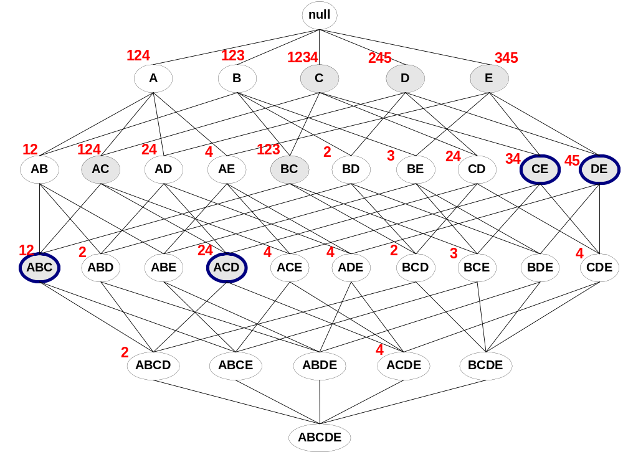
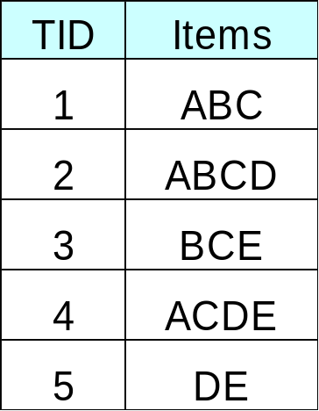
Maximal vs Closed Frequent Itemsets
Minimum support = 2
Closed but not maximal
Closed and maximal
# Closed = 9
# Maximal = 4

Slide 38
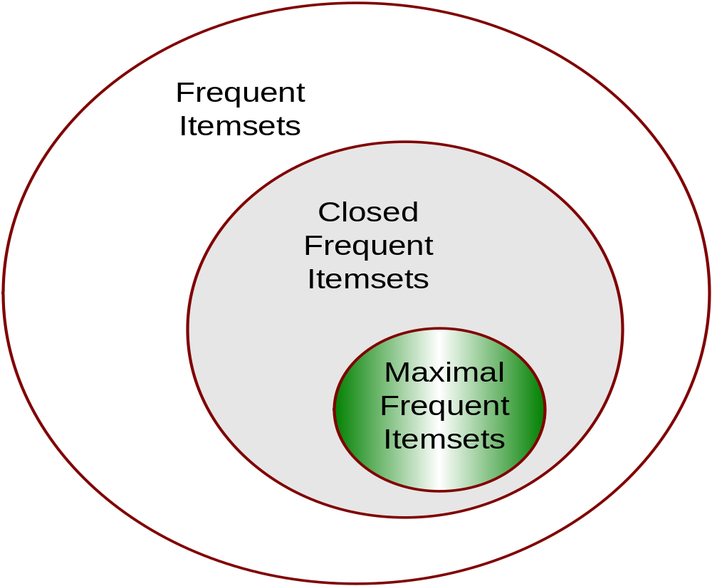
Maximal vs Closed Itemsets

Slide 39
Rule Generation
Given a frequent itemset L, find all non-empty subsets f ⊂ L such that f → L – f satisfies the minimum confidence requirement
  If {A,B,C,D} is a frequent itemset, candidate rules:
    ABC →D, ABD →C, ACD →B, BCD →A,
    A →BCD, B →ACD, C →ABD, D →ABC
    AB →CD, AC → BD, AD → BC, BC →AD,
    BD →AC, CD →AB,
If |L| = k, then there are 2^{k} – 2 candidate association rules (ignoring L → ∅ and ∅ → L)

Slide 40
Rule Generation
How to efficiently generate rules from frequent itemsets?
  In general, confidence does not have an anti-monotone property
    c(ABC →D) can be larger or smaller than c(AB →D)
  But confidence of rules generated from the same itemset has an anti-monotone property
  e.g., L = {A,B,C,D}:
  c(ABC → D) ≥ c(AB → CD) ≥ c(A → BCD)
    Confidence is anti-monotone w.r.t. number of items on the RHS of the rule

Slide 41
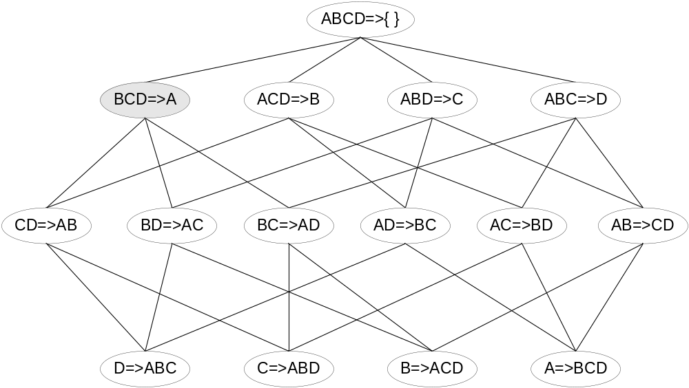

Rule Generation
Lattice of rules
Low Confidence Rule
Pruned Rules

Slide 42
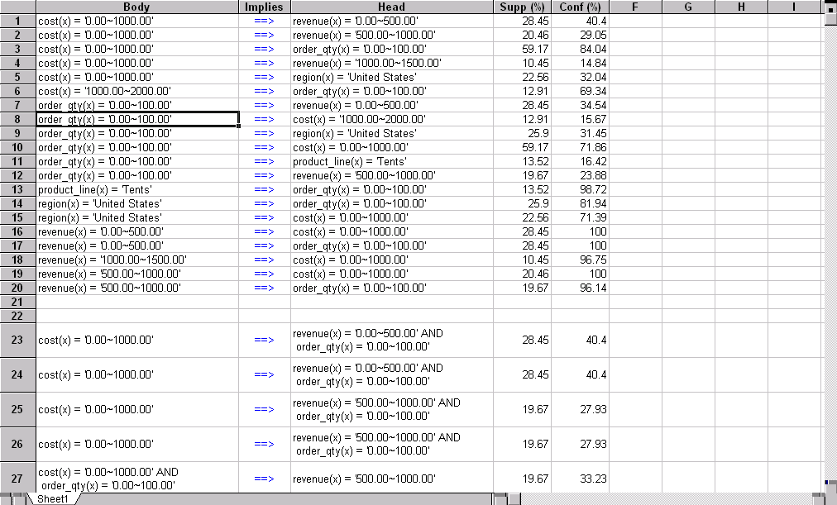
Presentation of Association Rules (Table Form)

Slide 43

Visualization of Association Rule Using Plane Graph

Slide 44

Visualization of Association Rule Using Rule Graph

