Slide 1
Mask R-CNN
https://openaccess.thecvf.com/content_ICCV_2017/papers/He_Mask_R-CNN_ICCV_2017_paper.pdf

Slide 2
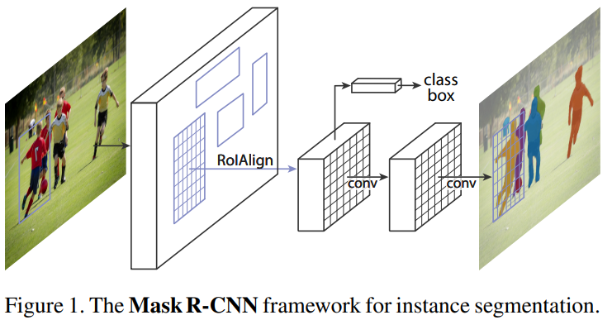
Bài toán cần giải quyết
Instance segmentation
Mask RCNN is a conceptually simple, flexible, and general framework for object instance segmentation. The approach efficiently detects objects in an image while simultaneously generating a high-quality segmentation mask for each instance.

Slide 3
Ý tưởng giải quyết
This method extends Faster R-CNN by adding a branch for predicting an object mask in parallel with the existing branch for bounding box recognition. Mask R-CNN is simple to train and adds only a small overhead to Faster R-CNN, running at 5 fps.

