Slide 1
https://openaccess.thecvf.com/content_ICCV_2017/papers/He_Mask_R-CNN_ICCV_2017_paper.pdf

Slide 2
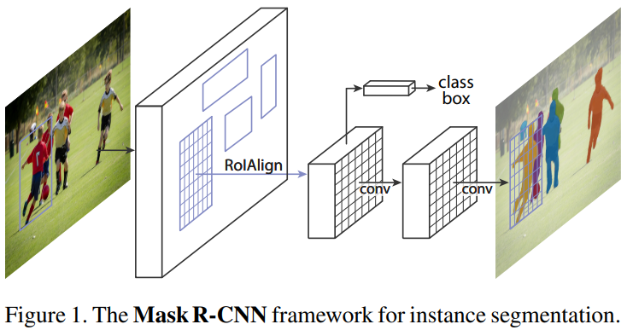
Bài toán cần giải quyết
We present a conceptually simple, flexible, and general framework for object instance segmentation. Our approach efficiently detects objects in an image while simultaneously generating a high-quality segmentation mask for each instance

Slide 3
Các câu hỏi đặt ra là gì?
How to classify each pixel into a fixed set of categories without differentiating object instances?

Slide 4
Ý tưởng giải quyết
In the second stage, in parallel to predicting the class and box offset, Mask R-CNN also outputs a binary mask for each RoI

