Slide 1
Midterm project presentation
Yichun Qu
Electrical and Computer Engineering
10/21/2024
GitHub:

Slide 2
1. Problem
Regression Problem
In this problem, the goal is to predict clinical scores of a new, unseen patient related to Parkinson's disease progression monitoring, specifically the total UPDRS scores, based on 16 biomedical voice measurements from individuals with early-stage Parkinson's disease.
This problem is important because it enables non-invasive, remote monitoring of Parkinson's disease progression, allowing for more frequent and convenient tracking of symptoms. Accurate prediction of UPDRS scores from voice data can improve patient care by facilitating early intervention and personalized treatment adjustments.

Slide 3
Dataset: Oxford Parkinson's Disease Telemonitoring
Data Collected: The dataset consists of 5,875 voice recordings from 42 patients with early-stage Parkinson's disease, collected over a six-month trial using a telemonitoring device for remote symptom monitoring. Each recording includes 16 biomedical voice measurements and patient details such as age, gender, and time since baseline recruitment. The recordings were automatically captured in the patients' homes.
Reference: Athanasios Tsanas, Max A. Little, Patrick E. McSharry, Lorraine O. Ramig (2009), 'Accurate telemonitoring of Parkinson’s disease progression by non-invasive speech tests', IEEE Transactions on Biomedical Engineering (to appear).

Slide 4
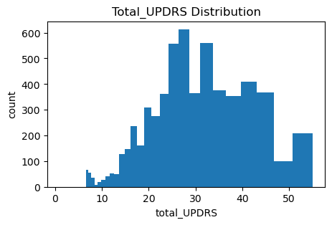
2. EDA
Visualize the distribution of the total_UPDRS scores.
Understand the target variable.
Facilitate Decision-Making

Slide 5
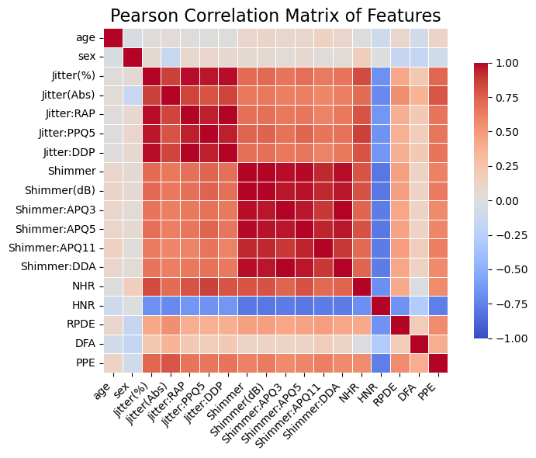
2. EDA
Visualize the Pearson correlation matrix of features.
Understanding Feature Relationships
Identifying Redundant Features

Slide 6
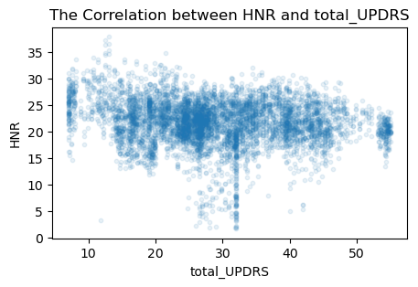
2. EDA
Visualizes the relationship between the target variable and ‘HNR’.
Exploration of Non-Linear Relationships
Data Quality Check

Slide 7
3. Split the dataset: Group-based split
The data is split into training, validation, and test sets using group-based splitting to ensure all recordings from the same patient stay in one set (validation/train/test), preventing data leakage.
The data is first split into a test set (20%) and an other set using GroupShuffleSplit. The other set is then divided into training (60%) and validation sets (20%) using GroupKFold for 4-fold cross-validation, ensuring patient groups remain distinct.

Slide 8
gss=GroupShuffleSplit(n_splits=1,test_size=0.8,random_state=random_state)
group_kfold=GroupKFold(n_splits=4)
Test set: [ 8 11 15 19 21 23 29 39]
Others set: [ 1 2 3 4 5 6 7 9 10 12 13 14 16 17 18 20 22 24 25 26 27 28 30 31 32 33 34 35 36 37 38 40 41 42]
TRAIN: [ 1 2 3 5 7 9 12 13 14 16 20 22 24 25 26 27 28 30 32 34 36 37 38 40 41 42]
Val: [ 4 6 10 17 18 31 33 35]
TRAIN: [ 1 2 3 4 5 6 7 10 14 16 17 18 20 22 24 27 30 31 32 33 34 35 36 38 40]
Val: [ 9 12 13 25 26 28 37 41 42]
TRAIN: [ 3 4 5 6 9 10 12 13 17 18 20 22 25 26 27 28 31 32 33 34 35 37 38 40 41 42]
Val: [ 1 2 7 14 16 24 30 36]
TRAIN: [ 1 2 4 6 7 9 10 12 13 14 16 17 18 24 25 26 28 30 31 33 35 36 37 41 42]
Val: [ 3 5 20 22 27 32 34 38 40]

Slide 9
4. Preprocess
One-Hot Encoding: Applied to the categorical feature 'sex' to convert it into binary columns representing each category (male or female). This is important because machine learning algorithms often require categorical variables to be represented numerically.
Standardization: Applied to continuous features such as 'age', 'test_time', and the biomedical voice measures. This standardization ensures that all features have a mean of 0 and a standard deviation of 1, making them comparable and improving model convergence.

Slide 10
4. Preprocess
onehot_ftrs=['sex']
std_ftrs=['age','test_time','Jitter(%)','Jitter(Abs)','Jitter:RAP','Jitter: PPQ5','Jitter:DDP','Shimmer','Shimmer(dB)','Shimmer:APQ3','Shimmer: APQ5','Shimmer:APQ11','Shimmer:DDA','NHR','HNR','RPDE','DFA','PPE']
preprocessor=ColumnTransformer(
transformers=[
('onehot',OneHotEncoder(sparse_output=False,handle_unknown='ignore '),onehot_ftrs),
('std',StandardScaler(),std_ftrs)],
remainder='passthrough' # This will keep the remaining columns
)
clf=Pipeline(steps=[('preprocessor',preprocessor)])

Slide 11
4. Preprocess
Number of Features and Data Points:
Before preprocessing: There were 20 features in the dataset: 1 categorical feature ('sex') and 19 continuous features. There were 3,515 data points in the training set.
After preprocessing: The feature count increased to 21 (due to the additional column for the 'sex' feature). The number of data points remained the same at 3,515.
No missing values.

Slide 12
Thanks for listening

