Slide 1





Beginner Course on Microbial Genomics: Applications & Research (2026)
Module 2.2
Long-Read Sequencing Oxford Nanopore Technology
Lecturer
PhD Student: Quynh Nguyen
Teaching assistant
Mr: Ton Ngoc Minh Quan

Slide 2
Our journeys
Annotated genomes
Hybrid Assembly
QC & Post-Assembly Profiling
Raw sequences
Assembled
genome
QC
Variant calling and filtering
Phylogeny
Mapping

Slide 3
Our journeys
Annotated genomes
Hybrid Assembly
QC & Post-Assembly Profiling
Raw sequences
Assembled
genome
QC
Variant calling and filtering
Phylogeny
Mapping

Slide 4
Agenda
Theory
Long-Read Introduction
Techniques and Platforms
Wet and Dry lab workflows
Long-Read vs Short-Read Sequencing
Practical Command-line (CLI)
Unicycler
Data Visualization and Manipulation with Bandage
Module 2.2: Long-Read Sequencing - Hybrid Assembly

Slide 5
Theory
Module 2.2: Long-Read Sequencing - Hybrid Assembly

Slide 6
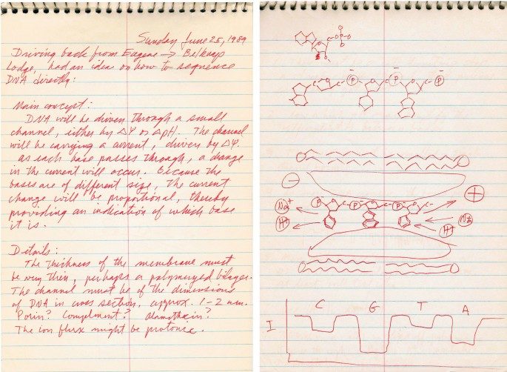
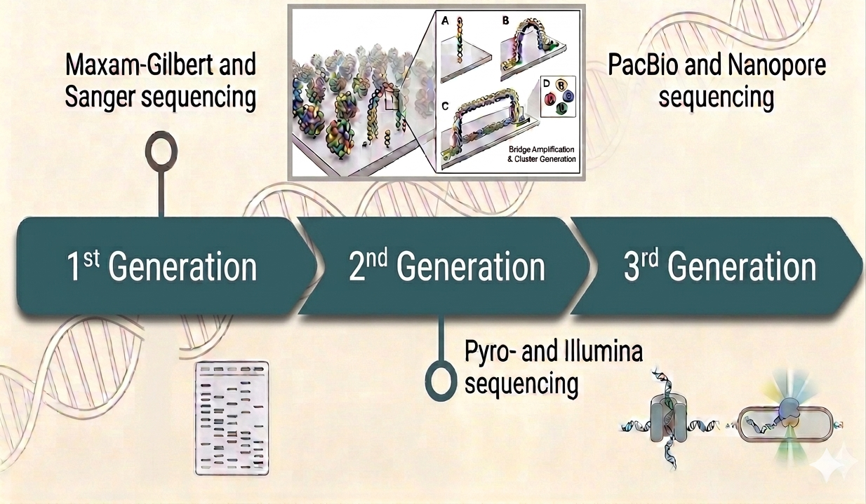
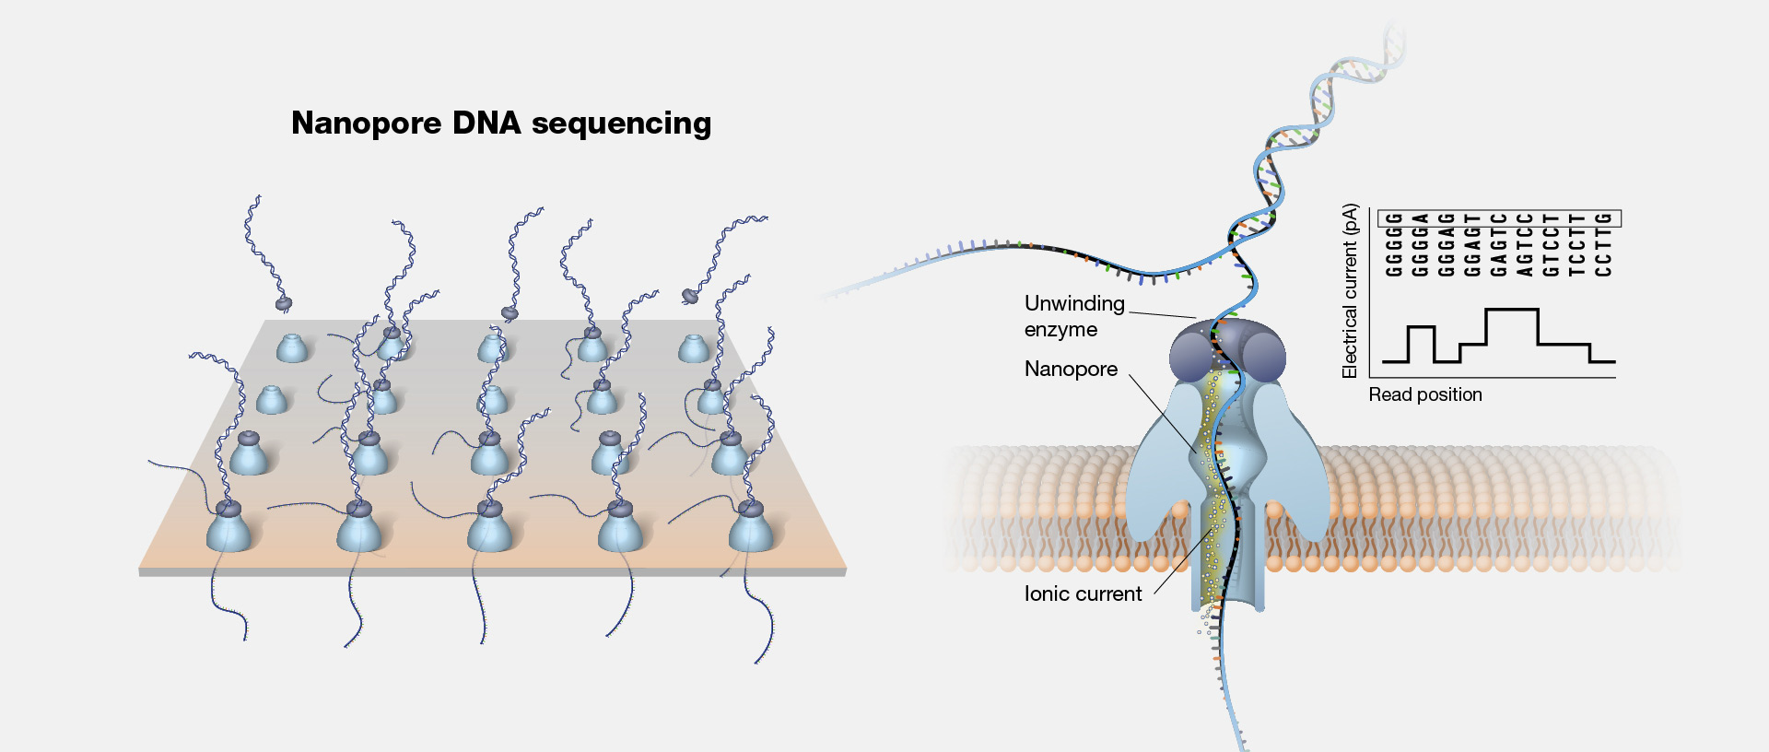
Theory
Long-Read Introduction
David Deamer’s original notebook sketch, 1989
History of DNA sequencing
10.1038/nbt.3423
Module 2.2: Long-Read Sequencing - Hybrid Assembly

Slide 7
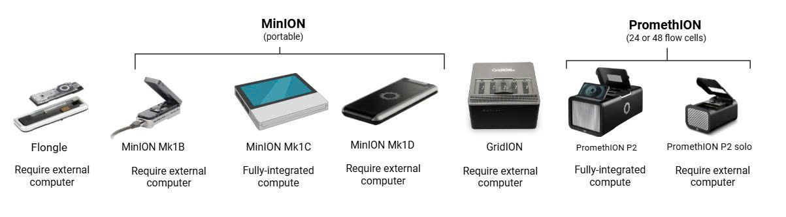
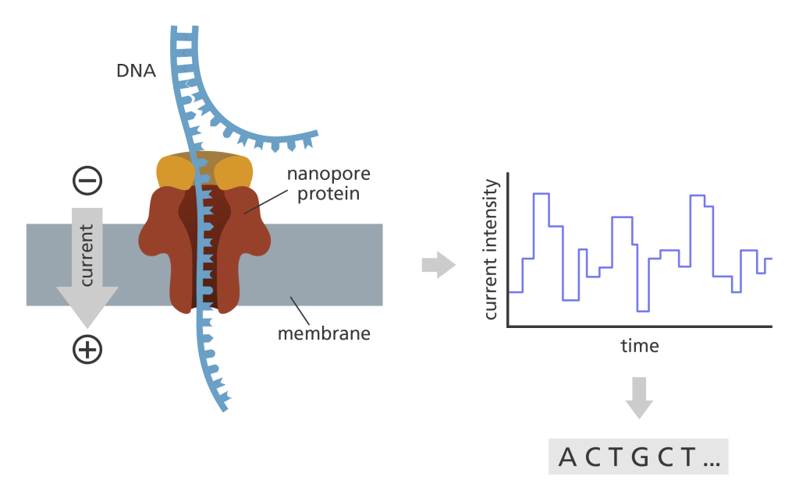
Theory
Techniques and Platforms
Illustration of nanopore
(https://www.goldengooseaward.org/)
Module 2.2: Long-Read Sequencing - Hybrid Assembly

Slide 8
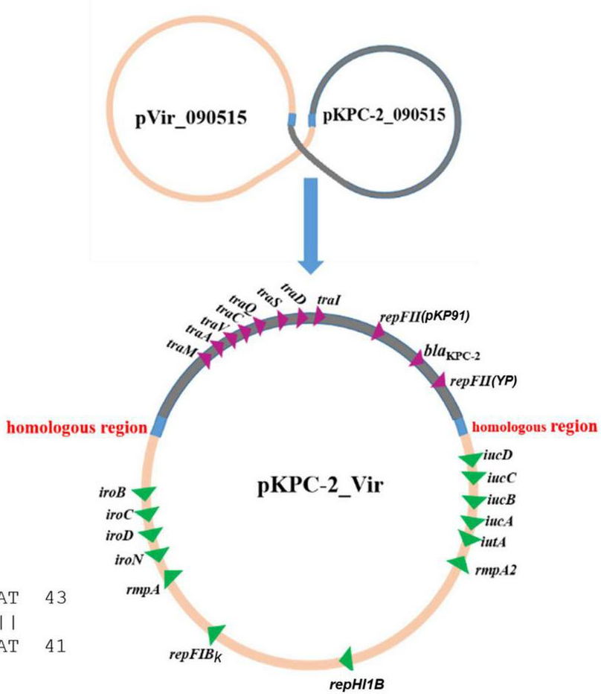
Theory
Why do we need Long-Read?
Faster and simpler workflows (Outbreak response – Ebola, COVID, Hantavirus,…)
Complete bacterial genome (AMR-carrying plasmid, VF-carrying plasmid,…), plasmid population diversity
10.3389/fmicb.2022.852596
Module 2.2: Long-Read Sequencing - Hybrid Assembly

Slide 9

Theory
Long-Read vs Short-Read Sequencing
Module 2.2: Long-Read Sequencing - Hybrid Assembly

Slide 10
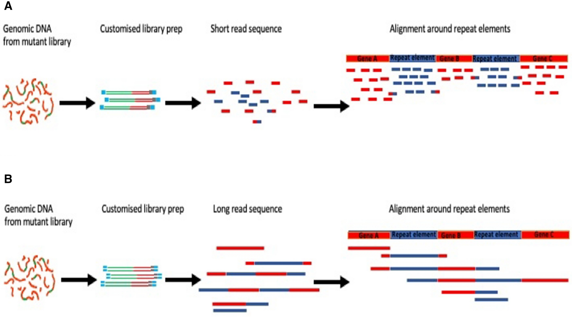
Theory
Long-Read vs Short-Read Sequencing
Feature | Short-Read | Long-Read
Read length | 100–300 bp | 5 kb → Mb
Raw accuracy | ~99.9% | ~95–98%
Cost per Gb | low | low–medium
Throughput | very high | scalable
Flexibility | low | high
Real-time | no | yes
10.1038/s41598-022-07557-x
Hybrid assembly
Module 2.2: Long-Read Sequencing - Hybrid Assembly

Slide 11
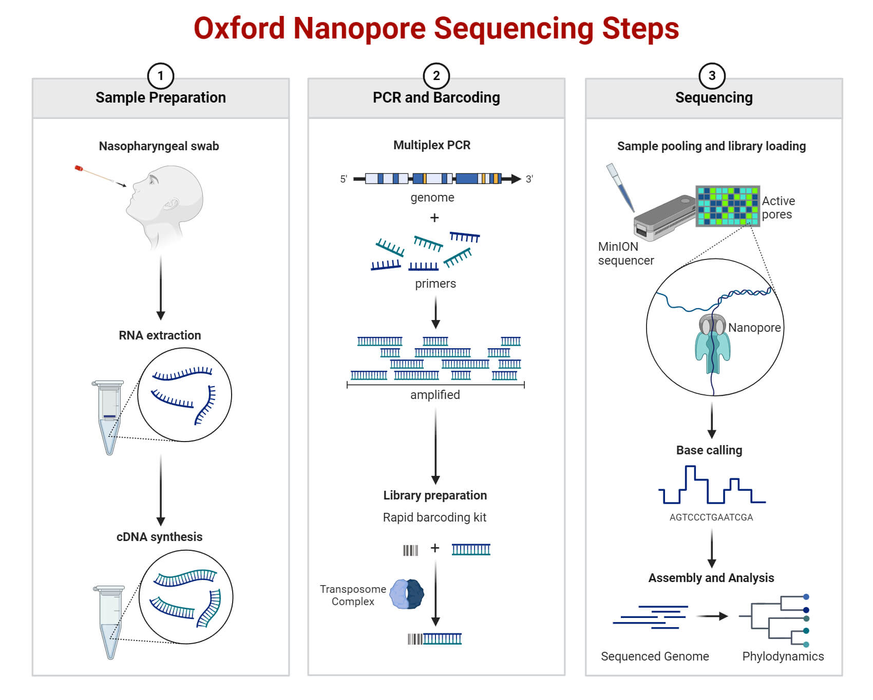
Theory
Wet and Dry lab workflows
N50 value (10.1371/journal.pcbi.1010752)
10.1515/ntrev-2022-0036
Module 2.2: Long-Read Sequencing - Hybrid Assembly

Slide 12
Practical Command-line (CLI)
Module 2.2: Long-Read Sequencing - Hybrid Assembly

Slide 13
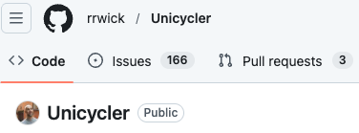
Practical Command-line (CLI)
Hybrid Assembly – unicycler
https://github.com/rrwick/unicycler
Module 2.2: Long-Read Sequencing - Hybrid Assembly

Slide 14
Data Visualization and Manipulation
Bandage / BandageNG
Module 2.2: Long-Read Sequencing - Hybrid Assembly

Slide 15


THE END.
Thank you for your attention
Module 2.2: Long-Read Sequencing - Hybrid Assembly

Slide 16
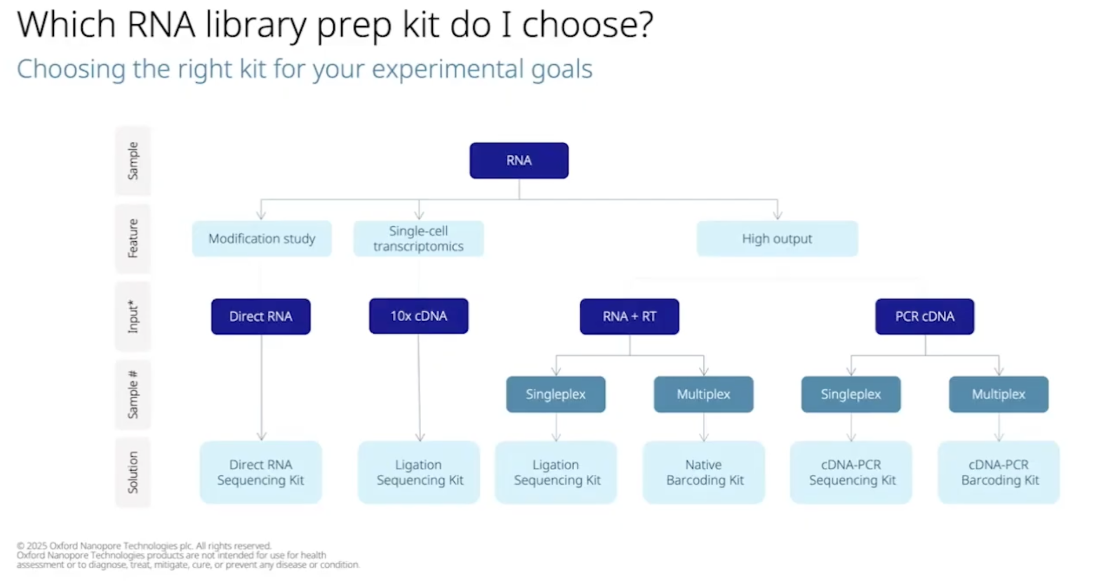
Notes:
Abricate (optional)

Slide 17
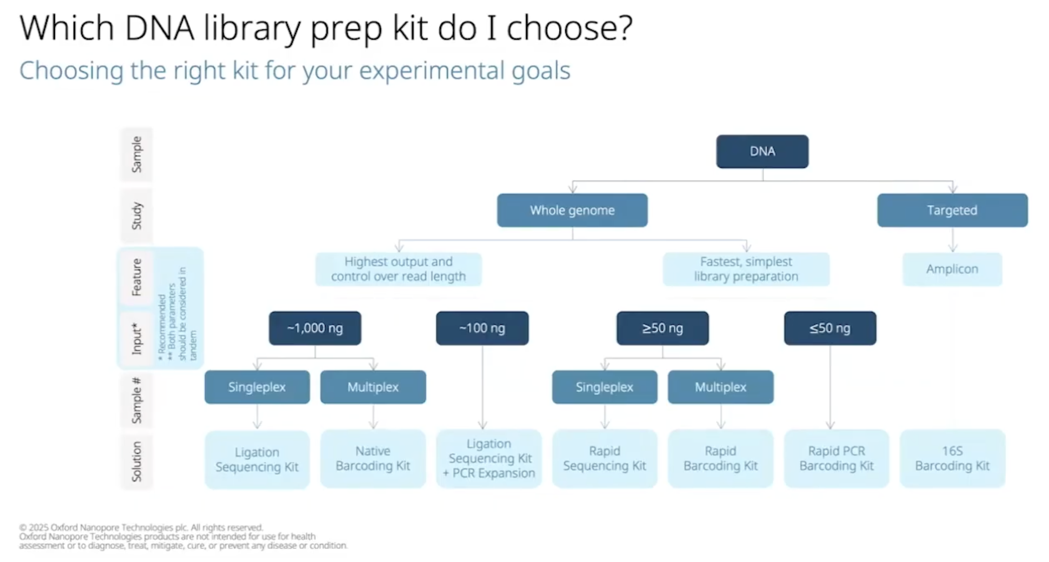
Notes:
Abricate (optional)

